Slide 1
Community Check Box:
Targeted Enhancement Project Presentation
Monday, June 27, 2016
Lizzie Miller, Prevention System Manager, DBHR
Martha Williams, Administrative Assistant, DBHR
Washington Community Prevention and Wellness Initiative Pilot Communities:
Clarkston, Castle Rock, Monroe, Omak, Prosser,
Republic, San Juan, Stevenson, Tekoa, Vashon Island

Slide 2
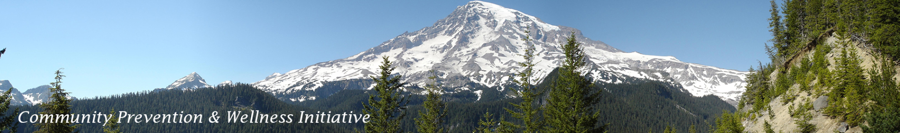
CPWI Community Check Box Project
History of Community Check Box
  Data evaluation system
    Partnership with University of Kansas
  Pilot testing goals (2014-2016)
    Does the Community Check Box system enhance statewide evaluation abilities?
    Does the Community Check Box system provide the ability to enhance coalition work and associated evaluation methods?
  2014-2015: 4 communities participating
  2015-2016: 10 communities participating

Slide 3
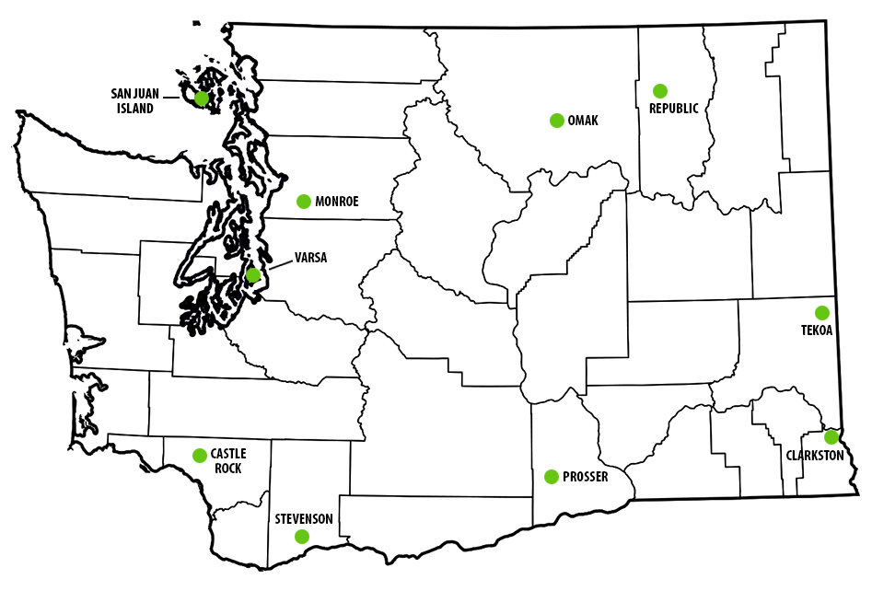
Community Check Box 2015-2016
∙ Castle Rock: Castle ROCK Care
Coalition
∙ Clarkston: EPIC Clarkston
∙ Monroe: Monroe
Community Coalition
∙ Omak: Okanogan County
Community Coalition
∙ Prosser: Prosser CIA
Coalition
∙ Republic: Students Taking
Action and Responsibility
(STAR) Youth Coalition
∙ San Juan: San Juan Prevention
Coalition
∙ Stevenson: ONE Prevention
Alliance
∙ Tekoa: HEALTHY Tekoa Coalition
∙ Vashon Island: Vashon Alliance to
Reduce Substance Abuse (VARSA)

Slide 4
What is Community Check Box?
A method of documenting qualitative data that:
  Explores innovative ways to measure coalition impact
  Collects contribution to community change
  Discovers the types of activities and accomplishments coalitions engage in that can have the most intense impact on a community
  Documents “What is happening in the community that would not be happening if the coalition were not there?”
  Tells the story of the coalition in a way that can’t be done by any other data system
Notes:
Explores innovative ways to measure coalition impact:
A data evaluation system that helps to capture the “who, what, when, where, why?” and “for whom and how much?” questions as they relate to a coalition's work and actions
Know WHAT you did (so you can describe the event – date, type, and description)
Know WHY you did it (so you can describe the outcome – behavior, risk and protective factors, and local conditions)
Know HOW you did it (so you can describe the means – strategy or process)
Know WHO did it (so you can describe the implementers – committee, individuals, and agencies)
Know FOR WHOM you did it (so you can describe the target – sector and place)
Know HOW MUCH you did (so you can describe outputs – numbers served, how long, and dollars generated)

Slide 5
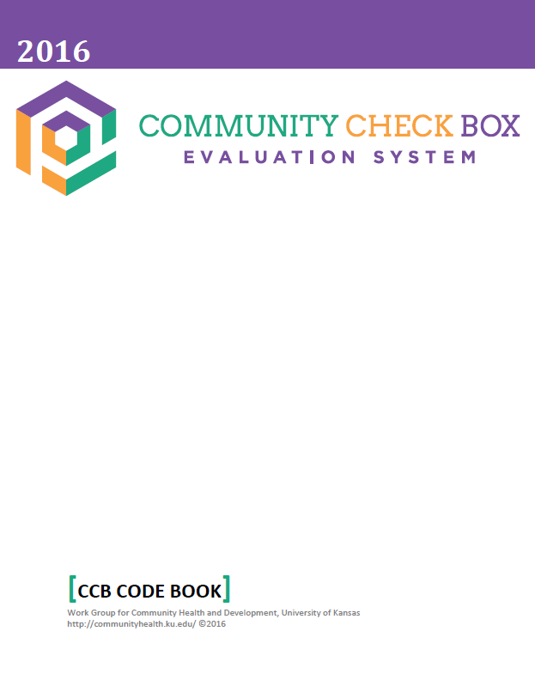
How does the program work?
Each month, 1-2 coalition members work as the primary observers for data collection
  Identify community and coalition events
  Code events into the CCB system
    Community Accomplishments
    Capacity Building Accomplishments
Monthly reliability scoring call with DBHR
Create lists, graphs, and charts to visually highlight CCB entries and the coalition’s collective work
Notes:
Monthly reliability scoring call with DBHR:
- Data validation purposes

Slide 6
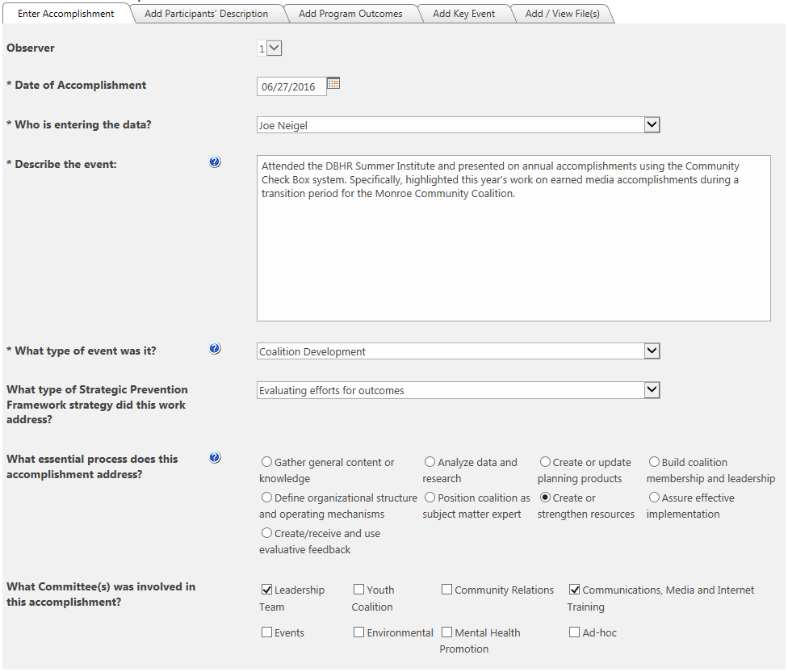
Example data entry:
Capacity Building Accomplishment
Date
Coordinator
Event description
Event type
SPF Strategy
Essential process accomplished by the event
Coalition committee(s) involved

Slide 7
Types of Coalition Events Captured by CCB
Community Accomplishments
Community Change
Services Provided
Media
Resources Generated
Community Action
Other Important Event
Capacity Building Accomplishments
Organizational Capacity Change
Training
Implementation Support
Coalition Development
Technical Assistance
Internal Coalition Meeting
Other Important Event

Slide 8
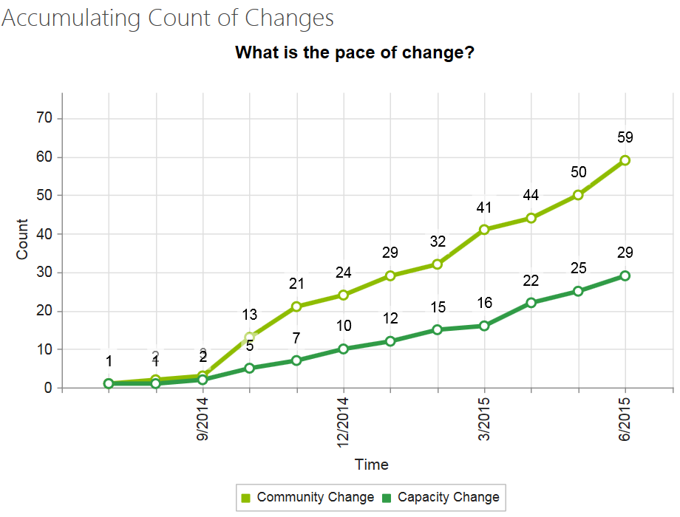
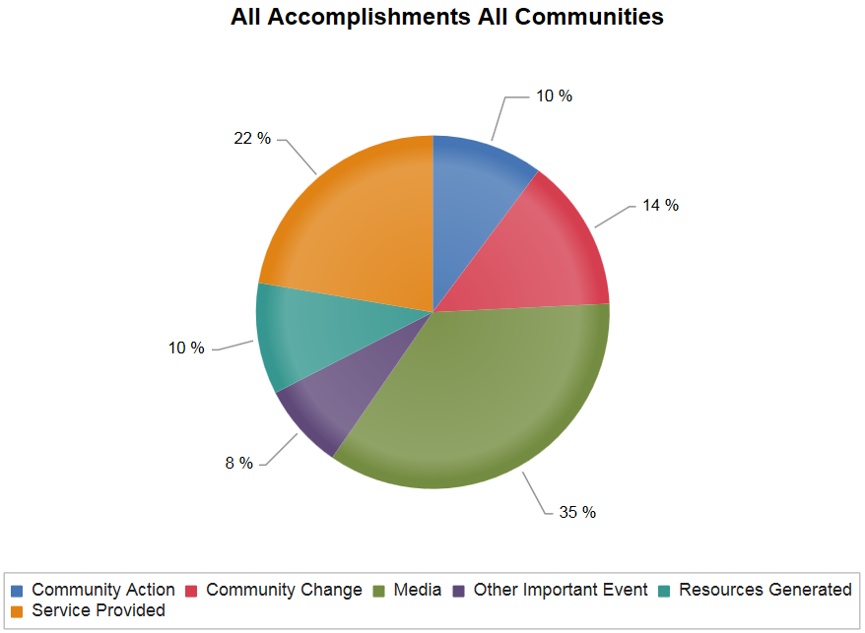
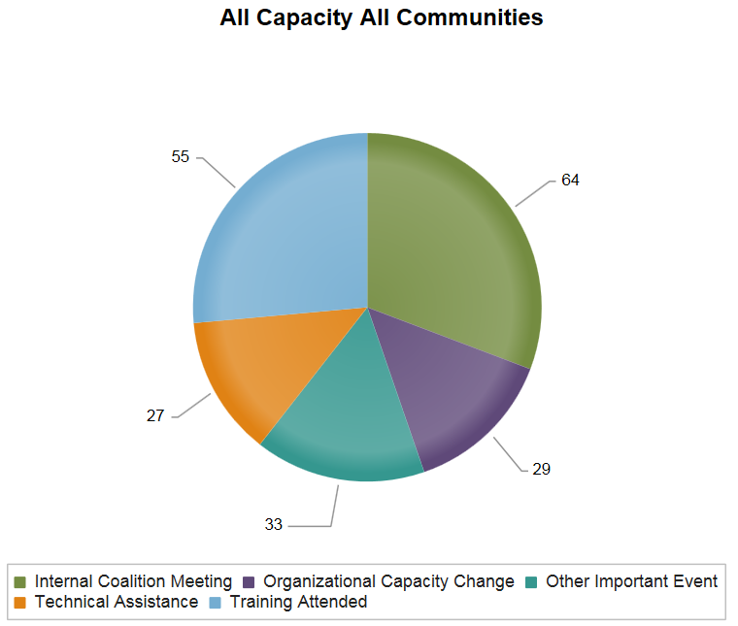
What You’ll Hear Today
    Has the Community Check Box system enhanced statewide evaluation abilities?
    Has the Community Check Box system provided the ability to enhance coalition work and associated evaluation methods?

Slide 9
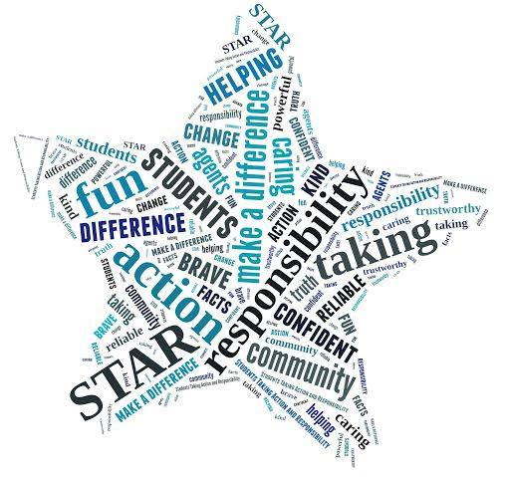
Janine Koffel
Students Taking Action and Responsibility (STAR) Youth Coalition:
Youth Coalition Highlights & NYLI Events

Slide 10

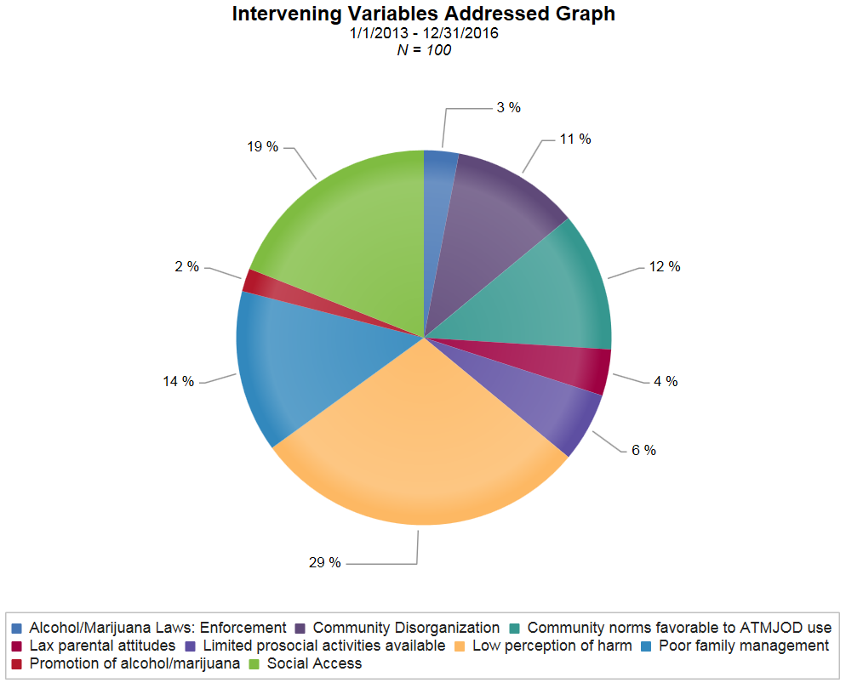
Notes:
Emphasis on low perception of harm, social access, and community norms favorable to ATMOD.

Slide 11
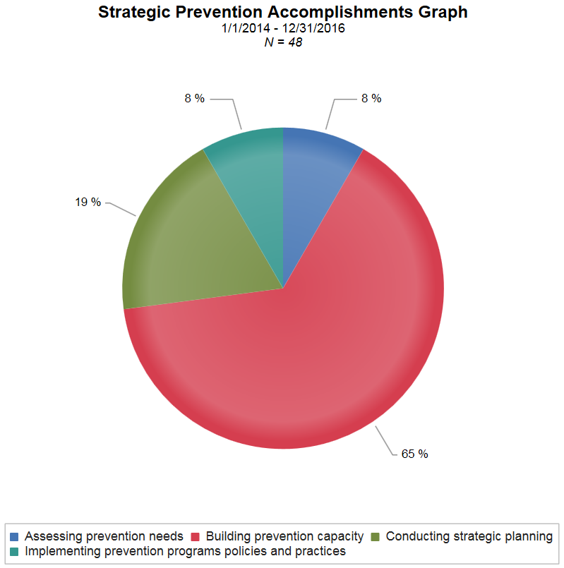
Notes:
Focus since October, 2013 inception has been building capacity to execute strategic action plan.
Youth coalition established August, 2014, with unique action plan (marijuana).

Slide 12
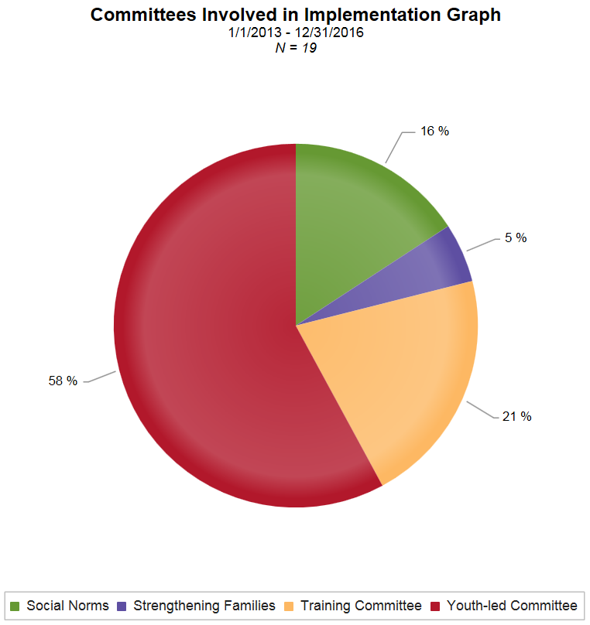
Engaging Youth as Agents of Change
Empowered with training, new skills, deeper knowledge
Meaningful opportunities to do ‘real’ work
Validate, recognize, celebrate
  2015 WA State Innovation Award
  2015 WA State Exemplary Youth Coalition
  2015 NYLI/NPN Presentation
  Multiple Scholarship and Mini-Grant Awards
Notes:
Youth members have demonstrated a strong commitment to executing action plan(s); first marijuana (Keep Off the Grass), then adding alcohol. Next: apathetic student body
Media-Smart Youth: Eat, Think, and Be Active, National Organizations of Youth Safety Teen Safe Driving Summit, CADCA, CADCA NYLI, CADCA Youth Leadership team,

Slide 13
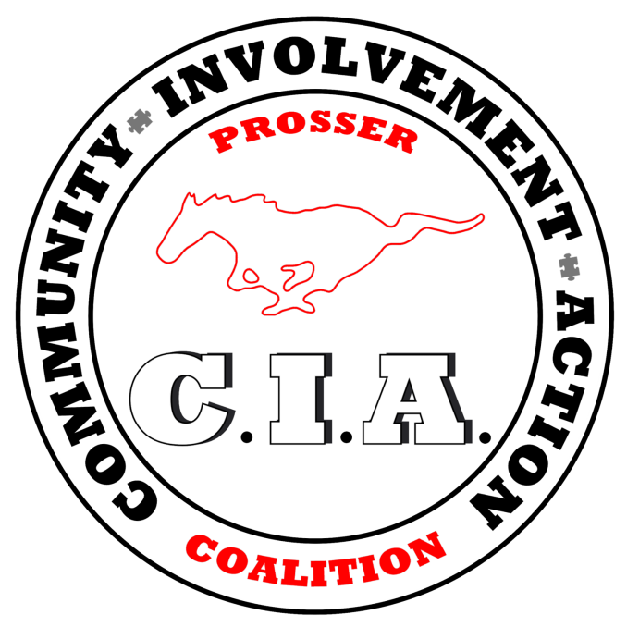
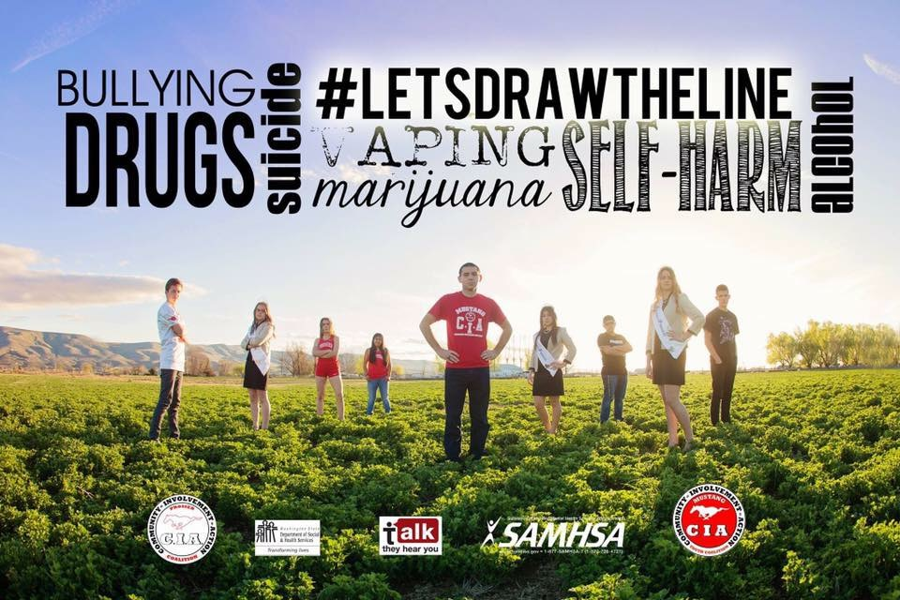
Prosser CIA Coalition:
Using CCB to Track Funding Matches
Jen Dorsett

Slide 14

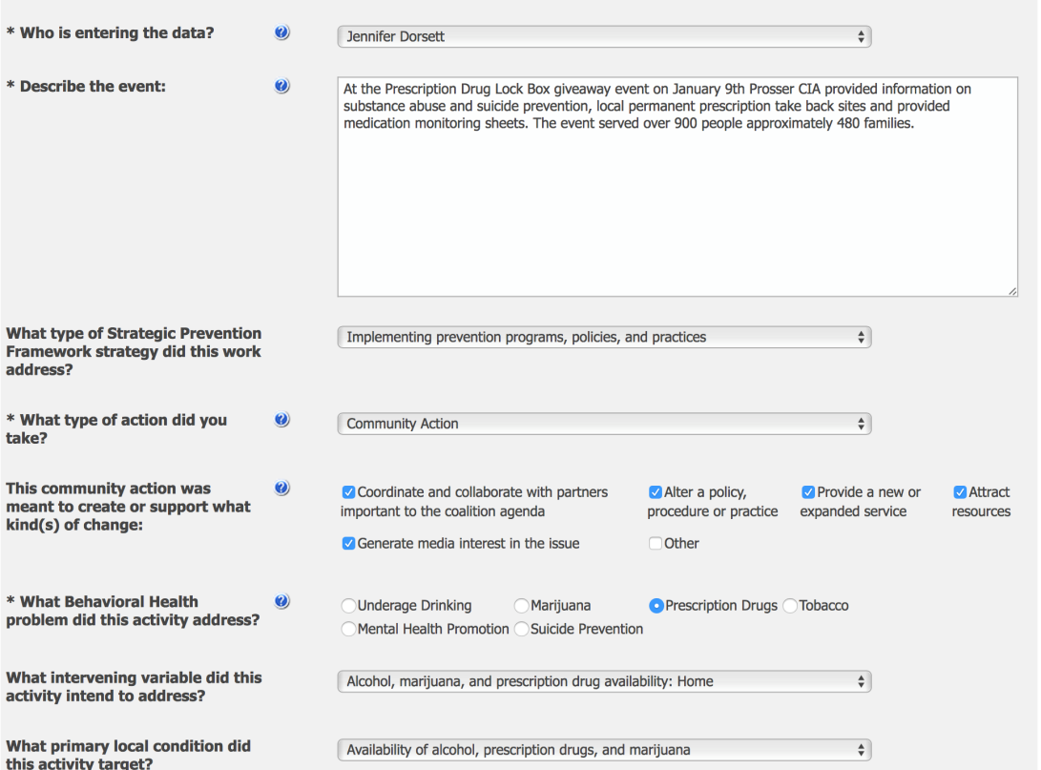
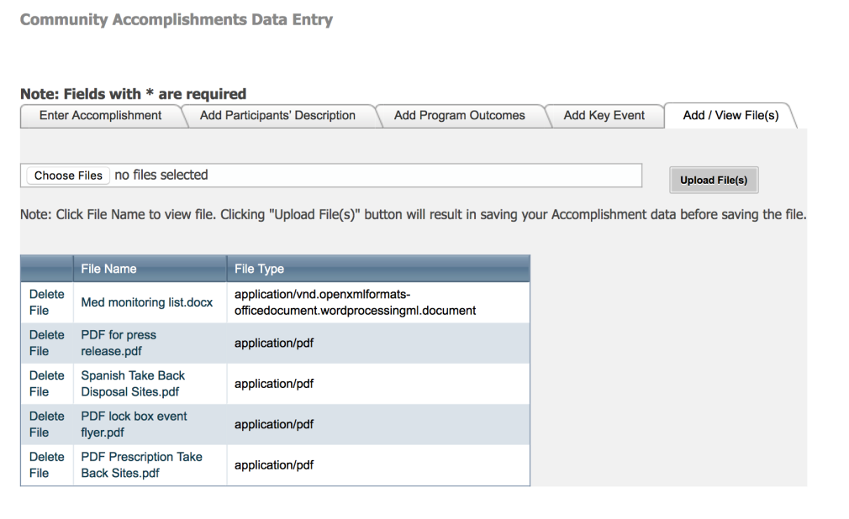
CCB – Why is it cool??

Slide 15
Here’s what you see when you click!!

Slide 16
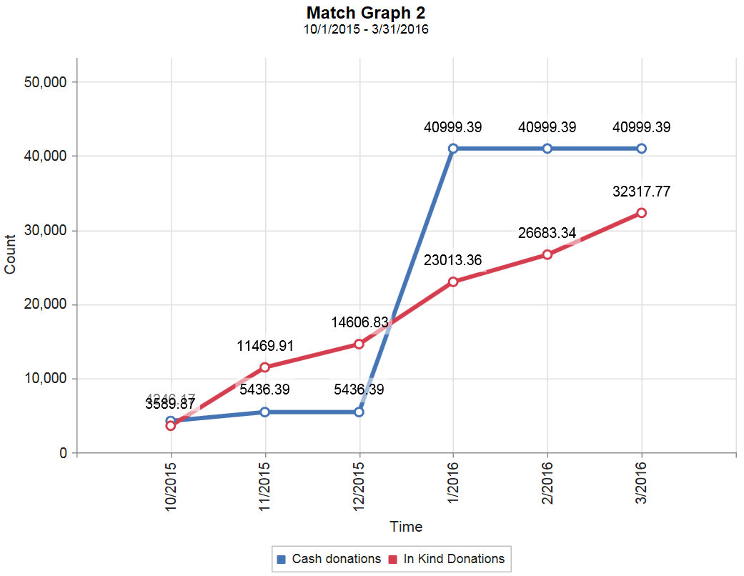
How Can I Use the Data from CCB?

Slide 17
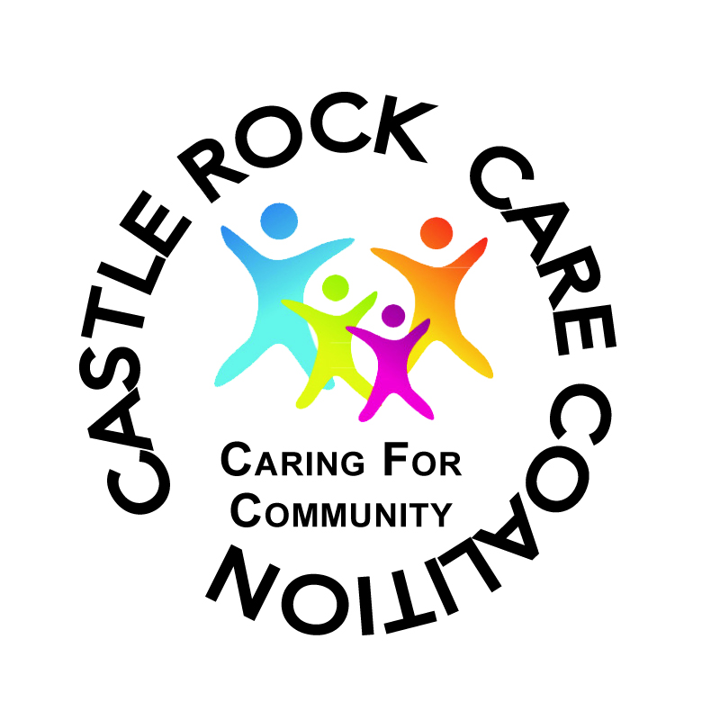


Castle Rock CARE Coalition:
Social Norms Work
Dianne Swanson
and Gina James

Slide 18

Social Norms Campaign Progress
Castle Rock’s CARE Coalition formed in 2003
Several years after our formation, the coalition focused on training members and community groups on social norms theory and practice
Our initial focus was on the youth population – specifically, doing classroom presentations at the middle and high school levels to correct misperceptions of underage alcohol use

Slide 19
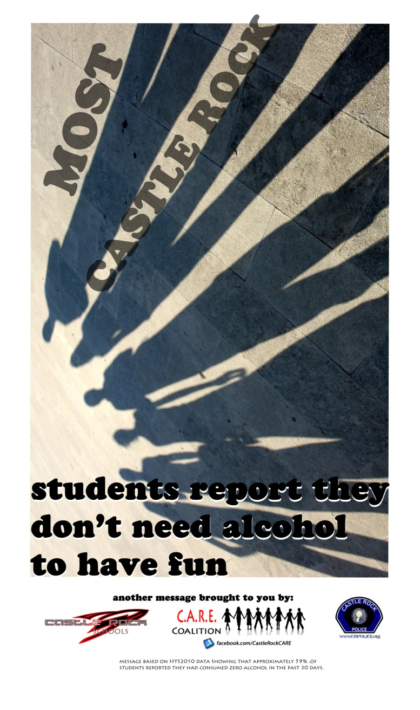
Our Approach in Castle Rock
Poster campaign developed for secondary level
Focus changed over the years to a community based approach
Utilized community survey data to create messages targeting parental support
Incorporated law enforcement data and created campaign messages to show local support of law enforcement efforts
With time, we expanded our social norms work into other areas, for example: seat belt safety, bicycle helmet safety, marijuana and electronic cigarettes campaigns, and nutrition

Slide 20
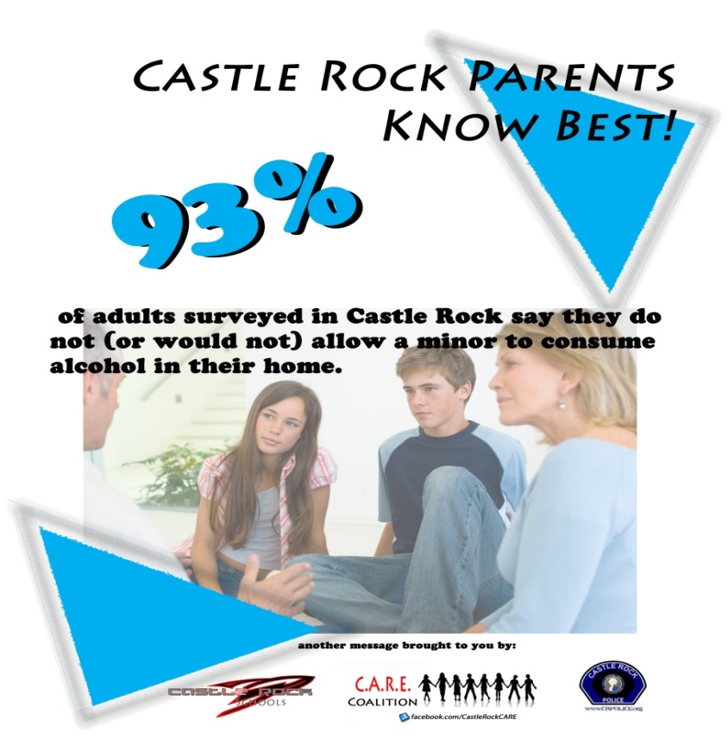
Social Norms Messaging on Coffee Sleeves
Most adults in Castle Rock believe law enforcement personnel in our community are effective when they respond to calls and requests about underage alcohol and drug use at parties or gatherings
Most parents in Castle Rock are talking to their children about the dangers of underage drinking and marijuana use
88% of adults in Castle Rock say they do not (or would not) allow a minor to consume alcohol in their home
95% of adults surveyed in Castle Rock believe people risk harming themselves and others when they drive under the influence of alcohol. Please don't drink and drive

Slide 21
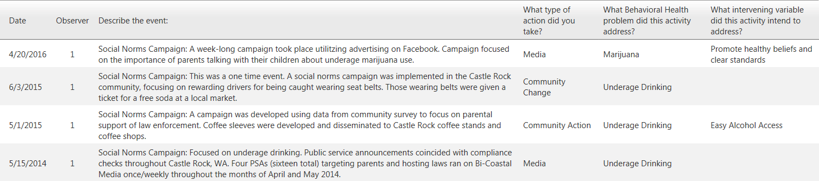
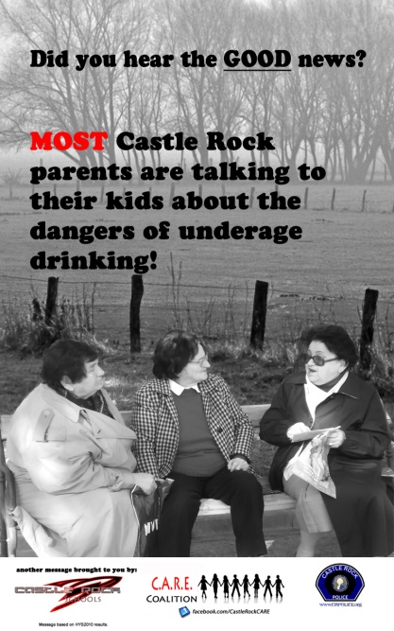
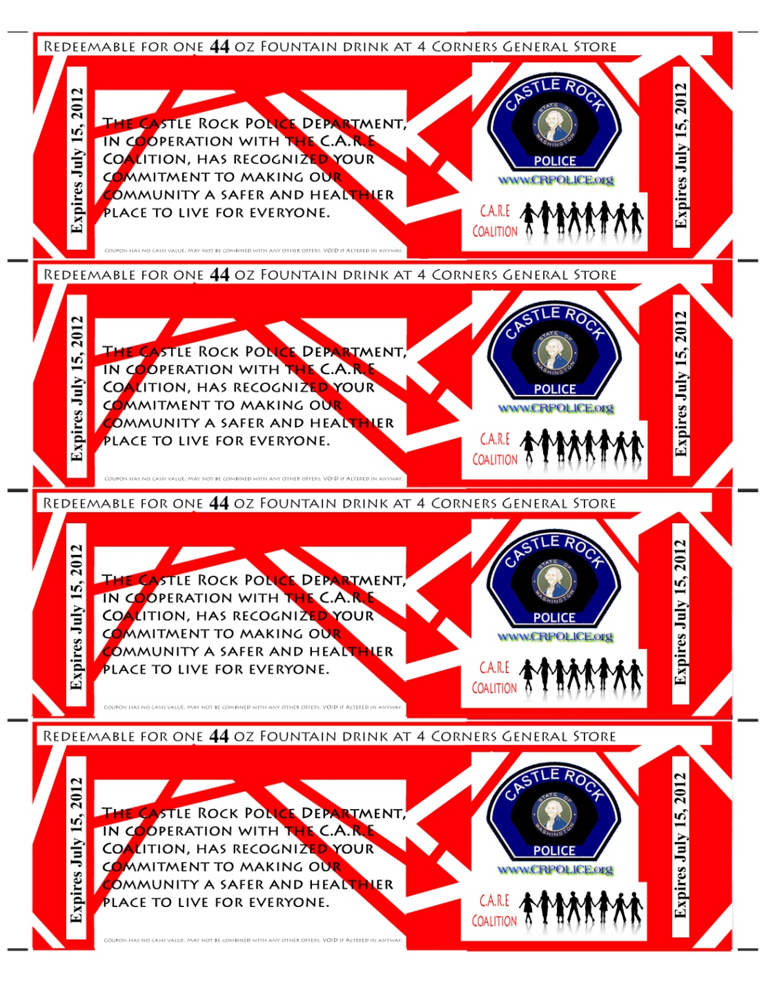

Using CCB to Report Social Norms Work

Slide 22
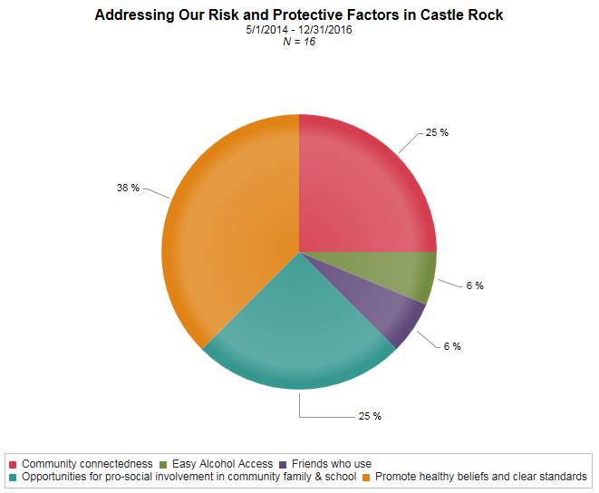
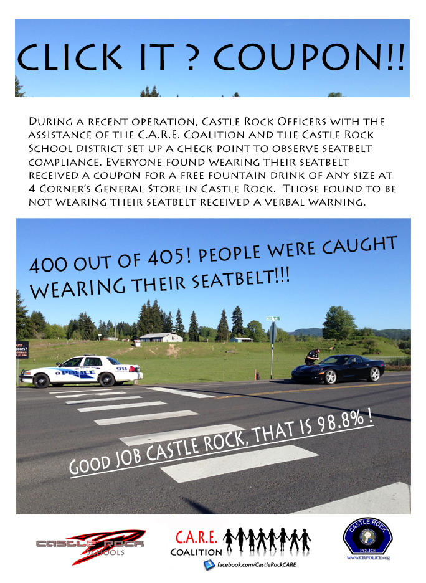
Using CCB to Report Social Norms Work

Slide 23

Diane Harp
Healthy Tekoa Coalition:
Community Sector Involvement

Slide 24
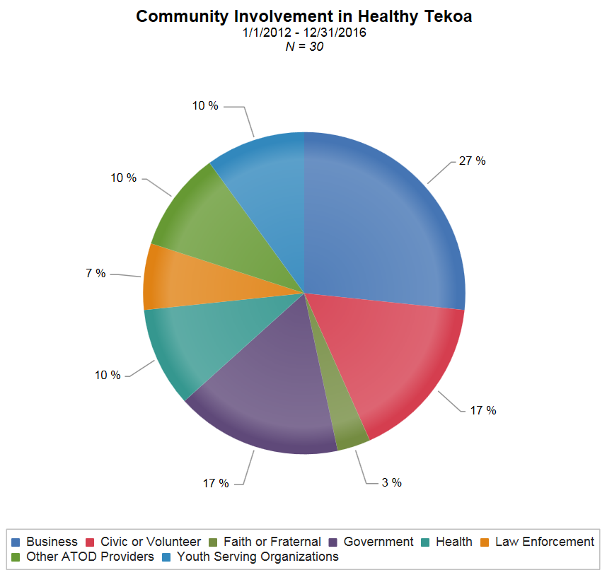


Slide 25
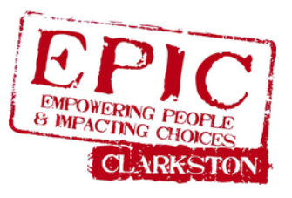
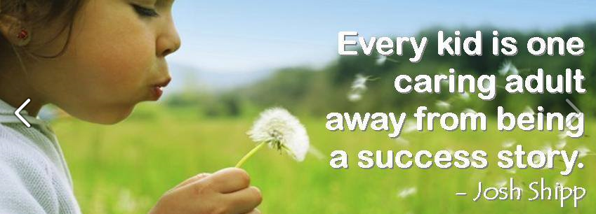
EPIC Clarkston:
Local Resiliency Movement
and Focus on Mental Health
Kristi Sharpe
and Melissa Welter

Slide 26
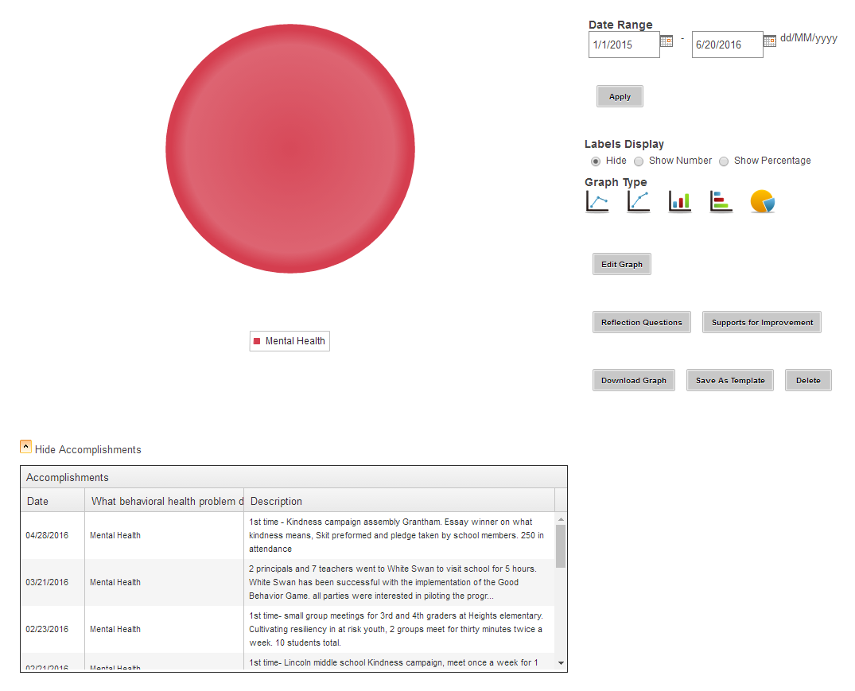
Mission Towards Resiliency

Slide 27
Resiliency Mission in Clarkston

Slide 28
What Mental Health Entries Look Like
10/08/2015 | Mental Health | First Time- Highland school begins Kindness campaign with Jodi Crane as adult leader. 1 hour weekly meetings occur and group size varies from 8 children and up.
10/19/2015 | Mental Health | First time- at risk groups (5th and 6th graders) in Highland Elementary began meeting weekly for 30 -35 students on Tuesdays. Meetings last approximately 1 hour and 30 minutes.
01/07/2016 | Mental Health | TV news segment on Kindness Campaign Highland kids promoted through EPIC coalition youth adviser.
02/03/2016 | Mental Health | 1st Time at Parkway school, Cultivating resiliency in at risk youth. meetings occur twice a week for 30 minutes each time total 10 students. 3rd graders.
03/21/2016 | Mental Health | 2 principals and 7 teachers went to White Swan to visit school for 5 hours. White Swan has been successful with the implementation of the Good Behavior Game. all parties were interested in piloting the program.

Slide 29
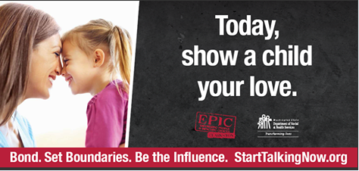
What Resiliency Through Underage
Drinking Entry May Entail
04/05/2016 | Underage Drinking | Leaders from EPIC presented with partnering Resiliency coalition and talked for an hour on the resiliency training recently attended.
03/08/2016 | Underage Drinking | 1st time Kristi spoke at Chamber of Commerce Luncheon explaining EPIC's mission and the move towards resiliency.
08/02/2015 | Underage Drinking | Jodi Crane started as New Youth Program Coordinator for Middle Schools and Grade Schools.
05/13/2015 | Underage Drinking | 1st time- Kristi met one on one with Tim Winters the superintendant of Clarkston School District, conversation had to do with hiring personal to have the ability to be in each of the schools to carry out strategic plan.

Slide 30
Training Entries Towards Resiliency
01/08/2015 | Training | Adverse Childhood Experience (ACE) training. How to develop a community action plan to help youth through Aces
03/26/2015 | Training | 11 coalition members attended Adverse childhood evaluation (ACEs) training took place at Walla Walla Community college. 1st session.
05/05/2015 | Training | Adverse Child Experiance (ACE) training at Walla Walla Community College. 2nd session
11/14/2015 | Training | National Prevention Network Conference attended by Kristi, Donna, Jodi, Dan, Carson, HeatherTopics attended: Triple P, ACE's, general updates, all provider meeting for coordinators Nov 15- 19th 8 hours a day
12/01/2015 | Training | Resiliency coalition: Topic- Dr.Blogett- Adverse Childhood Experiences training
01/05/2016 | Training | Resiliency coalition meeting: Discussed 2016 plan, round table report out

Slide 31
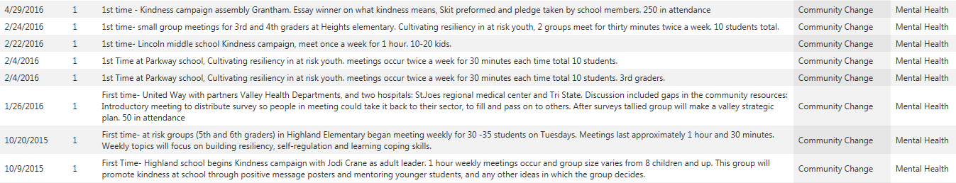
Making Community Change
01/22/2015 | Community Change | 1st time- Kristi went to the 7th graders in Asotin Junior High and talked about ways to develop self confidence, resilience, and sense of well-being while being above the influence of alcohol and marijuana
08/09/2015 | Community Change | Carson Kachalmier started as New Youth Adviser at the High School.
08/20/2015 | Community Change | First time- Mentors were trained for Pal/Mentoring program at clarkston high school. 45 students participated in all day training.
04/28/2016 | Community Change | 1st time - Kindness campaign assembly Grantham. Essay winner on what kindness means, Skit preformed and pledge taken by school members. 250 in attendance

Slide 32
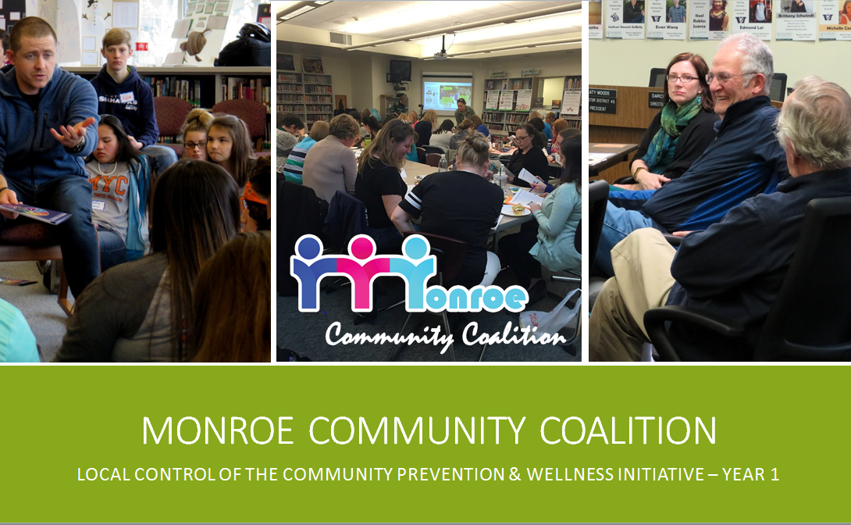
Joe Neigel

Slide 33
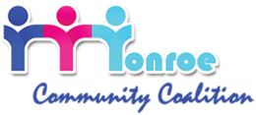
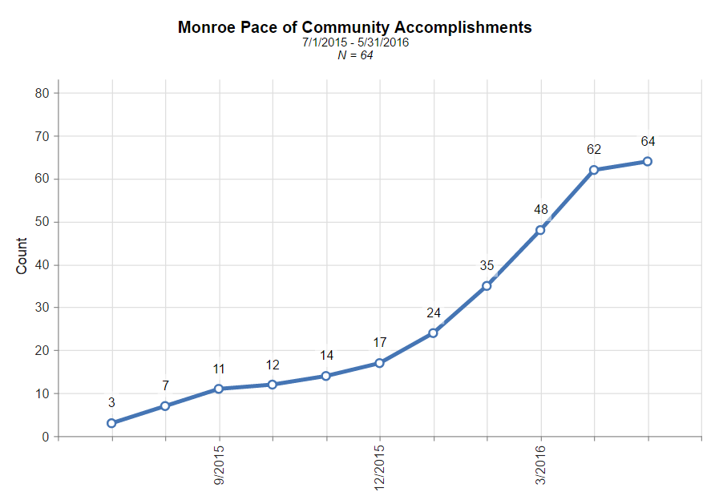

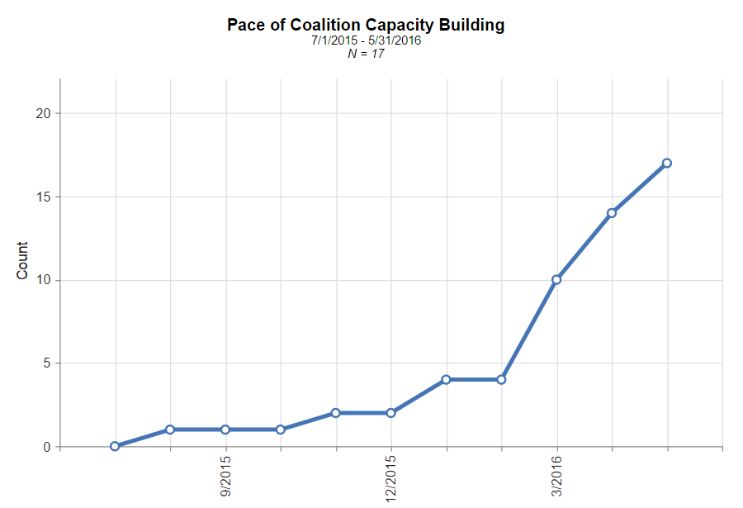
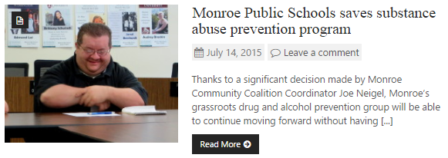
Monroe Public Schools Assumes Local Control of CPWI
Coalition activity slows from March to June, 2015 as County withdraws from CPWI
Dr. Ken Hoover, retiring Superintendent, shepherds the school board through assuming local control of the Coalition as his “parting gift”
Coordinator begins working on July 6, 2015
Notes:
Community Check Box gives the Community Coalition an opportunity to demonstrate its impact in the community to internal and external stakeholders.
Although this was Monroe Community Coalition’s third year of participation in the CPWI, it essentially became a start-up year as Monroe Public Schools accepted fiscal agent responsibilities for the Coalition. As one would expect, learning to become effective within a new operational culture takes time, and requires building relationships and the capacity of the organization.
Still, as the Coalition and the School District became familiar with each agency’s needs, the pace of capacity building and community accomplishments picked up considerably. While we’re still working through first year issues, you can see the Coalition began to hit its stride at about the 6 month point of this fiscal year. January through June 2016 has been an all out sprint.
Of Note:
Community Accomplishments don’t necessarily reflect the entire body of work of the Coalition. Rather, it reflects community impact through change – first time partnerships, grant funding received, new strategies implanted for the first time, etc.
The District did not have an executed contract with DBHR until November.
We did not have access to the PBPS until December.
I’ve been working to adjust the language of prevention to in order to make our strategies and activities relevant to the goals and priorities of an education-first agency.

Slide 34
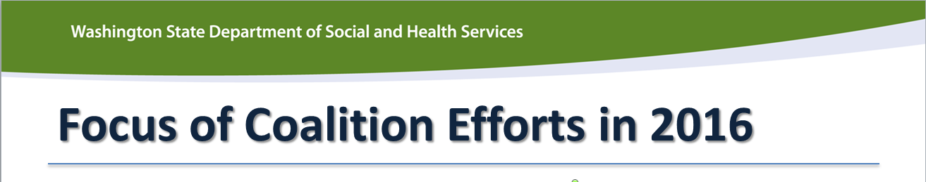
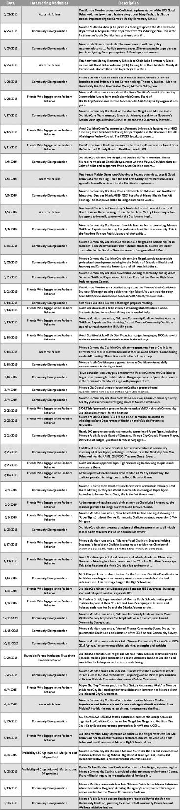
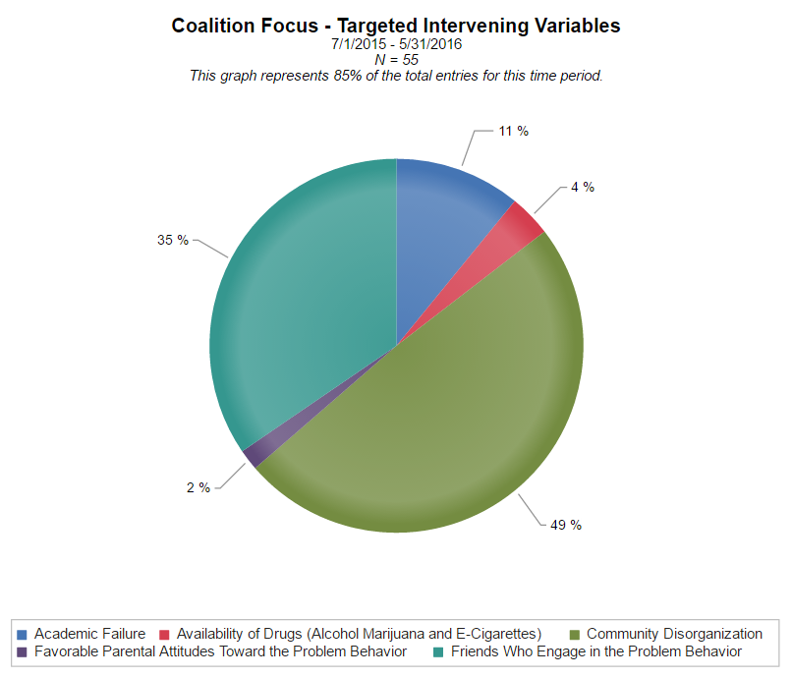
Focus of Coalition Efforts in 2016
Notes:
Community Check Box also gives the Coalition quick access to understanding where we’ve focused the bulk of our energy.
With the constraints of County CPWI practices lifted from the Coalition, MCC redoubled its efforts at making meaningful community partnerships with key leaders, agency’s and stakeholders. You can see from the chart that substantial energy went into improving community collaboration and coordination this year.
(Mention Youth Coalition collaboration with law enforcement – only the CCB allows us to capture the significance of that partnership. Also mention Love an Addict group.)
When I need to talk about what we’ve accomplished within a particular intervening variable , I can quickly use CCB to filter out entries that I don’t need.
Note:
Without understanding the context of the work the Coalition is doing or the qualitative nature of the CCB, it could appear that we have ignored the risk factors favorable parental attitudes and availability of drugs; however, since we already have strategies and activities in place that address those, the bulk of the reporting for those intervening variables occurs in the PBPS.

Slide 35
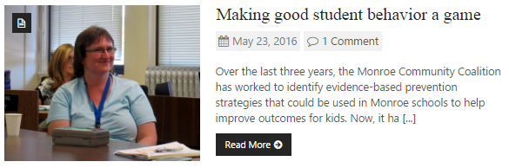
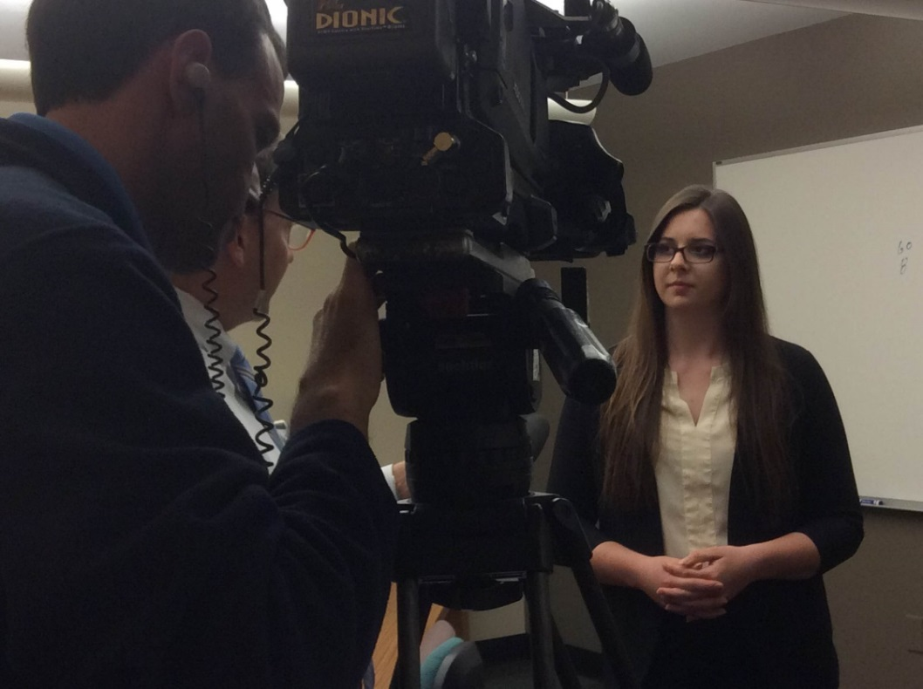
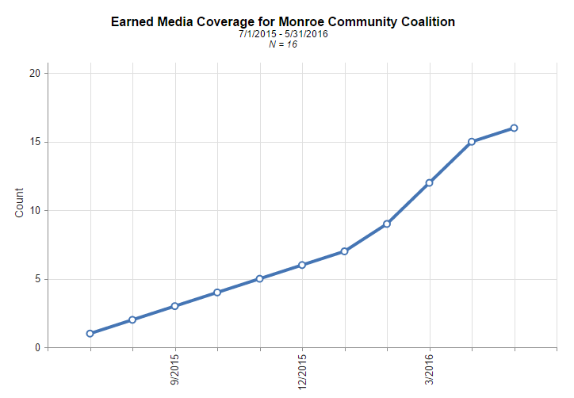
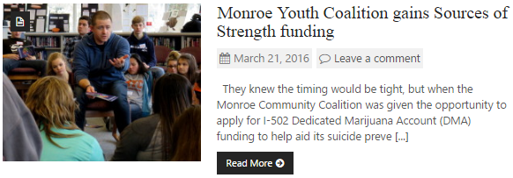

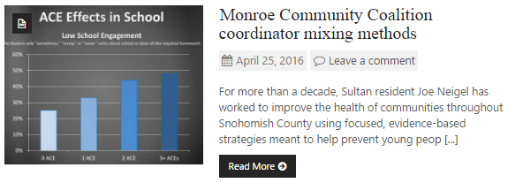
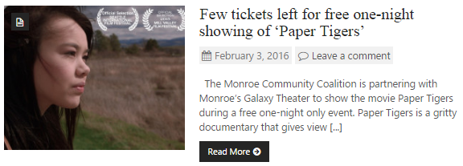

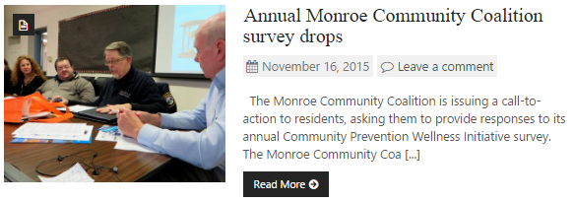
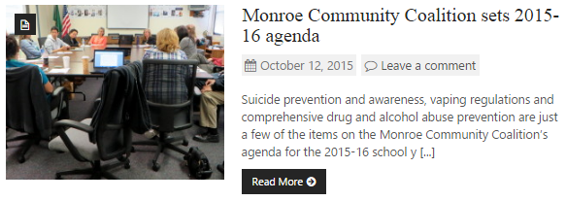
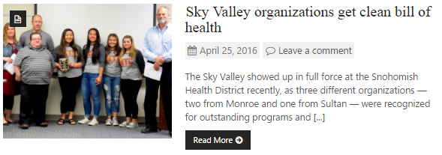
Earned Media Increases After Local Control
Notes:
A key strategy for the coalition this year has been engaging the public to increase community awareness and readiness. CCB allows us to capture earned media and show our stakeholders that the Coalition is growing in recognition.
We have seen an increase in community member participation in our meetings, strategies and activities as a result of this strong media sector support. Earned media is a critical component of our success in building relationships with key stakeholders in the community, but we didn’t have a meaningful way to quantify that component before the Community Check Box.

Slide 36
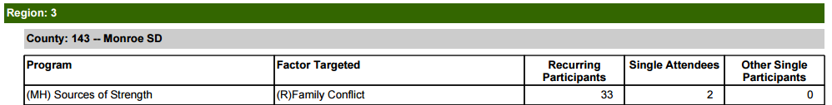
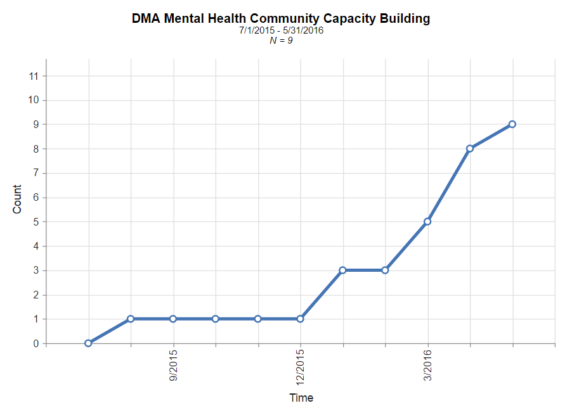
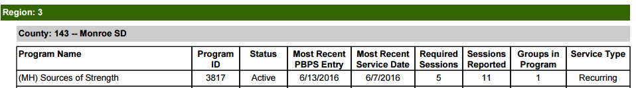



Monroe Awarded DMA Mental Health Grant Funding
Coalition members and community stakeholders view youth mental health as a significant area of concern
Monroe successfully applied for Dedicated Marijuana Account Mental Health Grant funding in January, 2016
We report services in the PBPS. We tell the story with Community Check Box
Notes:
This is a snapshot of how the CCB can compliment the quantitative reporting of the PBPS. While quantitative data entry helps DBHR to understand program compliance, it doesn’t equip the agency to tell the full story of community impact and change.
In fact, CCB allows us to demonstrate the impact of our funding by aggregating the significant community changes and capacity building that occur during implementation. It demystifies the efforts of the Coalition by capturing the community mobilization effort hat makes change possible.
I can finally show you that my Coalition’s hard work, not just money and magic, is responsible for creating meaningful community change.

Slide 37


Examining
Local Conditions
Lisa Bruce

Slide 38


Source of alcohol: friends
Limited access to professional family counseling
Parents tolerant of use

Slide 39


Slide 40



Susie Strom
ONE Prevention Alliance:
Coalition Community Accomplishments & Community Action during May 2016

Slide 41



Slide 42


Slide 43

San Juan Island
Prevention Coalition:
E-Cigarette Ordinance Progress
Cynthia Stark-Wickman
and Boyd Pratt
CCB 2016
Notes:
https://www.youtube.com/watch?v=rtSt0YH-FMk&feature=em-share_video_user

Slide 44
Thank you to our presenters!
Lizzie Miller
Prevention System Manager
Division of Behavioral Health and Recovery
Desk: 360-725-1497
Cell: 360-688-6909
Email: millelm@dshs.wa.gov
∙ Janine Koffel – Students Taking Action and Responsibility
(STAR) Youth Coalition; Republic, WA
∙ Jen Dorsett – Prosser CIA Coalition; Prosser, WA
∙ Dianne Swanson and Gina James– Castle Rock CARE
Coalition; Castle Rock, WA
∙ Diane Harp – Healthy Tekoa Coalition; Tekoa, WA
∙ Kristi Sharpe and Melissa Welter – EPIC Clarkston;
Clarkston, WA
∙ Joe Neigel – Monroe Community Coalition; Monroe, WA
∙ Lisa Bruce – VARSA; Vashon Island, WA
∙ Susie Strom – ONE Prevention Alliance; Stevenson, WA
∙ Cynthia Stark-Wickman and Boyd Pratt – San Juan Island Prevention Coalition; San Juan, WA
Martha Williams
Administrative Assistant
Division of Behavioral Health and Recovery
Desk: 360-725-3724
Email: williml2@dshs.wa.gov
Camille Goldy
Prevention System Project Manager
Division of Behavioral Health and Recovery
Desk: 360-725-3786
Cell: 360-688-6909
Email: goldycd@dshs.wa.gov
Notes:
Please add appropriate KU contact info

