Slide 1
Cohort 2
Prevention Redesign Initiative (PRI) Cohort 2 - Workshop Series
Resources Assessment Clinic
Workshop 2 – Incorporating information into your Strategic Plan
Division of Behavioral Health and Recovery
February 2013
Presented by:
Julia Greeson, Prevention System Manager
Sarah Mariani, Prevention Systems Integration Manager
Notes:
The background for the PowerPoint slides is what we at DBHR are required to use. You are not required to use this background in your work with your local coalition and data work group.
Please feel free to customize the background and colors used in the slides to those that are traditionally used in your presentations, etc. Also, feel free to insert your coalition logo, if you have one, or other information that you think helps to localize the presentation so it feels more “local” and familiar.
We think the content and sequence of content are important. So we ask that you contact us at pritraining@dshs.wa.gov to discuss any proposed changes before you actually present the information.
Thanks. And great success to you!

Slide 2
Analysis and Prioritization
So now what?
Part three:

Slide 3
Introduction
Before we start…

Slide 4
Poll - Hands
Did you attend Workshop 1?
Please ‘raise your hand’ if your answer is yes.

Slide 5
Workshop 2: Training Objectives
Participants will:
Understand functions of Analysis and Prioritization of Resources Assessment.
Understand how to use Resources Assessment to support strategy selection and implementation.
Understand how to incorporate Resources Assessment into Strategic Plan.
Understand how to use Resources Assessment to gather support for Action Plan.

Slide 6
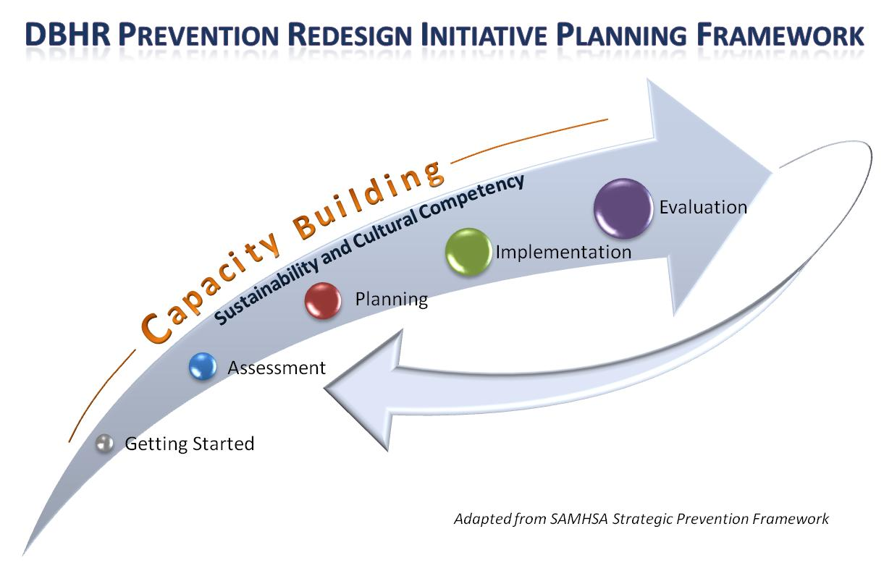
PRI Planning Framework
Notes:
The PRI is generally following the Strategic Prevention Framework (SPF) as the overall planning framework for this process. Based on our learning from the Strategic Prevention Framework State Incentive Grant (SPF-SIG) process, for the purposes of PRI, we have added a “Getting Started” section and have included “Capacity” as an ongoing step throughout the process. It is expected that all tasks associated with PRI will be conducted in a culturally competent and sustainable manner. This is not expected to be linear process.
EMPHASIZE – sustainability and cultural competence as well as capacity building.

Slide 7
Completing a
Resources Assessment
Workshop 1:
Process
Findings
Workshop 2:
Analysis and Prioritization
Today we will cover this part.

Slide 8
Analysis and Prioritization of Resources
Include in Strategic Plan:
  Describe the Coalition’s conclusions and explain how these were derived from the Coalition’s process and key findings.
  Explain how these conclusions connect the analysis from the needs and resources assessment to the strategies and activities described in the next section.

Slide 9
A Quick Review
Last week’s workshop covered…
…what a resource assessment is and why it is important
…identifying programs and services in your community that impact your prioritized intervening variables and/or contributing factors
…collecting information for the gaps assessment about the resources in the community
…the types of resource gaps and why identifying gaps is important.
… identifying resource gaps for each intervening variable.
…summarizing key findings from Resources Assessment.

Slide 10
Completing a Resources and Gaps Assessment
Five Steps…
Establish your process.
Identify, collect, and compile information on each existing resources which address the priority risk and protective factors.
Determine gaps in resources.
Determine key findings.
Integrate information into Strategic Plan.

Slide 11
Poll
Which of the steps have you completed so far?

Slide 12
[Name] Coalition Logic Model
Long-Term Outcome
Consequences
Behavioral Health Problems
(Consumption)
Intervening Variables
(Risk/Protective Factors)
Local Conditions and Contributing Factors
Strategies &
Local Implementation
Needs Assessment
(10-15 years)
(5-10 years)
Outcomes
(2-5 years)
(6 months – 2 years)
What is the problem?
Why?
Why here?
But why here?
What are we doing about it?
…with these common factors…
…specifically in our community…
…can be addressed thru these strategies…
These problems…
School performance (% of courses passed)
(HYS Academic)
Youth Delinquency
(either HYS Perception of Risk, or Alcohol related arrests of 10-17 year olds, depending on coalition’s strategy)
Mental Health
(HYS depression)
These types of problems…
Any Underage Drinking
(10th grade 30-day use)
Underage
Problem and Heavy Drinking
(10th grade)
[Add Yours Here]
Community Disorganization/ Community Connectedness
[Add Yours Here]
Community engagement/Coalition development:
[Coalition Name]
[Add Yours Here]
Alcohol Availability: Retail or Social Access
Promotion of Alcohol
Alcohol Laws: Enforcement; Penalties; Regulations
[Add Yours Here]
[Add Yours Here]
Public Awareness:
[Add Yours Here]
Environmental Strategies:
[Add Yours Here]
Low Commitment to School
Favorable Attitudes
Friends Who Use
Perception of Harm
[Based on individual assessment]
[Add Yours Here]
School-based Prevention/ Intervention Services:
Student Assistance Program
Risk & Protective Factors:
[Add Yours Here]
[Add Yours Here]
Direct Services:
[Add Yours Here]
State Assessment
Local Assessment
Plan/Implementation

Slide 13
[Name] Coalition Logic Model
Long-Term Outcome
Consequences
Behavioral Health Problems
(Consumption)
Intervening Variables
(Risk/Protective Factors)
Local Conditions and Contributing Factors
Strategies &
Local Implementation
Resources Assessment
(10-15 years)
(5-10 years)
Outcomes
(2-5 years)
(6 months – 2 years)
Action
What is the problem?
Why?
Why here?
But why here?
What are we doing about it?
What resources do we have, that we want to include in our plan?
What resources do we need in order to impact the local conditions we want to change?
…with these common factors…
…specifically in our community…
…can be addressed thru these strategies…
These problems…
School performance (% of courses passed)
(HYS Academic)
Youth Delinquency
(either HYS Perception of Risk, or Alcohol related arrests of 10-17 year olds, depending on coalition’s strategy)
Mental Health
(HYS depression)
These types of problems…
Any Underage Drinking
(10th grade 30-day use)
Underage
Problem and Heavy Drinking
(10th grade)
[Add Yours Here]
Community Disorganization/ Community Connectedness
[Add Yours Here]
Community engagement/Coalition development:
[Coalition Name]
[Add Yours Here]
Alcohol Availability: Retail or Social Access
Promotion of Alcohol
Alcohol Laws: Enforcement; Penalties; Regulations
[Add Yours Here]
[Add Yours Here]
Public Awareness:
[Add Yours Here]
Environmental Strategies:
[Add Yours Here]
Low Commitment to School
Favorable Attitudes
Friends Who Use
Perception of Harm
[Based on individual assessment]
[Add Yours Here]
School-based Prevention/ Intervention Services:
Student Assistance Program
Risk & Protective Factors:
[Add Yours Here]
[Add Yours Here]
Direct Services:
[Add Yours Here]
State Assessment
Local Assessment
Plan/Implementation

Slide 14
Step 4:
Summarizing Key Findings
Example 1:
  “After reviewing information collected from our resources assessment we determined that we have significant and effective resources available for children ages 5-12, however there are limited programs for youth ages 13-15…”
Notes:
This is where we left off in the last workshop…

Slide 15
Chat
Please type your answer into the chat box or raise your hand to speak.
If you attended the first workshop, did you use anything from the training?
If so, what parts?
What challenges did you face?
What worked well?

Slide 16
What does your Resources Assessment information tell you?
Step 4:
What we need…
What we have…
Ages served
Times offered
Locations
Evidence-based
Addressing local conditions
Culturally appropriate
Ages served
Times offered
Locations
Evidence-based
Addressing local conditions
Culturally appropriate
Step 5:
How does this inform, what we are going to do…
Notes:
Transition from step 4 to step 5

Slide 17
Step 5:
Integrate information in Strategic Plan
We are here
Phase 1: Developing Strategies
Phase 2: Building Toward Your Action Plan

Slide 18
Step 5:
Integrate information in Strategic Plan – Phase 1 Developing Strategies
Core questions:
  What resources do we have, that we want to include in our plan?
  What resources (strategies, programs, activities) do we need in order to impact the local conditions we want to change?
  How does the information from Resources Assessment inform the strategies we need to address our local conditions?
have,
need
inform the strategies

Slide 19
Step 5:
Integrate information in Strategic Plan – Phase 1 Developing Strategies
Example 1:
  “After reviewing information collected from our needs and resources assessment we determined that we have significant and effective resources available for children ages 5-12 to address youth that think they would be ‘viewed as cool if they drink’; however there are limited programs for youth ages 13-15 …
Resources
Gaps
Local Condition

Slide 20
Step 5:
Integrate information in Strategic Plan – Phase 1 Developing Strategies
Example 1:
  “After reviewing information collected from our needs and resources assessment we determined that we have significant and effective resources available for children ages 5-12 to address youth that think they would be ‘viewed as cool if they drink’; however there are limited programs for youth ages 13-15 …
  …we have decided that we need an evidence-based school curriculum at SuperStar Middle School...”
So what’s our strategy?
Strategy

Slide 21
Step 5:
Integrate information in Strategic Plan – Phase 1 Developing Strategies
Example 2: Inform the strategy selection
Priority intervening variable: Family Management
Local condition: Parents state that they lack communication skills to use with their children.
Resources and Gaps:
No parenting classes for parents of 12 – 14 year olds.
No parenting classes provided in Spanish.
Existing parenting classes are not evaluated for effectiveness
Existing parenting classes are not filled to capacity – not reaching “hard to reach parents”
Lack of skilled parenting instructors in the community
Needs Assessment
So how does this inform your strategies???
Resources Assessment
Phase 1
Notes:
Use this to set the stage for local conditions. Explain how Res. Asst. informs planning by helping determine strategies specific to local conditions.

Slide 22
What does your Resources Assessment information tell you?
Example 2:
What we need…
What we have…
Family Center that offers parenting
Facilities in two target neighborhoods
Grant to support EBP
Coalition to help recruit families
Parents to learn communication skills
EBP for parents with children ages 12-14
Translation services
Skilled facilitators
How does this inform, what we are going to do…

Slide 23
Step 5:
Integrate information in Strategic Plan – Phase 1 Developing Strategies
Example 2: Inform the strategy selection
Priority intervening variable: Family Management
Local condition: Parents state that they lack communication skills to use with their children.
Resources and Gaps:
No parenting classes for parents of 12 – 14 year olds.
No parenting classes provided in Spanish.
Existing parenting classes are not evaluated for effectiveness
Existing parenting classes are not filled to capacity – not reaching “hard to reach parents”
Lack of skilled parenting instructors in the community
Needs Assessment
Resources Assessment
Phase 1
Strategy: Parenting Education
Notes:
Use this to set the stage for local conditions. Explain how Res. Asst. informs planning by helping determine strategies specific to local conditions.

Slide 24
Step 5:
Integrate information in Strategic Plan
Phase 1: Developing Strategies
Phase 2: Building Toward Your Action Plan
We are here

Slide 25
Step 5:
Integrate information in Strategic Plan – Phase 2 Building Toward Your Action Plan
Core questions;
  Is someone already doing this?
  If so…
  If not…
  Which of our partners can help us with this strategy?

Slide 26
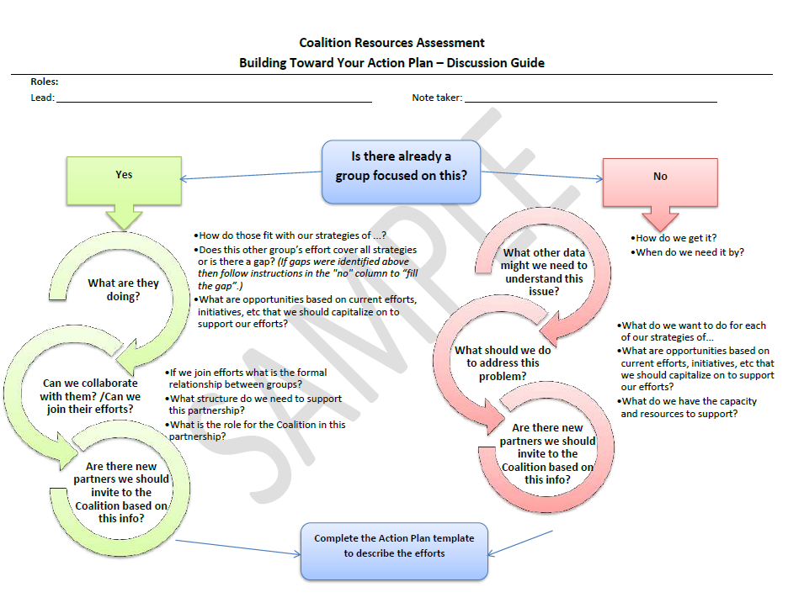
Step 5:
Integrate information in Strategic Plan – Phase 2 Building Toward Your Action Plan

Slide 27
Step 5:
Integrate information in Strategic Plan – Phase 2 Building Toward Your Action Plan
Example 1: Inform the Action Plan
Priority intervening variable: Family Management
Local condition: Parents state that they lack communication skills to use with their children.
Strategy: Parenting Education
Resources:
Family Center provides parenting classes, but..
  Existing parenting classes are not evaluated for effectiveness
  Existing parenting classes are not filled to capacity – not reaching “hard to reach parents”
Gaps:
No parenting classes for parents of 12 – 14 year olds.
Lack of skilled parenting instructors in the community
Needs Assessment
So how does this inform your Action Plan???
Resources Assessment
Phase 1 help select
Resources Assessment
Phase 2
Notes:
Use this to set the stage for local conditions. Explain how Res. Asst. informs planning by helping determine strategies specific to local conditions.

Slide 28
Step 5:
Integrate information in Strategic Plan – Phase 2 Building Toward Your Action Plan
Example 2:
  “After reviewing information collected from our resources assessment we determined that we have significant and effective resources available for children ages 5-12, however there are limited programs for youth ages 13-15 …so we have decided that we need an evidence-based school curriculum at SuperStar Middle School…”
  …The YMCA also includes delivery of classroom programs in their Plan so we will partner with the YMCA and the MS to implement Life Skills Training.”

Slide 29
[SAMPLE] Coalition Logic Model
Long-Term Outcome
Consequences
Behavioral Health Problems
(Consumption)
Intervening Variables
(Risk/Protective Factors)
Local Conditions and Contributing Factors
Strategies &
Local Implementation
Evaluation Plan
(10-15 years)
(5-10 years)
Outcomes
(2-5 years)
(6 months – 2 years)
Action
What is the problem?
Why?
Why here?
But why here?
What are we doing about it?
So what? How will we know?
…with these common factors…
…specifically in our community…
…can be addressed thru these strategies…
…and we will use these tools to measure our impact…
Engaging parents and youth with providers in local decisions.
These problems…
School performance (% of courses passed)
(HYS Academic)
Youth Delinquency
(either HYS Perception of Risk, or Alcohol related arrests of 10-17 year olds, depending on coalition’s strategy)
Mental Health
(HYS depression)
These types of problems…
Any Underage Drinking
(10th grade 30-day use)
Underage
Problem and Heavy Drinking
(10th grade)
Community Disorganization/ Community Connectedness
Community engagement/Coalition development:
Happy People Coalition
Low enforcement in public locations
Community engagement/Coalition development :
Annual Coalition Survey
Sustainability Documentation
Alcohol Availability: Social Access
Alcohol Laws: Enforcement; Youth Perception
Inconsistent consequences for offenders.
Public Awareness:
Media Advocacy for more or improved enforcement
Limited communication b/t enforcement and judiciary.
Environmental Strategies:
Enforcement Roundtable
Party Patrol
Public Awareness:
Process measures Community Survey
School Bonding
Social Skills
Friends who Use
Kids who are not performing at school tend to be those with substance use issues
Environmental Strategies:
Process measures Community Survey; HYS
Risk & Protective Factors:
Poor Family Management
Favorable Attitudes towards Drug Use
Intentions to Use
Lack of consistent and clear consequences at home.
School-based P/I Services:
Student Assistance Program - Happy Town MS
Prevention/ Intervention Services: pre/post
Youth think they would be viewed as “cool” if they drink
Direct Services:
Guiding Good Choices
Life Skills Training
Direct Services: Assigned Program pre/post and process measures; HYS
Youth exposure to favorable alcohol messages from their peers.
State Assessment
Local Assessment
Plan/Implementation
Reporting/Eval

Slide 30
[SAMPLE] Coalition Logic Model
Long-Term Outcome
Consequences
Behavioral Health Problems
(Consumption)
Intervening Variables
(Risk/Protective Factors)
Local Conditions and Contributing Factors
Strategies &
Local Implementation
Evaluation Plan
(10-15 years)
(5-10 years)
Outcomes
(2-5 years)
(6 months – 2 years)
Action
What is the problem?
Why?
Why here?
But why here?
What are we doing about it?
So what? How will we know?
…with these common factors…
…specifically in our community…
…can be addressed thru these strategies…
…and we will use these tools to measure our impact…
These problems…
School performance (% of courses passed)
(HYS Academic)
Youth Delinquency
(either HYS Perception of Risk, or Alcohol related arrests of 10-17 year olds, depending on coalition’s strategy)
Mental Health
(HYS depression)
These types of problems…
Any Underage Drinking
(10th grade 30-day use)
Underage
Problem and Heavy Drinking
(10th grade)
Poor Family Management
Lack of consistent and clear communication at home.
Parent Education:
Guiding Good Choices
Favorable Attitudes towards Drug Use
Intentions to Use
Youth think they would be viewed as “cool” if they drink.
Youth Education:
Life Skills Training
State Assessment
Local Assessment
Plan/Implementation
Reporting/Eval
Notes:
Point out that determining the actual program is the next step – to be done in the next training
Promote Athena – excellence in prevention list as a teaser.

Slide 31
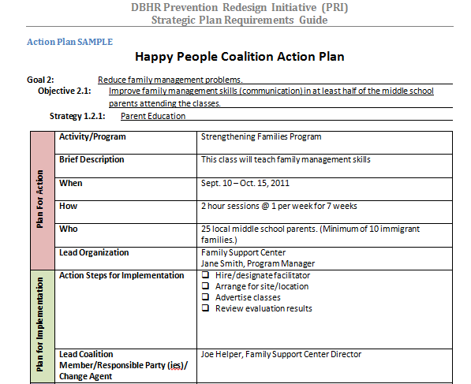
Action Plan

Slide 32
Analysis and Prioritization of Resources
Include in Strategic Plan:
  Describe the Coalition’s conclusions based on the key findings and explain how these were derived from the Coalition’s process and key findings.
  Explain how these conclusions connect the analysis from the needs and resources assessment to the strategies and activities described in the next section.

Slide 33
Summary:
Resources Assessment Findings
Today we covered…
… functions of Analysis and Prioritization of Resources Assessment.
… how to use Resources Assessment to support Strategy selection and implementation.
…how to incorporate Resources Assessment into Strategic Plan.
…how to use Resources Assessment to gather support for Action Plan.

Slide 34
Discussion Questions
What experience do you have to offer to the learning community around Resources Assessment?
What questions do you have as you work on these tasks?
What challenges have you encountered?
What have you done that worked really well?
What additional clarification is needed, if any, in order to move forward?

Slide 35
Resources
Strategic Plan Requirements Guide
The Athena Forum
Prevention System Managers
Cohort 1 Coordinators

Slide 36
Wrap up
Questions???
Follow up survey will be sent via email following this webinar. Please take a moment to complete it. It helps us continue to improve our trainings.

Slide 37
Questions?
If you would like additional technical assistance please contact your Prevention System Manager or email PRItraining@dshs.wa.gov.

