Slide 1
Cohort 2
Prevention Redesign Initiative (PRI)
Workshop Series
Workshop 3 – Fine Tuning Your Logic Model
Division of Behavioral Health and Recovery
February 2013
Presented by:
Julia Greeson, Prevention System Manager
Sarah Mariani, Prevention Systems Integration Manager

Slide 2
Introduction
Before we start…

Slide 3
Poll
Did you attend Workshops 1 and 2?

Slide 4
Workshop 3: Training Objectives
Participants will:
Understand how a logic model supports strategic planning.
Understand how to represent your strategic plan on the logic model template.
Understand how to explain and use the logic model with your coalition.
Understand how to integrate your logic model into your Strategic Plan.

Slide 5

Poll
How far along are you in completing your Logic Model?
  Haven’t started.
  Just starting to work through it.
  Have the information but haven’t put it into the template yet.
  Mostly finished, but still fine tuning.
  Completely finished.
Notes:
SWITCH

Slide 6
Building your Logic Model
Part one:

Slide 7
What is a Logic Model?
Demonstrates the logical links between what you plan to do and what it should impact.
If then.
Graphical illustration.
One page summary of your plan.

Slide 8
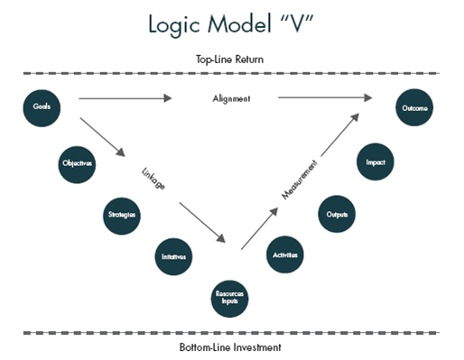
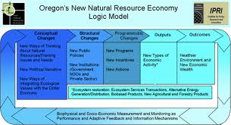
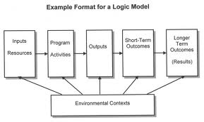
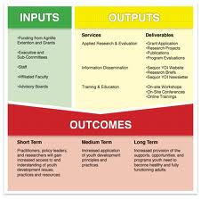
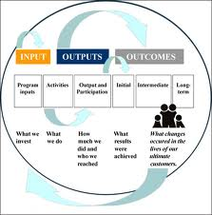
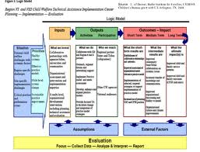
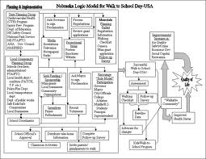
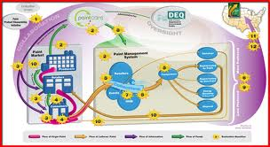
Side note: Lots of Logic Models
Long-Term Outcome:
Consequences
Behavioral Health Problems
(Consumption)
Intervening Variables
(Risk/Protective Factors)
Local Conditions and Contributing Factors
Strategies &
Local Implementation
Evaluation Plan
Notes:
Side note: It is all the same process – learn how the other professionals in your coalition under strategic planning and use that to meet them where they are at….
Credits:
Mary Ann's OfficeHere is an example of a “generic” logic model: Logic Modelwww.scheirerconsulting.com
Sequor Youth Development Initiative | Sequor YDI Logic ModelLogic models are a great tool in demonstrating how a program plans to ...ydi.tamu.edu
OKDHS - Preliminary Outcomes Report: Establishing Critical ...A logic model is a top-level depiction of the flow of materials and ...www.okdhs.org
The Logic Model | The Performance Institute's Logic Model for ...The Logic Model helps define priorities that maximize the impact of program ...www.performanceinstitute.org
UT-Arlington, Logic Models description and examplesExample 7: Logic model of a technical assistance program for child ...wweb.uta.edu
New Natural Resources Economy | Institute for Natural ResourcesNew Natural Resource Economy Logic Model (click to view large size)oregonstate.edu
theory of change logic model image search resultsTheory of change logic model imagespicsbox.biz
logic models · AEA365The fuzzy logic model concept (FLM) evolved out of the desire to make the ...aea365.org

Slide 9
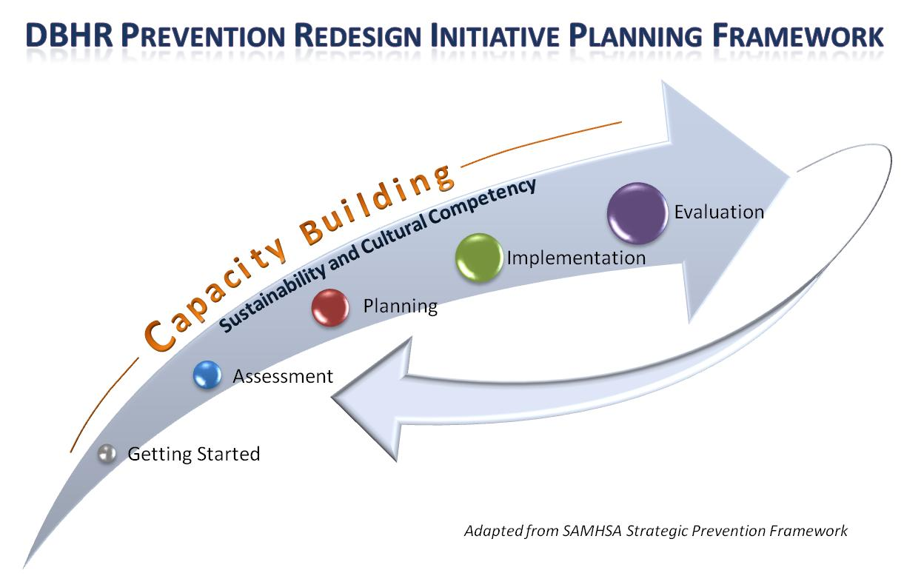
PRI Planning Framework
Notes:
The PRI is generally following the Strategic Prevention Framework (SPF) as the overall planning framework for this process. Based on our learning from the Strategic Prevention Framework State Incentive Grant (SPF-SIG) process, for the purposes of PRI, we have added a “Getting Started” section and have included “Capacity” as an ongoing step throughout the process. It is expected that all tasks associated with PRI will be conducted in a culturally competent and sustainable manner. This is not expected to be linear process.
EMPHASIZE – sustainability and cultural competence as well as capacity building.

Slide 10
Strategic Planning
Where are we going?
  Agree on Goals and Strategies that address substance abuse
  Demonstrate each partner’s role in supporting those goals and strategies
  Plan collaborative projects that support goals and objectives.

Slide 11
Strategic Plan –
Where does the Logic Model fit?
Executive Summary
Getting Started – Organizational Plan
Plan for Capacity Building
Assessment
  Needs Assessment
  Resources Assessment
Plan for Action
Plan for Implementation
Plan for Reporting and Evaluation

Slide 12
What goes into the Logic Model?
Results of …
  Needs Assessment Data
  Resources Assessment Information
  Selected Strategies/Activities/Programs
  Evaluation Plan

Slide 13
In Summary… SAMPLE
By addressing these factors in our community…
Family Communication
Using these programs…
Happy People Coalition
We effect community and family outcomes, which lead to reduction of…
Underage drinking
Marijuana misuse/ abuse
Prescription drug misuse/ abuse
Tobacco misuse/ abuse
We will build the health and wellness of individuals, families, schools and communities where people can be as healthy as possible in a safe and nurturing environment...
School Bonding
Enforcement
Parents and Youth Engagement
Improved enforcement
Enforcement Roundtable
Middle School
Student Assistance Program
Guiding Good Choices
Life Skills Training
Notes:
Talking Points:
This is known as a “theory of change”….It is a good way to simply state what you are trying to address in the community and how.
At the end of this process you will be able to answer all these questions about the coalition and its plans.
You can also call this the 30 second elevator speech.
Now let’s get into this…

Slide 14
[Name] Coalition Logic Model
Behavioral Health Problems
(Consumption)
Intervening Variables
(Risk/Protective Factors)
Behavioral Health Problems
(Consumption)
Intervening Variables
(Risk/Protective Factors)
Local Conditions and Contributing Factors
Strategies &
Local Implementation
Evaluation Plan
Long-Term Outcome:
Consequences
Local Conditions and Contributing Factors
Strategies &
Local Implementation
Long-Term Outcome
Consequences
Needs Assessment
(10-15 years)
(5-10 years)
Outcomes
(2-5 years)
(6 months – 2 years)
Action
What is the problem?
Why?
Why here?
But why here?
What are we doing about it?
So what? How will we know?
…with these common factors…
…specifically in our community…
…can be addressed thru these strategies…
…and we will use these tools to measure our impact…
These problems…
School performance (% of courses passed)
(HYS Academic)
Youth Delinquency
(either HYS Perception of Risk, or Alcohol related arrests of 10-17 year olds, depending on coalition’s strategy)
Mental Health
(HYS depression)
These types of problems…
Any Underage Drinking
(10th grade 30-day use)
Underage
Problem and Heavy Drinking
(10th grade)
[Add Yours Here]
Community Disorganization/ Community Connectedness
[Add Yours Here]
Community engagement/Coalition development:
[Coalition Name]
[Add Yours Here]
Community engagement/Coalition development:
Annual Coalition Survey
Sustainability Documentation
Alcohol Availability: Retail or Social Access
Promotion of Alcohol
Alcohol Laws: Enforcement; Penalties; Regulations
[Add Yours Here]
[Add Yours Here]
Public Awareness:
[Add Yours Here]
Public Awareness:
Process measures Community Survey
Environmental Strategies:
[Add Yours Here]
Low Commitment to School
Favorable Attitudes
Friends Who Use
Perception of Harm
[Based on individual assessment]
Environmental Strategies:
Process measures Community Survey; HYS
[Add Yours Here]
School-based Prevention/ Intervention Services:
Student Assistance Program
Prevention/ Intervention Services: pre/post
Risk & Protective Factors:
[Add Yours Here]
[Add Yours Here]
Direct Services:
[Add Yours Here]
Direct Services: Assigned Program pre/post and process measures; HYS
State Assessment
Local Assessment
Plan/Implementation
Reporting/Eval

Slide 15
[Name] Coalition Logic Model
Behavioral Health Problems
(Consumption)
Intervening Variables
(Risk/Protective Factors)
Behavioral Health Problems
(Consumption)
Intervening Variables
(Risk/Protective Factors)
Local Conditions and Contributing Factors
Strategies &
Local Implementation
Evaluation Plan
Long-Term Outcome:
Consequences
Local Conditions and Contributing Factors
Strategies &
Local Implementation
Long-Term Outcome
Consequences
Resources Assessment
(10-15 years)
(5-10 years)
Outcomes
(2-5 years)
(6 months – 2 years)
Action
What is the problem?
Why?
Why here?
But why here?
What are we doing about it?
So what? How will we know?
…with these common factors…
…specifically in our community…
…can be addressed thru these strategies…
…and we will use these tools to measure our impact…
These problems…
School performance (% of courses passed)
(HYS Academic)
Youth Delinquency
(either HYS Perception of Risk, or Alcohol related arrests of 10-17 year olds, depending on coalition’s strategy)
Mental Health
(HYS depression)
These types of problems…
Any Underage Drinking
(10th grade 30-day use)
Underage
Problem and Heavy Drinking
(10th grade)
[Add Yours Here]
Community Disorganization/ Community Connectedness
[Add Yours Here]
Community engagement/Coalition development:
[Coalition Name]
[Add Yours Here]
Community engagement/Coalition development:
Annual Coalition Survey
Sustainability Documentation
Alcohol Availability: Retail or Social Access
Promotion of Alcohol
Alcohol Laws: Enforcement; Penalties; Regulations
[Add Yours Here]
[Add Yours Here]
Public Awareness:
[Add Yours Here]
Public Awareness:
Process measures Community Survey
Environmental Strategies:
[Add Yours Here]
Low Commitment to School
Favorable Attitudes
Friends Who Use
Perception of Harm
[Based on individual assessment]
Environmental Strategies:
Process measures Community Survey; HYS
[Add Yours Here]
School-based Prevention/ Intervention Services:
Student Assistance Program
Prevention/ Intervention Services: pre/post
Risk & Protective Factors:
[Add Yours Here]
[Add Yours Here]
Direct Services:
[Add Yours Here]
Direct Services: Assigned Program pre/post and process measures; HYS
State Assessment
Local Assessment
Plan/Implementation
Reporting/Eval

Slide 16
[Name] Coalition Logic Model
Behavioral Health Problems
(Consumption)
Intervening Variables
(Risk/Protective Factors)
Behavioral Health Problems
(Consumption)
Intervening Variables
(Risk/Protective Factors)
Local Conditions and Contributing Factors
Strategies &
Local Implementation
Evaluation Plan
Long-Term Outcome:
Consequences
Local Conditions and Contributing Factors
Strategies &
Local Implementation
Long-Term Outcome
Consequences
Plan for Action
(10-15 years)
(5-10 years)
Outcomes
(2-5 years)
(6 months – 2 years)
Action
What is the problem?
Why?
Why here?
But why here?
What are we doing about it?
So what? How will we know?
…with these common factors…
…specifically in our community…
…can be addressed thru these strategies…
…and we will use these tools to measure our impact…
These problems…
School performance (% of courses passed)
(HYS Academic)
Youth Delinquency
(either HYS Perception of Risk, or Alcohol related arrests of 10-17 year olds, depending on coalition’s strategy)
Mental Health
(HYS depression)
These types of problems…
Any Underage Drinking
(10th grade 30-day use)
Underage
Problem and Heavy Drinking
(10th grade)
[Add Yours Here]
Community Disorganization/ Community Connectedness
[Add Yours Here]
Community engagement/Coalition development:
[Coalition Name]
[Add Yours Here]
Community engagement/Coalition development:
Annual Coalition Survey
Sustainability Documentation
Alcohol Availability: Retail or Social Access
Promotion of Alcohol
Alcohol Laws: Enforcement; Penalties; Regulations
[Add Yours Here]
[Add Yours Here]
Public Awareness:
[Add Yours Here]
Public Awareness:
Process measures Community Survey
Environmental Strategies:
[Add Yours Here]
Low Commitment to School
Favorable Attitudes
Friends Who Use
Perception of Harm
[Based on individual assessment]
Environmental Strategies:
Process measures Community Survey; HYS
[Add Yours Here]
School-based Prevention/ Intervention Services:
Student Assistance Program
Prevention/ Intervention Services: pre/post
Risk & Protective Factors:
[Add Yours Here]
[Add Yours Here]
Direct Services:
[Add Yours Here]
Direct Services: Assigned Program pre/post and process measures; HYS
State Assessment
Local Assessment
Plan/Implementation
Reporting/Eval

Slide 17
[Name] Coalition Logic Model
Behavioral Health Problems
(Consumption)
Intervening Variables
(Risk/Protective Factors)
Behavioral Health Problems
(Consumption)
Intervening Variables
(Risk/Protective Factors)
Local Conditions and Contributing Factors
Strategies &
Local Implementation
Evaluation Plan
Long-Term Outcome:
Consequences
Local Conditions and Contributing Factors
Strategies &
Local Implementation
Long-Term Outcome
Consequences
Plan for Reporting and Evaluation
(10-15 years)
(5-10 years)
Outcomes
(2-5 years)
(6 months – 2 years)
Action
What is the problem?
Why?
Why here?
But why here?
What are we doing about it?
So what? How will we know?
…with these common factors…
…specifically in our community…
…can be addressed thru these strategies…
…and we will use these tools to measure our impact…
These problems…
School performance (% of courses passed)
(HYS Academic)
Youth Delinquency
(either HYS Perception of Risk, or Alcohol related arrests of 10-17 year olds, depending on coalition’s strategy)
Mental Health
(HYS depression)
These types of problems…
Any Underage Drinking
(10th grade 30-day use)
Underage
Problem and Heavy Drinking
(10th grade)
[Add Yours Here]
Community Disorganization/ Community Connectedness
[Add Yours Here]
Community engagement/Coalition development:
[Coalition Name]
[Add Yours Here]
Community engagement/Coalition development:
Annual Coalition Survey
Sustainability Documentation
Alcohol Availability: Retail or Social Access
Promotion of Alcohol
Alcohol Laws: Enforcement; Penalties; Regulations
[Add Yours Here]
[Add Yours Here]
Public Awareness:
[Add Yours Here]
Public Awareness:
Process measures Community Survey
Environmental Strategies:
[Add Yours Here]
Low Commitment to School
Favorable Attitudes
Friends Who Use
Perception of Harm
[Based on individual assessment]
Environmental Strategies:
Process measures Community Survey; HYS
[Add Yours Here]
School-based Prevention/ Intervention Services:
Student Assistance Program
Prevention/ Intervention Services: pre/post
Risk & Protective Factors:
[Add Yours Here]
[Add Yours Here]
Direct Services:
[Add Yours Here]
Direct Services: Assigned Program pre/post and process measures; HYS
State Assessment
Local Assessment
Plan/Implementation
Reporting/Eval

Slide 18
[Name] Coalition Logic Model
Long-Term Outcome:
Consequences
Behavioral Health Problems
(Consumption)
Intervening Variables
(Risk/Protective Factors)
Local Conditions and Contributing Factors
Strategies &
Local Implementation
Evaluation Plan
(10-15 years)
(5-10 years)
Outcomes
(2-5 years)
(6 months – 2 years)
Action
What is the problem?
Why?
Why here?
But why here?
What are we doing about it?
So what? How will we know?
…with these common factors…
…specifically in our community…
…can be addressed thru these strategies…
…and we will use these tools to measure our impact…
These problems…
School performance (% of courses passed)
(HYS Academic)
Youth Delinquency
(either HYS Perception of Risk, or Alcohol related arrests of 10-17 year olds, depending on coalition’s strategy)
Mental Health
(HYS depression)
These types of problems…
Any Underage Drinking
(10th grade 30-day use)
Underage
Problem and Heavy Drinking
(10th grade)
[Add Yours Here]
Community Disorganization/ Community Connectedness
[Add Yours Here]
Community engagement/Coalition development:
[Coalition Name]
[Add Yours Here]
Community engagement/Coalition development:
Annual Coalition Survey
Sustainability Documentation
Alcohol Availability: Retail or Social Access
Promotion of Alcohol
Alcohol Laws: Enforcement; Penalties; Regulations
[Add Yours Here]
[Add Yours Here]
Public Awareness:
[Add Yours Here]
Public Awareness:
Process measures Community Survey
Environmental Strategies:
[Add Yours Here]
Low Commitment to School
Favorable Attitudes
Friends Who Use
Perception of Harm
[Based on individual assessment]
Environmental Strategies:
Process measures Community Survey; HYS
[Add Yours Here]
School-based Prevention/ Intervention Services:
Student Assistance Program
Prevention/ Intervention Services: pre/post
Risk & Protective Factors:
[Add Yours Here]
[Add Yours Here]
Direct Services:
[Add Yours Here]
Direct Services: Assigned Program pre/post and process measures; HYS
State Assessment
Local Assessment
Plan/Implementation
Reporting/Eval
Notes:
GET OFF EMAIL…..☺

Slide 19
[SAMPLE] Coalition Logic Model
Long-Term Outcome
Consequences
Behavioral Health Problems
(Consumption)
Intervening Variables
(Risk/Protective Factors)
Local Conditions and Contributing Factors
Strategies &
Local Implementation
Evaluation Plan
(10-15 years)
(5-10 years)
Outcomes
(2-5 years)
(6 months – 2 years)
Action
What is the problem?
Why?
Why here?
But why here?
What are we doing about it?
So what? How will we know?
…with these common factors…
…specifically in our community…
…can be addressed thru these strategies…
…and we will use these tools to measure our impact…
Engaging parents and youth with providers in local decisions.
These problems…
School performance (% of courses passed)
(HYS Academic)
Youth Delinquency
(either HYS Perception of Risk, or Alcohol related arrests of 10-17 year olds, depending on coalition’s strategy)
Mental Health
(HYS depression)
These types of problems…
Any Underage Drinking
(10th grade 30-day use)
Underage
Problem and Heavy Drinking
(10th grade)
Community Disorganization/ Community Connectedness
Community engagement/Coalition development:
Happy People Coalition
Low enforcement in public locations.
Community engagement/Coalition development :
Annual Coalition Survey
Sustainability Documentation
Alcohol Availability: Social Access
Alcohol Laws: Enforcement; Youth Perception
Inconsistent consequences for offenders.
Public Awareness:
Media Advocacy for more or improved enforcement
Limited communication b/t enforcement and judiciary.
Environmental Strategies:
Enforcement
Roundtable
Party Patrol
Public Awareness:
Process measures Community Survey
School Bonding
Social Skills
Friends who Use
Kids are skipping school a lot.
Youth say that their friends drink.
Environmental Strategies:
Process measures Community Survey; HYS
Risk & Protective Factors:
Poor Family Management
Favorable Attitudes Towards Drug Use
Lack of consistent and clear consequences at home.
School-based P/I Services:
Student Assistance Program - Happy Town MS
Prevention/ Intervention Services: pre/post
Youth think they would be viewed as “cool” if they drink.
Direct Services:
Guiding Good Choices
LifeSkills Training
Direct Services: Assigned Program pre/post and process measures; HYS
Youth exposure to favorable alcohol messages from their peers.
State Assessment
Local Assessment
Plan/Implementation
Reporting/Eval

Slide 20

Whoa! Rewind….

Slide 21
Strategic Planning
Ask
Find
Discuss and Decide

Slide 22
State Needs Assessments
SPF-SIG…
...PRI…C1…C2…C3…
...SPE….
Risk profiles
Community Selection
Notes:
RISK PROFILES: A set of indicators that include consumption, consequences associated with consumption (crime, truancy, lack of school success), and socio-economic data were identified based on data quality and availability, and input from stakeholders as to relevance and interpretability. Those indicators were grouped by domain, standardized, and then reported as composite scores. Every county received a Risk Profile that included the demographics and risk ranking for all the school districts in the county. They also received detailed data tables and a map with the composite scores by school district (see page 4). From these Risk Profiles a committee of key stakeholders within each county identified highest need communities for participation in PRI.

Slide 23
Long Term Outcomes
Long-Term Outcome:
Consequences
These problems…
School performance (% of courses passed)
Youth Delinquency
(either * HYS Perception of Risk, or Alcohol related arrests of 10-17 year olds, depending on coalition’s strategy)
Mental Health
(HYS depression)
What is the problem?
Based on the state assessment we know these problem are present in our state and our community, so...
How these are locally relevant?
Should we add any long-term consequences?
As we think about our community 10 years from now – what do we want to be able to say we have….done?
In what ways do problems with school performance and youth delinquency ‘show up’ in our community?
What 2-3 things if they changed could have the biggest impact on our issues?
…what’s changed…?
…what’s in place…?
…made progress towards…?
Notes:
If we could first explain how we intended these state identified priorities be used by each Coalition it will help them be able to answer the questions that follow in the slide. For instance if first we explain for how each of the Consequences, for example, Youth Delinquency (either * HYS Perception of Risk, or Alcohol related arrests of 10-17 year olds, depending on coalition’s strategy?)is intended to be used by or fit into their plan it will then help them answer the questions that follow in the slide and on the Strategic Plan Guide (Identify the prioritized long-term outcomes consequences and explain how these are locally relevant)
Consequences: Long Term Outcomes School performance (% of courses passed); Youth Delinquency (either * HYS Perception of Risk, or Alcohol related arrests of 10-17 year olds, depending on coalition’s strategy?); Mental Health (HYS depression)
Questions on the Slide
As we think about our community 5 years from now – what do we want to be able to say we have….done?
what’s changed…?
what’s in place…?
made progress towards…?
What 2-3 things if they changed could have the biggest impact on our issues?
Consumption: Behavioral Health Problems….
Same issue….. If we could first explain how these state identified priorities are intended to be used in the scheme of any of the Coalition’s Logic Model it will help each individual Coalition answer the questions both from the Strategic Plan Guide and on your slide…. (Identify the prioritized behavioral health problems and explain how these are locally relevant.)

Slide 24
Intermediate Outcomes
Behavioral Health Problems
(Consumption)
These types of problems…
Any Underage Drinking
(10th grade 30-day use)
Underage
Problem and Heavy Drinking
(10th grade)
[Add Yours Here]
Why is that a problem?
Based on the state assessment we know these problem are present in our state and our community, so...Based on Coalition's Needs Assessment…
How these are locally relevant?
Should we add any behavioral health problems?
How is substance abuse effecting our community?
Need to determine
What was prioritized in our needs assessment?
What elements of substance abuse are most important to us to do something about?
What problems are we trying to solve specifically about substance abuse?
What does our needs assessment data tell us about underage drinking in our community?
Notes:
If we could first explain how we intended these state identified priorities be used by each Coalition it will help them be able to answer the questions that follow in the slide. For instance if first we explain for how each of the Consequences, for example, Youth Delinquency (either * HYS Perception of Risk, or Alcohol related arrests of 10-17 year olds, depending on coalition’s strategy?)is intended to be used by or fit into their plan it will then help them answer the questions that follow in the slide and on the Strategic Plan Guide (Identify the prioritized long-term outcomes consequences and explain how these are locally relevant)
Consequences: Long Term Outcomes School performance (% of courses passed); Youth Delinquency (either * HYS Perception of Risk, or Alcohol related arrests of 10-17 year olds, depending on coalition’s strategy?); Mental Health (HYS depression)
Questions on the Slide
As we think about our community 5 years from now – what do we want to be able to say we have….done?
what’s changed…?
what’s in place…?
made progress towards…?
What 2-3 things if they changed could have the biggest impact on our issues?
Consumption: Behavioral Health Problems….
Same issue….. If we could first explain how these state identified priorities are intended to be used in the scheme of any of the Coalition’s Logic Model it will help each individual Coalition answer the questions both from the Strategic Plan Guide and on your slide…. (Identify the prioritized behavioral health problems and explain how these are locally relevant.)

Slide 25
Short Term Outcomes
Intervening Variables
(Risk/Protective Factors)
…with these common factors…
Why is that a problem here?
Based on the state assessment we know these problem are present in our state and our community, so...Based on Coalition's Needs Assessment
How these are locally relevant?
What should we select as our intervening variables?
Community Disorganization/ Community Connectedness
Alcohol Availability: Retail or Social Access
Promotion of Alcohol
Alcohol Laws: Enforcement; Penalties; Regulations
[Add Yours Here]
Need to determine
Which should we set target outcomes for?
Low Commitment to School
Favorable Attitudes
Friends Who Use
Perception of Harm
[Based on individual assessment]
Why is this happening in our community?
What are recommendations from the workgroup?
What specifically about those problems are most important to us?
Risk & Protective Factors:
[Add Yours Here]

Slide 26
Short Term Outcomes
Intervening Variables
(Risk/Protective Factors)
…with these common factors…
Why is that a problem here?
Community Disorganization/ Community Connectedness
What is happening in our community around collaboration and community engagement?
Alcohol Availability: Retail or Social Access
Promotion of Alcohol
Alcohol Laws: Enforcement; Penalties; Regulations
[Add Yours Here]
Need to determine
What sort of laws/norms are present in our community?
What is the experience children are having in our schools?
Low Commitment to School
Favorable Attitudes
Friends Who Use
Perception of Harm
[Based on individual assessment]
What other risks factors impact our families…individuals… youth?
What other protective factors impact our families…individuals… youth?
Risk & Protective Factors:
[Add Yours Here]

Slide 27
Short Term Outcomes
Intervening Variables
(Risk/Protective Factors)
…with these common factors…
Why is that a problem here?
Community Disorganization/ Community Connectedness
Alcohol Availability: Retail or Social Access
Promotion of Alcohol
Alcohol Laws: Enforcement; Penalties; Regulations
[Add Yours Here]
Need to determine
Which should we set target outcomes for?
What are we not ok with? What is an unacceptable rate for our community?
Low Commitment to School
Favorable Attitudes
Friends Who Use
Perception of Harm
[Based on individual assessment]
Based on all the data we reviewed, which data indicators are most important for us to track, monitor change, etc?
Risk & Protective Factors:
[Add Yours Here]

Slide 28
Short Term Outcomes
Intervening Variables
(Risk/Protective Factors)
What is happening in our community around collaboration and community engagement?
…with these common factors…
Why is that a problem here?
Based on Coalition's Needs Assessment
How these are locally relevant?
What should we select as or intervening variables?
Community Disorganization/ Community Connectedness
What sort of laws/norms are present in our community?
Alcohol Availability: Retail or Social Access
Promotion of Alcohol
Alcohol Laws: Enforcement; Penalties; Regulations
[Add Yours Here]
Need to determine
Which should we set target outcomes for
Why is this happening in our community?
What are we not ok with? What is an unacceptable rate for our community?
What is the experience children are having in our schools?
Low Commitment to School
Favorable Attitudes
Friends Who Use
Perception of Harm
[Based on individual assessment]
What are recommendations from the workgroup?
What other risks factors impact our families…individuals… youth?
Based on all the data we reviewed, which data indicators are most important for us to track, monitor change, etc?
What specifically about those problems are most important to us?
Risk & Protective Factors:
[Add Yours Here]
What other protective factors impact our families…individuals… youth?

Slide 29
Short Term Outcomes
Intervening Variables
(Risk/Protective Factors)
What is happening in our community around collaboration and community engagement?
…with these common factors…
Why is that a problem here?
Based on Coalition's Needs Assessment
How these are locally relevant?
What should we select as or intervening variables?
Community Disorganization/ Community Connectedness
What sort of laws/norms are present in our community?
Alcohol Availability: Retail or Social Access
Promotion of Alcohol
Alcohol Laws: Enforcement; Penalties; Regulations
[Add Yours Here]
Need to determine
Which should we set target outcomes for?
Why is this happening in our community?
What are we not ok with? What is an unacceptable rate for our community?
What is the experience children are having in our schools?
Low Commitment to School
Favorable Attitudes
Friends Who Use
Perception of Harm
[Based on individual assessment]
What are recommendations from the workgroup?
What other risks factors impact our families…individuals… youth?
Based on all the data we reviewed, which data indicators are most important for us to track, monitor change, etc?
What specifically about those problems are most important to us?
Risk & Protective Factors:
[Add Yours Here]
What other protective factors impact our families…individuals… youth?

Slide 30
Short Term Outcomes
Local Conditions and Contributing Factors
…specifically in our community…
But what specifically about that factor is present in our community?
Based on Coalition's Needs Assessment and Resources Assessment
How these are locally relevant?
What should we select as our local conditions?
Community Disorganization/ Community Connectedness
[Add Yours Here]
Laws and Norms
[Add Yours Here]
Need to determine
Why is this happening in our community?
What does our community survey tell us about these problems?
School
[Add Yours Here]
Risk and Protective Factors
[Add Yours Here]
What specifically about those problems are most important to us?

Slide 31
Short Term Outcomes
Local Conditions and Contributing Factors
…specifically in our community…
But what specifically about that factor is present in our community?
Community Disorganization/ Community Connectedness
[Add Yours Here]
What will work in this community to increase collaboration and community engagement?
Laws and Norms
[Add Yours Here]
Why are certain factors for laws/norms present in our community?
Need to determine
What about the experience children are having in our schools should we address?
School
[Add Yours Here]
What specifically should we address for the risks factors impacting our families… individuals… youth?
Risk and Protective Factors
[Add Yours Here]
What specifically should we enhance from our protective factors impacting our families… individuals… youth?

Slide 32
Short Term Outcomes
Local Conditions and Contributing Factors
…specifically in our community…
But what specifically about that factor is present in our community?
Community Disorganization/ Community Connectedness
[Add Yours Here]
Laws and Norms
[Add Yours Here]
Need to determine
Which should we set target outcomes for?
School
[Add Yours Here]
Based on all the data we reviewed, which data indicators are most important for us to track, monitor change, etc?
Risk and Protective Factors
[Add Yours Here]

Slide 33
Short Term Outcomes
Local Conditions and Contributing Factors
What will work in this community to increase collaboration and community engagement?
…specifically in our community…
But what specifically about that factor is present in our community?
Based on Coalition's Needs and Resources Assessments
How these are locally relevant?
What should we select as our local conditions?
Community Disorganization/ Community Connectedness
[Add Yours Here]
Why are certain factors for laws/norms present in our community?
Laws and Norms
[Add Yours Here]
What about the experience children are having in our schools should we address?
Need to determine
Which should we set target outcomes for?
Why is this happening in our community?
What does our community survey tell us about these problems?
School
[Add Yours Here]
What specifically should we address for the risks factors impacting our families… individuals… youth?
Based on all the data we reviewed, which data indicators are most important for us to track, monitor change, etc?
Risk and Protective Factors
[Add Yours Here]
What specifically about those problems are most important to us?
What specifically should we enhance from our protective factors impacting our families… individuals… youth?

Slide 34
Chat/Discussion
What else???
Please raise your hand to speak or type your answer into the question box.
What suggestions do you have for facilitating the coalition discussion around outcomes?

Slide 35
Poll
Have you selected your strategies, programs and activities yet?
  Haven’t started.
  Just starting to work through it.
  Have the information but haven’t put it into the template yet.
  Mostly finished, but still fine tuning.
  Completely finished.
Notes:
SARAH introduce and launch the poll on 29 then JULIA summarize the results, and start talking …

Slide 36
Strategies/Activities
Strategies &
Local Implementation
…can be addressed thru these strategies…
For each of these strategies, what are we going to do about it?
Based on Coalition's Needs and Resources Assessments
What are we currently doing that support these goals?
What could we expand on?
Community engagement/Coalition development:
[Coalition Name]
[Add Yours Here]
Public Awareness:
[Add Yours Here]
Need to determine
Environmental Strategies:
[Add Yours Here]
What else could we do?
What are the most important activities your organization supports that impact these issues?
School-based Prevention/ Intervention Services:
Student Assistance Program
What key strategies/activities are you willing to partner or collaborate on?
Direct Services:
[Add Yours Here]

Slide 37
Strategies/Activities
Strategies &
Local Implementation
…can be addressed thru these strategies…
For each of these strategies, what are we going to do about it?
Community engagement/Coalition development:
[Coalition Name]
[Add Yours Here]
How will we increase collaboration and community engagement?
Public Awareness:
[Add Yours Here]
How will we increase community awareness?
Need to determine
Environmental Strategies:
[Add Yours Here]
How will we change laws/norms present in our community?
How will we support children in our schools?
School-based Prevention/ Intervention Services:
Student Assistance Program
How will we support our families… individuals… youth?
Direct Services:
[Add Yours Here]

Slide 38
Strategies/Activities
Strategies &
Local Implementation
…can be addressed thru these strategies…
For each of these strategies, what are we going to do about it?
Community engagement/Coalition development:
[Coalition Name]
[Add Yours Here]
Public Awareness:
[Add Yours Here]
Need to determine
Environmental Strategies:
[Add Yours Here]
School-based Prevention/ Intervention Services:
Student Assistance Program
Are those resources able to provide the needed level of services needed?
What opportunities for partnership/ collaboration do we need to be more intentional about in the future?
Direct Services:
[Add Yours Here]

Slide 39
Strategies/Activities
Strategies &
Local Implementation
How will we increase collaboration and community engagement?
…can be addressed thru these strategies…
For each of these strategies, what are we going to do about it?
Based on Coalition's Needs and Resources Assessments
What are we currently doing that support these goals?
What could we expand on?
Community engagement/Coalition development:
[Coalition Name]
[Add Yours Here]
How will we increase community awareness?
Public Awareness:
[Add Yours Here]
Need to determine
How will we change laws/norms present in our community?
Environmental Strategies:
[Add Yours Here]
What else could we do?
What are the most important activities your organization supports that impact these issues?
How will we support children in our schools?
School-based Prevention/ Intervention Services:
Student Assistance Program
Are those resources able to provide the needed level of services needed?
What opportunities for partnership/ collaboration do we need to be more intentional about in the future?
How will we support our families… individuals… youth?
What key strategies/activities are you willing to partner or collaborate on?
Direct Services:
[Add Yours Here]

Slide 40
Selecting Programs
What else could we do?
Review programs
Select programs
Get partner confirmation

Slide 41

Selecting Programs
Look for the Excellence in Prevention.
What are our needs based on our local conditions?
What are the parameters for the program we want to provide?
  In which types of geography do you plan to implement the program?
  Where will you implement the program? (Community, Home, School, Workplace)
  What problems do you wish to address?
  What is the age of your intended audience? (Select all that apply)
  What is the race/ethnicity of your intended audience? (Select all that apply)

Slide 42
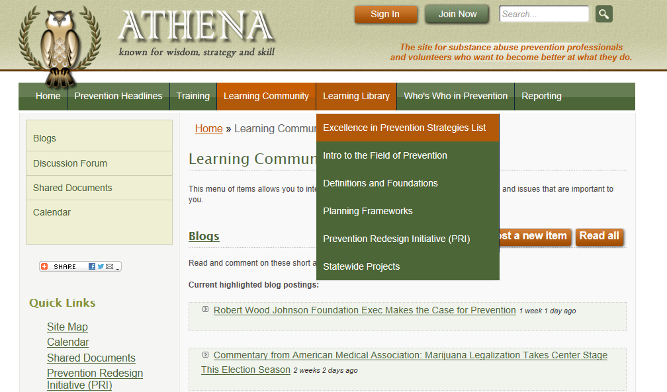
Programs List

Slide 43
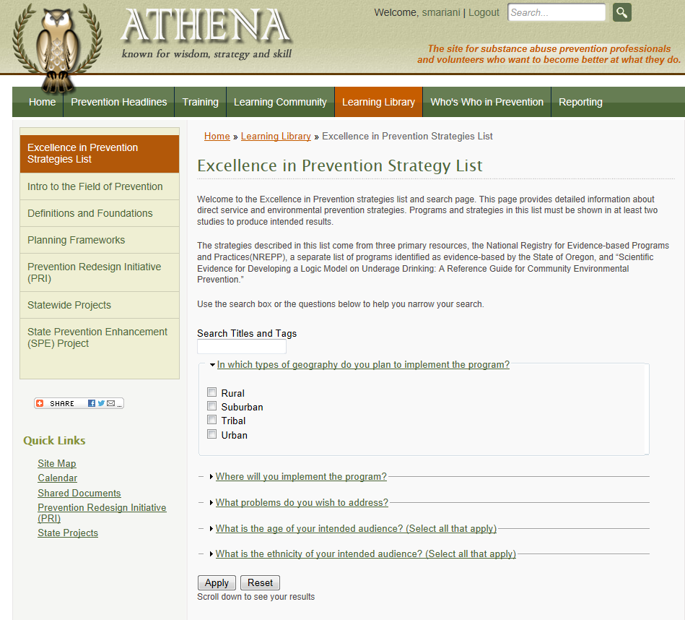

Slide 44
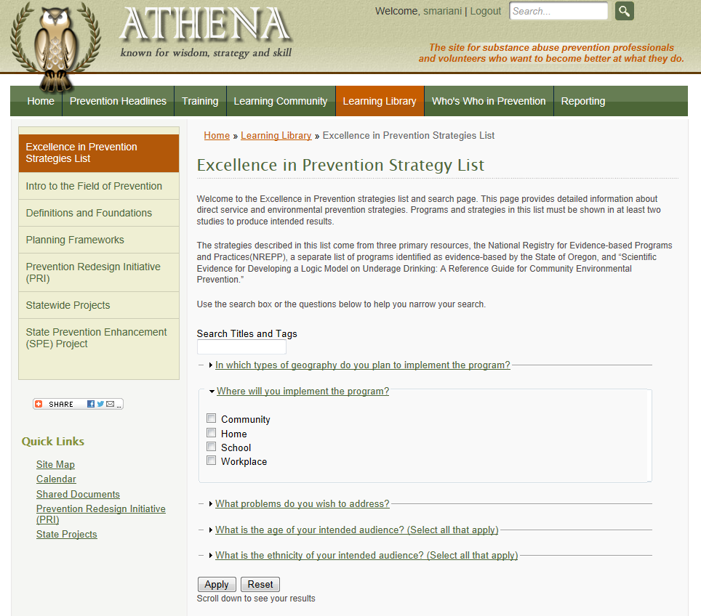

Slide 45
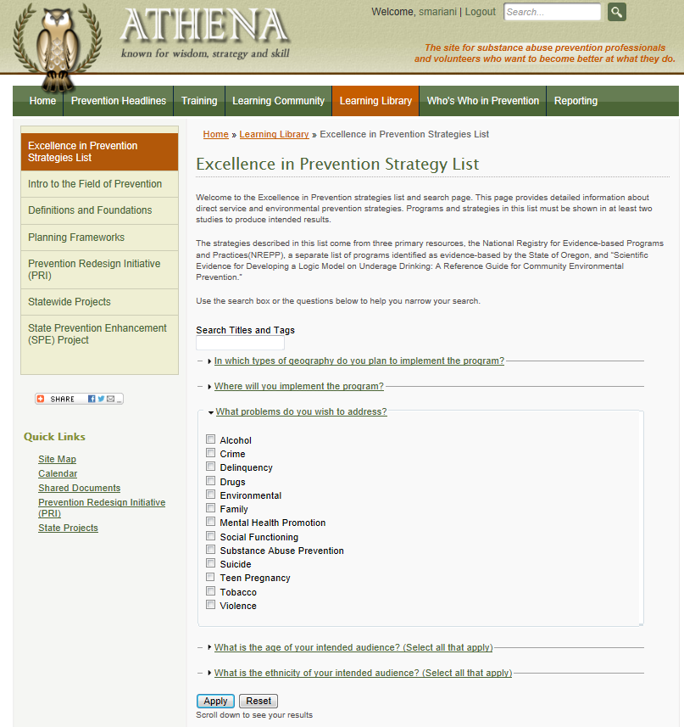

Slide 46
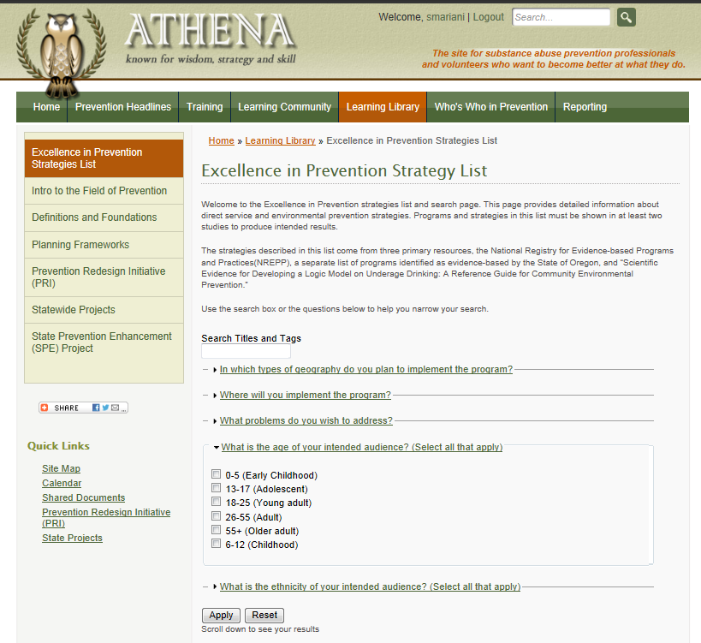

Slide 47


Slide 48
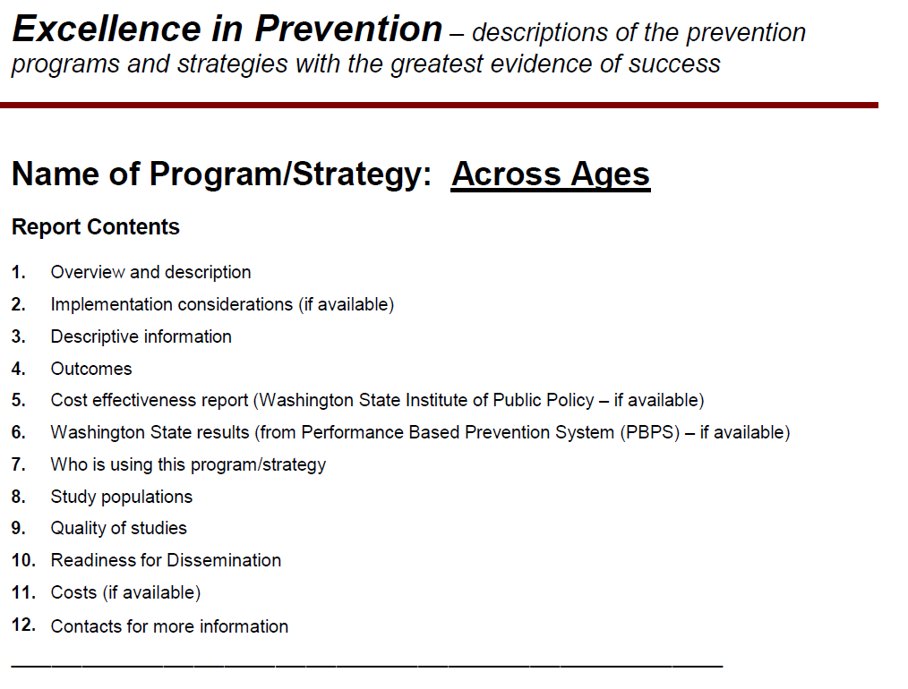
Evidence-based Programs

Slide 49
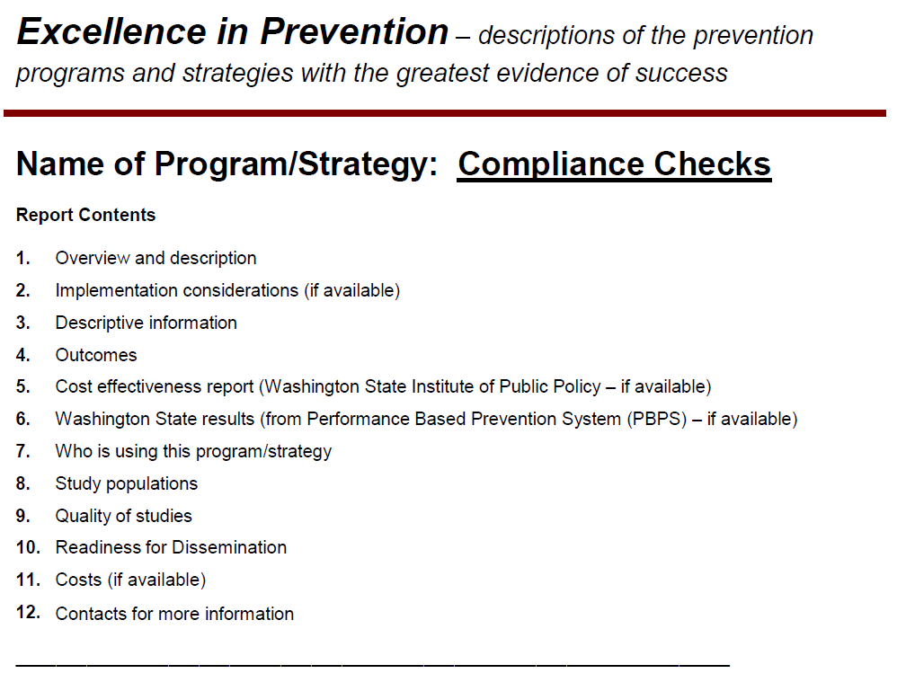
Environmental Strategies

Slide 50
Poll
Do you feel comfortable using the Excellence in Prevention list on Athena?
  Not yet, would like some more training/TA.
  Not yet, just need to practice on my own.
  Probably, but I haven't used it yet.
  Yes, I am good.
  Yes, I have already used it.
Notes:
JULIA launch the poll on and SARAH close it summarize and keep moving…

Slide 51
Strategic Plan – Action Plan
Where the rubber meets the road

Slide 52
Strategic Plan – Action Plan
Beginning on page 35 of the Guide there is a template of an Action Plan.

Slide 53
Evaluation
Evaluation Plan
…and we will use these tools to measure our impact…
So What?
How will we know success?
How will we know when we need to make adjustments?
Community engagement/Coalition development:
Annual Coalition Survey
Sustainability Documentation
What reports do we need to have?...For what purposes?
Public Awareness:
Process measures Community Survey
Who will want to know about the coalition efforts?
Need to determine
Environmental Strategies:
Process measures Community Survey; HYS
What is the feedback loop for information?
What do we want to track about the work we do?
Do we want to set targets?
Prevention/ Intervention Services: pre/post
What do we want to celebrate?
How will we make our programs better?
Direct Services: Assigned Program pre/post and process measures; HYS

Slide 54
Questions???
Please raise your hand if you would like to speak or type your question into the questions box.

Slide 55

Ok, Fast Forward…

Slide 56
[SAMPLE] Coalition Logic Model
Long-Term Outcome
Consequences
Behavioral Health Problems
(Consumption)
Intervening Variables
(Risk/Protective Factors)
Local Conditions and Contributing Factors
Strategies &
Local Implementation
Evaluation Plan
(10-15 years)
(5-10 years)
Outcomes
(2-5 years)
(6 months – 2 years)
Action
What is the problem?
Why?
Why here?
But why here?
What are we doing about it?
So what? How will we know?
…with these common factors…
…specifically in our community…
…can be addressed thru these strategies…
…and we will use these tools to measure our impact…
Engaging parents and youth with providers in local decisions.
These problems…
School performance (% of courses passed)
(HYS Academic)
Youth Delinquency
(either HYS Perception of Risk, or Alcohol related arrests of 10-17 year olds, depending on coalition’s strategy)
Mental Health
(HYS depression)
These types of problems…
Any Underage Drinking
(10th grade 30-day use)
Underage
Problem and Heavy Drinking
(10th grade)
Community Disorganization/ Community Connectedness
Community engagement/Coalition development:
Happy People Coalition
Low enforcement in public locations.
Community engagement/Coalition development :
Annual Coalition Survey
Sustainability Documentation
Alcohol Availability: Social Access
Alcohol Laws: Enforcement; Youth Perception
Inconsistent consequences for offenders.
Public Awareness:
Media Advocacy for more or improved enforcement
Limited communication b/t enforcement and judiciary.
Environmental Strategies:
Enforcement
Roundtable
Party Patrol
Public Awareness:
Process measures Community Survey
School Bonding
Social Skills
Friends who Use
Kids are skipping school a lot.
Youth say that their friends drink.
Environmental Strategies:
Process measures Community Survey; HYS
Risk & Protective Factors:
Poor Family Management
Favorable Attitudes Towards Drug Use
Lack of consistent and clear consequences at home.
School-based P/I Services:
Student Assistance Program - Happy Town MS
Prevention/ Intervention Services: pre/post
Youth think they would be viewed as “cool” if they drink.
Direct Services:
Guiding Good Choices
LifeSkills Training
Direct Services: Assigned Program pre/post and process measures; HYS
Youth exposure to favorable alcohol messages from their peers.
State Assessment
Local Assessment
Plan/Implementation
Reporting/Eval

Slide 57
[SAMPLE] Coalition Logic Model
Long-Term Outcome
Consequences
Behavioral Health Problems
(Consumption)
Intervening Variables
(Risk/Protective Factors)
Local Conditions and Contributing Factors
Strategies &
Local Implementation
Evaluation Plan
(10-15 years)
(5-10 years)
Outcomes
(2-5 years)
(6 months – 2 years)
Action
What is the problem?
Why?
Why here?
But why here?
What are we doing about it?
So what? How will we know?
…with these common factors…
…specifically in our community…
…can be addressed thru these strategies…
…and we will use these tools to measure our impact…
These problems…
School performance (% of courses passed)
(HYS Academic)
Youth Delinquency
(either HYS Perception of Risk, or Alcohol related arrests of 10-17 year olds, depending on coalition’s strategy)
Mental Health
(HYS depression)
These types of problems…
Any Underage Drinking
(10th grade 30-day use)
Underage
Problem and Heavy Drinking
(10th grade)
Community Disorganization/ Community Connectedness
Engaging parents and youth with providers in local decisions.
Community engagement/ Coalition development:
Happy People Coalition
Community engagement/
Coalition development:
Annual Coalition Assessment Tool
Sustainability Documentation
Annual Roundtable Focus groups
State Assessment
Local Assessment
Plan/Implementation
Reporting/Eval
Notes:
Point out that determining the actual program is the next step – to be done in the next training
Promote Athena – excellence in prevention list as a teaser.

Slide 58
[SAMPLE] Coalition Logic Model
Long-Term Outcome
Consequences
Behavioral Health Problems
(Consumption)
Intervening Variables
(Risk/Protective Factors)
Local Conditions and Contributing Factors
Strategies &
Local Implementation
Evaluation Plan
(10-15 years)
(5-10 years)
Outcomes
(2-5 years)
(6 months – 2 years)
Action
What is the problem?
Why?
Why here?
But why here?
What are we doing about it?
So what? How will we know?
…with these common factors…
…specifically in our community…
…can be addressed thru these strategies…
…and we will use these tools to measure our impact…
Engaging parents and youth with providers in local decisions.
These problems…
School performance (% of courses passed)
(HYS Academic)
Youth Delinquency
(either HYS Perception of Risk, or Alcohol related arrests of 10-17 year olds, depending on coalition’s strategy)
Mental Health
(HYS depression)
These types of problems…
Any Underage Drinking
(10th grade 30-day use)
Underage
Problem and Heavy Drinking
(10th grade)
Community Disorganization/ Community Connectedness
Community engagement/Coalition development:
Happy People Coalition
Low enforcement in public locations.
Community engagement/Coalition development :
Annual Coalition Survey
Sustainability Documentation
Alcohol Availability: Social Access
Alcohol Laws: Enforcement; Youth Perception
Inconsistent consequences for offenders.
Public Awareness:
Media Advocacy for more or improved enforcement
Limited communication b/t enforcement and judiciary.
Environmental Strategies:
Enforcement
Roundtable
Party Patrol
Public Awareness:
Process measures Community Survey
School Bonding
Social Skills
Friends who Use
Kids are skipping school a lot.
Youth say that their friends drink.
Environmental Strategies:
Process measures Community Survey; HYS
Risk & Protective Factors:
Poor Family Management
Favorable Attitudes Towards Drug Use
Lack of consistent and clear consequences at home.
School-based P/I Services:
Student Assistance Program - Happy Town MS
Prevention/ Intervention Services: pre/post
Youth think they would be viewed as “cool” if they drink.
Direct Services:
Guiding Good Choices
LifeSkills Training
Direct Services: Assigned Program pre/post and process measures; HYS
Youth exposure to favorable alcohol messages from their peers.
State Assessment
Local Assessment
Plan/Implementation
Reporting/Eval

Slide 59
[SAMPLE] Coalition Logic Model
Long-Term Outcome
Consequences
Behavioral Health Problems
(Consumption)
Intervening Variables
(Risk/Protective Factors)
Local Conditions and Contributing Factors
Strategies &
Local Implementation
Evaluation Plan
(10-15 years)
(5-10 years)
Outcomes
(2-5 years)
(6 months – 2 years)
Action
What is the problem?
Why?
Why here?
But why here?
What are we doing about it?
So what? How will we know?
…with these common factors…
…specifically in our community…
…can be addressed thru these strategies…
…and we will use these tools to measure our impact…
These problems…
School performance (% of courses passed)
(HYS Academic)
Youth Delinquency
(either HYS Perception of Risk, or Alcohol related arrests of 10-17 year olds, depending on coalition’s strategy)
Mental Health
(HYS depression)
These types of problems…
Any Underage Drinking
(10th grade 30-day use)
Underage
Problem and Heavy Drinking
(10th grade)
Alcohol Availability: Social Access
Alcohol Laws: Enforcement; Youth Perception
Low enforcement in public locations
Environmental Strategies:
Enforcement Roundtable
Party Patrol
Environmental Strategies:
Process measures;
Community Survey;
HYS
Inconsistent consequences for offenders.
Limited communication b/t enforcement and judiciary.
State Assessment
Local Assessment
Plan/Implementation
Reporting/Eval
Notes:
Point out that determining the actual program is the next step – to be done in the next training
Promote Athena – excellence in prevention list as a teaser.

Slide 60
[SAMPLE] Coalition Logic Model
Long-Term Outcome
Consequences
Behavioral Health Problems
(Consumption)
Intervening Variables
(Risk/Protective Factors)
Local Conditions and Contributing Factors
Strategies &
Local Implementation
Evaluation Plan
(10-15 years)
(5-10 years)
Outcomes
(2-5 years)
(6 months – 2 years)
Action
What is the problem?
Why?
Why here?
But why here?
What are we doing about it?
So what? How will we know?
…with these common factors…
…specifically in our community…
…can be addressed thru these strategies…
…and we will use these tools to measure our impact…
Engaging parents and youth with providers in local decisions.
These problems…
School performance (% of courses passed)
(HYS Academic)
Youth Delinquency
(either HYS Perception of Risk, or Alcohol related arrests of 10-17 year olds, depending on coalition’s strategy)
Mental Health
(HYS depression)
These types of problems…
Any Underage Drinking
(10th grade 30-day use)
Underage
Problem and Heavy Drinking
(10th grade)
Community Disorganization/ Community Connectedness
Community engagement/Coalition development:
Happy People Coalition
Low enforcement in public locations.
Community engagement/Coalition development :
Annual Coalition Survey
Sustainability Documentation
Alcohol Availability: Social Access
Alcohol Laws: Enforcement; Youth Perception
Inconsistent consequences for offenders.
Public Awareness:
Media Advocacy for more or improved enforcement
Limited communication b/t enforcement and judiciary.
Environmental Strategies:
Enforcement
Roundtable
Party Patrol
Public Awareness:
Process measures Community Survey
School Bonding
Social Skills
Friends who Use
Kids are skipping school a lot.
Youth say that their friends drink.
Environmental Strategies:
Process measures Community Survey; HYS
Risk & Protective Factors:
Poor Family Management
Favorable Attitudes Towards Drug Use
Lack of consistent and clear consequences at home.
School-based P/I Services:
Student Assistance Program - Happy Town MS
Prevention/ Intervention Services: pre/post
Youth think they would be viewed as “cool” if they drink.
Direct Services:
Guiding Good Choices
LifeSkills Training
Direct Services: Assigned Program pre/post and process measures; HYS
Youth exposure to favorable alcohol messages from their peers.
State Assessment
Local Assessment
Plan/Implementation
Reporting/Eval

Slide 61
[SAMPLE] Coalition Logic Model
Long-Term Outcome
Consequences
Behavioral Health Problems
(Consumption)
Intervening Variables
(Risk/Protective Factors)
Local Conditions and Contributing Factors
Strategies &
Local Implementation
Evaluation Plan
(10-15 years)
(5-10 years)
Outcomes
(2-5 years)
(6 months – 2 years)
Action
What is the problem?
Why?
Why here?
But why here?
What are we doing about it?
So what? How will we know?
…with these common factors…
…specifically in our community…
…can be addressed thru these strategies…
…and we will use these tools to measure our impact…
These problems…
School performance (% of courses passed)
(HYS Academic)
Youth Delinquency
(either HYS Perception of Risk, or Alcohol related arrests of 10-17 year olds, depending on coalition’s strategy)
Mental Health
(HYS depression)
These types of problems…
Any Underage Drinking
(10th grade 30-day use)
Underage
Problem and Heavy Drinking
(10th grade)
Poor Family Management
Lack of consistent and clear communication at home.
Parent Education:
Guiding Good Choices
Direct Services: Assigned Program pre/post and process measures;
HYS
State Assessment
Local Assessment
Plan/Implementation
Reporting/Eval
Notes:
Point out that determining the actual program is the next step – to be done in the next training
Promote Athena – excellence in prevention list as a teaser.

Slide 62
Integrating your Logic Model into your Strategic Plan
Part two:

Slide 63
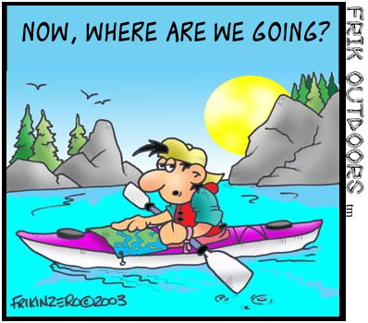
Who needs to know this?
Everyone! We all have different roles and depth of understanding needed.

Slide 64
Chat/Discussion
Please raise your hand to speak or type your answer into the question box.
What roles does Coalition Coordinator have in explaining this?
What roles do coalition members have?
Why do you think it is important for coalition members to be able to explain this?

Slide 65
In Summary… SAMPLE
By addressing these factors in our community…
Family Communication
Using these programs…
Happy People Coalition
We effect community and family outcomes, which lead to reduction of…
Underage drinking
Marijuana misuse/ abuse
Prescription drug misuse/ abuse
Tobacco misuse/ abuse
We will build the health and wellness of individuals, families, schools and communities where people can be as healthy as possible in a safe and nurturing environment...
School Bonding
Enforcement
Parents and Youth Engagement
Improved enforcement
Enforcement Roundtable
Middle School
Student Assistance Program
Guiding Good Choices
Life Skills Training
Notes:
Talking Points:
This is known as a “theory of change”….It is a good way to simply state what you are trying to address in the community and how.
At the end of this process you will be able to answer all these questions about the coalition and its plans.
You can also call this the 30 second elevator speech.
Now let’s get into this…

Slide 66
Key Structures for Support
What key structures do we need to have in place to support this plan?
What is the coalition’s unique role to support the community?
What conditions will help us succeed?
What needs to be in place for that to happen?
  Training?
  Partnerships?
  Communication?
  Data systems? Reporting systems?

Slide 67
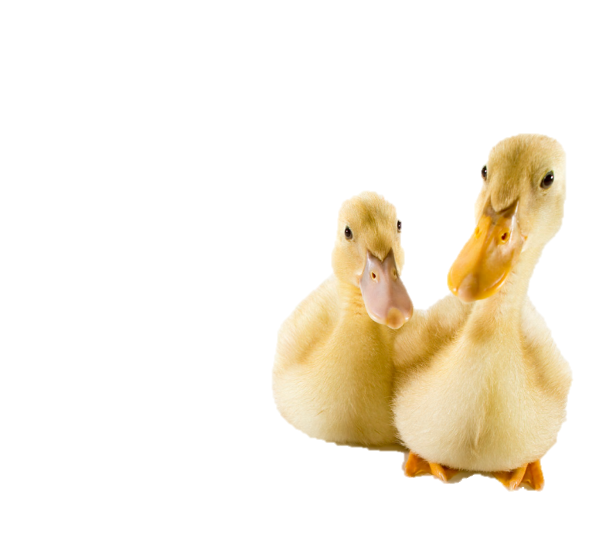
Building Capacity
How do we reach out to other groups?
What is the role of ‘members’?
What is the role of partnering organizations?
What is the role of Coalition Coordinator?
Some jobs are like swimming ducks….most of the work is invisible to others. - Unknown

Slide 68
Implementation Workgroups: SAMPLE
Coalition
School-based Strategies workgroup
Needs Assessment Ad-hoc workgroup
Resources Assessment Ad-hoc Workgroup
Coalition Membership and Community Outreach Workgroup
Environmental Strategies Workgroup
Youth Engagement workgroup
Evaluation Ad-hoc Workgroup
Executive Leadership Committee

Slide 69
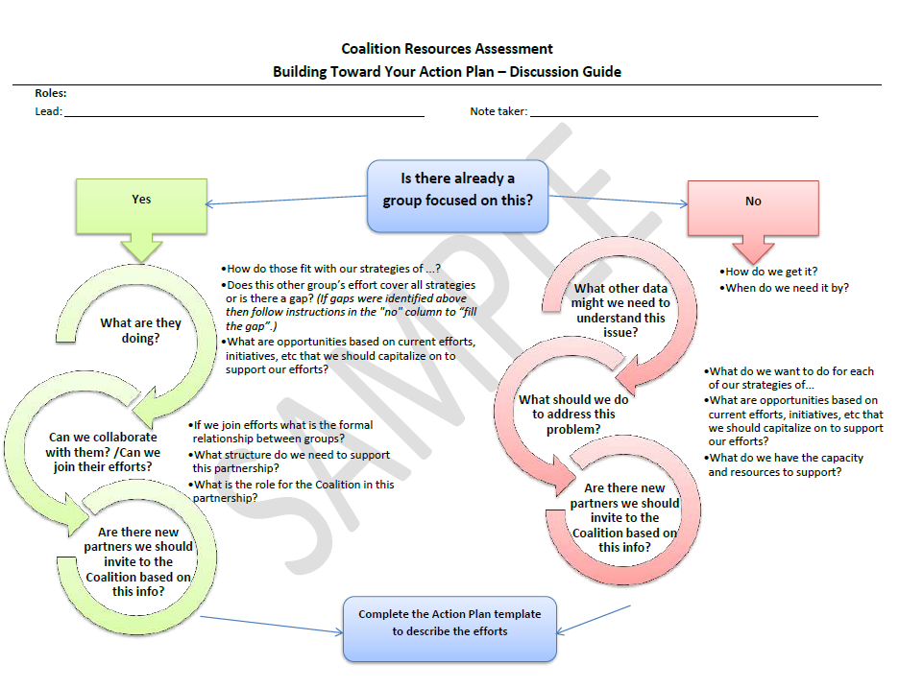
Reminder….(from your Resources Assessment)

Slide 70
Structural Support for Collaboration
Partner Agency/Organization | Needs Assessment Ad-hoc Workgroup | Resources Assessment Ad-hoc workgroup | Membership/Outreach Workgroup | Environmental Strategies Workgroup | School-Based Strategies Workgroup | Youth engagement Workgroup | Evaluation ad-hoc Workgroup
Family Support Center | X | X |  | X
Community College | X |  | X
Best Schools School District | X |  | X
Rotary |  |  |  |  |  | X
Bethel Church |  | X |  | X
Happy Town, Mayor’s Office | X | X | X | X | X | X | X
Parks and Recreation Department |  |  |  |  | X | X | X
Boys and Girls Club |  |  |  |  |  | X
PTSA | X | X
XYZ Youth Group |  |  |  |  |  | X | X
Happy Town Middle School | X
Go Kids Youth Center |  | X | X |  |  | X | X
Good Health Clinic | X
Local Health District |  |  |  | X | X
Safe Routes to School Task Force | X |  | X | X | X | X | X

Slide 71
Implementation Workgroups
Roles:
  Facilitator for group?
  Note taker?
Getting the work done:
  Regular meetings?
  Communication?
  Connection to full Coalition?

Slide 72
All set!

Slide 73
Discussion Questions
What experience do you have to offer to the learning community around logic models?
What questions do you have as you work on these tasks?
What challenges have you encountered?
What have you done that worked really well?
What additional clarification is needed, if any, in order to move forward?

Slide 74
Summary:
Logic Model
Today we covered…
…how your logic model supports strategic planning.
….how to represent your strategic plan on the logic model template.
….how to explain and use the logic model with your coalition.
…how to integrate your logic model into your Strategic Plan.

Slide 75
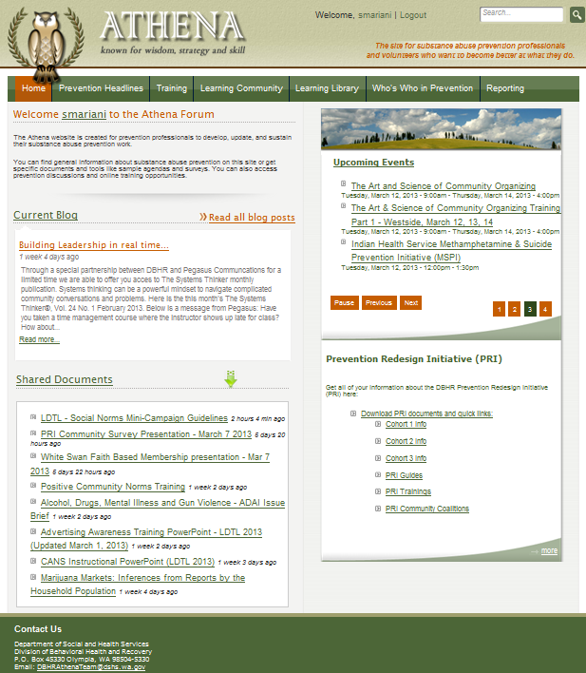
Resources
Strategic Plan Requirements Guide
The Athena Forum
  Shared docs
  PRI Training
  OWL E-Learning
  PRI Community Coalitions
Prevention System Managers
Cohort 1 Coordinators

Slide 76
Wrap up
Questions???
Follow up survey will be sent via email following this webinar. Please take a moment to complete it. It helps us continue to improve our trainings.

Slide 77
Questions?
If you would like additional technical assistance please contact your Prevention System Manager or email PRItraining@dshs.wa.gov.

