Slide 1
Prevention Messaging
An introduction to
updated prevention messaging
for the Health Care Authority (HCA)

Slide 2
Why update prevention messaging?
Prevention plays a crucial role in a holistic strategy to promote
mental health and wellbeing and prevent substance use disorder (SUD).
HCA's Division of Behavioral Health and Recovery's prevention
system is innovative and grounded in science.
Yet, both policymakers and the public misunderstand prevention's role
in addressing mental health and substance use.
Ultimately, this affects access to services, leads to the unintentional
duplication of efforts, and means people may not know how they can help.

Slide 3
Why update prevention messaging?
With this updated messaging, we have an opportunity to bring
people along. This messaging will:
  Welcome everyday people and key decision makers into the world of prevention using plain language and vivid visuals.
  Center the people prevention helps, and the problems prevention solves.
  Translate prevention's impact so people recognize the return on investment and improved health outcomes.
  Offer clear calls to action.

Slide 4
Who is this messaging for?
This messaging is for two primary audiences:
Everyday Washingtonians who can use
their influence to further community-based prevention efforts.
  Coalitions
  Schools
  Parents & caregivers
Washington leaders who can use their influence to affect the funding, policies, programs, and narrative about prevention.
  Decision makers
  State agencies
  Tribal leaders
  Media outlets

Slide 5
Who is this messaging for?
Tips to keep in mind as you're messaging to these audiences:
They are important influencers to reach.
  Whether they're working in their community or at the state or national level, these audiences can carry our message and mission forward.
They're likelier to care more about the “why” than the “how.”
  Don't spend all your time talking about the nuts and bolts. Talk about the heart of prevention—the people it helps and the problems it solves.
They'll respond strongly to stories.
  Humans like stories. They relate to and remember stories. Don't drown out the message in data. Data can support a story, but it is not the story.
They are not prevention experts.
  Avoid acronyms and jargon. Use plain language.

Slide 6
Messaging approach
What we did | And why
Simple, three-theme approach: What prevention is Who does it Why it matters | These themes address the most important prevention questions audiences are likely to have. They give us the chance to talk about prevention's benefits to Washington.
Companion visuals | The companion visuals ground each messaging theme in a visual metaphor and give audiences a mental picture to remember.
Two, broad audience groups | By prioritizing only two groups, we simplify the amount of information you as a message carrier need to remember and explain.

Slide 7
Messaging themes
Theme 1
What prevention is: A two-part approach
Theme 2
Who does prevention: A stream we all pour into
Theme 3
Why prevention matters: A protective path

Slide 8
The message: What is prevention?
When we say “prevention,” we mean the prevention of substance use disorder (SUD) AND the promotion of health and wellbeing for people across the state.
Preventing substance use disorders is not only about addressing risk factors—like family instability, inadequate resources, or risky behavior. It’s also about improving protective factors—like strong family bonds, access to services, and a sense of connectedness.

Slide 9
The message: What is prevention?
When we do both, we create thriving communities where children and young people feel healthy and safe in their bodies, minds, and surroundings. And when they feel safe and healthy, they’re able to navigate life in safer, healthier ways.
With proven practices, community programs, and smart policies, prevention gets to the root cause of a problem before it becomes a crisis. Families, schools, communities, and policymakers all play a role in preventing substance use disorders and promoting healthy behaviors. We share a responsibility to equip young people with the knowledge, skills, and resilience to thrive. We call that responsibility—prevention.

Slide 10
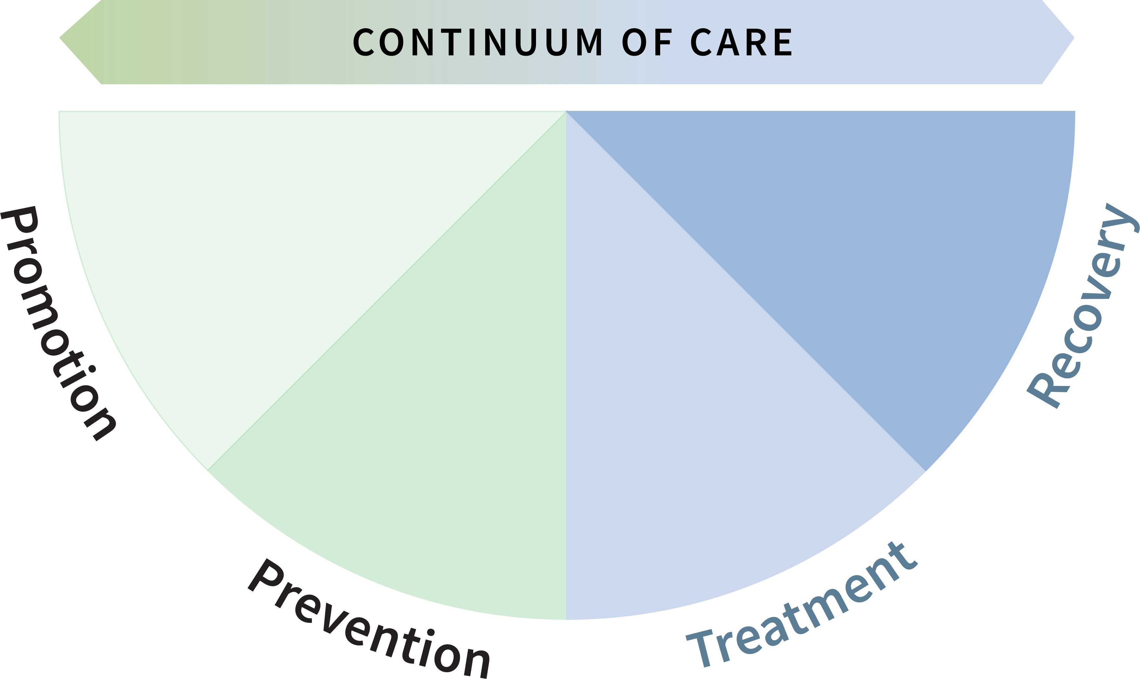
What is prevention?

Slide 11
The takeaways: What is prevention?
You don't have to memorize the messaging.
Here are key points to remember:
  Prevention is about preventing SUD and promoting health and wellbeing.
  Prevention is about addressing risk factors and improving protective factors.
  Prevention creates thriving communities and young people who feel healthy and safe.
  Prevention gets to the root cause of a problem before it's a crisis.
  Families, schools, communities, and leaders all play a role in prevention.

Slide 12

The message: Who does prevention?
No single person or organization can achieve the aims of prevention work alone. Effectively preventing substance use disorders and promoting health and wellbeing require us to work together.
Imagine prevention as a wide, flowing stream. Like any waterway, it’s fed by many small but vital sources. First, parents and caregivers, siblings, grandparents, aunts, uncles, and neighbors all contribute. Healthy early headwaters can reduce stress, build resilience, and carve a path for long-term mental and emotional wellbeing in young people.

Slide 13
The message: Who does prevention?
Later, more prevention tributaries pour in. During and after school, teachers, coaches, counselors, and student assistance professionals play a role. Elsewhere, trusted role models, mentors, and peers do their part. Cultural groups and other community organizations all feed into the stream.
Larger systems like educational service districts, local health jurisdictions, community coalitions, and state and federal policymakers also shape and strengthen the prevention stream. They plan, allocate resources, and create programs that ensure prevention waterways steadily carry generations of young people toward healthy, stable futures.

Slide 14
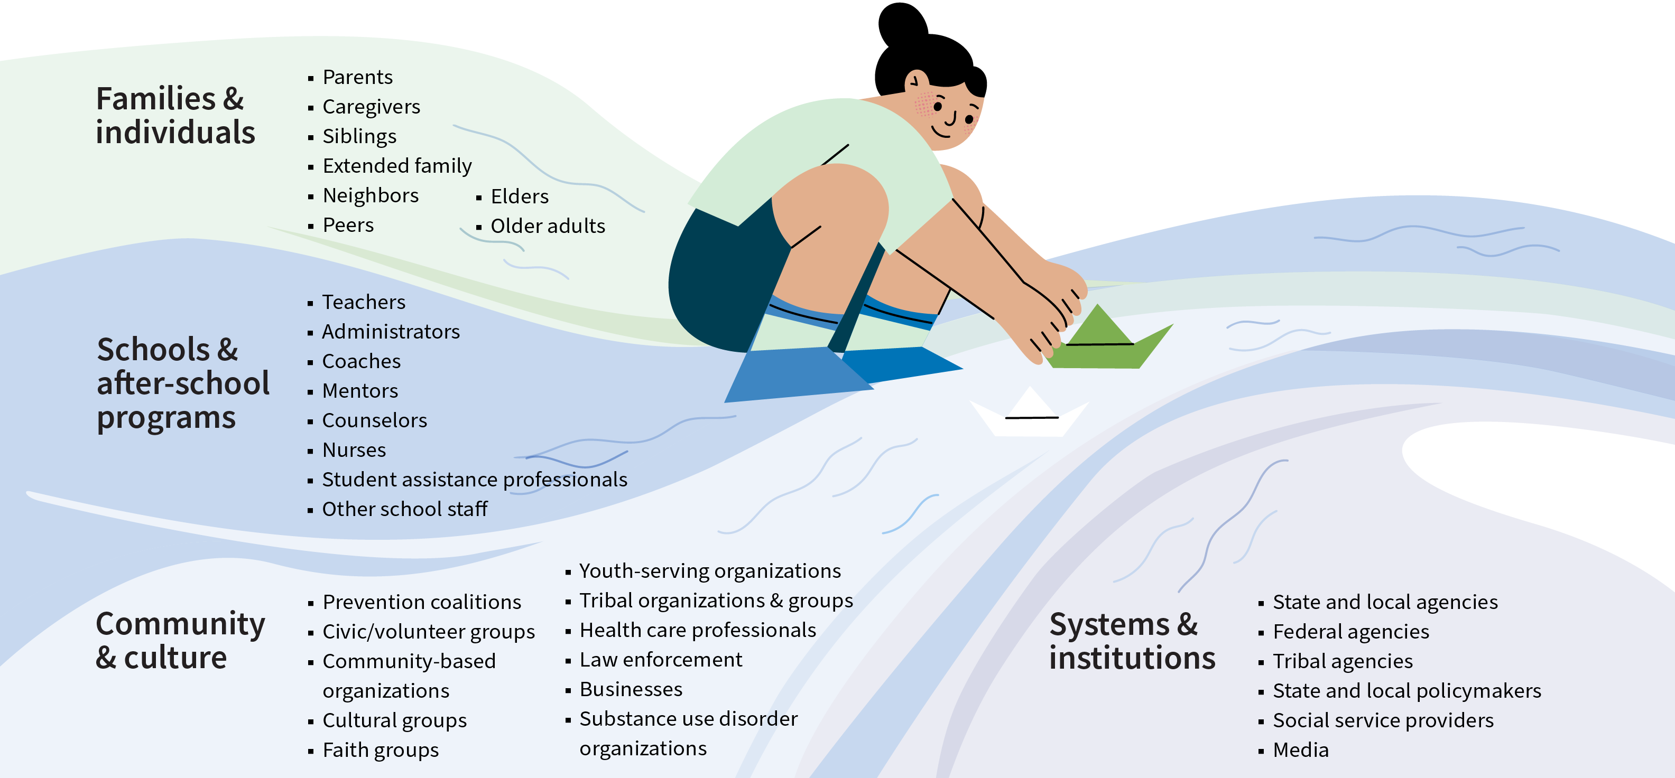
Who does prevention?

Slide 15
The takeaways: Who does prevention?
You don't have to memorize the messaging.
Here are key points to remember:
  Prevention works best when we work together.
  Families, schools, community, culture, and systems all play a role
  in prevention.
  Our collective effort carries generations of young people
  toward healthy, stable futures.

Slide 16
The message: Why does prevention matter?
Prevention is a path we all walk starting in early childhood and winding through adolescence into young adulthood. At every stage, prevention can be there to smooth and light the way forward.
Prevention is collective. We walk the path together.
  No one makes the journey alone. Prevention works best when families, schools, communities, policymakers, and systems clear the path and provide support along the way.
Prevention is community-based. Prevention shapes the person and the path.
  The path isn’t just about individual choices. It’s about the world people walk through. Prevention creates safer schools, healthier families and neighborhoods, and more equitable systems. When we create a supportive environment, young people can stay on track.

Slide 17
The message: Why does prevention matter?
Prevention is culturally relevant. Everyone's path is different.
  Culture, language, and identity help shape people’s norms, attitudes, and behaviors. Prevention, therefore, must reflect the lives, values, traditions, and voices of the communities it serves.
Prevention is rooted in connection. Relationships guide the way.
  Preventing substance use disorder is about more than just saying, "No." While abstinence may be part of the picture, prevention is also about helping young people feel connected, capable, and confident in their ability to make safe and healthy choices. It's about giving them the tools to handle life's challenges and surrounding them with people who care. Because every healthy relationship in a person’s life is a beacon lighting the way.

Slide 18
The message: Why does prevention matter?
Prevention saves money. It's a smart investment in infrastructure we all need.
  Paving a path—whether literal or figurative—is an investment in necessary infrastructure. When a path is smooth and the way is clear, it prevents hazards and accidents. Prevention reduces the need for costly care like crisis response, justice involvement, or long-term treatment. It improves outcomes over a lifetime, so as people reach adulthood, they too can play a part in someone else’s prevention journey.

Slide 19
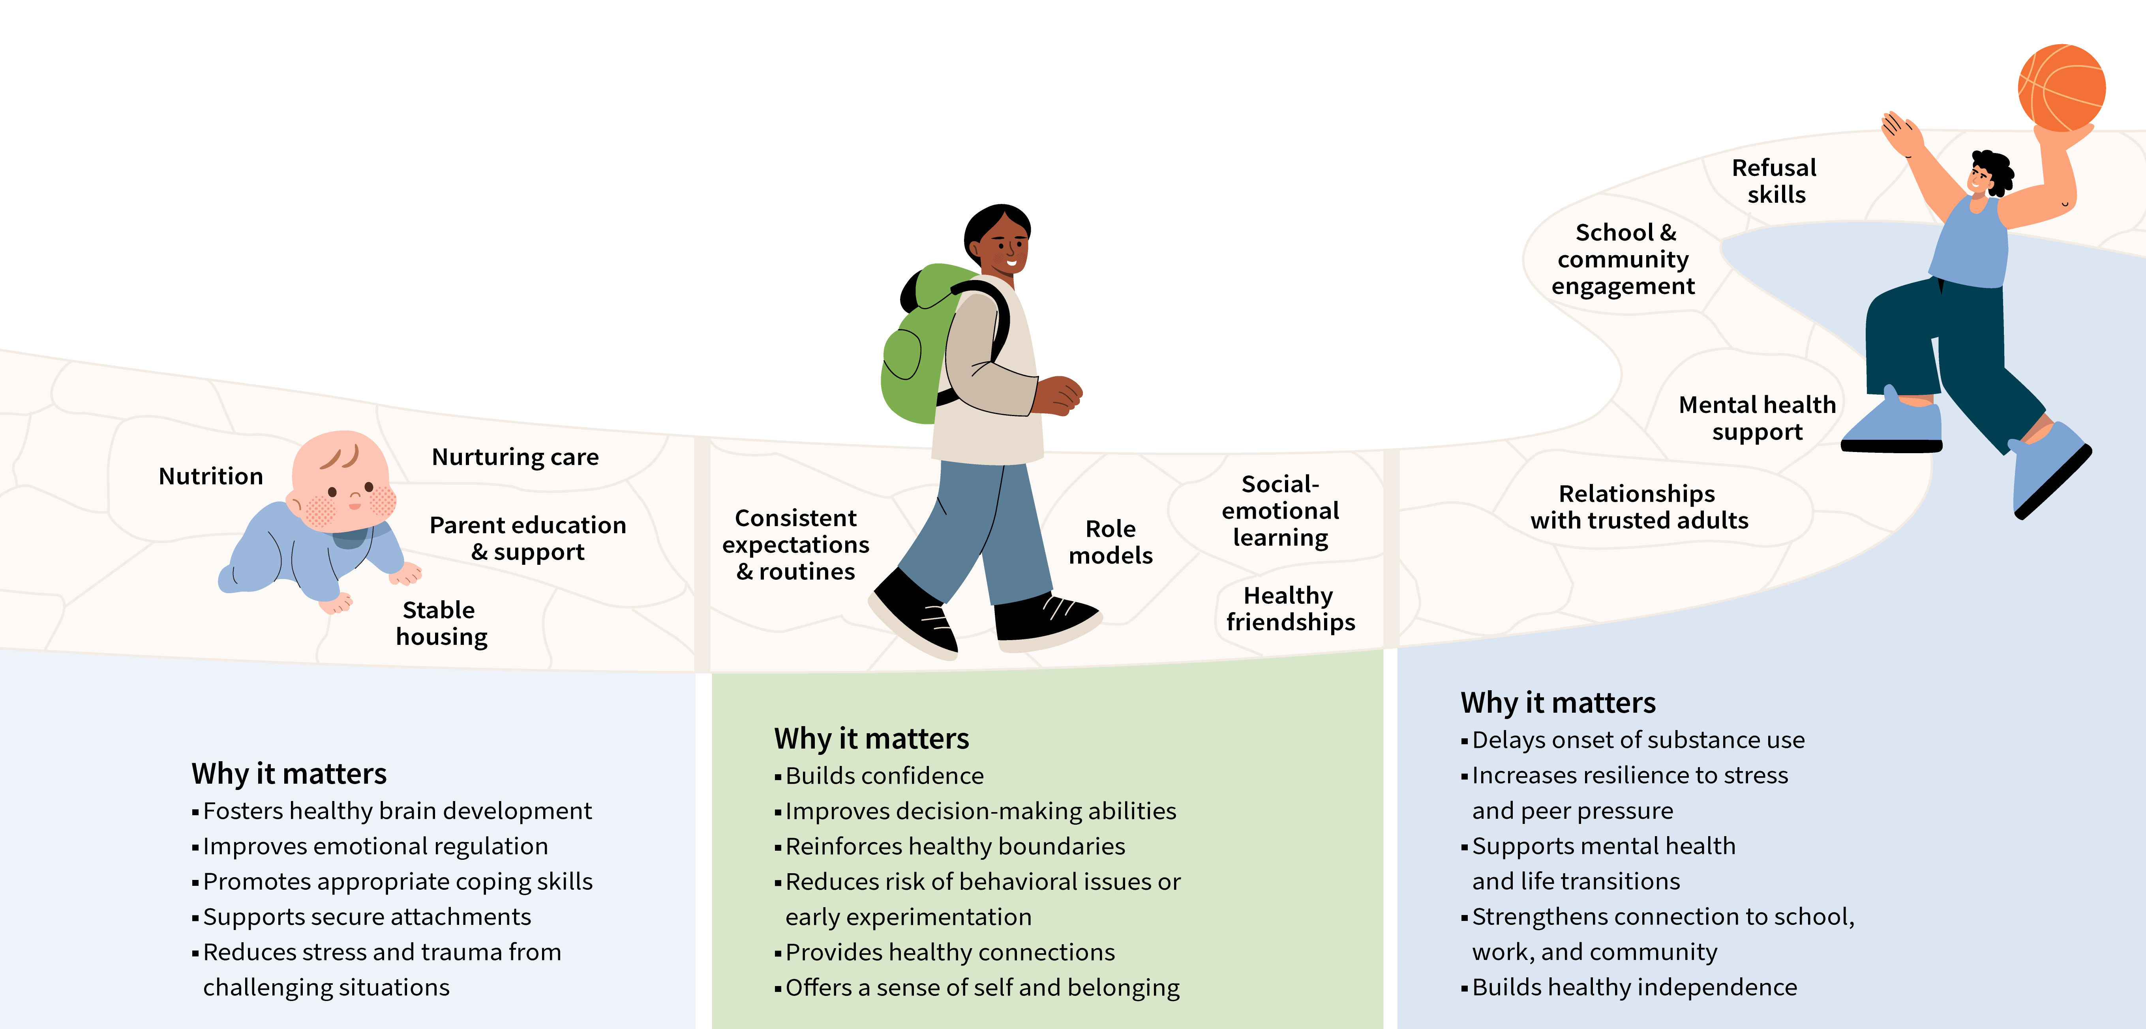
Why does prevention matter?

Slide 20
The takeaways: Why does prevention matter?
You don't have to memorize the messaging.
Here are key points to remember:
  Effective prevention takes all of us working together. It's collective.
  Prevention creates supportive environments. It's community-based.
  Prevention is culturally relevant.
  Prevention is rooted in connection. Every healthy relationship matters.
  Prevention saves money and improves outcomes over a lifetime.

Slide 21
Available materials
This training presentation
A one-pager for decision makers
A tri-fold brochure for coalitions
Social media graphics and post copy

