Slide 1
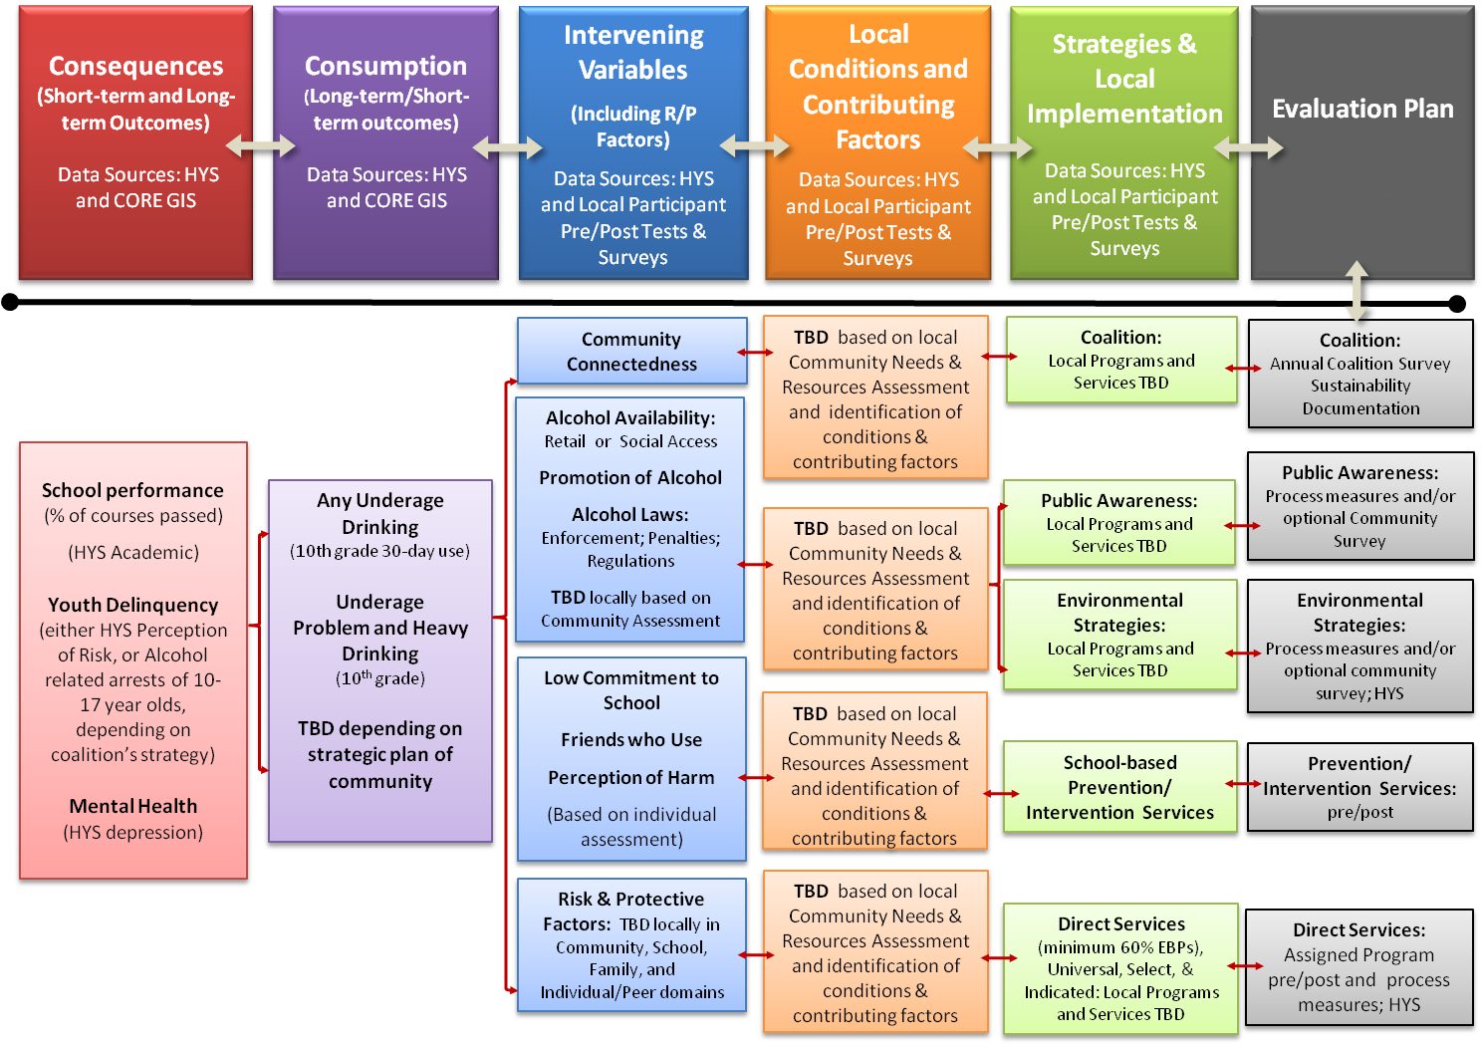
Local Prevention Redesign Initiative Cohort 1 Logic Model
- Planning Sequence -

Slide 2
[Name] Coalition Logic Model
Consequences (Short-term and Long-term Outcomes)
Consumption
(Long-term/Short-term outcomes)
Intervening Variables
(Including R/P Factors)
Local Conditions and Contributing Factors
Strategies &
Local Implementation
Evaluation Plan
Community Connectedness
TBD
Coalition:
[NAME]
Coalition:
Annual Coalition Survey
Sustainability Documentation
Alcohol Availability: Retail or Social Access
Promotion of Alcohol
Alcohol Laws: Enforcement; Penalties; Regulations
TBD:
Public Awareness:
TBD
Public Awareness:
Process measures and/or optional Community Survey
TBD
School performance (% of courses passed)
(HYS Academic)
Youth Delinquency
(either HYS Perception of Risk, or Alcohol related arrests of 10-17 year olds, depending on coalition’s strategy)
Mental Health
(HYS depression)
Any Underage Drinking
(10th grade 30-day use)
Underage
Problem and Heavy Drinking
(10th grade)
TBD
Environmental Strategies:
TBD
Environmental Strategies:
Process measures and/or optional community survey; HYS
Low Commitment to School
Friends who Use
Perception of Harm
(Based on individual assessment)
TBD
School-based Prevention/ Intervention Services
Prevention/ Intervention Services: pre/post
Risk & Protective Factors:
TBD
TBD
Direct Services:
TBD
Direct Services: Assigned Program pre/post and process measures; HYS
Notes:
Side note: other logic models
Read CADCA def of logic model
Use them to explain logic
Use for communication to stakeholders

