Slide 1
PRI Logic Model
The following slides demonstrate various displays of the PRI logic model for your reference and use in local presentations.
If you need assistance interpreting the PRI Logic model please contact your Prevention System Manager or you may email PRITraining@dshs.wa.gov.

Slide 2
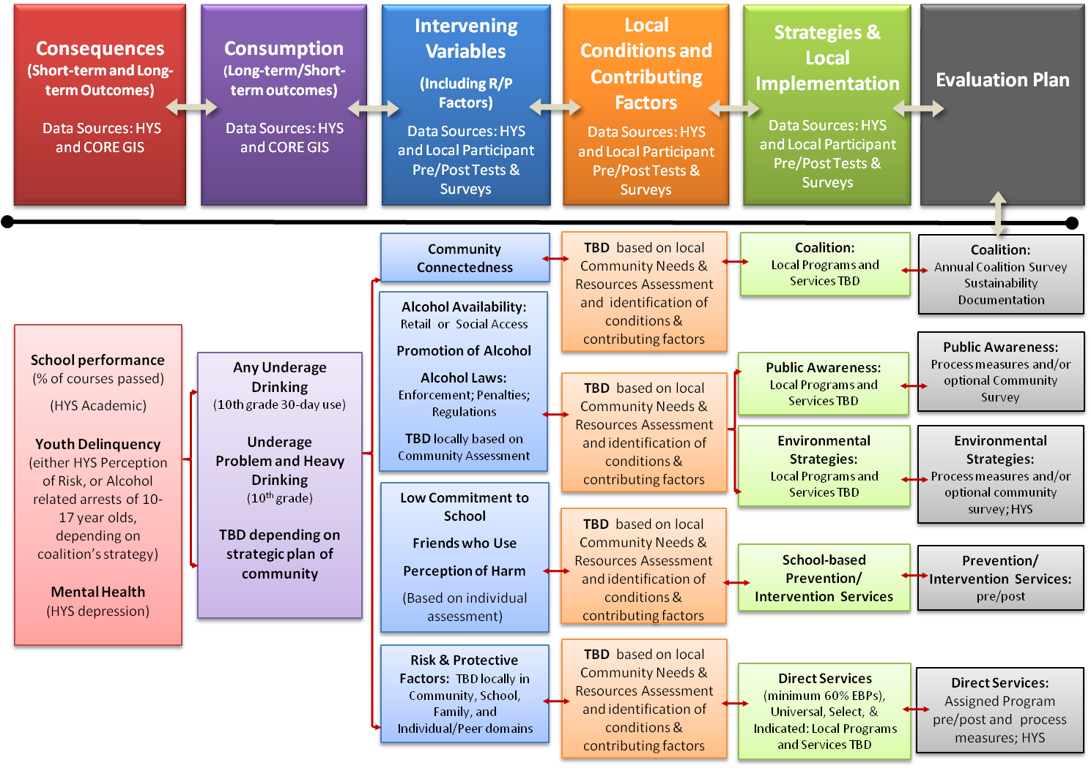
Local Prevention Redesign Initiative Cohort 1 Logic Model
- Planning Sequence -
Notes:
This is the Cohort 1 Logic model for PRI.

Slide 3
Local Prevention Redesign Initiative Cohort 1 Logic Model
- SAMPLE Planning Sequence -
Consequences (Short-term and Long-term Outcomes)
Consumption
(Long-term/Short-term outcomes)
Intervening Variables
(Including R/P Factors)
Local Conditions and Contributing Factors
Strategies &
Local Implementation
Community Connectedness
Engaging parents and youth with providers in local decisions.
Coalition:
Happy People Coalition
School performance (% of courses passed)
(HYS Academic)
Youth Delinquency
(either * HYS Perception of Risk, or * Alcohol related arrests of 10-17 year olds, depending on coalition’s strategy)
* Mental Health
(HYS depression)
Any Underage Drinking
(10th grade 30-day use)
*Underage Problem and Heavy Drinking
(10th grade)
Alcohol Availability: Social Access
Alcohol Laws: Enforcement; Youth Perception
Low enforcement in public locations
Public Awareness:
Media Advocacy for more or improved enforcement
Inconsistent consequences for offenders.
Environmental Strategies:
Enforcement Roundtable
Party Patrol
Parent Pledge
School Bonding
Social Skills
Friends who Use
(Based on individual assessment)
Limited communication b/t enforcement and judiciary.
Kids who are not performing at school tend to be those with substance use issues
School-based Prevention/ Intervention Services: Happy Town MS
Risk & Protective Factors:
Poor Family Management
Favorable Attitudes towards Drug Use
Intentions to Use
Lack of consistent and clear consequences at home.
Direct Services
(minimum 60% EBPs):
Guiding Good Choices
Life Skills Training
Youth think they would be viewed as “cool” if they drink
Youth exposure to favorable alcohol messages from their peers.
*proposed
Notes:
PRI Logic model showing “Planning sequence” (arrow pointing from consequences to strategies). We plan from what are we trying to change to how are we going to do that.

Slide 4
Local Prevention Redesign Initiative Cohort 1 Logic Model
- Theory Sequence -
Consequences (Short-term and Long-term Outcomes)
Consumption
(Long-term/Short-term outcomes)
Intervening Variables
(Including R/P Factors)
Local Conditions and Contributing Factors
Strategies &
Local Implementation
TBD based on local Community Needs & Resources Assessment
and identification of conditions & contributing factors
Coalition:
Local Programs and Services TBD
Community Connectedness
School performance (% of courses passed)
(HYS Academic)
Youth Delinquency
(either * HYS Perception of Risk, or * Alcohol related arrests of 10-17 year olds, depending on coalition’s strategy)
* Mental Health
(HYS depression)
Any Underage Drinking
(10th grade 30-day use)
*Underage Problem and Heavy Drinking
(10th grade)
TBD depending on strategic plan of community
Alcohol Availability: Retail or Social Access
Promotion of Alcohol
Alcohol Laws: Enforcement; Penalties; Regulations
TBD locally based on Community Assessment
Public Awareness:
Local Programs and Services TBD
TBD based on local Community Needs & Resources Assessment
and identification of conditions & contributing factors
Environmental Strategies:
Local Programs and Services TBD
Low Commitment to School
Friends who Use
Perception of Harm
TBD based on local Community Needs & Resources Assessment
and identification of conditions & contributing factors
Prevention/ Intervention Services: Local Programs and Services TBD
TBD based on local Community Needs & Resources Assessment
and identification of conditions & contributing factors
Risk & Protective Factors: TBD locally in Community, School, Family, and Individual/Peer domains
Direct Services
(minimum 60% EBPs): Local Programs and Services TBD
*proposed
Notes:
PRI Logic model showing “theory sequence” (arrow pointing from strategies to consequences). We evaluate what we did to our “theory of change” for impacting the consequences.

Slide 5
Local Prevention Redesign Initiative Cohort 1 Logic Model
- SAMPLE Theory Sequence-
Consequences (Short-term and Long-term Outcomes)
Consumption
(Long-term/Short-term outcomes)
Intervening Variables
(Including R/P Factors)
Local Conditions and Contributing Factors
Strategies &
Local Implementation
Community Connectedness
Engaging parents and youth with providers in local decisions.
Coalition:
Happy People Coalition
School performance (% of courses passed)
(HYS Academic)
Youth Delinquency
(either * HYS Perception of Risk, or * Alcohol related arrests of 10-17 year olds, depending on coalition’s strategy)
* Mental Health
(HYS depression)
Any Underage Drinking
(10th grade 30-day use)
*Underage Problem and Heavy Drinking
(10th grade)
Alcohol Availability: Social Access
Alcohol Laws: Enforcement; Youth Perception
Low enforcement in public locations
Public Awareness:
Media Advocacy for more or improved enforcement
Inconsistent consequences for offenders.
Environmental Strategies:
Enforcement Roundtable
Party Patrol
Parent Pledge
School Bonding
Social Skills
Friends who Use
(Based on individual assessment)
Limited communication b/t enforcement and judiciary.
School staff don’t have the resources to deal with this
Prevention/ Intervention Services: Happy Town MS
Risk & Protective Factors:
Poor Family Management
Favorable Attitudes towards Drug Use
Intentions to Use
Lack of consistent and clear consequences at home.
Direct Services
(minimum 60% EBPs):
Guiding Good Choices
Life Skills Training
Youth think they would be viewed as “cool” if they drink
Youth exposure to favorable alcohol messages from their peers.
*proposed
Notes:
Sample of completed version of above.

Slide 6
Consequences (Short-term and Long-term Outcomes)
Data Sources: HYS and CORE GIS
Consumption
(Long-term/Short-term outcomes)
Data Sources: HYS and CORE GIS
Intervening Variables
(Including R/P Factors)
Data Sources: HYS and Local Participant Pre/Post Tests & Surveys
Local Conditions and Contributing Factors
Data Sources: HYS and Local Participant Pre/Post Tests & Surveys
Strategies &
Local Implementation
Data Sources: HYS and Local Participant Pre/Post Tests & Surveys
Evaluation Plan
Community Connectedness
TBD based on local Community Needs & Resources Assessment
and identification of conditions & contributing factors
Coalition:
Local Programs and Services TBD
Coalition:
Annual Coalition Survey
Sustainability Documentation
Alcohol Availability: Retail or Social Access
Promotion of Alcohol
Alcohol Laws: Enforcement; Penalties; Regulations
TBD locally based on Community Assessment
School performance (% of courses passed)
(HYS Academic)
Youth Delinquency
(either HYS Perception of Risk, or Alcohol related arrests of 10-17 year olds, depending on coalition’s strategy)
Mental Health
(HYS depression)
Public Awareness:
Process measures and/or optional Community Survey
Any Underage Drinking
(10th grade 30-day use)
Underage Problem and Heavy Drinking
(10th grade)
TBD depending on strategic plan of community
Public Awareness:
Local Programs and Services TBD
TBD based on local Community Needs & Resources Assessment
and identification of conditions & contributing factors
Environmental Strategies:
Local Programs and Services TBD
Environmental Strategies:
Process measures and/or optional community survey; HYS
Low Commitment to School
Friends who Use
Perception of Harm
(Based on individual assessment)
TBD based on local Community Needs & Resources Assessment
and identification of conditions & contributing factors
School-based Prevention/ Intervention Services
Prevention/ Intervention Services: pre/post
Risk & Protective Factors: TBD locally in Community, School, Family, and Individual/Peer domains
TBD based on local Community Needs & Resources Assessment
and identification of conditions & contributing factors
Direct Services
(minimum 60% EBPs), Universal, Select, & Indicated: Local Programs and Services TBD
Direct Services: Assigned Program pre/post and process measures; HYS
Notes:
Same as above but without background and titles.

Slide 7
[Name] Coalition Logic Model
Consequences (Short-term and Long-term Outcomes)
Consumption
(Long-term/Short-term outcomes)
Intervening Variables
(Including R/P Factors)
Local Conditions and Contributing Factors
Strategies &
Local Implementation
Evaluation Plan
Community Connectedness
TBD
Coalition:
[NAME]
Coalition:
Annual Coalition Survey
Sustainability Documentation
Alcohol Availability: Retail or Social Access
Promotion of Alcohol
Alcohol Laws: Enforcement; Penalties; Regulations
TBD:
Public Awareness:
TBD
Public Awareness:
Process measures and/or optional Community Survey
TBD
School performance (% of courses passed)
(HYS Academic)
Youth Delinquency
(either HYS Perception of Risk, or Alcohol related arrests of 10-17 year olds, depending on coalition’s strategy)
Mental Health
(HYS depression)
Any Underage Drinking
(10th grade 30-day use)
Underage Problem and Heavy Drinking
(10th grade)
TBD
Environmental Strategies:
TBD
Environmental Strategies:
Process measures and/or optional community survey; HYS
Low Commitment to School
Friends who Use
Perception of Harm
(Based on individual assessment)
TBD
School-based Prevention/ Intervention Services
Prevention/ Intervention Services: pre/post
Risk & Protective Factors:
TBD
TBD
Direct Services:
TBD
Direct Services: Assigned Program pre/post and process measures; HYS
Notes:
This is the Logic Model template to be used for local coalitions to complete with their local information.

Slide 8
Local Prevention Redesign Initiative Cohort 1 Logic Model
- Planning Sequence -
Evaluation Plan
Strategies &
Local Implementation
Local Conditions and Contributing Factors
Intervening Variables
(Including R/P Factors)
Consumption
(Long-term/Short-term outcomes)
Consequences (Short-term and Long-term Outcomes)
Coalition:
Local Programs and Services TBD
Coalition:
Local Programs and Services TBD
Locally Determined
Community Connectedness
School performance (% of courses passed)
(HYS Academic)
Youth Delinquency
(either * HYS Perception of Risk, or * Alcohol related arrests of 10-17 year olds, depending on coalition’s strategy)
* Mental Health
(HYS depression)
Any Underage Drinking
(10th grade 30-day use)
*Underage Problem and Heavy Drinking
(10th grade)
TBD depending on strategic plan of community
Alcohol Availability:
Promotion of Alcohol
Alcohol Laws:
TBD locally based on Community Assessment
Public Awareness:
Local Programs and Services TBD
Public Awareness:
Local Programs and Services TBD
Locally Determined
Environmental Strategies:
Local Programs and Services TBD
Environmental Strategies:
Local Programs and Services TBD
School Bonding
Social Skills
Friends who Use
Prevention/ Intervention Services: Local Programs and Services TBD
Prevention/ Intervention Services: Local Programs and Services TBD
Locally Determined
Risk & Protective Factors: TBD locally in Community, School, Family, and Individual/Peer domains
Direct Services
(minimum 60% EBPs): Local Programs and Services TBD
Direct Services
(minimum 60% EBPs): Local Programs and Services TBD
Locally Determined
*proposed
Notes:
This is the PRI Logic Model but displayed with ‘consequences’ on the right moving to ‘eval’ on the left rather than ‘consequences’ on the left moving to ‘eval’ on the right.

Slide 9
Local Prevention Redesign Initiative Cohort 1 Logic Model
- Theory Sequence-
Evaluation Plan
Strategies &
Local Implementation
Local Conditions and Contributing Factors
Intervening Variables
(Including R/P Factors)
Consumption
(Long-term/Short-term outcomes)
Consequences (Short-term and Long-term Outcomes)
Coalition:
Local Programs and Services TBD
Coalition:
Local Programs and Services TBD
Locally Determined
Community Connectedness
School performance (% of courses passed)
(HYS Academic)
Youth Delinquency
(either * HYS Perception of Risk, or * Alcohol related arrests of 10-17 year olds, depending on coalition’s strategy)
* Mental Health
(HYS depression)
Any Underage Drinking
(10th grade 30-day use)
*Underage Problem and Heavy Drinking
(10th grade)
TBD depending on strategic plan of community
Alcohol Availability:
Promotion of Alcohol
Alcohol Laws:
TBD locally based on Community Assessment
Public Awareness:
Local Programs and Services TBD
Public Awareness:
Local Programs and Services TBD
Locally Determined
Environmental Strategies:
Local Programs and Services TBD
Environmental Strategies:
Local Programs and Services TBD
School Bonding
Social Skills
Friends who Use
Prevention/ Intervention Services: Local Programs and Services TBD
Prevention/ Intervention Services: Local Programs and Services TBD
Locally Determined
Risk & Protective Factors: TBD locally in Community, School, Family, and Individual/Peer domains
Direct Services
(minimum 60% EBPs): Local Programs and Services TBD
Direct Services
(minimum 60% EBPs): Local Programs and Services TBD
Locally Determined
*proposed
Notes:
Same as previous but with “theory sequence” showing for the background arrow rather than “planning sequence” showing on previous slide.

Slide 10
Local Prevention Redesign Initiative Cohort 1 Logic Model
- Planning Sequence -
Evaluation Plan
Coalition:
Annual Coalition Survey
Sustainability Documentation
Public Awareness:
Process measures and/or optional Community Survey
Environmental Strategies:
Process measures and/or optional community survey; HYS
Prevention/ Intervention Services: pre/post
Direct Services: Assigned Program pre/post and process measures; HYS
*proposed
Notes:
This image is to emphasize the Evalaution part of the logic model.

