Slide 1
Division of Behavioral Health and Recovery
Prevention Redesign Initiative (PRI)
Review updated Task Guide; the Community Coalition Guide
August 21, 2013
PRI Learning Community Meeting
Presented by:
Julia Greeson, Prevention System Manager
Sarah Mariani, Behavioral Health Administrator

Slide 2
What is this New Guide?
PRI was designed to be a learning process.
We have improved on guidance documents each year of the PRI from process evaluation feedback and Learning Community meetings.
Now, we have a combined the PRI Key Objectives, Task Categories Guide and Strategic Plan Requirements Guide into one Guide – the Community Coalition Guide.

Slide 3
Who uses the
Community Coalition Guide?
The Community Coalition Guide is to be used by ALL PRI Cohorts (1,2 & 3) beginning July 2013.
There are only a couple new requirements/ tasks in the New Guide. You’ll notice:
  We’ve removed and re-organized tasks to be less redundant.
  We’ve highlighted subtasks in the Quick Reference Timeline Overview that were only previously in the narrative of the Task Guides to improve clarity.

Slide 4
Purpose of this Presentation
Review the Community Coalition Guide
Summarize noteworthy modifications made from previous guidance documents (Task Guides and Strategic Planning Requirements Guides).
  Items followed by (*) notes a modification from a Cohort 1 guidance document.
  Items followed by (**) notes a modification from a Cohort 2 guidance document.
  Items followed by (*/**) notes modification from a Cohort 1 & 2 guidance document.
  Items followed by (***) notes modification from Cohort 1, 2 & 3 guidance documents.

Slide 5
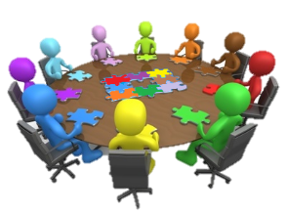
Community Coalition Guide
Chapter 1: General Information – provides general information about the PRI planning framework.
Chapter 2: Key Objectives – provides an overview of the intent of PRI and the established milestones and benchmarks.
Chapter 3: Implementing PRI – identifies the required tasks and provides guidance, definition, and clarification on each task category grouped by the PRI Planning Framework steps.
Chapter 4: Strategic Plan Requirements - provides the PRI requirements for completing the coalition’s Strategic Plan.
Appendix – provides templates and samples for use in writing your Strategic Plan and implementing PRI.

Slide 6
Chapter 1: PRI General Information
Provides a summary of Prevention Theory.
Provides an outline of the Guide.
Identifies Resources for Implementing PRI that DBHR has created.*/**
Explains a Coalition.
Clarifies Roles and tasks.*/**
Provides tips for successful meetings.*/**

Slide 7
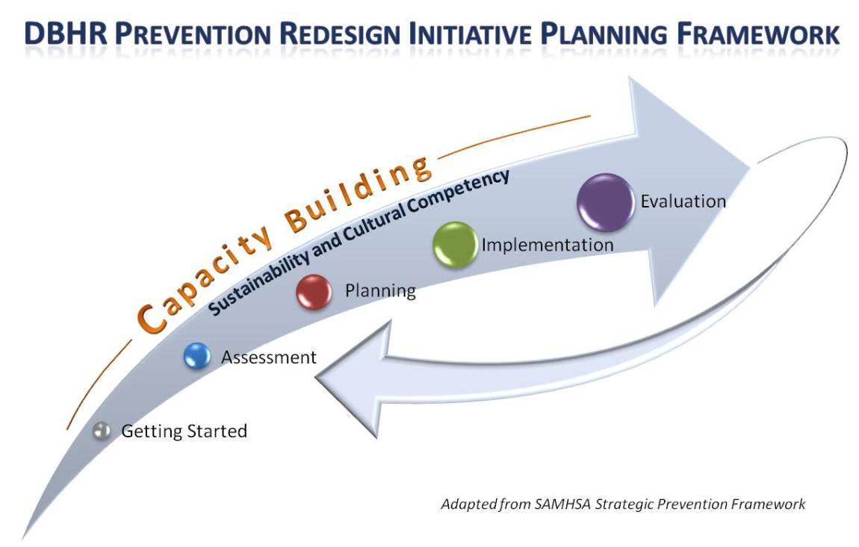
Strategic Framework for PRI
Notes:
Talking Points:
The PRI is generally following the Strategic Prevention Framework (SPF) as the overall planning framework for this process. Based on our learning from the Strategic Prevention Framework State Incentive Grant (SPF-SIG) process, for the purposes of PRI, we have added a “Getting Started” section and have included “Capacity” as an ongoing step throughout the process. It is expected that all tasks associated with PRI will be conducted in a culturally competent and sustainable manner. This is not expected to be linear process.
This is the PRI process you will follow:
Develop a profile of community needs, resources, readiness, and gaps.
Mobilize the community to deal with prioritized problems – this coalition makes the prioritization decision.
Develop a strategic prevention plan with measurable goals and objectives.
Implement evidence-based prevention programs, policies, and practices. We will talk about this at the community planning training
Monitor the implementation of the project and measure and evaluate its results.
Extra Notes: - may use next optional slide or just mention this.
These trainings and much of the theory base for development of the community efforts is based on an existing evidence-based community organization system called “Communities That Care,” or, CTC.
Communities That Care (CTC) is evidence-based and continues to be extensively researched.
This is tested model – we know this stuff works…

Slide 8
Community Coalition Tasks
Attend Trainings.
Facilitate the development of a community vision.
Learn prevention science and SPF.
Serve as community ambassadors.
Coordinate work-group activities.
Participate in decision-making processes.
Develop Community Strategic Plan including evaluation plan.
Notes:
Talking Points:
Coalition members are the active meeting participants.
They contribute to the meeting and make sure the Coordinator and Recorder fulfill their roles and remain neutral. Coalition members focus on the content of the agenda and are responsible for making decisions.

Slide 9
Community Coalition Leadership (supported by coordinator)
Set an agenda.
Provide oversight and accountability.
Keep group focused and moving forward.

Slide 10
Role of Coordinator
Provide staff support.
(Note: Staff are not members of the coalition.)
Coordinate meeting preparation and follow up.
Coordinate training and technical assistance.
Coordinate implementation of strategies.
Documentation of PRI efforts.
Prepare reports, as needed.
Be a resource for the coalition.
Notes:
CADCA transformational leaders…
Clear vision
Serve as role models build trust
Promote peer problem solving
Build involvement and inclusion
Give meaning to the coalition

Slide 11
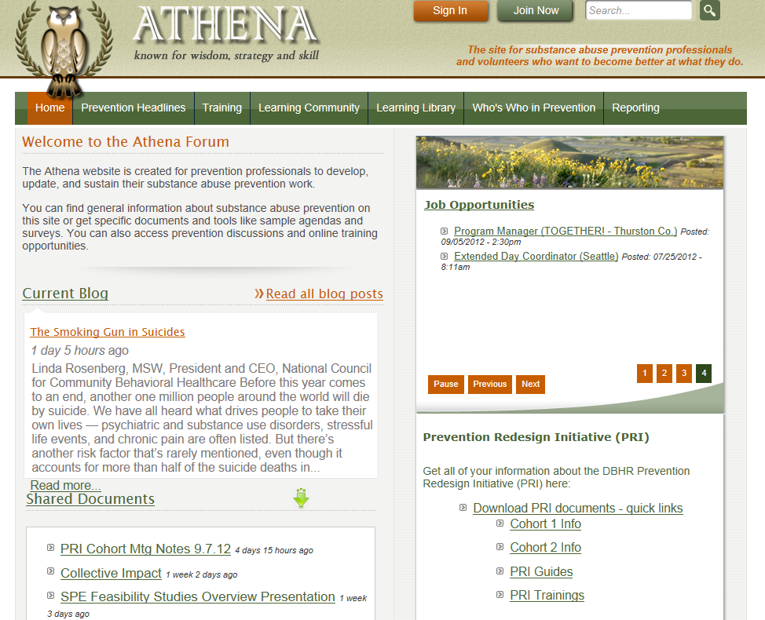

Slide 12

Chapter 2: Key Objectives
Guide p. 10
Establishment of a community coalition
Identification of a community coordinator
Define and select communities
Implementation of environmental, public awareness, direct service, and capacity building strategies
School-based prevention specialist
Participating communities are distributed statewide
Resources match outcomes
DBHR technical assistance/support
Evaluating program and community-level change
Workforce development
Compliance with Synar

Slide 13
Chapter 3: Implementing PRI in Your Community
Guide p. 14
Quick Reference Timeline Overview
Getting Started
Capacity Building
Assessment
Planning
Implementation
Reporting and Evaluation
Cultural Competency
Sustainability

Slide 14
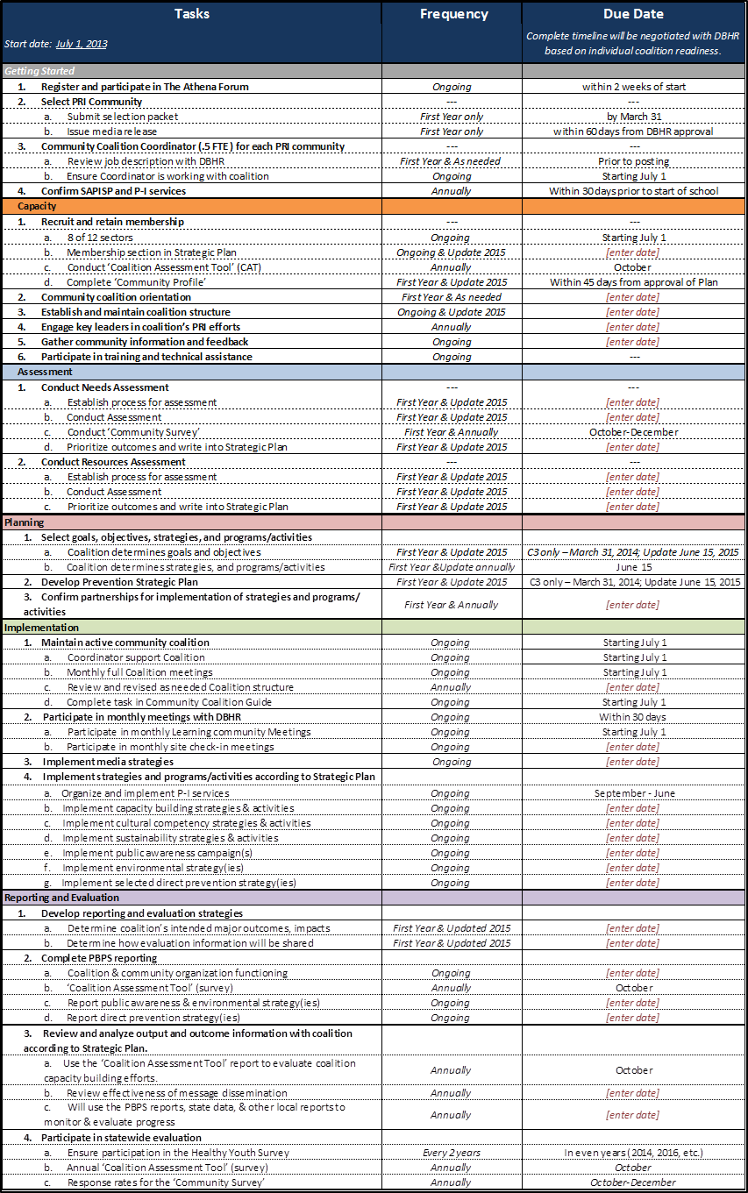
Quick Reference Timeline Overview
Guide p. 16

Slide 15
Quick Reference Timeline Overview
Organized by task and not by sequence.
Based on an annual schedule at the beginning of the fiscal year (July).
Now includes sub-tasks that are associated with strategic planning requirements.
Moves some tasks to new categories*/**

Slide 16
Getting Started
Summary of Modifications from Previous Guides
Modified “Notify media” to “Issue media release” under Select PRI Community task.*/**
Modified Core Workgroup and Clarify roles tasks to Establish and maintain coalition structure in Capacity.*
Clarified the Select Community task.*
Added review job coordinator description with DBHR.*
Removed Co. Risk Profile yr. notification task.**
Added Confirm SAPISP and P-I services.*/**

Slide 17
Getting Started Overview
Guide pgs.17-18
PRI tasks
Register and participate in The Athena Forum
Select PRI Community
  Submit selection packet (p. 43)
  Issue media release (p. 59)
Community Coalition Coordinator (.5 FTE ) for each PRI community
  Review job description with DBHR
  Ensure Coordinator is working with coalition
Confirm SAPISP and P-I services
Notes:
Note:
Typically by the time you are conducting your orientation you have completed all of the getting started tasks. This is a time to celebrate work that is already completed!

Slide 18
Capacity Building:
Mobilizing your coalition and community
Guide p. 19
Purpose: Developing and increasing coalition and community ability to address the problem locally.
Build effective coalition.
Establish your working coalition structure.
Increasing involvement from members.
Increasing involvement from community members in strategies and activities.

Slide 19
Capacity
Summary of Modifications from Previous Guides
Clarified complete community profile task.*/**
Clarified Community Coalition Orientation task.*
Highlighted requirements related to Recruit and retain membership on Quick Reference Timeline Overview.***
Removed Coalition charter and Core workgroups and expanded on Establish and maintain Coalition Structure.*
Moved Gather community information and feedback task from Assessment.*/**
Highlighted Coalition Assessment Tool on Timeline Overview. ***

Slide 20
Capacity Building Overview
PRI tasks:
Recruit and retain membership
  8 of 12 sectors
  Membership section in Strategic Plan
  Conduct ‘Coalition Assessment Tool’ (CAT)
  Complete ‘Community Profile’ (p. 59)
Community coalition orientation
Establish and maintain coalition structure
Engage key leaders in coalition’s PRI efforts
Gather community information and feedback
Participate in training and technical assistance
Notes:
Cohort 2 – these notes are for Cohort 2

Slide 21
Assessment
Guide p. 21
Purpose: Develop and update the ‘picture of your community’.
Identify and review data that demonstrates the needs of the community.
Identify people, community readiness and resources.
Identify gaps of services for community needs.
Notes:
Cohort 2 – these notes are for Cohort 2

Slide 22
Assessment
Summary of Modifications from Previous Guides
Reformatted most tasks to reduce duplication and connected with strategic planning requirements and update schedule. */**
Moved and re-organized tasks to better match the planning process. */**
Highlighted sub-tasks of Needs Assessment and Resources Assessment separately in Quick Reference Timeline Overview.***
Clarified community survey task and timeline. */**

Slide 23
Assessment Overview
Guide pgs. 21-22
PRI Tasks:
Conduct Needs Assessment
  Establish process for assessment
  Conduct Assessment
  Conduct ‘Community Survey’
  Prioritize outcomes and write into Strategic Plan
Conduct Resources Assessment
  Establish process for assessment
  Conduct Assessment
  Prioritize outcomes and write into Strategic Plan
Notes:
Cohort 2 – these notes are for Cohort 2

Slide 24
Planning
Guide p. 23
Purpose: Create a plan for implementing and evaluating tested, effective programs, policies and practices.
Selection of programs, policies
and practices to fill gaps
Implementation and evaluation plans
Set measurable outcomes
Notes:
Cohort 2 – these notes are for Cohort 2

Slide 25
Planning
Summary of Modifications from Previous Guides
Defined and separated subtasks of Coalition in Select goals, objectives & programs/activities.
  Provided timeline for Strategic Plan update schedule. ***
Moved confirming partnerships from Implementation. */**
Clarified what to include in Action Plan for goals, objectives, programs and activities planned and moved from Implementation.*/**
Removed Select Community Organizing Framework.*

Slide 26
Planning Overview
Guide p. 23
PRI Tasks:
Select goals, objectives, strategies, and programs/activities
  Coalition determines goals and objectives
  Coalition determines strategies, and programs/activities
Develop Prevention Strategic Plan
Confirm partnerships for implementation of strategies and programs/ activities
Notes:
Cohort 2 – these notes are for Cohort 2

Slide 27
Implementation:
Implement evidence-based prevention strategies
Guide p. 24
Purpose: Implement the plan.
Maintain an active coalition leading the efforts
Implement selected programs, policies
and practices
Notes:
Cohort 2 – these notes are for Cohort 2

Slide 28
Implementation
Summary of Modifications from Previous Guides
Removed Implement community organizing framework.*
  Replaced with Maintain active community coalition.*/**
Moved participate in monthly check-ins with DBHR from Getting Started.*/**
Organized subtasks of maintaining active coalition.*/**
  Clarified Monthly full coalition meetings.*/**
Moved Confirming partnerships to Planning.*/**
Clarified and re-organized Implement strategies and programs according to strategic plan tasks and subtasks to match up with implementing Strategic Plan requirements.*/**

Slide 29
Implementation Overview
Guide p. 24
PRI Tasks:
Maintain active community coalition
  Coordinator support Coalition
  Monthly full Coalition meetings
  Review and revised as needed Coalition structure
  Complete task in Community Coalition Guide
Participate in monthly meetings with DBHR
  Participate in monthly Learning community Meetings
  Participate in monthly site check-in meetings
Notes:
Cohort 2 – these notes are for Cohort 2

Slide 30
Implementation Overview
Guide p. 24
PRI Tasks: (continued)
Implement media strategies
Implement strategies and programs/activities according to Strategic Plan
  Organize and implement P-I services
  Implement capacity building strategies & activities
  Implement cultural competency strategies & activities
  Implement sustainability strategies & activities
  Implement public awareness campaign(s)
  Implement environmental strategy(ies)
  Implement selected direct prevention strategy(ies)
Notes:
Cohort 2 – these notes are for Cohort 2

Slide 31
Evaluation and Reporting
Summary of Modifications from Previous Guides
Re-Organized tasks related to Strategic Plan requirements for developing reporting and evaluation strategies.*/**
Clarified Coalition’s strategies for reporting and evaluation and determine outcomes and sharing evaluation results.*/**
Clarified Annual Coalition Assessment Tool (aka annual coalition survey) administration timeline.*/**
Organized and highlighted what is reported in PBPS and subtasks of Participation in statewide evaluation on Quick Reference Timeline Overview.***

Slide 32
Evaluation and Reporting:
Evaluate and monitor results, change as necessary
Guide p. 25
Purpose: Evaluate the plan, and refine as needed.
Evaluate the process and outcomes
Review and adjust the plan and implementation as needed
Coalition uses to monitor success
Notes:
Cohort 2 – these notes are for Cohort 2

Slide 33
Evaluation and Reporting Overview
Guide p. 25
PRI Tasks:
Develop reporting and evaluation strategies
  Determine coalition’s intended major outcomes, impacts
  Determine how evaluation information will be shared
Complete PBPS reporting
  Coalition & community organization functioning
  ‘Coalition Assessment Tool’ (survey)
  Report public awareness & environmental strategy(ies)
  Report direct prevention strategy(ies)
Notes:
Cohort 2 – these notes are for Cohort 2

Slide 34
Evaluation and Reporting Overview
PRI Tasks:(continued)
Review and analyze output and outcome information with coalition according to Strategic Plan.
  Use the ‘Coalition Assessment Tool’ report to evaluate coalition capacity building efforts.
  Review effectiveness of message dissemination
  Will use the PBPS reports, state data, & other local reports to monitor & evaluate progress
Participate in statewide evaluation
  Ensure participation in the Healthy Youth Survey
  Annual ‘Coalition Assessment Tool’ (survey)
  Response rates for the ‘Community Survey’
Notes:
Cohort 2 – these notes are for Cohort 2

Slide 35

Chapter 4: Strategic Plan Requirements
Guide p. 27
General Information
Executive Summary
Organizational Development
Capacity Building
Assessment
Plan
Implementation
Reporting and Evaluation

Slide 36
Strategic Plan Requirements
Summary of Modifications from Previous Guides
Added detailed Section Contents for at-a-glance.*
Cohort 3 does not have a previous “Strategic Plan Guide.”
Reduced duplication of repeating tasks in Strategic Plan requirements.*
Added a General Information section that outlines purpose and definitions of Strategic Plan and Plan update schedule.*/**
Provided suggested sequence steps for Plan development.*
Incorporated many of the Cohort 1 “Guiding Questions” into requirements.*

Slide 37
Strategic Plan Requirements
Summary of Modifications from Previous Guides (cont.)
Moved summary of entire planning process requirement to Plan section from Organizational Development.
Removed two requirements under Membership and Recruitment to reduce duplication.
Re-worded Cultural Competency and Sustainability requirements in Organizational Development for clarity.
Re-worded Training and Technical Assistance in Capacity for clarity and to reduce duplication.
Modified Cultural Competency and Sustainability in Capacity Building for clarity and to reduce duplication.

Slide 38
Strategic Plan Requirements
Summary of Modifications from Previous Guides (cont.)
Added educational information about the Assessment process.*/**
Removed one requirement in Assessment Process to reduce duplication.
Modified much of Assessment requirement wording to improve clarity.
Refined Goals, Objective and Strategies and Action Plan instructions.
Refined Cultural Competency and Sustainability wording and added one Cultural Competency requirement in Plan section.

Slide 39
Strategic Plan Requirements
Summary of Modifications from Previous Guides (cont.)
Moved Action Plan out of Implementation section.
Reduced requirements in Cultural Competency and Sustainability in Implementation.
Clarified expectations for Reporting and Evaluation Plan.
Removed one Sustainability in Reporting and Evaluation requirement .
Expanded and enhanced Appendix section.

Slide 40

Organizational Development
Guide p. 32
Mission Statement and Key Values
Coalition Structure and Organization
Membership Recruitment and Retention
Cultural Competency in Organizational Development
Sustainability in Organizational Development

Slide 41
Capacity Building
Guide p. 33
Outreach
Training/Technical Assistance (TA)
Cultural Competency in Capacity Building
Sustainability in Capacity Building

Slide 42

Assessment
Guide p. 34
Needs Assessment
Resources Assessment
Logic Model
Sustainability in Assessment
Cultural Competency in Assessment

Slide 43
Plan
Guide p. 36
Process for Planning
Goals, Objectives and Strategies
Action Plan
Cultural Competency in Plan
Sustainability in Plan
Update Logic Model

Slide 44
Implementation
Guide p. 37
Structural Support for Implementation
Budget
Cultural Competency in Implementation
Sustainability in Implementation

Slide 45
Reporting and Evaluation
Guide p. 38
Expected Outcomes (Baseline and Target Data)
Plan for Tracking and Reviewing Evaluation Information
Cultural Competency in Reporting and Evaluation
Sustainability in Reporting and Evaluation

Slide 46
Appendix
Guide p. 41
Appendix 1: SAMPLE Timeline to Prepare for Implementing PRI
Appendix 2: SAMPLE County Risk Profile
Appendix 3: SAMPLE Community Selection Packet
Appendix 4: SAMPLE Timeline for Writing your Strategic Plan
Appendix 5: Strategic Plan Outline TEMPLATE
Appendix 6: Cover Letter SAMPLE
Appendix 7: SAMPLE Data Book
Appendix 8: Logic Model
Appendix 9: List of Coalition Members TEMPLATE

Slide 47
Appendix
Appendix 10: Community Survey Results
Appendix 11: Action Plan
Appendix 12: Budget TEMPLATE
Appendix 13: Plan-on-a-Page TEMPLATE
Appendix 14: Plan-on-a-Page SAMPLE
Appendix 15: New/Media Release TEMPLATE
Appendix 16: Community Profile Brochure TEMPLATE
Appendix 17: PBPS Coalition Program Entry Instructions
Appendix 18: Commonly Used Prevention Resources

Slide 48
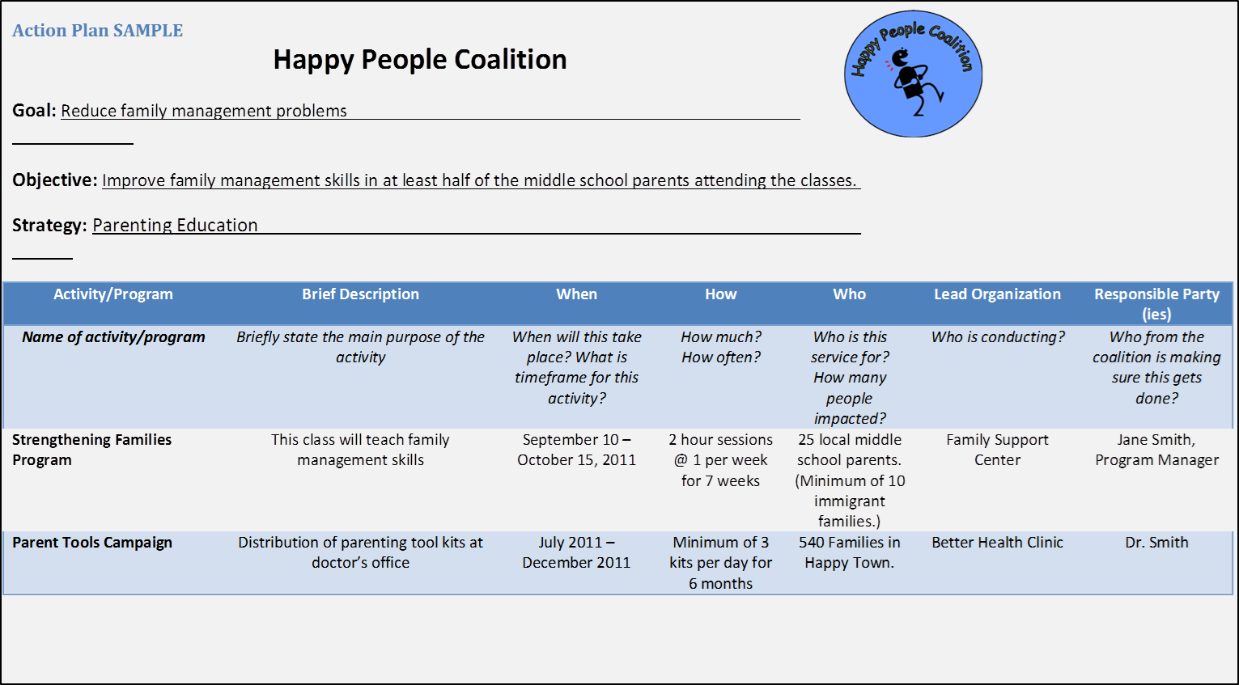
Plan
Action Plan - Sample
Template of an Action Plan (page 53).

Slide 49
PBPS Reporting for Coalition
Full Coalition Meetings
Leadership Committee Meetings
Standing Committee Meetings
Ad-hoc Workgroup Meetings

Slide 50
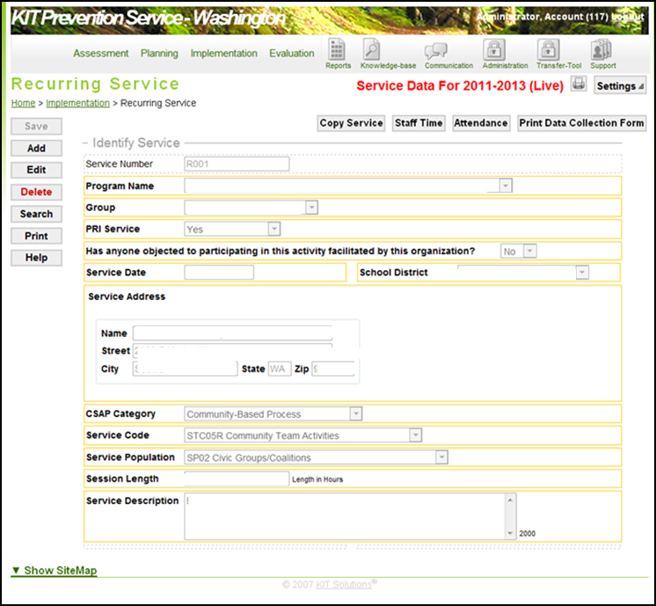
Full Coalition Meetings
Meeting of the full membership of the designated PRI Coalition.
Instructions
Select ‘name of coalition’
Select ‘full coalition’
Select ‘yes’
Select appropriate answer
Enter ‘date of service’
Select appropriate school district
Enter the address of meeting location
Select ‘Community-Based Process’
Select ‘STC05R Community Team activities’
Select ‘SP02 Civic Groups/coalition’
Enter session length
Enter primary meeting topics especially those specific to accomplishing required tasks.

Slide 51
Leadership Committee Meetings
Meeting of the Elected officers of the Coalition. (i.e. Executive Committee, Steering committee, etc.)
Instructions
Select ‘name of coalition’
Select ‘Leadership Committee – [Name of committee]’
Select ‘yes’
Select appropriate answer
Enter ‘date of service’
Select appropriate school district
Enter the address of meeting location
Select ‘Community-Based Process’
Select ‘STC05R Community Team activities’
Select ‘SP02 Civic Groups/coalition’
Enter session length
Enter primary meeting topics especially those specific to accomplishing required tasks.

Slide 52
Standing Committee Meetings
Long standing and ongoing meetings throughout the year of a group of people that have a specific focus. (i.e. Membership Committee)
Instructions
Select ‘name of coalition’
Select ‘Standing Committee – [Name of committee]’
Select ‘yes’
Select appropriate answer
Enter ‘date of service’
Select appropriate school district
Enter the address of meeting location
Select ‘Community-Based Process’
Select ‘STC05R Community Team activities’
Select ‘SP02 Civic Groups/coalition’
Enter session length
Enter primary meeting topics especially those specific to accomplishing required tasks.

Slide 53
Ad-hoc Workgroup Meetings
Short-term meeting commitment of a group of people to accomplish a specific task. (i.e. Needs Assessment Workgroup)
Instructions
Select ‘name of coalition’
Select ‘Ad-hoc Workgroup – [Name of workgroup]’
Select ‘yes’
Select appropriate answer
Enter ‘date of service’
Select appropriate school district
Enter the address of meeting location
Select ‘Community-Based Process’
Select ‘STC05R Community Team activities’
Select ‘SP02 Civic Groups/coalition’
Enter session length
Enter primary meeting topics especially those specific to accomplishing required tasks.

Slide 54
Questions?
For additional technical assistance implementing PRI, please contact your assigned Prevention System Manager.
Thank you for doing great work in your communities!

