Slide 1

May 29, 2020
Monthly coalition meeting

Slide 2
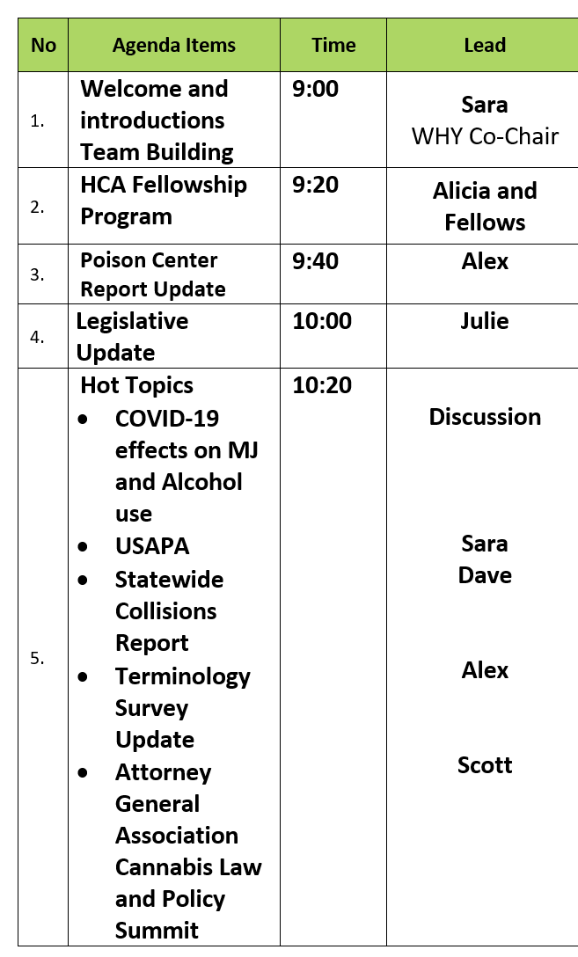
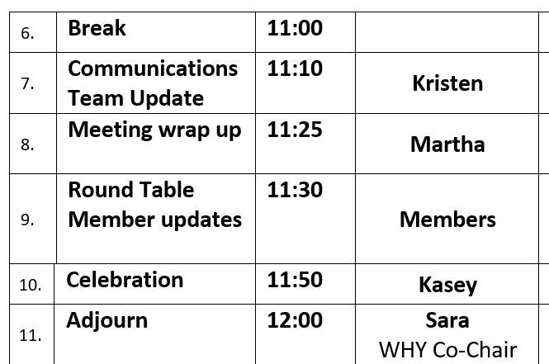
Today’s agenda

Slide 3

What made you laugh out loud this week?
No laughing? Smiling works too.
Internet video? Meme? Your pet?

Slide 4
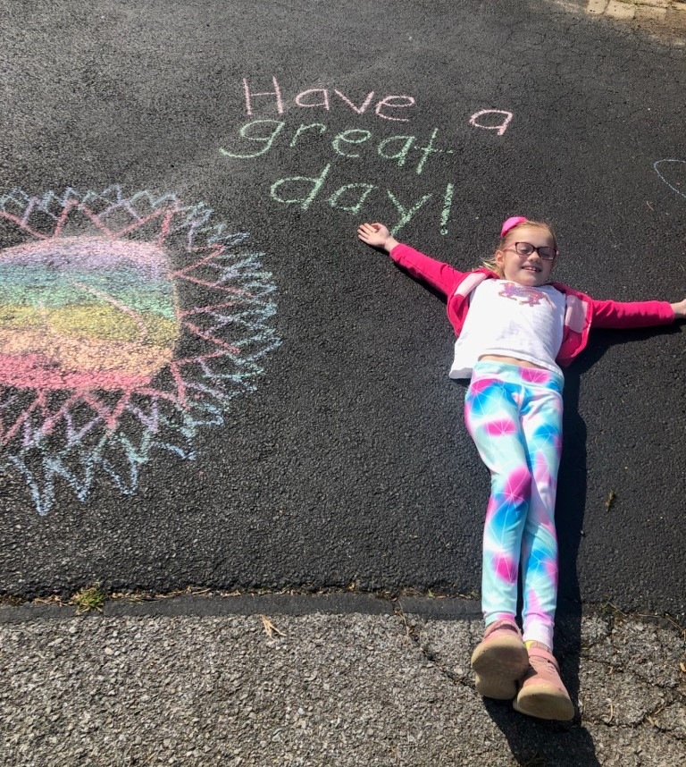

Slide 5

Fellowship Program
Alicia Hughes and Fellows

Slide 6
Prevention Workforce Development and the Fellowship Program
Alicia Hughes, MA, CPP
HCA/DBHR
Strategic Development and Policy Supervisor

Slide 7
Washington State Workforce Development
Goals:
Enhance capacity of current prevention practitioners at the local and state levels
Bringing people into the prevention field
Strategies:
Assessment of workforce development needs
Training, tools, resources for prevention professionals and providers
Notes:
Alicia
We have specific goals of workforce development for WA State –
Alicia
Workforce Development survey
Trainings, TA
High School Internship Program:
Work experience in an office environment, including:
Word and Excel documents, copying, filing, mailings, and subject area information packets
Exposure to behavioral health
Logistic preparations for conferences
Fellowship Program (to be discussed today)
High school Internship Program
DBHR-WSU Fellowship Program

Slide 8
Workforce Development Survey
Biennial assessment survey
Demographics to understand who providers are
Workforce development framework to measure competencies: confidence, frequency, and importance
Notes:
Alicia
Washington Prevention Workforce Development Survey – This workforce development assessment has been part of work of the prevention system over past 15 years. Most recently, as part of a study done in 2011 for strategic plan and again in 2017. Used as a means to assess the three competencies (perception of importance of competencies, the frequency of work with the competencies, and the confidence/knowledge and skills about the competencies), as well as provides important demographic information on the prevention workforce such as age, ethnicity, hours worked per week, and job satisfaction. In 2019, Prevention Transfer technology Center did the assessment to look at statewide and regional (region 10) results.
Training – Required: Coalition Leadership Institute, Prevention Summit, Substance Abuse Prevention Skills Training, prevention Ethics
Additional: CTC Clinic, Opioid Summit, eLearning Classes, Navigating Differences, CADCA Boot Camp, Coalition Coordinator Orientation, Spring Youth Forum
Tools – Athena Forum, OWL E-Learning, Community Data Book, Community Coalition Guide, Logic Model, Action Plan, Budgets, Strategic Plan
Understand who your providers are, what training/skill development they’ll be willing to do, assess their needs, predict provider turnover
Not only understanding the confidence levels, but also understanding the workforce’s perception of importance towards these competencies allows us to avoid providing training for things that the work force doesn’t believe they’ll need.
***Most places exclusively focus on confidence
Understanding the frequency the skills/training is needed, or when the skills are needed (only once every 2 years for strategic plans), helps us know when the best time to provide training is

Slide 9
Common Barriers Identified
How to meet the deliverables of prevention services contracts
Not understanding prevention science and frameworks
Unable to articulate meaning behind deliverables to communities to gain buy in from stakeholders
Notes:
Alicia
This is a barrier we have seen and actively work to address:
We have people who know how to meet the deliverables, such as form a mission statement, but don't understand prevention or how to articulate things (such as importance of key leaders). We know we don’t want to over train on specifics, like how to use Minerva or write an action plan, if they can’t explain prevention or understand the components of the system.

Slide 10
Overview of the Community Wellness
& Prevention Initiative (CPWI)
A community and school-based model focused on reducing underage use of substances
Partnership of state agencies, counties, schools, and prevention coalitions
Focuses on high-need communities and priority populations
Healthy Youth Survey data to identify risk factors
Prevention/Intervention services in identified schools in coordination with CPWI
Provides funding, training, and technical assistance
Notes:
Alicia
CPWI is a community and school-based model for delivering prevention programs and strategies in high risk communities, focused on reducing underage use of alcohol, marijuana, tobacco, prescription drugs, and other drugs.
Community coalitions: a formal arrangement of community members who work together towards building a safe, healthy, and drug-free community.
CPWI expansion efforts with continue with SOR, PFS grant and DMA and SABG
SAPISP is a comprehensive, integrated model of school-based prevention and intervention services that focuses on substance-use prevention and other supports.
Healthy Youth Survey is administered to in-school adolescents and collects data on risk factors that predict poor behavioral health outcomes.
Coalition strategic planning includes:
Develop a profile of community needs, resources, readiness, and gaps.
Mobilize the community to deal with prioritized problems – this coalition makes the prioritization decision.
Develop a strategic prevention plan with measurable goals and objectives.
Implement evidence-based prevention programs, policies, and practices. We will talk about this at the community planning training
Monitor the implementation of the project and measure and evaluate its results.
CPWI is only possible through collaboration and partnership.
Partnerships include: Washington State University, Department of Health (DOH), the Office of Superintendent of Public Instruction (OSPI), each of the 9 Educational Services Districts (ESDs), DSHS’ Research and Data Analysis, counties, and school districts across Washington State.
Through various funding streams and based upon community need, CPWI communities target a variety of substances including marijuana, alcohol, opioids, and the method of vaping in selected, high-need communities.
Cohort 6, provides expansion of CPWI efforts to 18 new high-need communities.

Slide 11
CPWI Prevention Fellowship
  Division of Behavioral Health and Recovery: Alicia Hughes, MA, CPP.
  Washington State University: Laura Hill, PhD. & Brittany Cooper, PhD.
Vision
Capacity Building
Workforce Development
Capacity building for high-needs communities to get ready for CPWI “Getting Started” phase; learning from community stakeholders and authentically building a coalition
Workforce development: prepare for CPP test or to become a coalition coordinator in that community; get CPP and then be able to find a job.
Notes:
Alicia
The Fellowship Program is a partnership between DBHR & WSU.
The vision of the Fellowship program was two-fold: to increase capacity building in high need communities to respond to prevention services and get a coalition started with prevention services and community engagement activities; and to increase the pipeline of prevention professionals in the field.
As we see in the field, when there are vacancies at the community coalition level, to the county level of prevention specialists, to the state level of prevention managers, there is a large gap in the workforce. WSU has a prevention science graduate degree and UW has a doctorate in prevention science program, but this is still relatively new.
We only have about 85 Certified Prevention Professionals in the state of Washington as well, indicating a great need to offer the work experience in prevention.

Slide 12
DBHR – WSU Fellowship Program
DBHR contracts with university partners to manage logistics of fellowships
Recruitment through university internship preparation classes, social work program, and Athena Forum
DBHR and WSU screen and interview applicants jointly
WSU faculty meet monthly with Fellows and provide additional learning resources (e.g. program evaluation training modules)
Notes:
Alicia
As mentioned, this is a partnership between WSU and DBHR. It was created this way primarily because WSU has the prevention science graduate program and the CPWI evaluators (Laura, Brittany) work closely with DBHR on the CPWI model. When we first started talking about the program, WSU had the idea of partnering with the WSU Internship Program required for graduating seniors. WSU worked closely with Joe Hewa, the internship coordinator, to identify a few students that still needed placements for the Winter/Spring semester. This worked out perfectly for the start of the program.
Together, WSU and DBHR screens and interviews applicants. Applicants must satisfy the HCA requirements (background check, reference check) and once hired, WSU and HCA jointly offer pre-Fellowship webinars and meetings to get to know each other and prep the Fellow for their first day.
[Laura to add – how WSU supports the students throughout the Fellowship with resources, with pre/post surveys, etc.]

Slide 13
CPWI Prevention Fellowship Structure
Phase 1
3 months
Phase 2
3 months
Phase 3
4 months
  At the DBHR office gaining an understanding of the statewide prevention system and gaining professional development through trainings.
  In an existing CPWI community, mentoring under an existing CPWI coordinator and assisting the coalition as appropriate.
  Placed in a high-need community with building a coalition, gathering key leaders, and beginning the “Getting Started” phase of the CPWI model.
Notes:
Alicia
There are three phases, 3 – 3- 4.

Slide 14
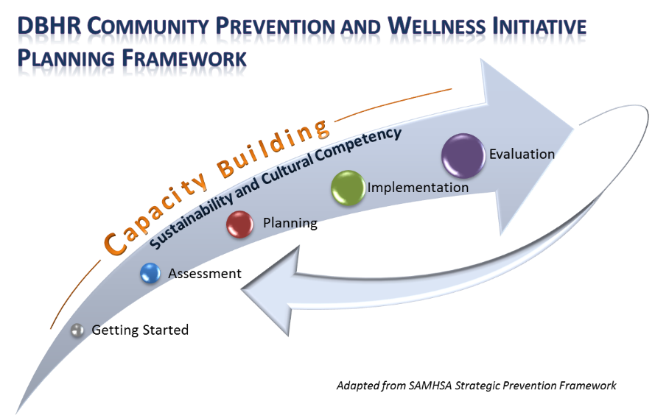
Notes:
Alicia
Here is our CPWI model again – as mentioned, the Fellows are focused on the Getting Started Phase of CPWI which I will explain on the next slide.

Slide 15
Getting Started
Function as the liaison among the coalition members, DBHR and other state partners, and with the community.
Participate in CPWI learning community meetings, monthly DBHR check-in meetings, and required training.
Help recruit and retain membership on the coalition and support from local key stakeholders/leaders.
CPWI Prevention Planning Framework, Action Plan, Needs Assessment and Strategic Planning, Budget
Align and integrate community organization's work with the goals and strategies of the coalition
Coordinate community outreach efforts (i.e., presentations, newsletter, volunteer recruitment, etc.).
Notes:
Alicia
Overall, the getting started phase consists of community engagement and development efforts, rallying a community behind the idea of prevention.

Slide 16
Program Timeline
Cohort 1,
Jan-Oct ‘19
Cohort 2,
Jun ‘19-Mar ‘20
Cohort 3,
Oct ’19-Jul ‘20
Cohort 4,
Jan-Sep ‘20
Phase 1
Jan.-Mar.
Phase 1
Jun.-Aug.
Phase 1
Oct.-Dec.
Phase 1
Jan.-Mar.
Phase 2
Apr.-Jun.
Phase 2
Sept.-Nov.
Phase 2
Jan.-Mar.
Phase 2
Apr.-Jun.
Phase 3
Jul.-Oct.
Phase 3
Dec.-Mar.
Phase 3
Apr.-Jul.
Phase 3
Jul.-Sep.
Notes:
Alicia
This slide demonstrates the time/duration of each phase for each cohort. It shows viewers the overlap in the cohorts phases as they progress through the fellowship.
Now, as part of the overall workforce development professional development opportunity, we’ve invited our Fellows to join me for this presentation to discuss a little about their experience in the program and provide an overview of the full program and phases.

Slide 17
Phase 4
Exciting opportunity that allowed for the Fellowship contract to be extended for Cohorts 1 and 2.
Return to Olympia office to apply skills acquired in the field, support the team, and continue build experience in prevention field.

Slide 18
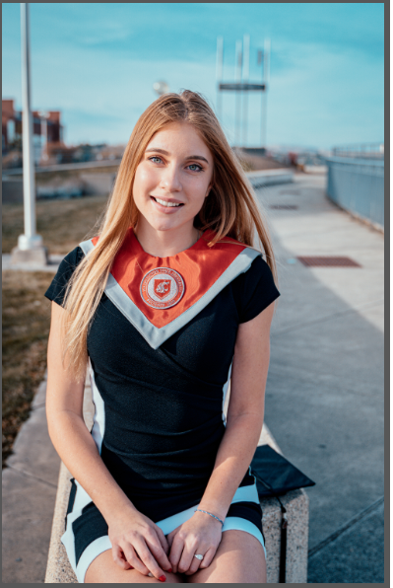
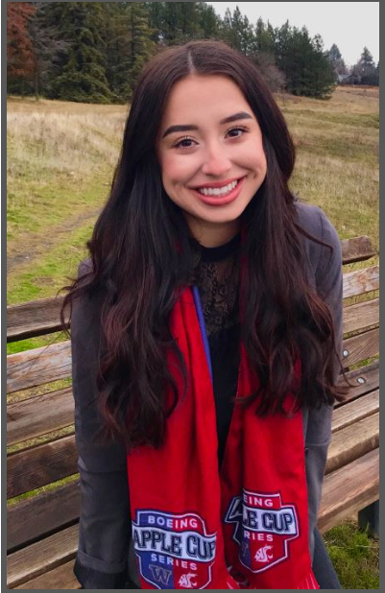
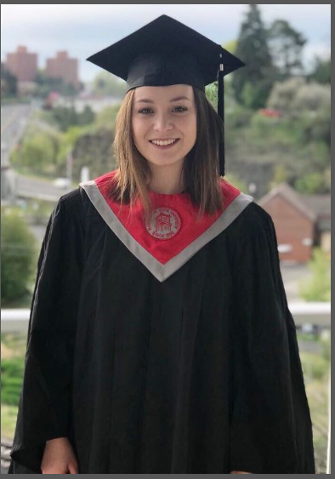
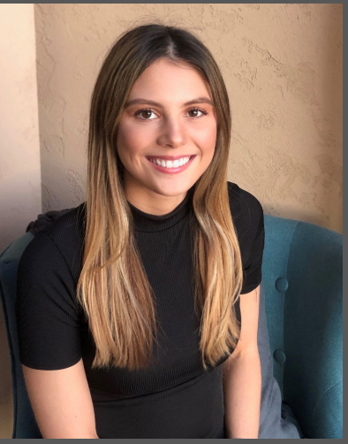
Meet the Phase 2 Fellows!
Grace Wilkowski
Point Roberts, WA
Cohort 4 Fellow
Samantha Pangelinan
Long Beach, CA
Cohort 4 Fellow
Rachel Oliver
Deer Park, WA
Cohort 4 Fellow
Sabrina DiGennaro
Orange, CA
Cohort 4 Fellow

Slide 19
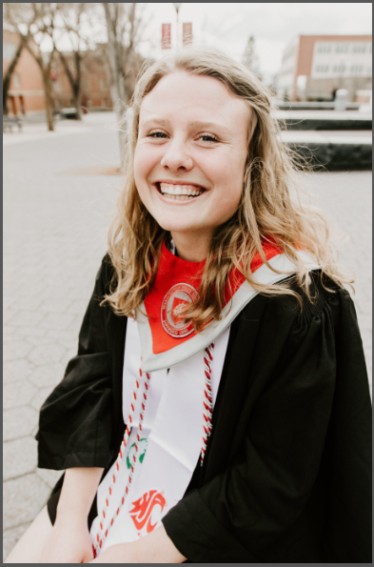
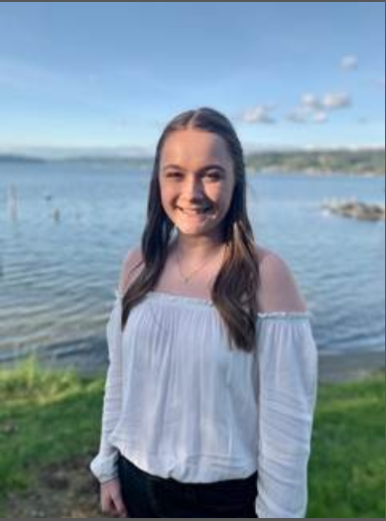
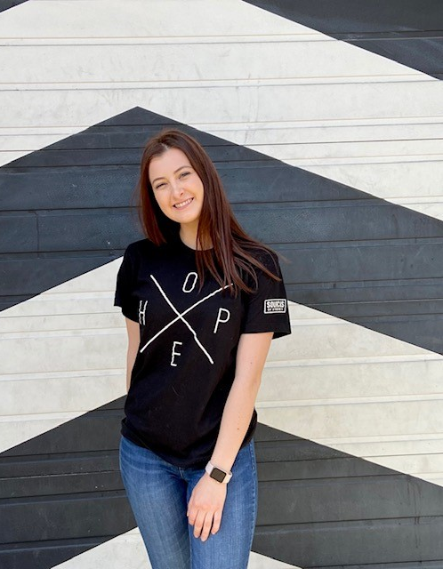
Meet the Phase 3 Fellows!
Sophia Hilsen
Normandy Park, WA
Cohort 3 Fellow
Emma Neller
Ellensburg, WA
Cohort 3 Fellow
Krista Timm
Lakewood, WA
Cohort 3 Fellow
Notes:
The 4th Fellow from this cohort was able to get a job in the field at HCA!

Slide 20
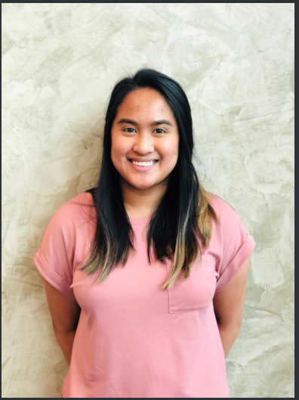
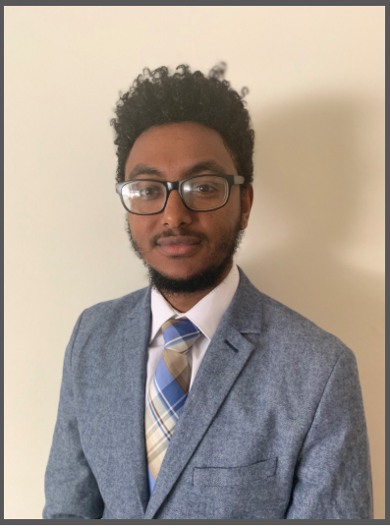
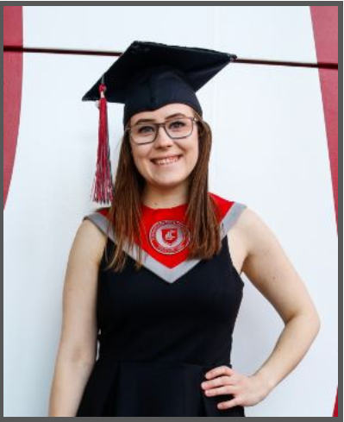
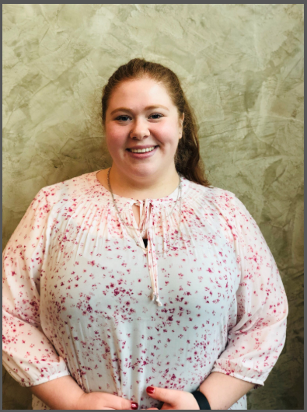
Meet the Phase 4 Fellows!
Kersten Tano
Ewa Beach, HI
Cohort 1 Fellow
Endalkachew Abebaw
Renton, WA
Cohort 2 Fellow
Tori McDermott Hale
Maple Valley, WA
Cohort 2 Fellow
Destiny Eversull
Seattle, WA
Cohort 1 Fellow
Notes:
The missing Fellows from Cohorts 1 and 2 were able to apply skills from the Fellowship to pursue career opportunities ☺

Slide 21
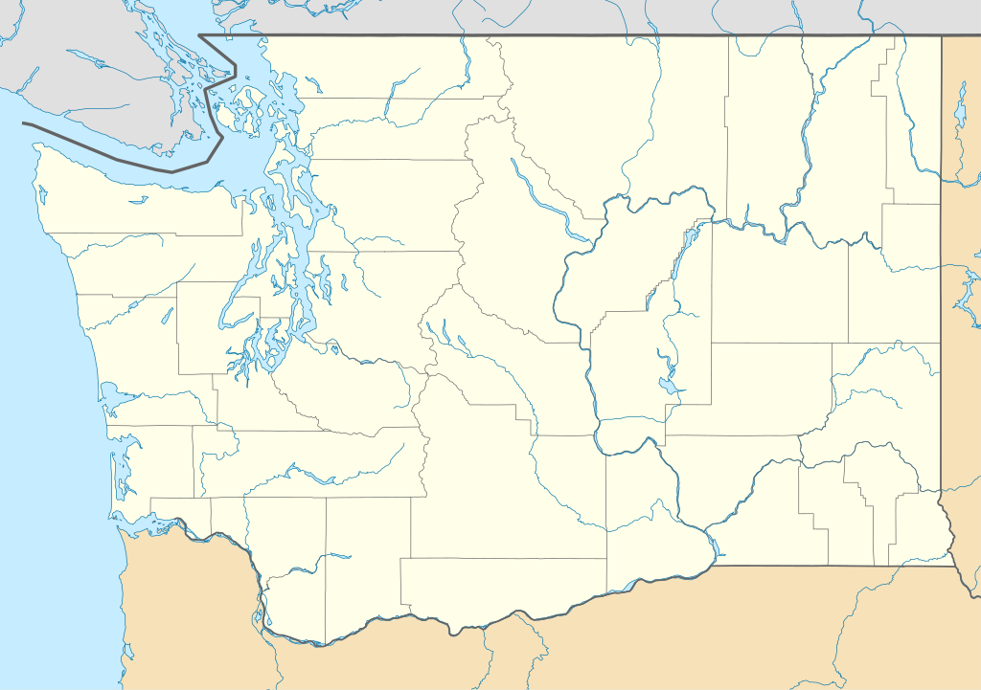
As of April 2020, we have placed 14 Fellows all around the state and in multiple counties. The map below shows the phase 2 placements (blue), where Fellows have learned from established CPWI sites, and phase 3 placements (yellow), where Fellows are placed in an identified high-need community to build readiness for a coalition and expanded prevention services.
Notes:
As of January 2020, we have placed 14 Fellows all around the state and in multiple counties. This map shows the phase 2 placements (blue), where Fellows have learned from established CPWI sites, and phase 3 placements (grey lavender), where Fellows are placed in an identified high-need community to build readiness for a coalition and expanded prevention services.

Slide 22
Fellowship Data Collection

Slide 23
Overview of the Survey
Using a Likert-style scale with scores ranging from 1 (strongly disagree) to 7 (strongly agree).
WSU creates, disseminates and reviews the survey and its results.
Fellows are asked “I feel confident in my knowledge of…” in the various domains, which are chosen based on the Fellowship Learning Objectives.
Currently, only Cohort 1 has been through all 3 phases and had the data compiled. Cohort 2 has just completed all 3 phases as of 4/1.

Slide 24
Reflecting on Phase 1
 | Time 1 | Time 2
Cohort 1 | 3.7 | 5.6
Cohort 2 | 5.0 | 6.7
Cohort 3 | 4.4 | 5.8
Time 1 refers to the beginning of Phase 1
Time 2 refers to the beginning of Phase 2
Notes:
All of Cohorts 1-4 have been through Phase 1. This graph shows the Knowledge Confidence between Time 1 and Time 2 for Cohorts 1-3 only.
Time 1 being taken at the beginning of Phase 1 and Time 2 being taken at the beginning of Phase 2.
All cohorts show an increase in knowledge confidence! Showing that these individuals are definitely growing within Phase 1.

Slide 25
Focusing on Cohort 1
Data collected on 3 different times
Time 1 (Baseline) = Start of Phase 1
Time 2 = Start of Phase 2
Time 4 (Exit) = End of Phase 3

Slide 26
Focusing on Cohort 1
Cohort 1 has shown a 78% improvement in their mean scores between baseline, time 2 and exit.
 | Baseline (Time 1) | Time 2 | Exit (Time 4)
Cohort 1 | 3.7 | 5.6 | 6.6

Slide 27
Highlighted Cohort 1 Results
Notes:
Note: Compared to the other questions, the “managing contract activities” question had the lowest mean score at exit, which definitely will be interesting to ask at the end of Cohort 1 fellows, Phase 4, as they take on a more contract monitoring role.

Slide 28
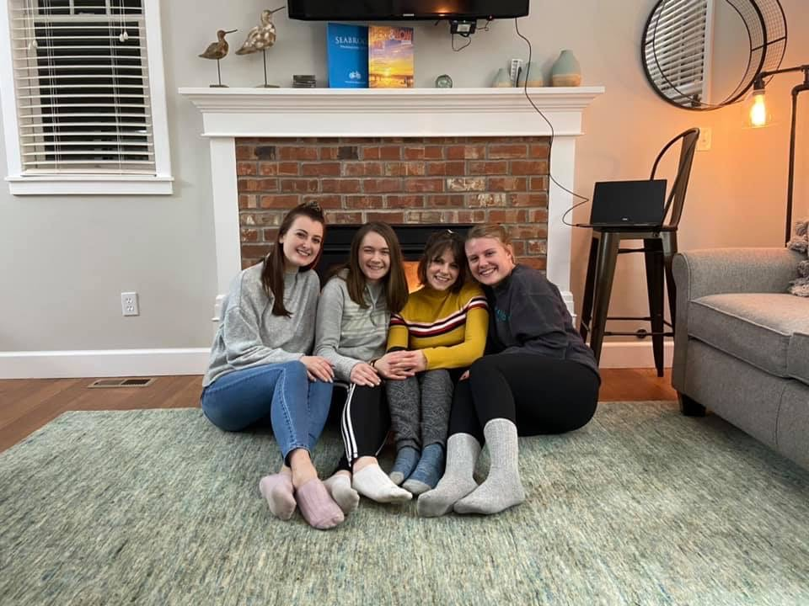
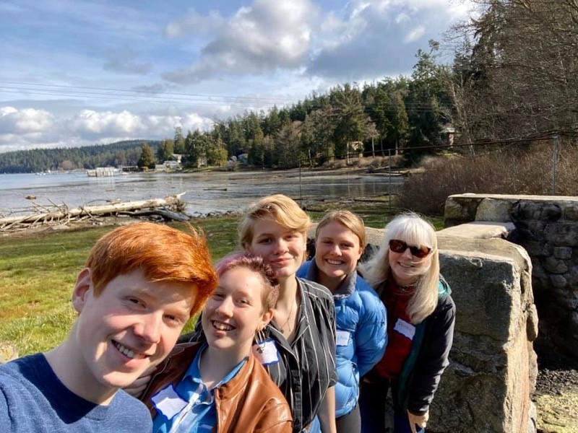
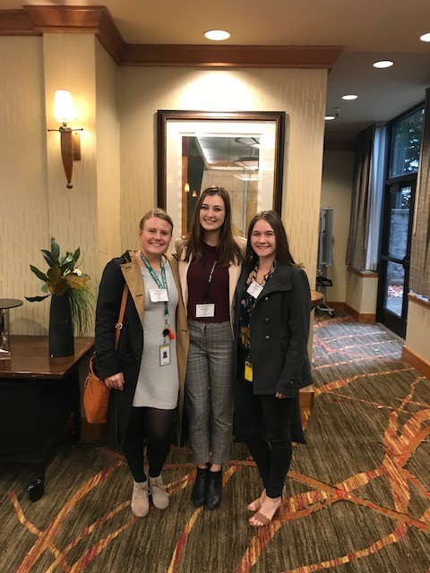
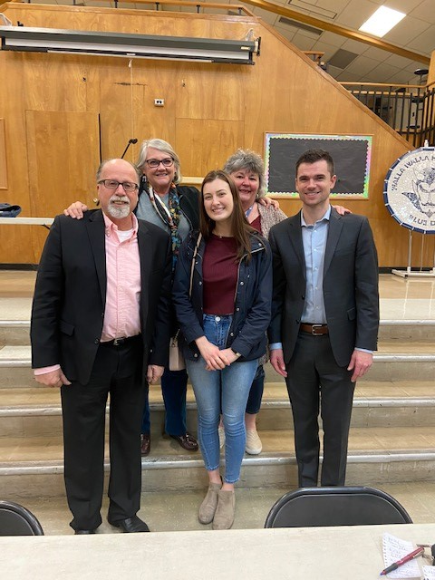
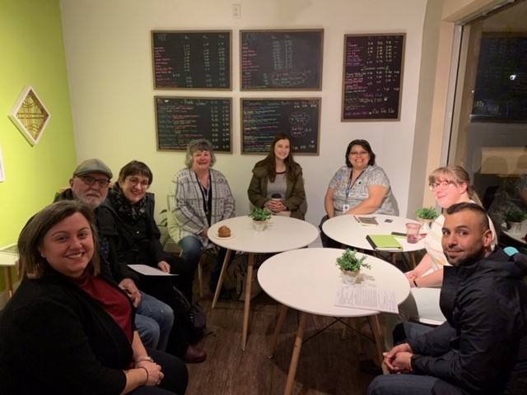
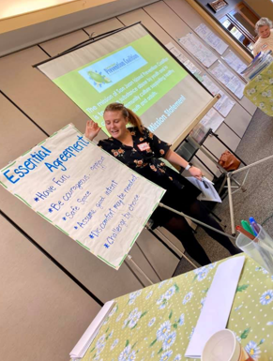
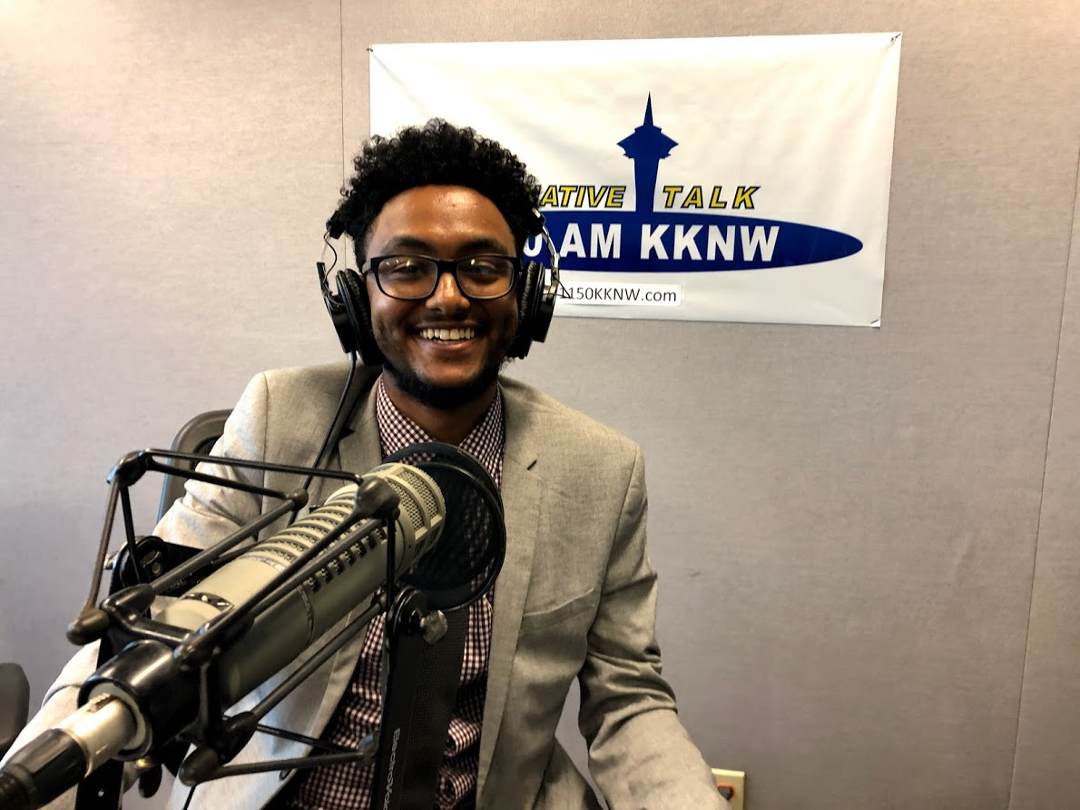
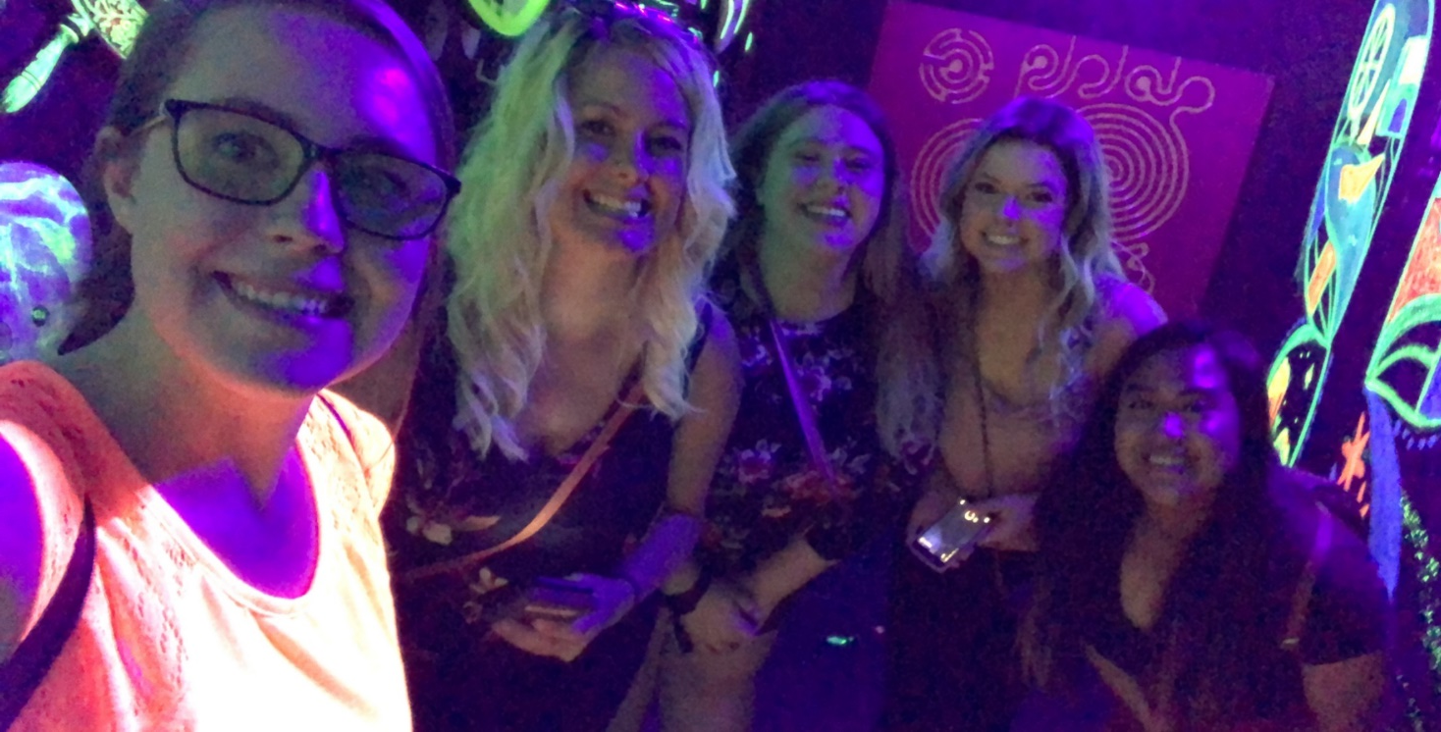
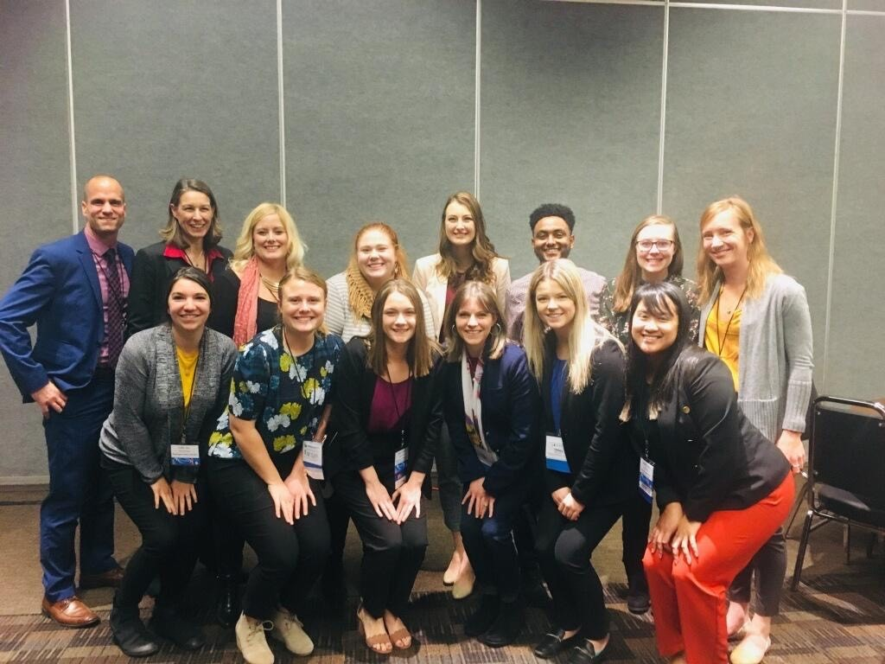
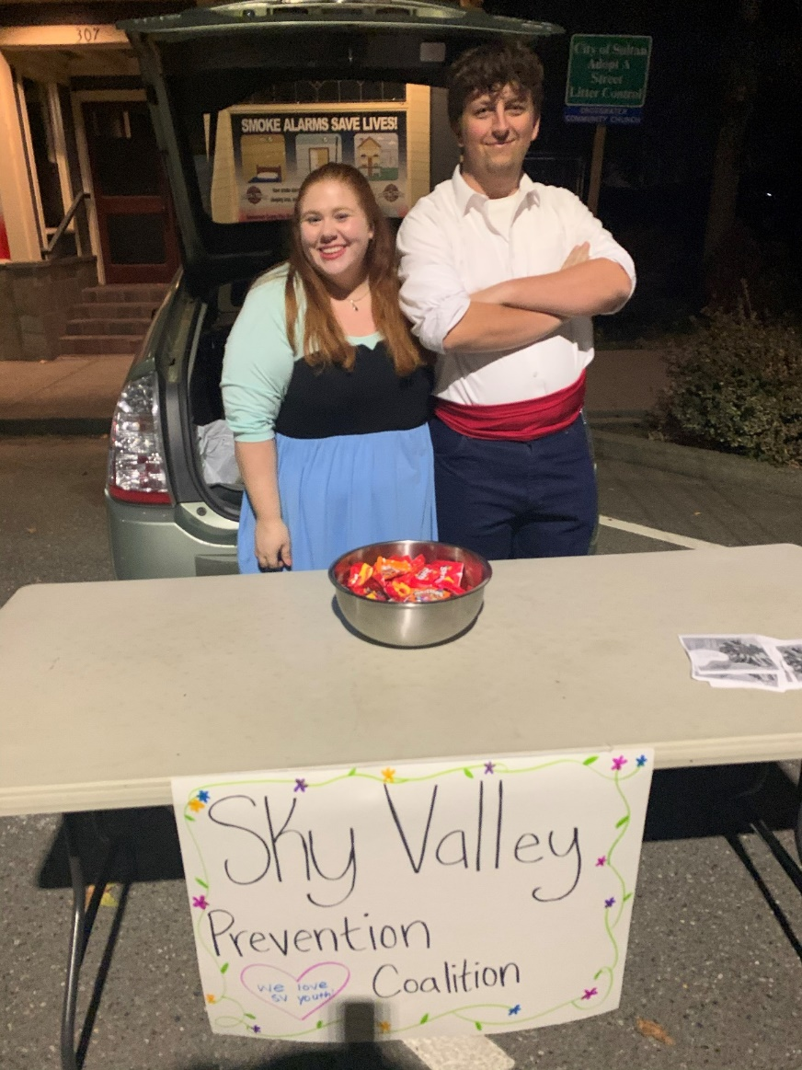
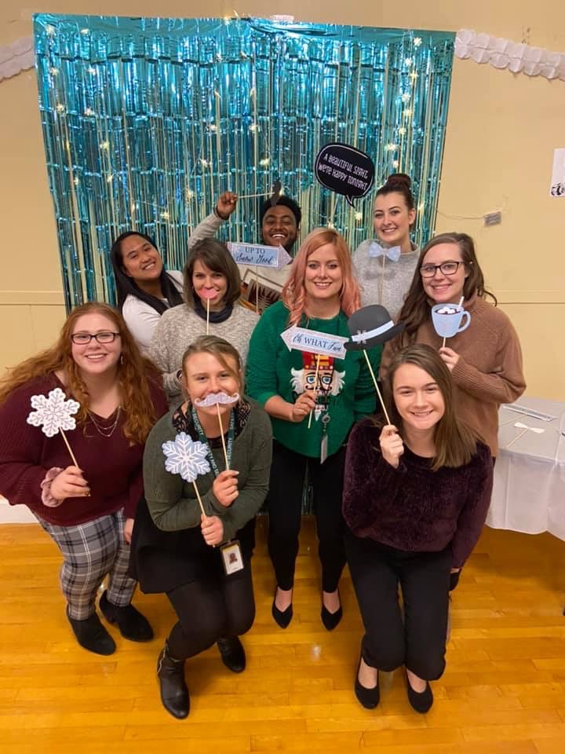
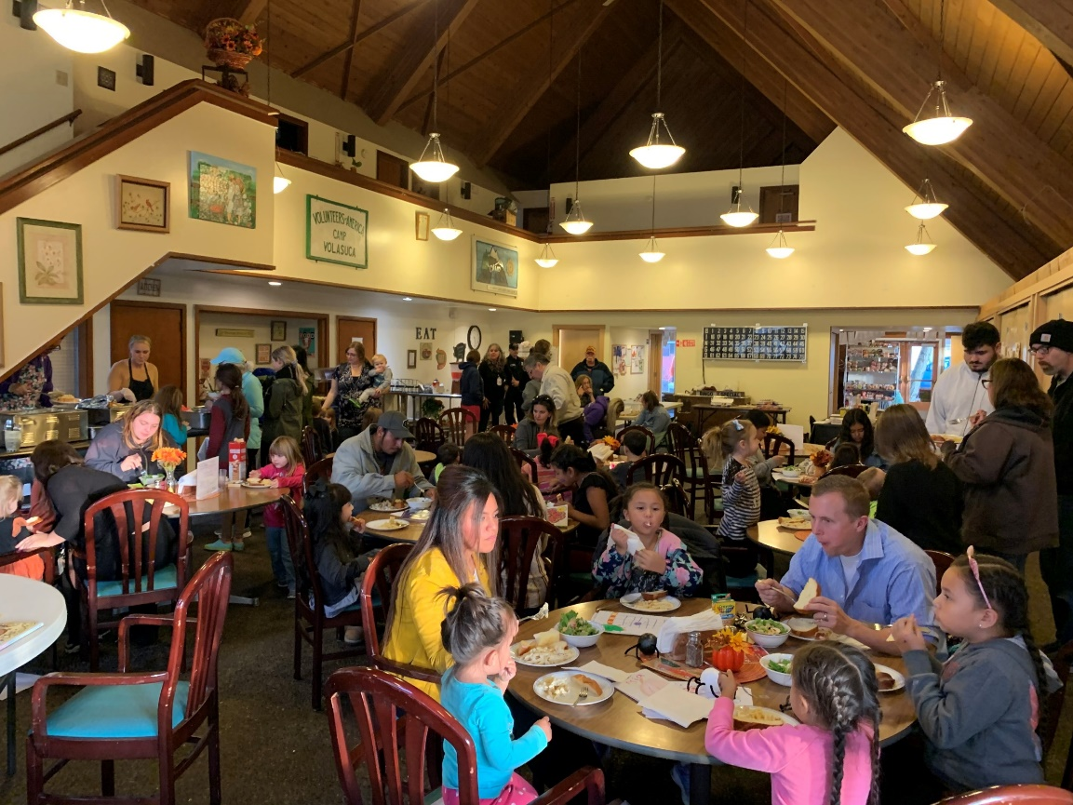
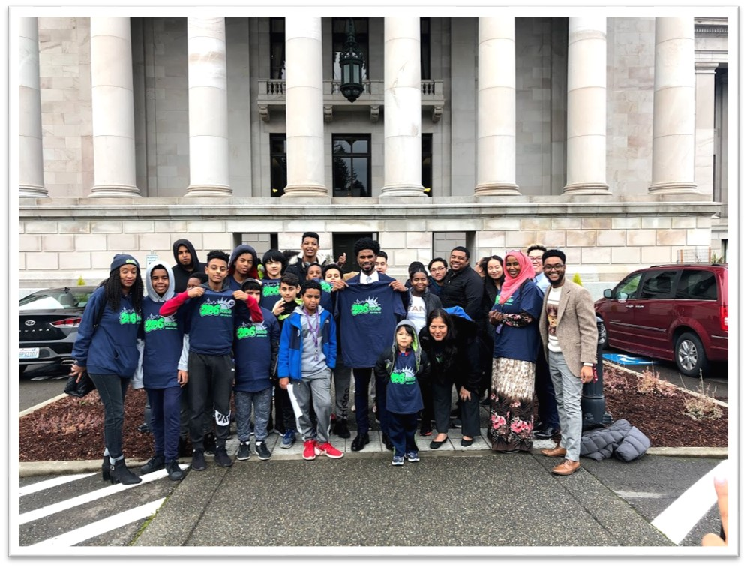
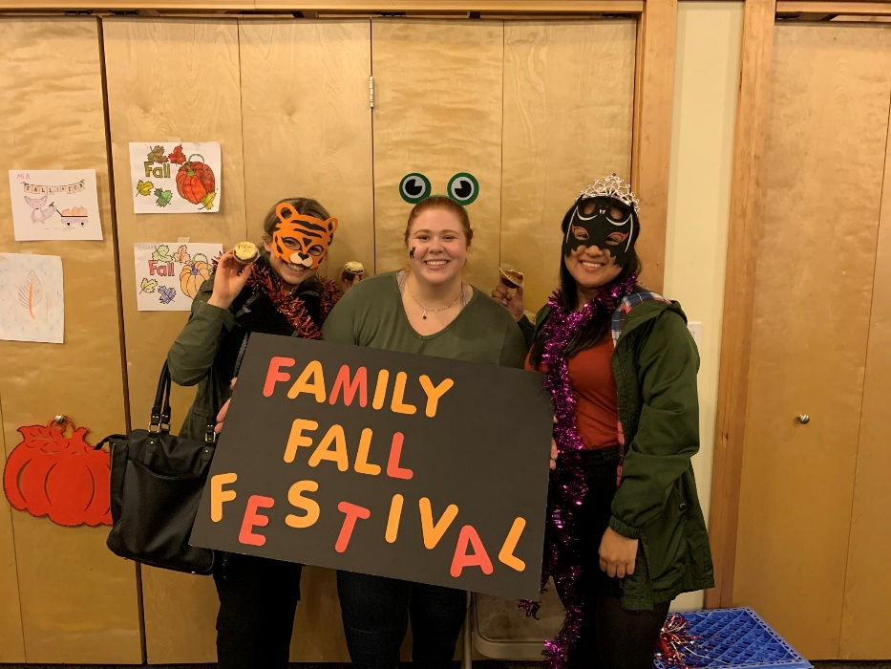
Achievements
Notes:
In the Fellowship, we have been blessed to
Participate in DBHR events
Work with youth groups
Build lasting professional and personal relationships
Be involved in a community that is new to us
Host large community events
Present on prevention and prevention topics
Attend conferences
Lead meetings
Develop relationships with the youth we serve
Coordinate and implement programs
Meet with local officials and mayors
Contribute to audio/visual campaigns (Destiny, Chewy, Krista!)
Have fun
And come together

Slide 29
Future of the Fellowship
SOR Year 3 Grant
Planning for Cohorts 5 – 8
Cohort 5 set to begin in September 2020
3 Fellows per cohort
At the end of Cohort 8 we will have had a total of 26 individuals be in the Fellowship program

Slide 30
Training Opportunities
Coalition Leadership Institute
WA State Prevention Summit
Spring Youth Forum
Technical Trainings
Trainings as requested
Prevention Technology Transfer Center (PTTC)
Navigating Difference (WSU Cultural Humility training)
Trainings specific to helping Fellows work towards their CPP
Notes:
Alicia
Coalition Leadership Institute – Frameworks
Telling the prevention story
Case study: Start-to-finish messaging success story
Using local data in prevention storytelling
Telling the Washington prevention story: A strategic communication workshop
The message is developed, now what? Engaging key leaders and stakeholders in your community
Telling your story through social media - keys to personal and professional social media success
Audience engagement for rural and urban communities
Determining next steps in prevention messaging for your community
Prevention Summit
Spring Youth Forum
Technical Trainings
Community Coalition Orientation
Ethics Training
Minerva Training
We accept training requests from providers

Slide 31

Resources
Athena Forum – Fellowship Program
http://www.TheAthenaForum.org/Fellowship
SAMHSA Website
https://www.samhsa.gov/
WSU IMPACT Lab – Fellowship Program
https://hd.wsu.edu/community-prevention-wellness-initiative-cpwi-prevention-fellowship-program-2/
Notes:
Alicia
So in summary, this program is vey robust and has continued to evolve over the year. As we go into the next cycle of this, we will evaluate the pre and post tests that the Fellows take at each phase and identify areas of growth or improvement. Perhaps it is extending the length of time in the program. Offering different kinds of learning opportunities. It’s been an incredible program and I’m proud to co-supervise it – it’s a pleasure getting to know each of the Fellows and watching their journeys along the way. If you are one of our CPWI sites, I hope we hear from you that you are interested in hosting a Fellow in the future. It’s a really wonderful opportunity and it’s fun to establish these partnerships together! Thanks for listening to us today and we’re here if you have any questions.

Slide 32
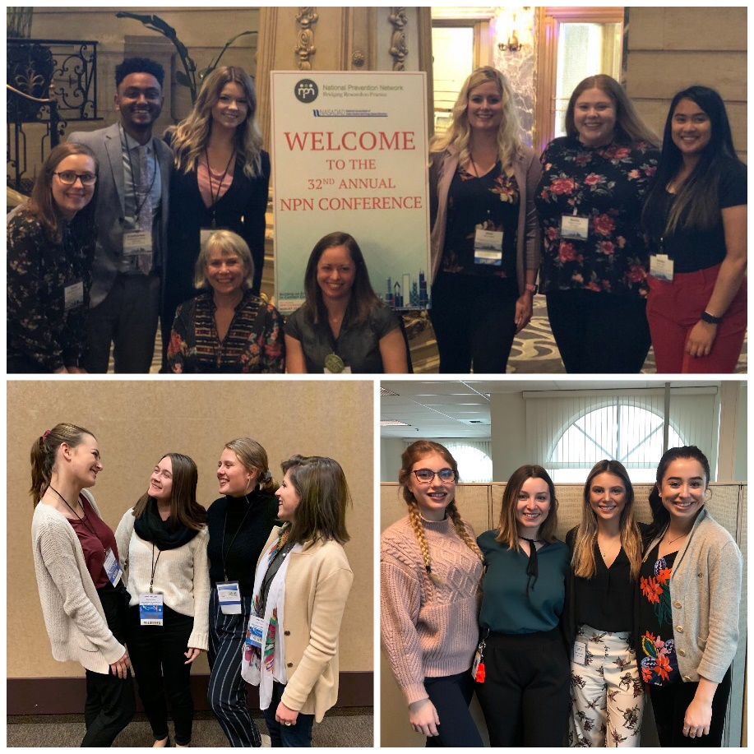
Questions?
Notes:
All

Slide 33

WPC Update
Alex Sirotzki

Slide 34
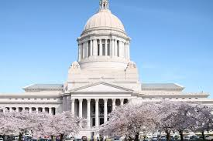
Legislative Session update
Julie Peterson

Slide 35

Hot topics
Statewide Collisions Report (Dave)
Terminology Considerations update (Alex)
Attorney General Association Cannabis Law and Policy Summit (Scott)
US Alcohol Policy Alliance Interactive Dialogue and action (Sara)
Covid19 and effects on marijuana and alcohol use (Discussion)

Slide 36
Hot topics
Statewide Collisions Report (Dave)
Terminology Considerations update (Alex)
Attorney General Association Cannabis Law and Policy Summit (Scott)
US Alcohol Policy Alliance Interactive Dialogue and action (Sara)
Covid19 and effects on marijuana and alcohol use (Discussion)

Slide 37
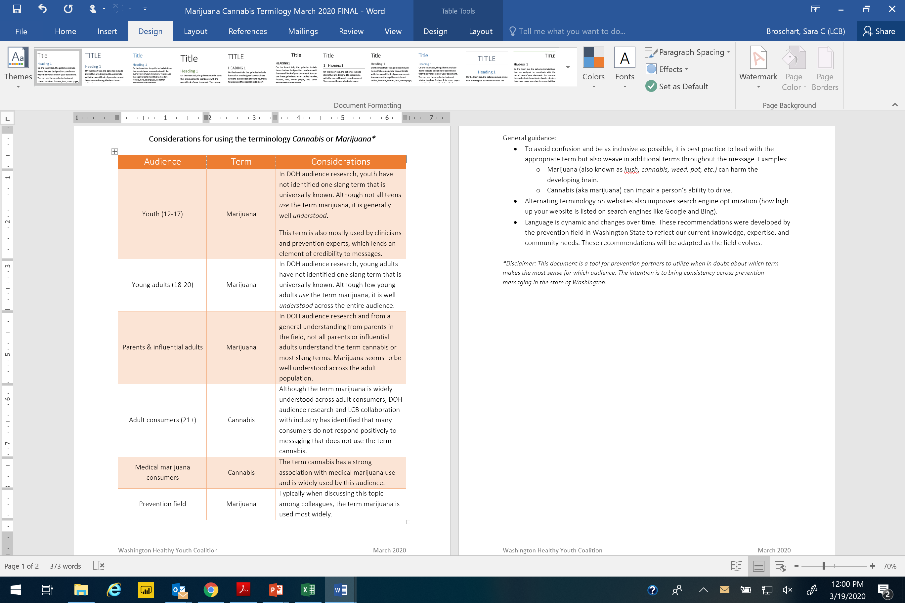

Slide 39
Hot topics
Statewide Collisions Report (Dave)
Terminology Considerations update (Alex)
Attorney General Association Cannabis Law and Policy Summit (Scott)
US Alcohol Policy Alliance Interactive Dialogue and action (Sara)
Covid19 and effects on marijuana and alcohol use (Discussion)

Slide 40
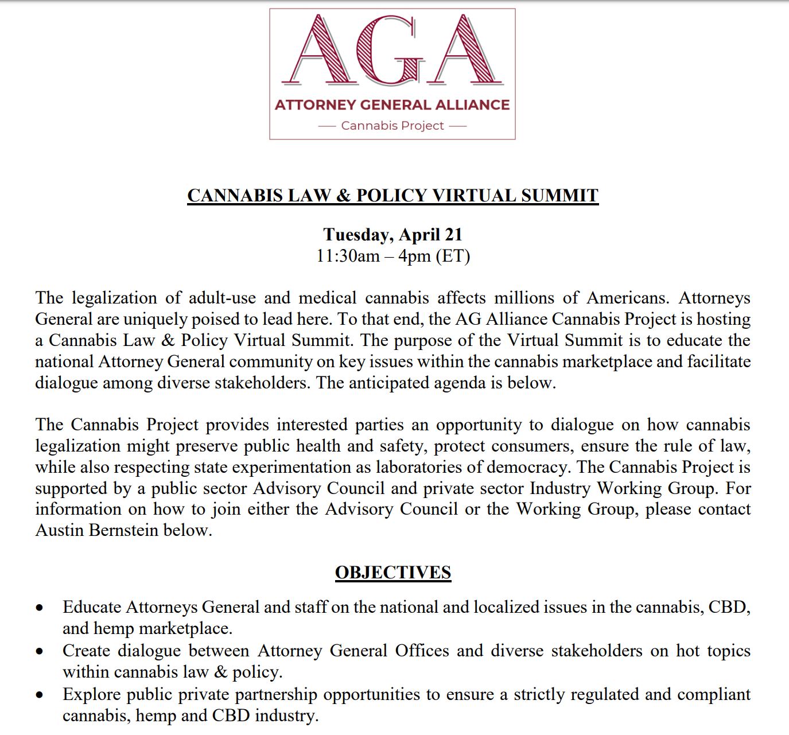

Slide 41
Hot topics
Statewide Collisions Report (Dave)
Terminology Considerations update (Alex)
Attorney General Association Cannabis Law and Policy Summit (Scott)
US Alcohol Policy Alliance Interactive Dialogue and action (Sara)
Covid19 and effects on marijuana and alcohol use (Discussion)

Slide 42

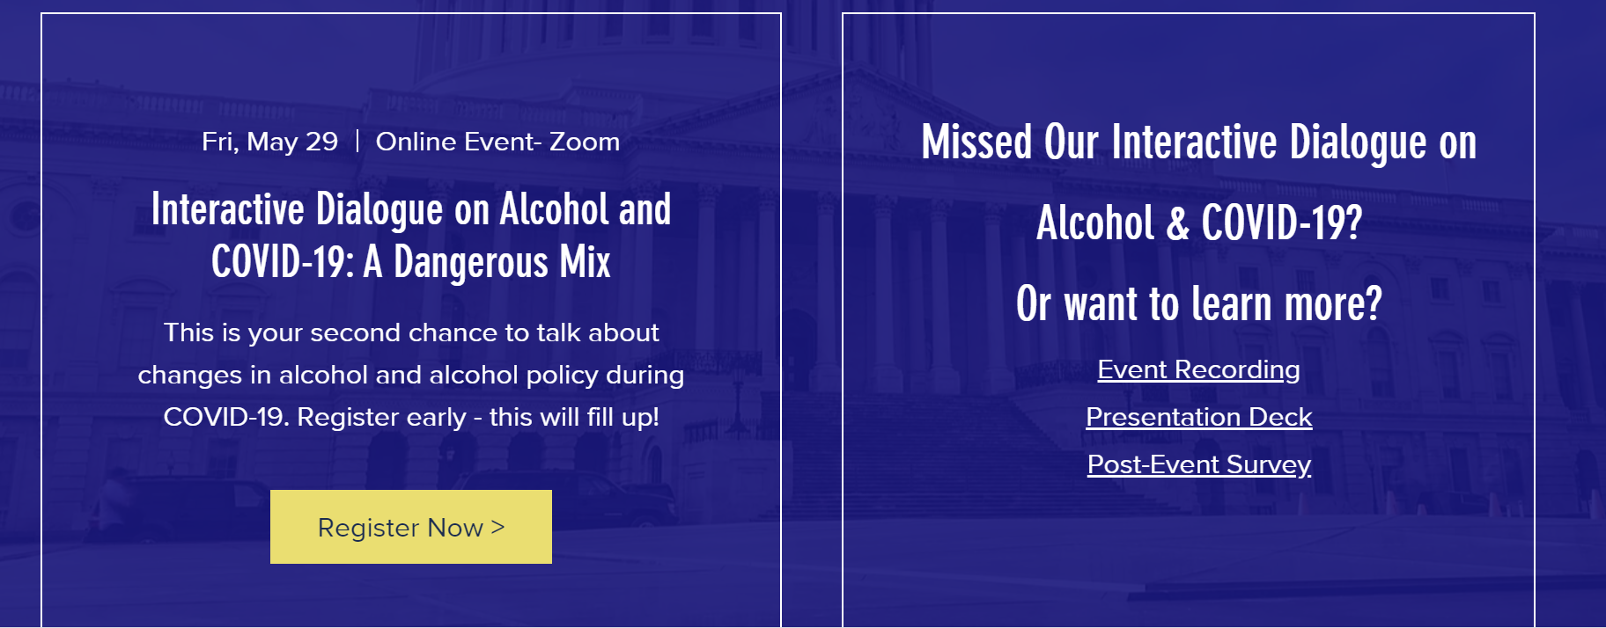
https://www.alcoholpolicy.org/events-1

Slide 43
Hot topics
Statewide Collisions Report (Dave)
Terminology Considerations update (Alex)
Attorney General Association Cannabis Law and Policy Summit (Scott)
US Alcohol Policy Alliance Interactive Dialogue and action (Sara)
Covid19 and effects on marijuana and alcohol use (Discussion)

Slide 44

Let’s talk: Covid19 effects on alcohol and marijuana use and prevention programming
Roundtable updates
Any bright spots?
What kind of additional action is necessary?
Next steps for WHY?

Slide 45
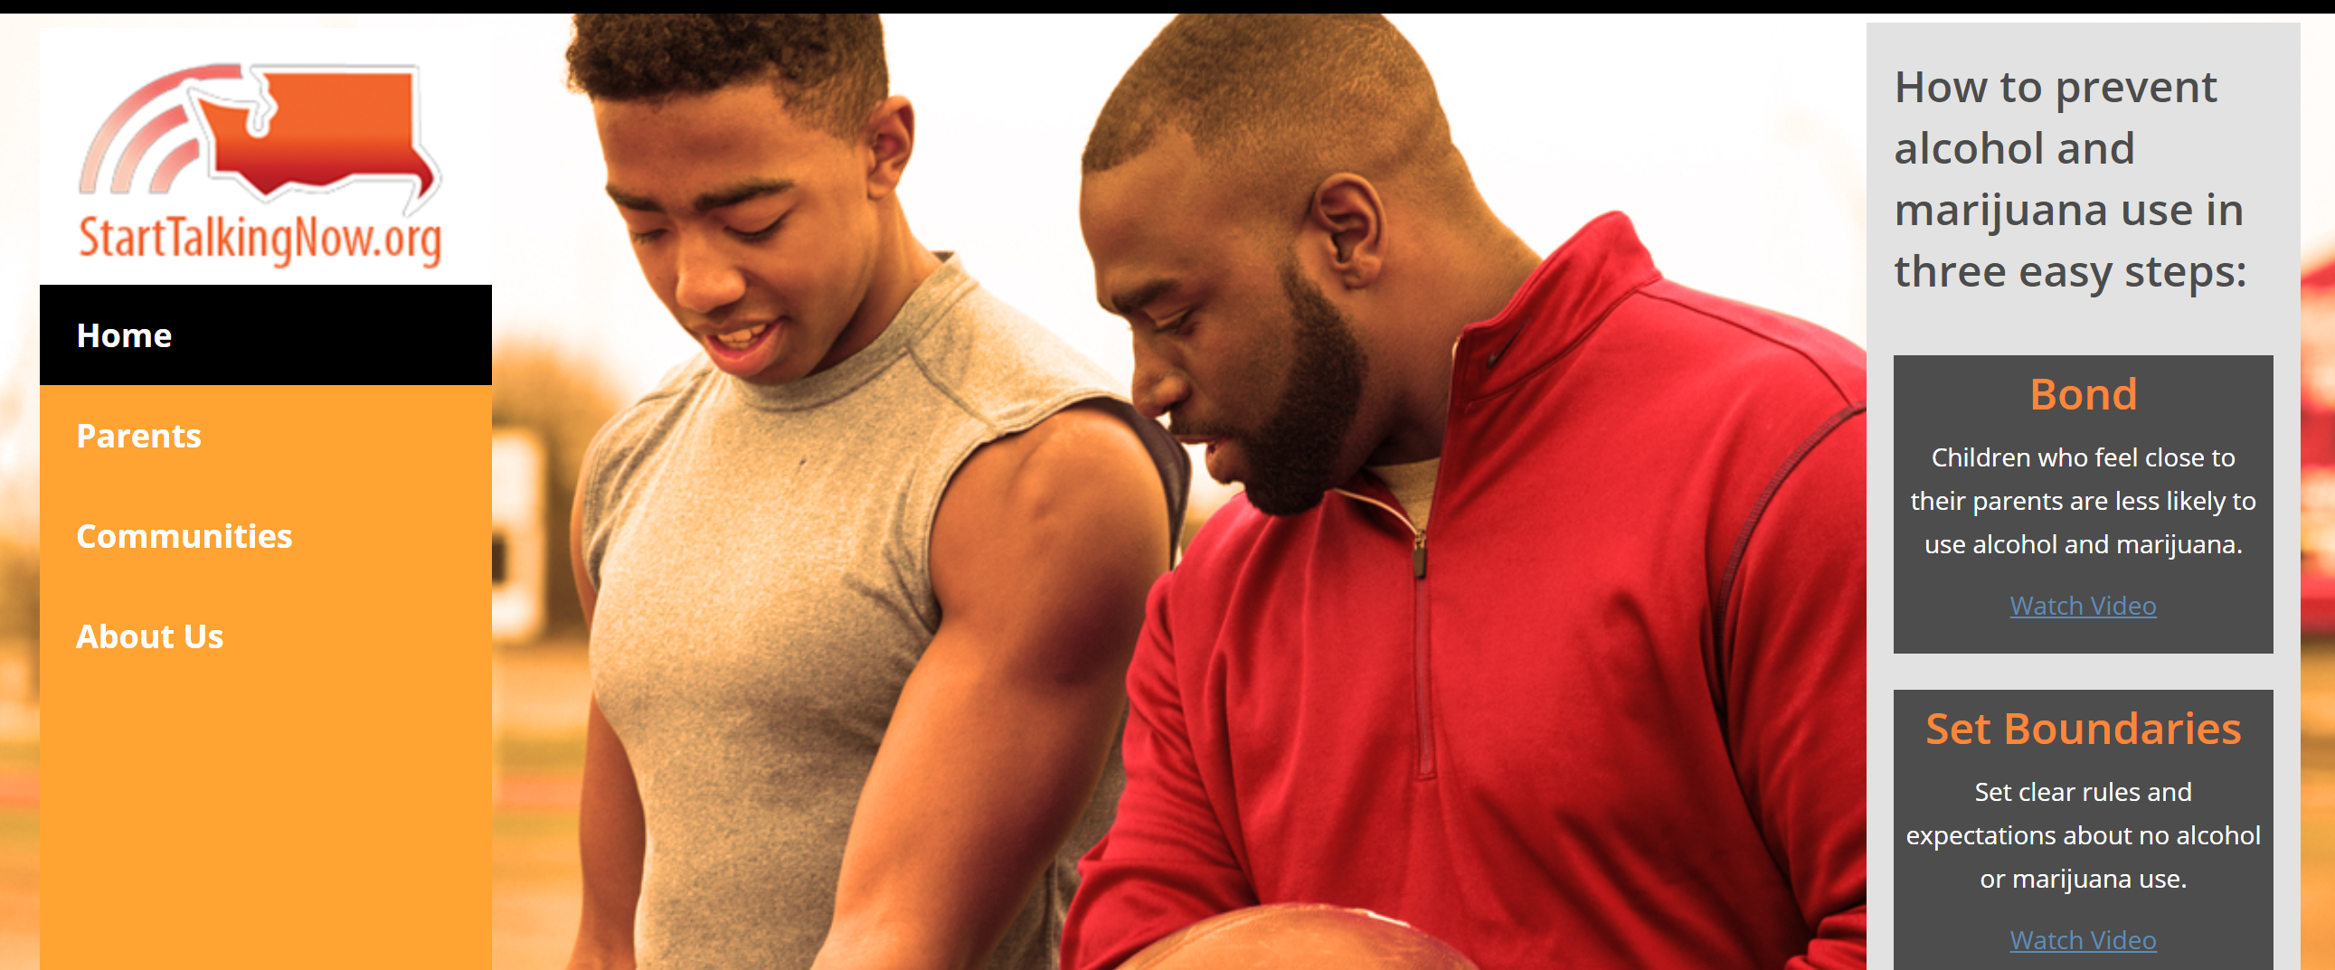
Communications Team update

Slide 46
Today’s agenda

Slide 47
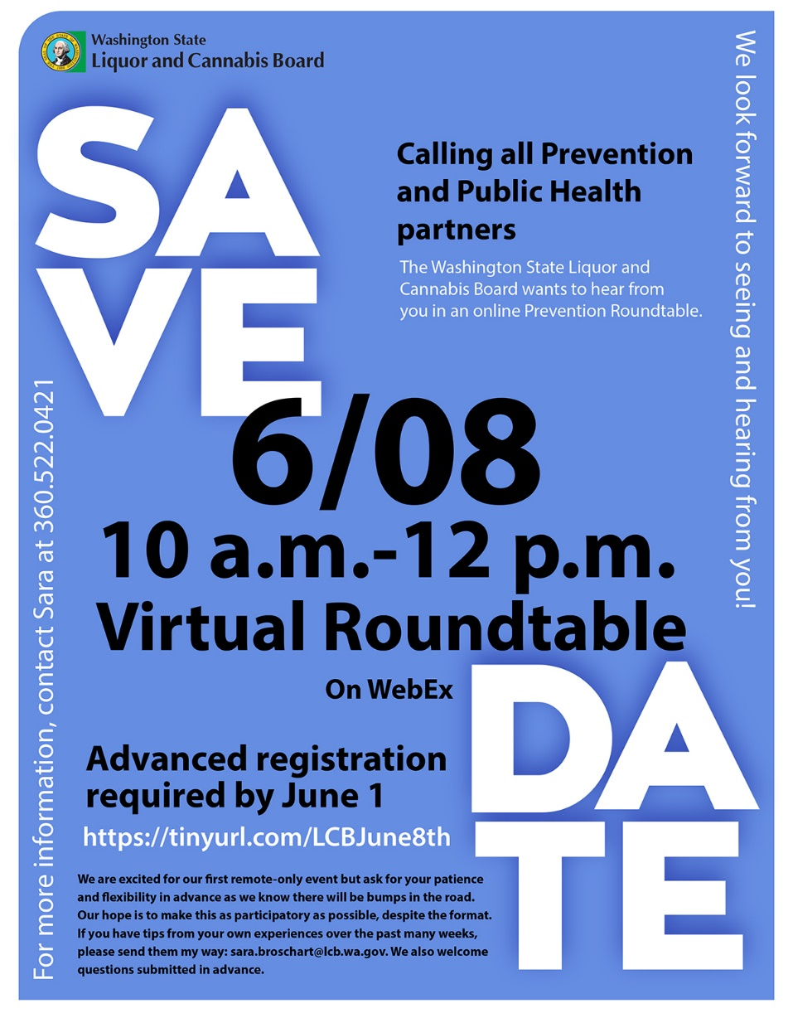
LCB updates
LCB-Prevention Virtual
Roundtable NEXT MONDAY
Rulemaking open on
True party of interest
Voluntary compliance
Quality assurance
See more at: https://lcb.wa.gov/laws/get_notifications/archive

Slide 48

Congratulations Sara on this wonderful and fun new adventure <3!!! I am so happy for you and your family and look forward to future pictures! With love, Sazi
Woohoo! Congratulations to you and your family, Sara! ☺ Fallon Baraga
Sara, congratulations on your new bundle of joy. Best wishes for a lifetime of happiness for you and your growing family. ~Sandy
Sara – so happy for you. I hope you have tons of fun with your new addition!
-Sarah
Congrats on this exciting new chapter!
-Grace Wilkowski
Sara,
Congratulation on the new addition!
Send pictures for me to share!
~Martha
Sara, congrats! Cannot wait until your little one arrives! Excited for you and your husband on this new journey. You will be missed! Stay in touch ☺
-Kasey
Sara ~ Congratulations on this exciting new adventure! Sending you all our best! – Alicia
Hey Sara! I am so excited for you and the family! Babies are just the best, and are great reminders of what we’re all working toward. All the best, Isaac.
Congratulations, Sara! Wishing you and your growing family all the health and happiness in the world 😊 Jason Kilmer
Congratulations Sara! I’m so excited for you!
Emily
Sara,
Congrats! Wishing you and your family all the best. I can’t wait for the stories☺ Angie
Sara,
I am so excited for you and your family. Your kindness, generosity, humor and patience are going to make you the best mama! Sending love and joy as you enter this new chapter!
--Kristen (and Melanie!) Haley
Sara - So excited for you! Sending you hugs and best wishes for your new addition. -Julee Christianson
Congrats!
Exciting times ahead!
- Ray H 
Congratulations!!! Can’t wait to meet your little one!
Congratulations Sara!
Thank you for meeting with me and sharing your story and being a kind soul! I appreciate you and I know you will be a great mother!
Best wishes,
~Krista Timm
Sara-
Your friends at Washington Traffic Safety Commission are excited for this beautiful addition to your family. Congratulations!
Sara, congrats to a new addition to your family! Sending you well wishes through this new chapter! –Kersten Tano
Congrats Sara! You have been an inspiration to me and you are going to be such a caring and loving mother.
-Samantha Pangelinan
Congrats Sara! That baby is so lucky to have you as a mom! ☺
~ Sophia Hilsen
Congratulations on this new chapter for your family! ~ Alicia Hughes

Slide 49

Next WHY Coalition meeting is June 19

