Slide 1
June 19, 2020
Monthly coalition meeting

Slide 2
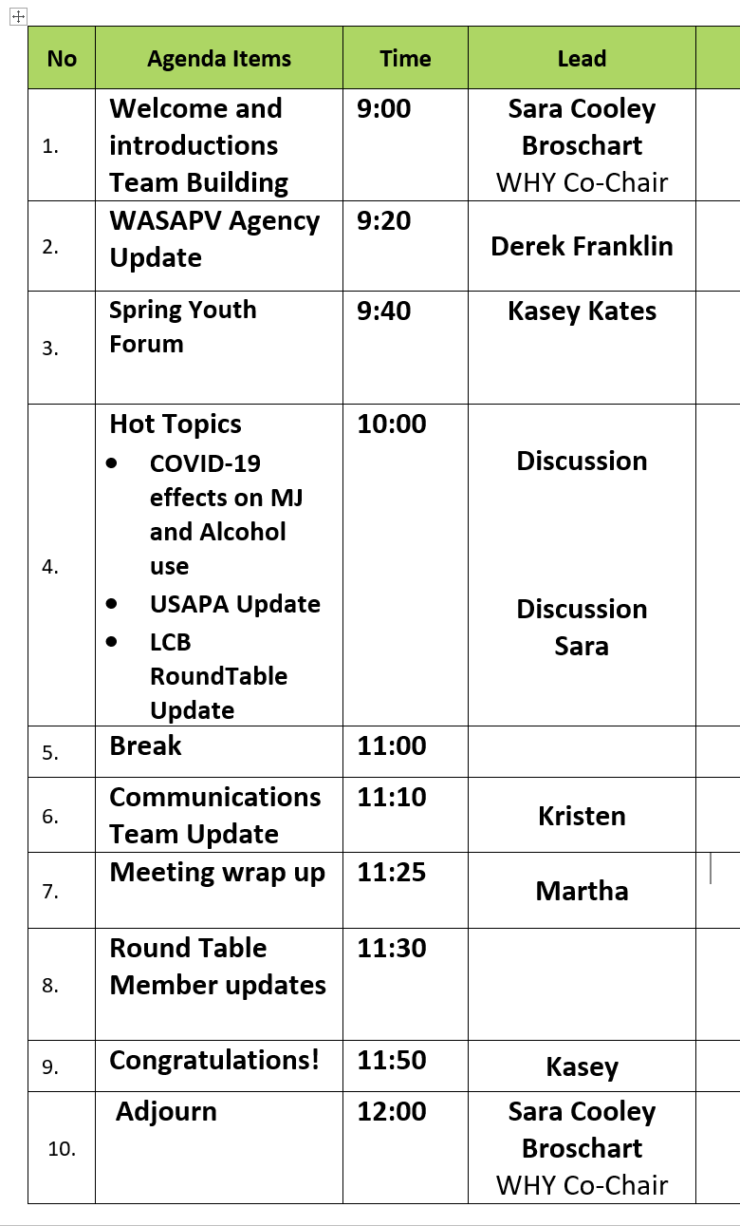
Today’s agenda

Slide 3
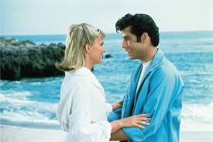
Favorite summer spot in PNW?
Okay. We can include Idaho and Montana too.

Slide 4
Agency Update: Washington Association for Substance Abuse and Violence Prevention (WASAVP)
WHY Coalition
6/19/20

Slide 5
Board of Directors
Priscilla Lisicich, President , Founding Member
Lisa Stewart, Co-Vice President
Laura Hyde, Co-Vice President
Ramona Leber, Treasurer, Founding Member
Derek Franklin, Secretary
Steve Freng
Mike Graham-Squire
Marilee Hill-Anderson
Kim Nygard
Stacey Okland
Lisa Stewart
Linda Thompson, Founding Member
Danika Troupe
Liz Wilhelm

Slide 6
Mission
The mission of the Washington Association for Substance Abuse and Violence Prevention (WASAVP) is to unite prevention advocates in Washington State in order to create environments that support safe and healthy communities through prevention of substance abuse and violence.

Slide 7
Vision
Washington Association for Substance Abuse and Violence Prevention (WASAVP) is recognized as the lead voice for state and national advocacy and essential stakeholder in matters of substance abuse and violence prevention in Washington State.

Slide 8
2020 Legislative Priorities
Support funding for statewide and community level prevention efforts
Partner with government, law enforcement and key stakeholders
Recognize that state funding does not reach all communities and additional funding is needed.
1. Funding

Slide 9
2020 Legislative Priorities
A. Recognize commercial marijuana presents similar risks as “Big Tobacco”
Restore original I-502 funding for protective measures
Strengthen regulations and enforcement of marijuana advertising, including billboards
Strengthen regulation related to MJ edibles and prevent products that resemble regular food items, appeal to youth, and require plain packaging
Replace “recreational” with “adult use” in all MJ legislation and rules
B. Advocate for polices that support suicide and violence prevention
2. Safety
Measures

Slide 10
2020 Legislative Priorities
Advocate to prevention youth becoming addicted to vaping
Restrict advertising that appeals to under 21
Restrict flavors and additives that appeal to youth
Regulate and limit nicotine content
3. Restrict Youth Access to Vaping

Slide 11
2020 Legislative Priorities
4. Focus on Preventing Alcohol Normalization and Outlet Density
Limit expansion of alcohol availability
Prevent expansion of alcohol outlets

Slide 12
2020 Legislative Priorities
5. Monitor and Support Opiate Prevention Efforts
Prevent youth addiction to opiates
Support safe storage and disposal
Support limiting prescriptions to youth

Slide 13
Our Efforts
Education
Lobbying
Advocacy

Slide 14
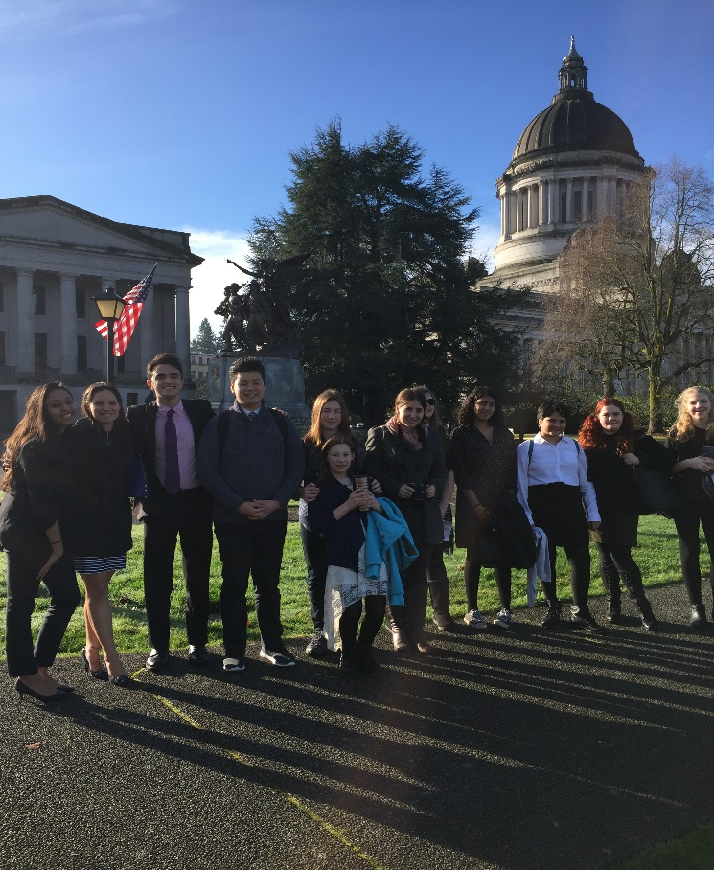
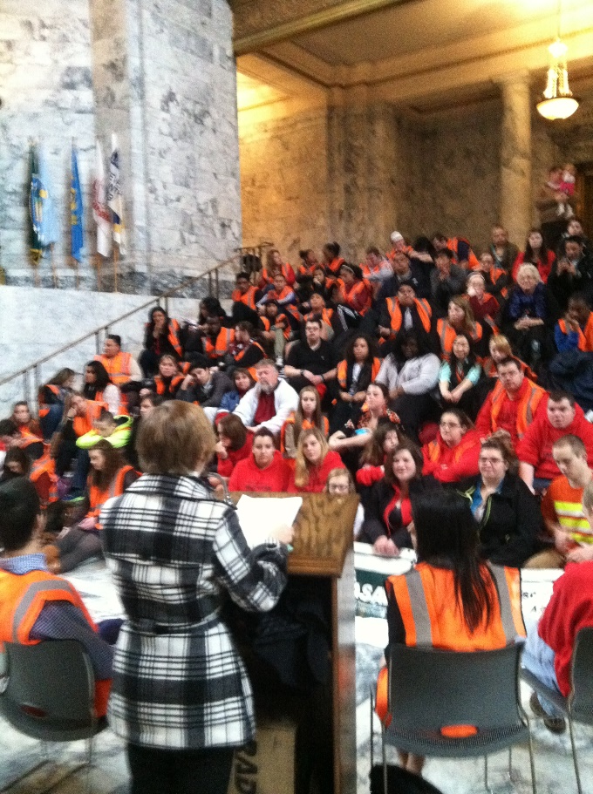
Events: Prevention Policy Day

Slide 15
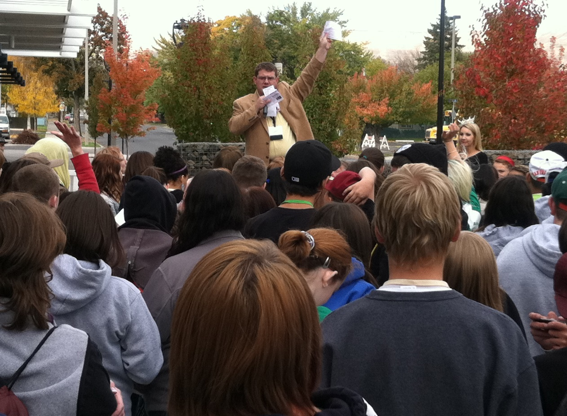
Events: Prevention Summit Meetings

Slide 16
2020 Legislative Efforts: Successes
Helpful Bills Enacted:
Impaired Driving, Preventing Suicide, Firearm Background Checks/ System Enhancement, DUI Vehicle Impound, Accessing SUD Treatment, SEL in Classrooms, Adolescent Behavioral Health Care, Drug Offender Sentencing, Law Enforcement Officer Mental Health
Problematic Bills Defeated:
Residential MJ, Limited Spirits Retail License, Liquor at Sports Facilities, Expanding MJ Businesses, Craft Cannabis Production, Special Permits to Sell Liquor/Wine/Beer/Cider

Slide 17
2020 Legislative Efforts: Successes
Alcohol and MJ Legislative “decision guides” to lawmakers:

Slide 18
Membership Organization
Board Members Across the State
WWW.WASAVP.ORG
Thank you WHY Coalition and Prevention Partners

Slide 19
All virtual this year
http://springyouthforum.org/virtual-program/

Slide 20
Hot topics
US Alcohol Policy Alliance Interactive Dialogue and action (Sara)
Covid19 and effects on marijuana and alcohol use (Discussion)
LCB Roundtable update (Sara)

Slide 21
https://www.alcoholpolicy.org/events-1

Slide 22
Hot topics
US Alcohol Policy Alliance Interactive Dialogue and action (Sara)
Covid19 and effects on marijuana and alcohol use (Discussion)
LCB Roundtable update (Sara)

Slide 23
Let’s talk: Covid19 effects on alcohol and marijuana use and prevention programming
Roundtable updates
Any bright spots?
What kind of additional action is necessary?
Next steps for WHY?
Convening this Tuesday at noon → who is in??

Slide 24
Hot topics
US Alcohol Policy Alliance Interactive Dialogue and action (Sara)
Covid19 and effects on marijuana and alcohol use (Discussion)
LCB Roundtable update (Sara)

Slide 25
LCB updates
LCB-Prevention Virtual
Roundtable
Rulemaking open on
True party of interest
Voluntary compliance
Quality assurance
See more at: https://lcb.wa.gov/laws/get_notifications/archive

Slide 26
Communications Team update

Slide 27
Today’s agenda

Slide 28
Congratulations Sara on this wonderful and fun new adventure <3!!! I am so happy for you and your family and look forward to future pictures! With love, Sazi
Woohoo! Congratulations to you and your family, Sara! ☺ Fallon Baraga
Sara, congratulations on your new bundle of joy. Best wishes for a lifetime of happiness for you and your growing family. ~Sandy
Sara – so happy for you. I hope you have tons of fun with your new addition!
-Sarah
Congrats on this exciting new chapter!
-Grace Wilkowski
Sara,
Congratulation on the new addition!
Send pictures for me to share!
~Martha
Sara, congrats! Cannot wait until your little one arrives! Excited for you and your husband on this new journey. You will be missed! Stay in touch ☺
-Kasey
Sara ~ Congratulations on this exciting new adventure! Sending you all our best! – Alicia
Hey Sara! I am so excited for you and the family! Babies are just the best, and are great reminders of what we’re all working toward. All the best, Isaac.
Congratulations, Sara! Wishing you and your growing family all the health and happiness in the world 😊 Jason Kilmer
Congratulations Sara! I’m so excited for you!
Emily
Sara,
Congrats! Wishing you and your family all the best. I can’t wait for the stories☺ Angie
Sara,
I am so excited for you and your family. Your kindness, generosity, humor and patience are going to make you the best mama! Sending love and joy as you enter this new chapter!
--Kristen (and Melanie!) Haley
Sara - So excited for you! Sending you hugs and best wishes for your new addition. -Julee Christianson
Congrats! Exciting times ahead!
- Ray H 
Congratulations!!! Can’t wait to meet your little one!
Congratulations Sara!
Thank you for meeting with me and sharing your story and being a kind soul! I appreciate you and I know you will be a great mother!
Best wishes,
~Krista Timm
Sara-
Your friends at Washington Traffic Safety Commission are excited for this beautiful addition to your family. Congratulations!
Sara, congrats to a new addition to your family! Sending you well wishes through this new chapter! –Kersten Tano
Congrats Sara! You have been an inspiration to me and you are going to be such a caring and loving mother.
-Samantha Pangelinan
Congrats Sara! That baby is so lucky to have you as a mom! ☺ ~ Sophia Hilsen
Congratulations on this new chapter for your family! ~ Alicia Hughes

Slide 30
Next WHY Coalition meeting is August 21

