Slide 1
Needs Assessment 101 - the basics
Webinar #2 in training series
Presented by Julia Havens & Scott Waller,
Division of Behavioral Health and Recovery
February 23, 2015
2:00 p.m. – 3:30 p.m.

Slide 2
Training Objectives
Participants will:
Be able to explain why needs assessments are important.
Understand common sources of data.
Understand the sequence for conducting a needs assessment.
Understand the considerations for organizing a data workgroup.

Slide 3
Community Prevention & Wellness
Initiative (CPWI) Process Model
Notes:
The PRI is generally following the Strategic Prevention Framework (SPF) as the overall planning framework for this process. Based on our learning from the Strategic Prevention Framework State Incentive Grant (SPF-SIG) process, for the purposes of PRI, we have added a “Getting Started” section and have included “Capacity” as an ongoing step throughout the process. It is expected that all tasks associated with PRI will be conducted in a culturally competent and sustainable manner. This is not expected to be linear process.

Slide 4
Definition of Assessment
A community assessment is a sequence of activities in which community members with varying skills and interests use data to determine the severity of problems in their community and the factors or conditions that either make the problems worse or better.

Slide 5
…in other words
…assessment is a process for reviewing and prioritizing community information to determine the best way to move forward with prevention efforts.

Slide 6
Why are needs assessments important?

Slide 7
What does assessment do for us?
Creates community-specific profiles
Develops a focus for prevention planning
Mobilizes the community
Addresses misconceptions
Establishes baselines and expected outcomes for prevention planning process
Helps select effective prevention programs
Evaluates progress
Supports fund development
Notes:
The community assessment process offers an objective method for prioritizing intervening variables for attention and identifying your community's strengths on which to build. It helps you create a "customized" picture of how youth problem behaviors and intervening variables appear in your community, and how your community compares with other communities .
•. Using this data to identify your community's priorities and strengths is key to developing a focus for prevention planning in your community.
•. The data can be used to build public awareness about the extent of youth problem behaviors and the levels of risk and protection that exist in the community, helping to mobilize your community to action.
Youth problem behavior data can be used to counteract misconceptions caused by media attention to certain high-profile events involving youth. For example, consider methamphetamine use. The incredible negative consequences of methamphetamine use dominated the news for several years. Now, many people start a conversation about substance abuse by wanting to talk about methamphetamine. But methamphetamine use is down in Washington State and alcohol use – for youth and adults – remains the number one cause of substance-related problems.
The initial community assessment data provides a baseline that can be used to develop expected outcomes of your community's prevention efforts, and to track your progress
toward those outcomes.
Your community will use the assessment data, the expected outcomes and the results of the community resources and gaps analysis to identify tested, effective prevention programs to address your community's unique profile.
We recommend repeating the community assessment process every two years. This way, you can reassess your priorities, track your progress against the baseline data and make any necessary adjustments in your prevention plan.
Grant-makers want solid data that demonstrates the need for funding, and they want to see measurable outcomes of the programs they fund. The community assessment data can help you "make your case" to grant-makers and report your community's progress with solid data.

Slide 8
Prevention planning foundation
Substance abuse prevention planning is most effective when based on:
  Reliable information about substance abuse and its consequences;
  Reliable data and/or information about those factors that place youth at higher risk, and, protect/buffer youth from those risks…

Slide 9
Why does this matter?
We know that youth involvement with alcohol negatively impacts standardized test scores and grades.
Early use of alcohol and cigarettes = lower standardized test scores
More disruptive/aggressive behavior = lower standardized test scores
More alcohol and drug use = less likelihood of passing standardized tests
Higher bonding to school = higher standardized test scores and better grades
Better social skills = higher standardized test scores and better grades

Slide 10
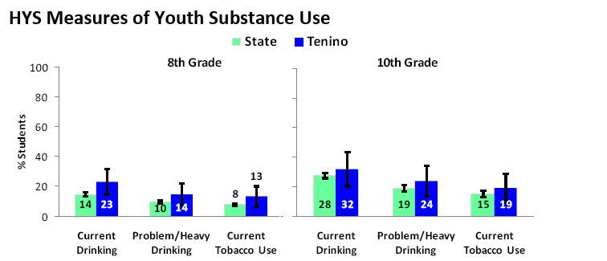
Why does this matter?
Looking at needs assessment data lets you know how serious your problem is. Beyond that, it lets you know – over time – if you’re making any progress.
The information below shows that Tenino 8th graders reported more alcohol use than the state in 2012. Given the information from the previous slide, what would you expect would happen to standardized test scores? So what is one of the arguments for schools being involved in substance abuse prevention in Tenino?
Notes:
You can choose to either insert your own slide here so that it shows a comparison between the state and your community. Or you can use this as a sample to explain the concept from and then have your data work group members “apply” the learning to their examination of your community data in the Data Book.

Slide 11
Risk/Protective factors most strongly associated with alcohol use
Parental attitudes favorable towards drug use.
Early initiation of drugs.
Intentions to use drugs.
Friends’ use of drugs.
Social skills (Protective factor).
Data on all of the risk and protective factors are available at the end of the data book.

Slide 12
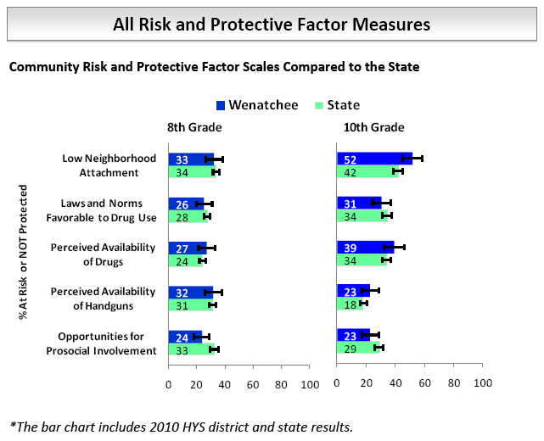
Risk and Protective Factors
Notes:
You can choose to either insert your own slide here so that it shows a comparison between the state and your community. Or you can use this as a sample to explain the concept from and then have your data work group members “apply” the learning to their examination of your community data in the Data Book.

Slide 13
Sources of data

Slide 14
Sources of data we use
Social Indicator data
Healthy Youth Survey
Local data
Data Assessment
Notes:
Washington State Healthy Students Survey (HYS)
Social indicator data (aka “indicator data” or “agency data”)
Local Data

Slide 15
Needs Assessment
Long-Term Consequences
Behavioral Health Problems
(Consumption)
Intervening Variables
(Risk/Protective Factors)
Local Conditions and Contributing Factors
Strategies &
Local Implementation
Evaluation Plan
(10-15 years)
(5-10 years)
Outcomes
(2-5 years)
(6 months – 2 years)
Action
What is the problem?
Why?
Why here?
But why here?
What are we doing about it?
So what? How will we know?
…with these common factors…
…specifically in our community…
…can be addressed thru these strategies…
…and we will use these tools to measure our impact…
These types of problems…
Any Underage Drinking
Underage
Problem and Heavy Drinking
[Add Yours Here]
Community Disorganization/ Community Connectedness
[Add Yours Here]
Community engagement/Coalition development:
[Coalition Name]
[Add Yours Here]
These problems…
School Performance
Youth Delinquency
Mental Health
[Add Yours Here]
Community engagement/Coalition development:
Annual Coalition Survey
Sustainability Documentation
Alcohol Availability: Retail or Social Access
Promotion of Alcohol
Alcohol Laws: Enforcement; Penalties; Regulations
[Add Yours Here]
[Add Yours Here]
Public Awareness:
[Add Yours Here]
Public Awareness:
Process measures Community Survey
Environmental Strategies:
[Add Yours Here]
Low Commitment to School
Favorable Attitudes/Perception of Harm
Friends Who Use
[Based on assessment]
Environmental Strategies:
Process measures Community Survey; HYS
[Add Yours Here]
School-based Prevention/ Intervention Services:
Student Assistance Program
Prevention/ Intervention Services: pre/post
[Add Yours Here]
Risk & Protective Factors:
[Add Yours Here]
Direct Services:
[Add Yours Here]
Direct Services: Assigned Program pre/post and process measures; HYS
State Assessment
Local Assessment
Plan/Implementation
Reporting/Eval
Notes:
Instructions:
All boxes in the middle of the diagram above are currently set to wrap the text left to right but not auto resize to fit your text. You will need to adjust the size of the box to match your text. To do this just click on the box and drag the corners to the size you would like.
To change the formatting of the text boxes right click on the box and then make your selections.
If you would like to move multiple boxes you can select multiple items by holding down the ‘control key’. You will notice a small ‘+’ next to the items you want to ‘add to your selection”. Just click each item while holding down the control (ctrl) key.
If you need additional assistance with formatting your logic model, please contact PRItraining@dshs.wa.gov.

Slide 16
Types of data used assessing communities
Quantitative Data – are expressed in numerical terms, counted, or compared on a scale. These data help to answer the question “how many” and can give your coalition perspective about the breadth of an issue, e.g., how many people are affected.

Slide 17
Types of data used assessing communities
Qualitative Data – are non-numerical data rich in detail and description.
Usually presented in narrative form.
  such as information from focus groups,
  key informant interviews, and/or
  observational data collection.
Can help address the question,
“What does it mean?”

Slide 18
Sources of Quantitative Data
Social indicator or archival data, such as Administrative reports (e.g., hospital emergency room admissions or law enforcement records of DUI arrests).
Healthy Youth Survey
Notes:
Social indicator data are, generally, information that indicates the presence of a risk factor. They are not measuring the risk factor itself. It’s sort of like this - When you have a cold, you would recognize symptoms like a runny nose or achy feel. You add all the symptoms together and diagnose yourself with a cold. That’s the way it is with social indicators data. Certain indicators act like symptoms of the risk factor. If the indicators are elevated, the risk factor is present to a greater degree.
Some local information – like hospital emergency room data or even local law enforcement agency data – may not be available through statewide data bases. But they usually keep records of cases that could be helpful. Through this needs assessment process, we’ll be identifying if we need any local information to supplement the information we have from Healthy Youth Survey and archival data sources.

Slide 19
Sources of data
Healthy Youth Survey
Most recently last administered fall 2014
Risk Factor Indicator | Think back over the last 2 weeks. How many times have you had five or more drinks in a row? (A drink is a glass of wine, a bottle of beer, a shot glass of liquor, or a mixed drink.)
Protective Factor Indicator | There are people in my neighborhood who are proud of me when I do something well.
Problem Behavior Indicator | During the past 30 days, how many times did you ride in a car or other vehicle driven by someone who had been drinking alcohol?
Notes:
More than 211,000 students across Washington State participated in the fall 2010 Healthy Youth Survey. The survey has been administered since 1996 and gives our state and communities some of the richest data available in the country. (You may want to add local data here.)
Questions are not just put on the survey willy-nilly. They are scientifically validated to make sure that they will be effective in gathering the desired information. There are different lengths of surveys for 6th graders than for 8th, 10th, and 12th graders.
The survey contains questions about substance abuse, but also about other youth problems such as bullying and obesity.
The survey has numerous features that ensure the confidentially of the respondent. But it also has numerous features that control for lying on the survey or for intentionally exaggerating involvement in problem behaviors.
If you want more information about the HYS you can find it on AskHYS.net or Athena Forum (www.TheAthenaForum.org).

Slide 20
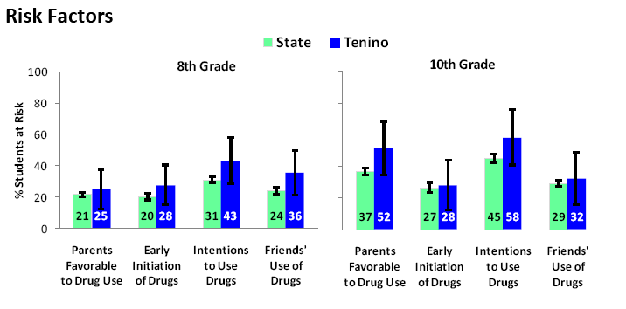
Healthy Youth Survey data

Slide 21
Healthy Youth Survey (HYS)
What is this information good for?
How does it help us with assessment?
Notes:
Facilitator notes – what you’re looking for.
What is this information good for?
Gives a heads-up about what youth think about different issues and gives a firsthand report about drug use trends from their perspective.
How does it held us with assessment?
Most communities think that the input of youth is one of the key factors in developing prioritizations.

Slide 22
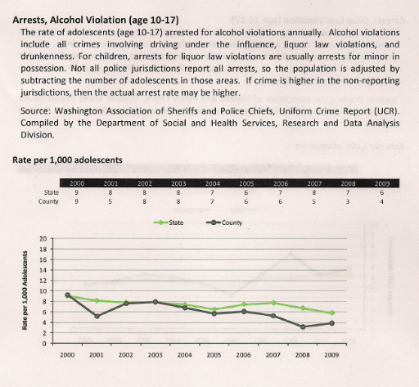
Social indicator data
State
Tenino
Rate per 1,000 – how often something happens in a given population size
What do you think this means?
Notes:
Click 1: Chart plus pages reference. This chart is about Alcohol Arrests for 10-17 year olds.
In addition to the archival indicators in the Data Book, there is more information available at – write on easel pad - http://www.dshs.wa.gov/rda/research/risk.shtm. This information is updated regularly and gives you the ability to look at county data, local data (population grouping of about 20,000) and school district data.
Click 2: Rate per 1,000 – this is a way of telling how often a given event happens in a specific population group. We use rates so we can compare information and show trends over time.
Click 3: State and Tenino plus lines
Click 4: What do you think this means?

Slide 23
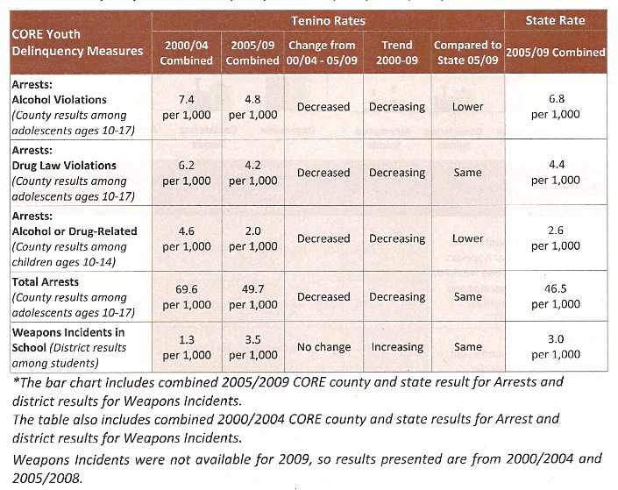
Social indicator data
This is another way of showing the information from the previous slide.
Trend information helps to understand what is going on in the community.
Notes:
Click 1: Trends are very important to look at. The Data Book contains a lot of trend information. In this chart, you can see that for this community there is just one indicator with an increasing trend. The others are decreasing or, apparently, getting better.
How would we use this information in the assessment process?

Slide 24
Social indicator data
What is this information good for?
How does it help us with assessment?
Is this data quantitative or qualitative data?

Slide 25
Local Data
Examples:
Hospital emergency room data
Interviews with key individuals in your community about their feelings about substance abuse.
Community Survey
  Why would this information be interesting to look at?
Notes:
Hospital emergency room data for alcohol or drug-related cases (not names, just numbers) -
Could help us understand how often alcohol and other drugs are involved in emergency room cases. This helps to paint a picture of the cost of alcohol and other drug incidents at the local level.
Interviews –
Sometimes in order to get more local assessment information from agencies, you will need to go directly to them with a request to provide you with the information that you want. The key to actually getting what you want is forming a relationship with the law enforcement agency or other organization ahead of time so the request for information comes from a “trusted” partner.

Slide 26
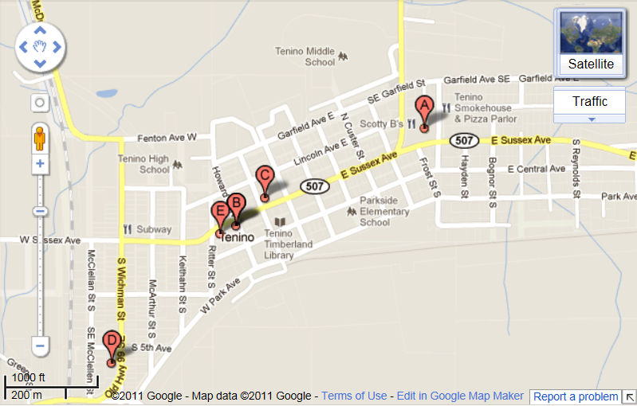
Example - Alcohol Outlets in Tenino, WA using Google Maps
Tenino Middle School
Tenino High School
Tenino High School
Parkside Elementary
Parkside Elementary
Notes:
How could this information be used for planning prevention efforts?

Slide 27
Types of data used assessing communities
Qualitative Data – are non-numerical data rich in detail and description.
Usually presented in narrative form.
  such as information from focus groups,
  key informant interviews, and/or observational data collection.
Can help address the question,
“What does it mean?”

Slide 28
Sources of Qualitative Data
Key informant interviews, such as an interview with the local police chief about local enforcement polices.
Focus groups
Community survey
Notes:
Social indicator data are, generally, information that indicates the presence of a risk factor. They are not measuring the risk factor itself. It’s sort of like this - When you have a cold, you would recognize symptoms like a runny nose or achy feel. You add all the symptoms together and diagnose yourself with a cold. That’s the way it is with social indicators data. Certain indicators act like symptoms of the risk factor. If the indicators are elevated, the risk factor is present to a greater degree.
Some local information – like hospital emergency room data or even local law enforcement agency data – may not be available through statewide data bases. But they usually keep records of cases that could be helpful. Through this needs assessment process, we’ll be identifying if we need any local information to supplement the information we have from Healthy Youth Survey and archival data sources.

Slide 29
Fundamentals for understanding data
Validity and reliability
Generalizability
Confidence intervals
Comparing state and local results
Comparing data over time
Notes:
Validity and reliability
Generalizability
Confidence intervals
Comparing state and local results
Comparing data over time
Talk about fundamental statistical issues.
You may be asked the question, “why are the results of this survey valid?” So we want to talk about validity and reliability, how to use the confidence intervals provided in your report. And give you some tips on comparing your data and generalizing it to a larger population.

Slide 30
Reliability
Reliability: Does the survey consistently produce the same results under the same conditions?
How we assure reliability:
  Standardized administration procedures
Notes:
Next we want to talk about data processing and quality control
To ensure the validity and the reliability of the data, HYS is implemented with standard administration and data cleaning procedures.
The purpose for covering this is so you can answer the question “How do you know we can believe these students?”
We want to create an environment in which students feel they can answer the survey honestly. A great deal of effort to make a safe and comfortable environment.
Reliability: A survey is reliable if it consistently produces the same results under the same conditions.
To facilitate this, we create standardized administration procedures.
Examples:
Student and parent notification: Per IRB requirements, parental notification is required at least two weeks before the survey administration and students and parents are allowed to opt out of the survey. The IRB takes this very seriously and we appreciate everyone’s work on this.
Safe and confidential environment
Consistent administration procedures : We train coordinators, who train teachers. They are given written instructions for implementing the survey.
Students informed of importance of survey
No student name or other identifying information

Slide 31
Validity
Validity: Does the item measure what it is intended to measure?
How we assure validity:
  Items from established instruments, validity checks
Notes:
A survey is valid if it accurately measures the concept it is intended to measure. To ensure the validity of the survey we use items from established instruments and using validity checks.
Examples:
Inconsistent answers
Evidence of faking high levels of substance use
Dishonesty
Wrong grade
To encourage honesty, we inform the students about the importance of the survey.
To ensure their anonymity, there is no place on the survey forms for students names or anything that can identify them. Students place their own survey in an envelope instead of passing it in.
Once we get the data we have to do some cleaning
One thing we do is look for inconsistent answers. Like if they say they have never drank alcohol in their life, but they drank a lot in the past 30 days. We allow for a little of this, but if they have multiple inconsistencies, then we throw out their survey.
We also ask them about how honest they were in their answers, and if they say they were not honest at all, we pull the survey.
We also pull out students not in the target grade
Pretty consistently we lose about 4% in the data cleaning process.
Taking these surveys out makes a small difference in the total results, but if you look at the pulled surveys, they look really different than the average. So it makes sense to pull them
These types of procedures are also used for national surveys like MTF, that have done a lot of field work to determine if kids are answering honestly.

Slide 32
Generalizability
What is generalizability?
Why 70% participation is important
Challenges to generalizability
  School level
  ESD, County, or District level
How do these challenges affect data interpretation?
Notes:
Generalizability is the extent to which survey results can be applied to a population larger than that surveyed.
So generally we are looking to generalize our results of the state sample to the public school students in the whole state, from the county sample to the whole county, from those who participated at the district level or building level to the district or the building.
For example at the state level we surveyed 8,800 public school 6th graders, but we want to generalize to all public-school 6th graders in the state. Likewise in your school, some students participated, but not all participated.
Frequently we are asked why good participation is important and where does 70% come from.
Let’s think about the effects of participation.
If I have 100% I feel pretty good about saying that my results are what my students say.
If I have 90%, am I still comfortable saying that they represent the other 10%
I’m probably still feeling good with 70%.
But when I start getting down to only half of my students participation, I start feeling less comfortable that that half represents the other half.
So by convention we pick the 70%
This is why recruitment and participation are so important. You want to have a large enough number of kids so you can feel comfortable generalizing the results to your whole population
What is important, is the standardized administration.
What happens if a school administers the survey on a day when the entire football team is away on a field trip? How might that affect your results?
Think about things that might have happened in your school or district when you are interpreting your data. It’s also a good reminder to think about making sure that your administration is done in a way that these situations don’t occur

Slide 33
Do I have to generalize?
Yes, if you want to apply the results to a larger population.
  8th graders in our district said….
Yes, if you want to compare to others or results over time
No, if you want to just describe the students surveyed, in that moment, without confidence intervals:
  Students at our school who took the survey said….
Notes:
So what if you don’t want to generalize?
What if you have 20 students and 18 of them took the survey.
Our 18 students said this. It’s pretty much everybody. So it’s always fair to talk about your results this way.

Slide 34
Using contributing factors to localize the assessment
There is another step beyond identifying the data-based priorities.
We also need to understand “why” these problems exist in our community.
You will likely use qualitative data sources to determine this.

Slide 35
Needs Assessment
Long-Term Consequences
Behavioral Health Problems
(Consumption)
Intervening Variables
(Risk/Protective Factors)
Local Conditions and Contributing Factors
Strategies &
Local Implementation
Evaluation Plan
(10-15 years)
(5-10 years)
Outcomes
(2-5 years)
(6 months – 2 years)
Action
What is the problem?
Why?
Why here?
But why here?
What are we doing about it?
So what? How will we know?
…with these common factors…
…specifically in our community…
…can be addressed thru these strategies…
…and we will use these tools to measure our impact…
These types of problems…
Any Underage Drinking
Underage
Problem and Heavy Drinking
[Add Yours Here]
Community Disorganization/ Community Connectedness
[Add Yours Here]
Community engagement/Coalition development:
[Coalition Name]
[Add Yours Here]
These problems…
School Performance
Youth Delinquency
Mental Health
[Add Yours Here]
Community engagement/Coalition development:
Annual Coalition Survey
Sustainability Documentation
Alcohol Availability: Retail or Social Access
Promotion of Alcohol
Alcohol Laws: Enforcement; Penalties; Regulations
[Add Yours Here]
[Add Yours Here]
Public Awareness:
[Add Yours Here]
Public Awareness:
Process measures Community Survey
Environmental Strategies:
[Add Yours Here]
Low Commitment to School
Favorable Attitudes/Perception of Harm
Friends Who Use
[Based on assessment]
Environmental Strategies:
Process measures Community Survey; HYS
[Add Yours Here]
School-based Prevention/ Intervention Services:
Student Assistance Program
Prevention/ Intervention Services: pre/post
[Add Yours Here]
Risk & Protective Factors:
[Add Yours Here]
Direct Services:
[Add Yours Here]
Direct Services: Assigned Program pre/post and process measures; HYS
State Assessment
Local Assessment
Plan/Implementation
Reporting/Eval
Notes:
Instructions:
All boxes in the middle of the diagram above are currently set to wrap the text left to right but not auto resize to fit your text. You will need to adjust the size of the box to match your text. To do this just click on the box and drag the corners to the size you would like.
To change the formatting of the text boxes right click on the box and then make your selections.
If you would like to move multiple boxes you can select multiple items by holding down the ‘control key’. You will notice a small ‘+’ next to the items you want to ‘add to your selection”. Just click each item while holding down the control (ctrl) key.
If you need additional assistance with formatting your logic model, please contact PRItraining@dshs.wa.gov.

Slide 36
Using contributing factors to localize the assessment
Research shows if we can change perceptions about a problem, the problem itself is oftentimes reduced.
Here’s an example.
  It’s a commonly held belief in some communities that law enforcement does not enforce underage drinking laws.

Slide 37
Using contributing factors to localize the assessment
  When strategies encourage enforcement of laws and that enforcement is widely publicized, the perception changes.
  In that case, it is more likely that parents will communicate the likelihood of getting caught to their teenage children.

Slide 38
Using contributing factors to localize the assessment
  But there may be a lot of reasons why the community perceives enforcement is not occurring.
  Here are just a few of the local factors that other communities have identified that influence enforcement decisions:
  budget cuts
  other community priorities
  perceived lack of community support
  no facilities to deal appropriately with arrested juveniles
Notes:
A different strategy is needed to address each of those issues.
So it’s as important to understand the reason a problem exists as much as what the problem is.
That way, we increase our chances of choosing the correct strategies to address our community problems.

Slide 39
Using contributing factors to localize the assessment
Why? …..
….Why here?
(And don’t expect 100% agreement!)
Notes:
We will use a very active facilitation process called All on the Wall. On the table in front of you are pieces of paper and pens. What we will do first is select one of the priorities .
You will briefly write why you think the problem exists. Write as many responses as needed. I will then collect those responses, one at a time and post them on the wall. We’ll want to eliminate duplicates.
Then we’ll ask “Why here?” – why does this problem exist here? What increased our vulnerability? What were we not doing that we should have been doing? I’ll collect those responses. Then we’ll compare the two lists and see if there are any duplicates between them. We’ll eliminate those.
Suddenly, we will have our explanation – tonight – for why the problem exists here. We want to confirm your perceptions are shared by the community. Generally, that is does with a community survey. That survey will also be how we demonstrate change in our community.
This process almost always shows the diversity of opinions held by members of a coalition. People’s opinions are shaped based on their own experiences and observations. So the point of this exercise is not to get 100-percent agreement on one or two explanations. Instead, this exercise is designed specifically to collect as many different explanations as possible. Then, with a combination of information from a community survey and coalition discussion, the coalition can select prevention programs and strategies that will lead to measurable community change.
Understand how this will work? Which priority do you want to start with?

Slide 40
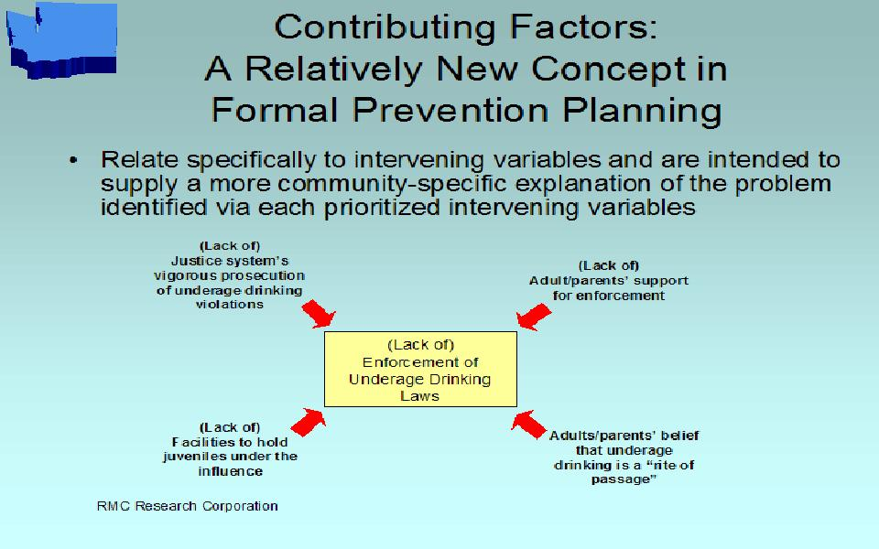
Using contributing factors to localize the assessment

Slide 41
Needs Assessment Process

Slide 42
Needs assessment process
Coalition receives overview of needs assessment
Coalition forms data work group
Data work group reviews Data Book, including Healthy Youth Survey and social indicator data, and local data as needed
Notes:
This training will support some key steps in coalition and data work group development that will result in completion of a substance abuse prevention needs assessment.
Coalition receives overview of needs assessment (that’s what we’re doing today)
Coalition forms data work group (we’ll be doing this in a few minutes)
The data work group will review the Data Book, with community-specific information including Healthy Youth Survey and social indicator data, and they will also collect local data as needed

Slide 43
Needs assessment process (Continued)
Data work group recommends intervening variables to be prioritized by community coalition
Coalition acts on data work group recommendations
Coalition identifies local contributing factors that apply to prioritized intervening variables
Notes:
Data work group recommends intervening variables to be prioritized by community coalition and these will form the foundation of prevention programming and evaluation decisions
Coalition acts on data work group recommendations
Coalition identifies local contributing factors that apply to prioritized intervening variables

Slide 44
Data Work Groups

Slide 45
Needs assessment process
Coalition
overview
Form data work group
Work groups reviews all data, including information in the data book
Data work group makes recommendations to coalition
Coalition reviews and acts on data work group recommendations
Coalition identifies local contributing factors that apply to prioritized intervening variables
Data Book
Notes:
Note to facilitator: You can use either the wording S17 and S18 or the graphic S16.
Coalition receives overview of needs assessment
Coalition forms data work group
Data work group reviews Data Book, including Healthy Youth Survey and social indicator data, and local data as needed (we are here)
Data work group recommends intervening variables to be prioritized by community coalition (and we are here)
Coalition acts on data work group recommendations
Coalition identifies local contributing factors that apply to prioritized intervening variables

Slide 46
Considerations for a data workgroup
Identify and engage local stakeholders.
Identify members that have specific experience or skills.
Include at least one team member that has an understanding of data and an ability to explain it to the larger team.
Notes:
This group will review Healthy Youth Survey data, social indicator data, and applicable local data like hospital or law enforcement information.
Ultimately, they will recommend to the coalition the prioritization of some of the intervening variables. These prioritized intervening variables will help the coalition select community-focused prevention efforts.
The data work group will then present its recommendations at a coalition meeting. The coalition will discuss the recommendations and act on them. The coalition can add to, or subtract from, the list of recommendations based on its discussions.
Finally, the coalition will identify factors that may explain why the prioritized intervening variable exists in the community.
The next step will be to identify what resources already exist in the community to address the selected priorities. Finally, the coalition will identify gaps that exist between needs (priorities) and resources and will select prevention programs, policies and practices to address those gaps.

Slide 47
Considerations for a data workgroup
Recruit members with experience conducting a community need assessments.
Begin the recruitment process with an existing coalition or advisory board if applicable.
Notes:
If possible, you should recruit one or two people who are comfortable with data to participate on the data work group in advance of the coalition meeting happens. These could be health department epidemiologists or high school or middle school math teachers. To do this, just call them on the telephone, tell them that the coalition is required to review data as part of a needs assessment process and that you would like their help for six to 10 hours over the next two months.
It is not essential that these early recruits are already members of the coalition, but it is helpful. You do want to have at least one member of the coalition agree in advance to be on the data work group. Remember not everyone on the group needs to be trained in data analysis.
When you reach the part of this module, you will be asking for volunteers from the coalition to serve on a data work group for the next two months.
You will want five to seven people total on this work group. If you have done your pre-recruiting correctly, the coalition member that you recruited raises his/her hand as a volunteer right away and other hands will go up as well.
Once the work group members are identified, tell them that within the next few days you will schedule the first meeting of the work group.

Slide 48
The coalition at work
The data work group schedules meetings to
  review the data for our community.
  identify priorities to recommend to the coalition.
  decide how to present recommended priorities to the full coalition.

Slide 49
Report from Data Work Group
Our prioritization criteria were:
  A.
  B.
  C.
Insert presentation by data work group here

Slide 50
Report from Data Work Group
We looked closely at the Consumption, Consequences, and Intervening Variables document using both Healthy Youth Survey and social indicator data found in the Data Book
Insert presentation by data work group here

Slide 51
Report from Data Work Group
Based on our review and application of our prioritization criteria, we recommend the coalition prioritize the following:
  A.
    Because…
  B.
    Because…
  C.
    Because…
Insert presentation by data work group here

Slide 52
Finalize Prioritization
Which of these recommendations do we want to adopt for our Coalition to focus our efforts?
Coalition follows its rules to consider approval of the recommendations by the data work group
Notes:
You're looking for something like limited resources to do a limited agenda…want to do the most good with what we have so we target our resources through an assessment process.

Slide 53
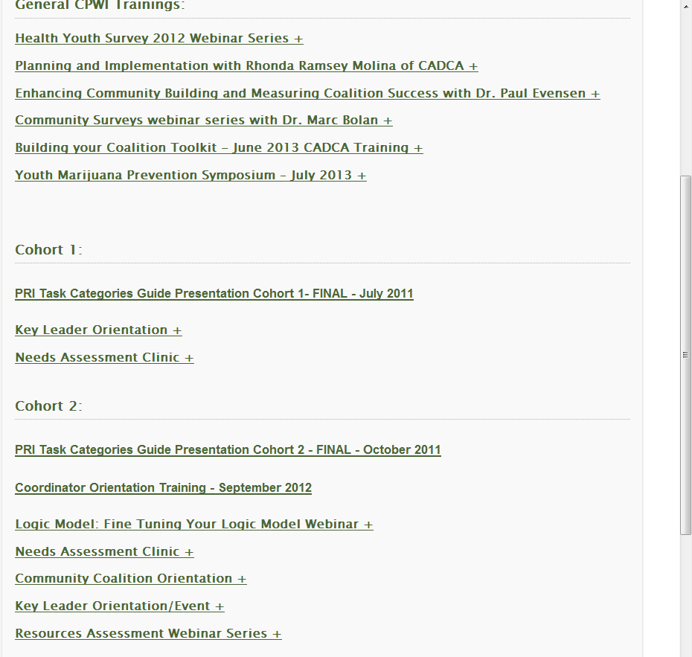
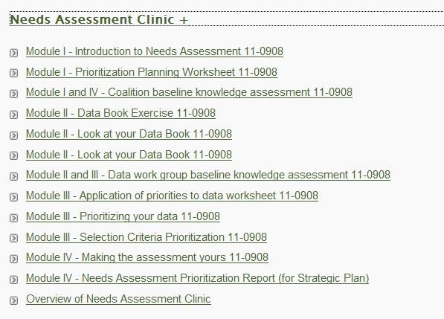
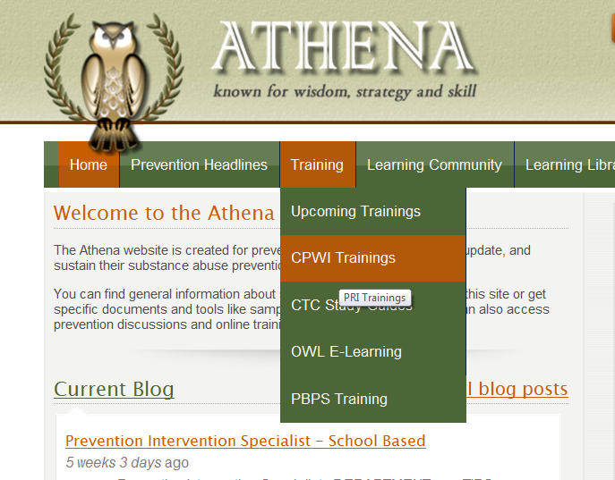
Resources
Athena Training Page www.theathenaforum.org/training/cpwi_trainings
  ➔ Ray will be doing an Athena tutorial at March CPWI meeting

Slide 54

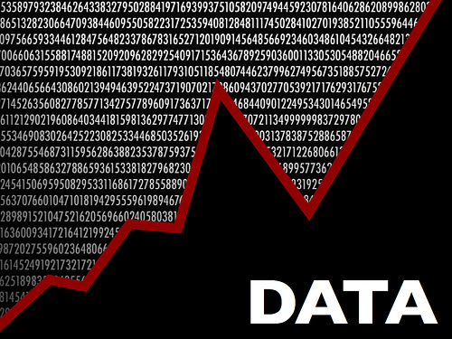
What questions do you have?

