Slide 1
Sustainability Planning
June 27, 2016
Jill Parker, CAPT Associate
SAMHSA’s Center for the Application of Prevention Technologies

Slide 2
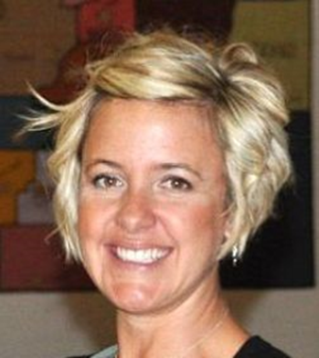
Facilitator
Jill is a CAPT Associate providing substance abuse prevention services for the CAPT’s Resource Teams in many states, Tribes, and Pacific Jurisdictions.
Jill Parker

Slide 3
This training was developed under the Substance Abuse and Mental Health Services Administration’s Center for the Application of Prevention Technologies task order. Reference #HHSS283201200024I/HHSS28342002T.
For training use only.

Slide 4
Agenda/Roadmap
Define Sustainability
Introduce the Keys to Sustainability
Identify tools throughout the Strategic Prevention Framework (SPF) that can help create a plan for sustainability
5 Core Components of Sustainability
Sustainability Planning Workbook
Interactive Panel

Slide 5
Objectives
Define sustainability
Illustrate ways of implementing the Keys to Sustainability into prevention work
Identify and discuss why sustainability is important throughout the SPF process
Introduce the 5 Core Components of Sustainability
Learn from communities who have been able to leverage resources to sustain positive outcomes

Slide 6

Parking Lot
Questions to be addressed later in the training
Questions to be addressed outside of the training

Slide 7

When I Think of Sustainability
…I think of…
Notes:
Have a conversation about what people think when they think of sustainability and write it In different colors on chart paper
Spend a lot of time on words they think about.

Slide 8
Sustainability Is….
…a community’s ongoing capacity and resolve to work together to establish, advance, and maintain effective strategies that continuously improve health and quality of life for all.¹
Notes:
Ultimately, sustainability is about maintaining positive outcomes in communities.
Suggested questions to ask participants to process slide content:
What words do we generally use to define sustainability?
What does it mean to be sustainable?
How does this definition (presented here on the slide) differ from other definitions?
What comes to mind when you hear the definition presented here?
Why do you think it’s important for a community to agree on a clear definition of sustainability?

Slide 9
SAMHSA’s Definition
“In the case of substance abuse prevention, that involves developing prevention systems that promote and support the delivery of effective prevention strategies in order to prevent and reduce substance use, misuse and abuse among whole populations. Ultimately, sustainability is about maintaining positive outcomes in these populations.” ²
Notes:
Definition according to SAMHSA’s Center for the Application of Prevention Technologies (2012). Planning for Sustainability.

Slide 10
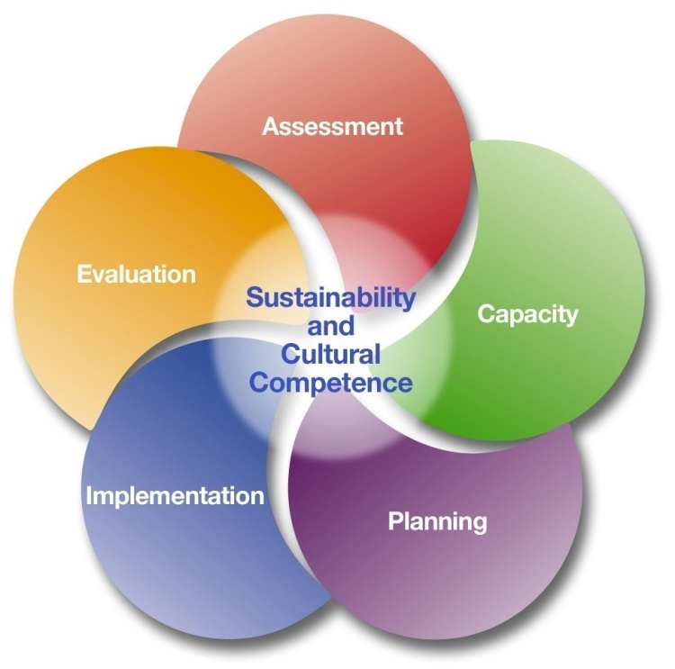
Sustainability is Central to the SPF

Slide 11

Keys to Sustainability
Community Support
Organizational Capacity
Effectiveness
Notes:
Who here has taken the SAPSTs? Remember the keys to sustainability, just to review, here they are again’

Slide 12
Strategic Prevention Framework
Notes:
consider where these keys come into play in the SPF process, in the first three steps…in Assessment, Capacity and Planning
So it’s very important to think about sustainability all through the SPF process, and no matter where you are, it’s never too late to begin!
The keys are the broader larger level ideas of sustainability. Usually these are integrated into the steps of the SPF so chances are, you are already doing these things without necessarily realizing their link to sustainability. Let’s talk a little about the particulars of what each of these mean and how you may already be doing them.

Slide 13
Key: Build Community Support
Encourage
Develop
Connect
Celebrate
Notes:
[In slideshow, the image will appear automatically when you come to the slide.]
Discuss ways to build community support, such as:³
Encourage community ownership (this relates to community readiness)
Develop community leaders and champions
Connect to other prevention efforts locally, regionally, and statewide
Celebrate accomplishments publicly in the media, in local newsletters, and through e-mail blasts
Ask participants for examples of ways that they have built community support for substance abuse prevention (or examples of ways that they have seen it built).

Slide 14
Key: Enhance Organizational Capacity
Enhance organizational capacity
Strong administrative support
Access to resources
Formal linkages
Notes:
Discuss ways to enhance organizational capacity, such as:⁴
Formal linkages (MOUs) with key partners
Access to resources and expertise (i.e., Who is good at what? Who has the skills, talents, or materials to assist you?)
Strong administrative structure that will allow you to be competitive for grants and other opportunities
Ask for other suggestions.
Have participants think about a group (e.g., a book group, a religious group) they have been a part of for awhile—have them pair up with someone and share why they have stayed in the group.

Slide 15
Key: Ensure Effectiveness
Interventions that are aligned
Interventions that are a good fit and evidence-based
High-quality implementation
Evaluation plan that provides ongoing data
Notes:
Point out that effectiveness is more than just using evidence-based interventions. Effectiveness depends on making sure the logic model lines up. For example:⁵
Interventions are aligned with the problem and risk factors, and have sufficient reach.
Evidence-based interventions are selected that are a good fit conceptually and practically.
Implementation is high quality, which involves buy-in from the community, administrative support, and adequate training for staff to do the intervention. (This will be discussed more in a little while.)
There is a plan for evaluation that will provide ongoing data to make improvements as needed. (This will be discussed more later on.)

Slide 16
Three Approaches to Sustainability
Partnerships and Collaborations
Norms and Guidelines
Financial
Notes:
This triangle represents three approaches to sustaining your prevention processes and outcomes. What is the first thing you notice?
Partnerships and collaborations provide the foundation and are the biggest part of the triangle; this is intentional.
Policy is second in terms of focus and central to effective sustainability.
Finally financial approaches are on top, and represent the capstone.
While very important, they will not be truly effective if they are not built upon the other two approaches….we will be looking at all three of these approaches as we go through the core components of sustainability planning…but let’s focus in for a moment on that foundation piece; partnerships and collaborations.

Slide 17

Parallel Tracks - Activity
Sustaining the SPF Process
Sustaining Positive Outcomes
Notes:
Activity – Label one side of the room process and the other outcome. Have participants line up in a line according to how comfortable they are with each. Use it to talk about the importance of having different people in the room for different needs.

Slide 18

Framing Outcomes for Sustainability
Link substance abuse prevention outcomes
to other related health outcomes and ultimately to overall community health and well-being.
Notes:
Remember in the SAPSTs we talked about broadening our focus to Behavioral Health and related community conditions…think about how your work connects beyond youth underage drinking prevention; consider the link to other issues including’ Violence, property values, pro social, etc.

Slide 19
Core Components of Sustainability
5. Implement sustainability actions
4. Develop communication and marketing products and strategies
1. Capture the current picture
2. Identify priorities to sustain outcomes
3. Complete a resource and feasibility analysis
Handout 1: Sustainability Planning Workbook
Notes:
Can emphasize and clarify that these are ‘actionable’ core components
Capture the current picture
Identify priorities to sustain prevention outcomes
Complete a resource analysis and identify feasible strategies
Develop communication and marketing products and strategies
Implement dissemination plan to funders, stakeholders and supporters
In this next section we are going to get into the details of planning for sustainability. As we talked about earlier, sustainability starts early on in the very first steps of the SPF. In order to be able to be successful in the planning for next steps, you already need to have set the groundwork with your relationship building, capacity building, and strong effective strategies. We will continue to talk about analyzing and strengthening that groundwork in the next section of this training. For that reason even your planning for next steps needs to start early. If there are gaps in relationship or new ones you need to form, you don’t want to do that a month before you lose funding or need to write a new grant.

Slide 20

#1 – Capture the current picture
What processes should you sustain?
What have you achieved?
What is pending/upcoming that you have left to do?
Do you have a clear, effective way to make decisions?
Handout 1: Sustainability Planning Workbook, Page 2
Notes:
Review everything; including structure, process, staffing, programs, and identify what is completed, what is not effective or not essential, and get down to the core of what really needs to stay in place to maintain and sustain positive outcomes.
Highlight the need for continual assessment of partners and collaborations, who is fully engaged, who needs to be at the table that isn’t currently, do partners and collaborators have clear roles and understand what they have agreed to, are agreements up to date and do they reflect what is really happening on the ground?

Slide 21
Why Review the SPF Process?
Show how the coalition’s work is effectively linked to your stated outcomes
Phase out components of work that are not effective or essential to achieving positive outcomes^{3,4}
Identify key partnerships and collaborations that need to be sustained
Notes:
Remember in the recent SAPSTs we talked about broadening our focus to Behavioral Health and related community conditions…think about how your work connects beyond youth underage drinking prevention; consider the link to other issues including’ Violence, property values, pro social, etc.
Review everything; including structure, process, staffing, programs, and identify what is completed, what is not effective or not essential, and get down to the core of what really needs to stay in place to maintain and sustain positive outcomes.

Slide 22
Strengthen Partnerships
Initiate and engage partners in contract negotiation
Develop a Memorandum of Understanding (MOU) or a Memorandum of Agreement (MOA) that outlines agreements between organizations
Craft and implement intergovernmental agreements (for example: data sharing)
Notes:
Resources from Chuck, consider where the examples provided and information might be accessed- handout, portal?

Slide 23

#2 – Identify Priorities to Sustain Outcomes
Identify evidence of strategy effectiveness (data)
Assess the level of community support
Document available and potential resources
Document the ongoing need for prevention efforts
Handout 1: Sustainability Planning Workbook, Page 3
Notes:
You may not be able to sustain it all. If we could only do one out of the 3 strategies which one would be most important. Go back to the logic model. If you had to chose because you have less resources...resources are going to tease . If we only have $5 and we had $50 where is that 4% going. Prioritization at a very concrete level. Linked into effectiveness (29)

Slide 24
Identify Evidence of Effectiveness
Problems: Underage Drinking
Risk and Protective Factors: Retail Access
Interventions: Compliance Checks
(Short-term)
Reduce the number of sales to minors
(Long-term)
Reduce underage current use
Changes in Risk and Protective Factors
Process
Data
Outcome
Data
Reported decrease in retail access
50% more retailers trained
Higher compliance rates
3% reduction in current use
Increased perception of harm
Notes:
Use the example on the slide of short- and long-term outcome for underage drinking with the risk factor of retail access. What data do you currently have to show you are on your way to reaching your outcomes; two good places to look are at changes in risk and protective factors (example; perception of risk has increased, # of merchants passing compliance checks is holding steady or increasing). These are the ‘mile markers’ on the road to reaching your long term goal of reducing current underage drinking.

Slide 25
Develop Criteria for Priorities
Impact (data!)
Community Support
Resource Potential
TO BE SUSTAINED!
Still a Need
Notes:
Impact- this is begun in the previous slide, you have shown evidence of the impact you are making. Other ways to measure impact are also important and include:
Increased community collaboration
Measurable improvement in community health
Improved health policy
Increased community capacity
Benefits justify the cost of doing the work.
Community Support
Community commitment
Community support
Key decision-makers support
Recognition- community members identify specific accomplishments/ activities with our work
Resource Potential
Filling a gap or niche in the community.
Currently leveraging additional resources
Potential to secure additional funding
Effective track record
Existing capacity to implement strategies
Still A Need
Long-term community goal (i.e. tobacco free by 2020).
There is still a community need
Discontinuing will have a negative impact
Value-relative to other problems in the community
Again highlight how partnerships and collaborations are key to identifying priorities to continue….do you have the right partners engaged effectively?
Activity: Count off into groups of 4. What do you have in place that would help you determine need, resources and community support? (brainstorm)

Slide 26

Target Sustainability Goals!
Now you will have:
An understanding of what needs to be sustained and why
An initial understanding of the sustainability potential of your priority strategies

Slide 27

#3 – Complete a Resource and Feasibility Analysis
What will it take to sustain prevention efforts?
For each sustainability goal, develop:
  Objectives (SMART)
  Requirements
  Costs (do not forget in-kind values!)
Handout 1: Sustainability Planning Workbook, Page 5
Notes:
This comes from : Center for Substance Abuse Treatment, Sustaining Grassroots Community-Based Programs: A Toolkit for Community- and Faith-Based Service Providers. HHS Publication No. (SMA) 08-4340. Rockville, MD: Substance Abuse and Mental Health Services Administration, U.S. Department of Health and Human Services, 2008.
Ask the audience if they know what SMART goal are? Are there differences in definitions? (Can write this out on chart paper)

Slide 28

Develop a Projected Budget
Your resource analysis will help you develop a projected budget that outlines what it will take to sustain your priorities.
Consider cash, in-kind, and
collaborative partnerships.

Slide 29
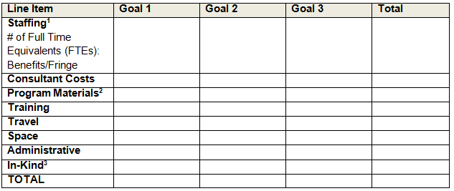
Sample Budget Worksheet
Projected Budget Form, Page 5 of Handout 1: Sustainability Workbook
Notes:
Take 5 minutes to think about what some of your goals may be. What are the obvious resources? What are some resources you aren’t sure about?

Slide 30

#3 – Feasibility Analysis
Feasibility for each community will depend on:
Available local resources
Local competition for funding
Community buy-in
Available partners
What else?
Photo Source: http://www.flickr.com/photos/paxson_woelber/5426373830/
Handout 1: Sustainability Planning Workbook, Page 8
Notes:
Metaphor of planning for a big hike-much like trying to reach your long term goals. In sustainability planning it’s important to think about what you need to get you the rest of the way up the mountain. What efforts must be continued to keep prevention efforts on track and moving in the right direction. What resources will you need to continue the hike? What supports do you have in place? Where do you need to engage new resources? Bottom line; what will it really take to reach your goal?

Slide 31
#4 – Develop a Communication Plan
Identify the different sectors, audiences, and/or partners that you want to engage and customize accordingly
Develop a one- to two-page case statement
Train coalition members in making “elevator speeches” about your successes
Utilize social media!
Handout 1: Sustainability Planning Workbook, Page 9

Slide 32

Know your Audience
Who has an interest in community prevention programs?
What is important to each specific audience?
Consider new partnerships, collaborations, and funding sources
Photo Source: http://www.flickr.com/photos/glenbledsoe/4858103965/
Notes:
Especially when you don’t have a lot of time or capacity, it’s important to prioritize your audience-
Not everyone needs to know everything.
When reaching out to community members it is essential we know what we want to say. That we can summarize our issues and needs. Sometimes this is referred to as an elevator speech. Elevator speeches are always carefully crafted toward the intended audience. For example what we would want an legislator to know may be different that what we would want a local grass roots community effort to know or a group of youth we would like to partner with.
Refer to Workbook

Slide 33

Create a Tweet - Activity
Take five minutes to create a 140-character tweet about your community effort. Include:
Who you are
What the focus is
Accomplishments
A goal
Partnerships @mentions
Notes:
Rather than have you create an elevator speech I would like you to think of this principle and create a tweet.
How many of you are familiar with twitter?
How many of you use Twitter?
These are 140 character messages intended to share information. If you had to communicate about your coalition and what you are sustaining, what would be the most important this you would want to say?
Share. What were the most difficult parts of doing this (e.g. thinking of what to write about, making it only 140 characters, having only 5 minutes to write it….)

Slide 34

Tweet
NUSAPT has reduced the number of youth who get alcohol from retailers by 40%. Community partners and programs made this happen. #reduceunderagedrinking @schooldistrict @lawenforcement @nusapt
https://www.iconfinder.com/icons/60859/blue_button_round_social_twitter_icon

Slide 35
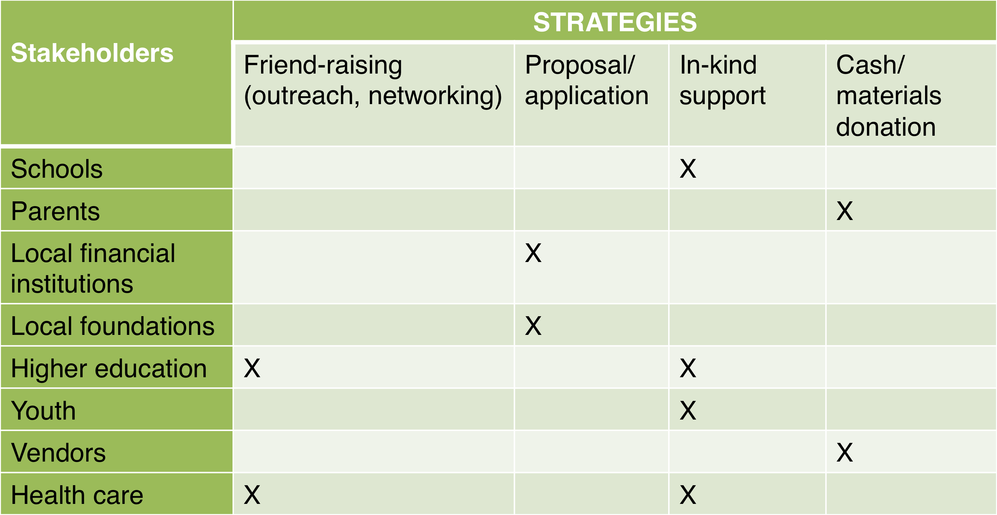
Plan the Approach
Notes:
Who needs to know and what can they do?

Slide 36
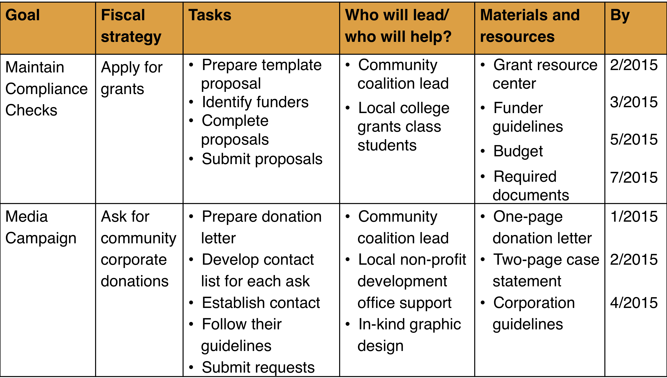
#5 – Implement Sustainability Actions
Notes:
Take some time to fill in the goals. What more will you need to know in order to decide if these are goals that are priorities? Who do you need to talk with? (go back to Component 2 activity from day 1) Are there goals that you can sustain without new grants?

Slide 37
5 Core Components of Sustainability
5. Implement sustainability actions
4. Develop communication and marketing products and strategies
1. Capture the current picture
2. Identify priorities to sustain outcomes
3. Complete a resource and feasibility analysis
Notes:
Can emphasize and clarify that these are ‘actionable’ core components
Capture the current picture
Identify priorities to sustain prevention outcomes
Complete a resource analysis and identify feasible strategies
Develop communication and marketing products and strategies
Implement dissemination plan to funders, stakeholders and supporters
What pieces struck you most about today? What is something new that you learned? What is something that is still circling around in your head

Slide 38

Questions?

Slide 39

Evaluation
Please take the time to complete a brief evaluation form.
Your feedback is appreciated!

Slide 40
CAPT Liaison for WA
If you have questions or comments, please don’t hesitate to contact:
Janet Porter, MPH
jporter@casat.org
(530) 249-1790

Slide 41
Citations
¹Center for Disease Control’s Health Communities Program. (2011). A sustainability planning guide for healthy communities.
²Center for Disease Control and Prevention’s Health Communities Program. (2011). A sustainability planning guide for healthy communities. Retrieved from http://www.cdc.gov/nccdphp/dch/programs/healthycommunitiesprogram/pdf/sustainability_guide.pdf
³Green, L., & Kreuter, M. (2005). Health program planning: an educational and ecological approach. (4th Edition). Boston: McGraw-Hill.
⁴Birckmayer, J., Holder, H., Yacoubian, G., & Friend, K. (2004). A general causal model to guide alcohol, tobacco, and illicit drug prevention: Assessing the research evidence. J. Drug Education, 34(2), 121-153.

