Slide 1
What’s Happening in Your Community?
A Community Needs Assessment Data Book
March 2015

Slide 2
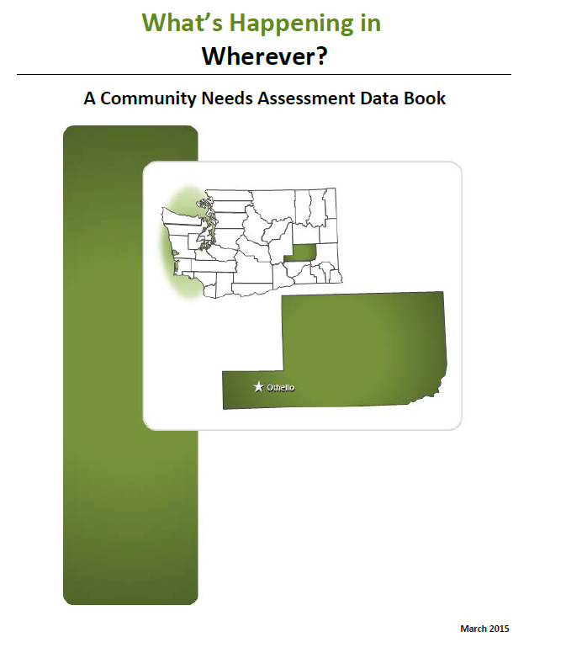

Slide 3
Have used the data book before?
A. Yes, I have used previous versions of the data book.
B. No, this is new to me.

Slide 4
Learning Objectives
Describe the contents of this data book and articulate how the data relate to the CPWI logic model.
Describe the two different templates of the data book.
Understand the types of data presented in the data book.
Understand the new data elements in the data book.
Apply data analysis skills to interpret tables and charts included in the data book.

Slide 5
Learning Objectives
√
Describe the contents of this data book and articulate how the data relate to the CPWI logic model.
Describe the two different templates of the data book.
Understand the types of data presented in the data book.
Understand the new data elements in the data book.
Apply data analysis skills to interpret tables and charts included in the data book.

Slide 6
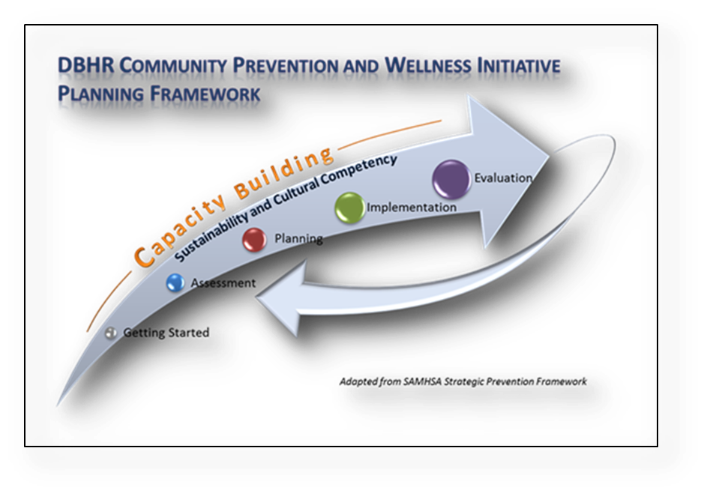
Purpose of the Data Book
The data book provides data for your needs assessment.
The data book is organized around the CPWI logic model.

Slide 7
[Name] Coalition Logic Model
Long-Term Consequences
Behavioral Health Problems
(Consumption)
Intervening Variables
(Risk/Protective Factors)
Local Conditions and Contributing Factors
Strategies &
Local Implementation
Evaluation Plan
(10-15 years)
(5-10 years)
Outcomes
(2-5 years)
(6 months – 2 years)
Action
What is the problem?
Why?
Why here?
But why here?
What are we doing about it?
So what? How will we know?
…with these common factors…
…specifically in our community…
…can be addressed thru these strategies…
…and we will use these tools to measure our impact…
These types of problems…
Any Underage Drinking
Underage
Problem and Heavy Drinking
[Add Yours Here]
Community Disorganization/ Community Connectedness
[Add Yours Here]
Community engagement/Coalition development:
[Coalition Name]
[Add Yours Here]
These problems…
School Performance
Youth Delinquency
Mental Health
[Add Yours Here]
Community engagement/Coalition development:
Annual Coalition Survey
Sustainability Documentation
Alcohol Availability: Retail or Social Access
Promotion of Alcohol
Alcohol Laws: Enforcement; Penalties; Regulations
[Add Yours Here]
[Add Yours Here]
Public Awareness:
[Add Yours Here]
Public Awareness:
Process measures Community Survey
Environmental Strategies:
[Add Yours Here]
Low Commitment to School
Favorable Attitudes/Perception of Harm
Friends Who Use
[Based on assessment]
Environmental Strategies:
Process measures Community Survey; HYS
[Add Yours Here]
School-based Prevention/ Intervention Services:
Student Assistance Program
Prevention/ Intervention Services: pre/post
[Add Yours Here]
Risk & Protective Factors:
[Add Yours Here]
Direct Services:
[Add Yours Here]
Direct Services: Assigned Program pre/post and process measures; HYS
State Assessment
Local Assessment
Plan/Implementation
Reporting/Eval

Slide 8
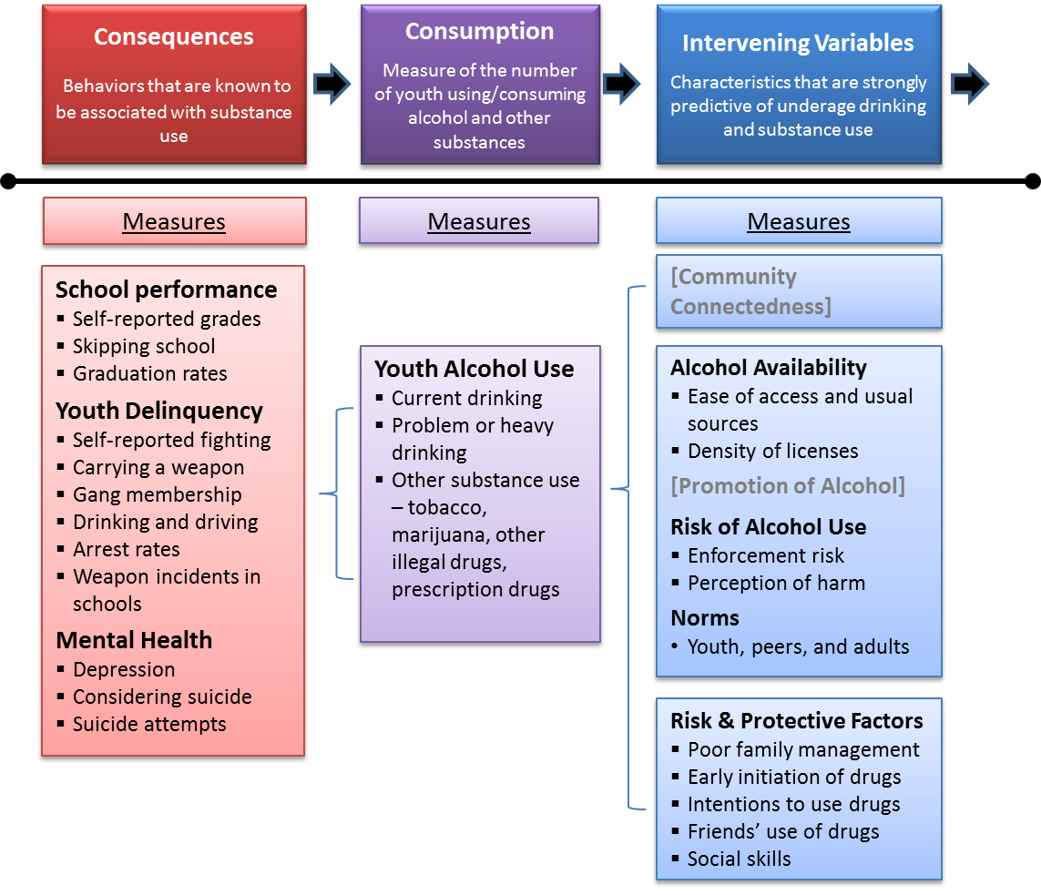

Slide 9
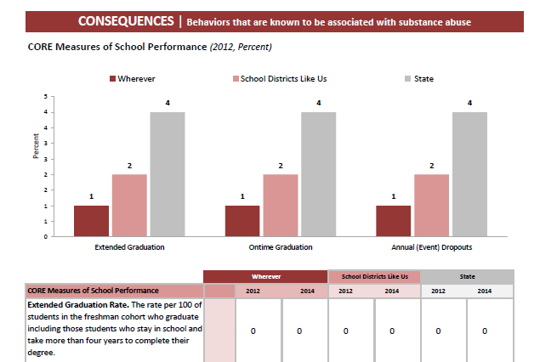
Consequence Data

Slide 10
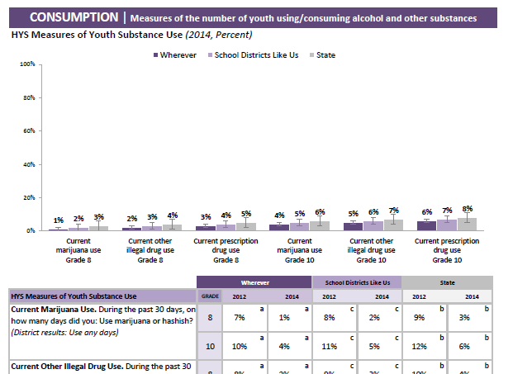
Consumption Data

Slide 11
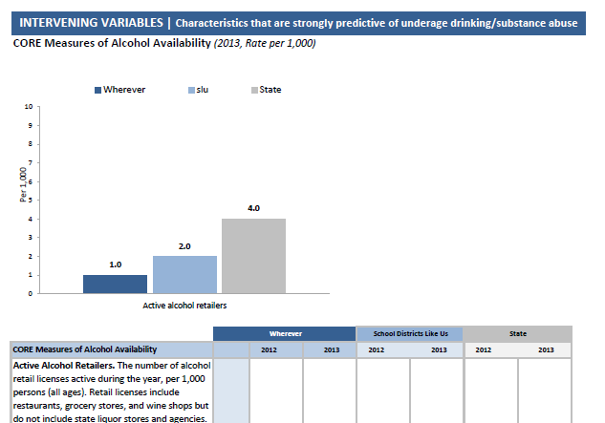
Intervening Variables

Slide 12
Data Sources
Washington State Healthy Youth Survey (HYS)
School-based survey in 6th, 8th, 10th, and 12th grade
Conducted every two years
Small schools/school districts eligible to participate in “small school pilot”, which surveys 7th, 9th, 11th graders in 2014
Community Outcome and Risk Evaluation (CORE) System
Archival/administrative data
Data from various agencies: DSHS, DOH, LCB, DOL, OFM

Slide 13
Learning Objectives
Describe the contents of this data book and articulate how the data relate to the CPWI logic model.
Describe the two different templates of the data book.
Understand the types of data presented in the data book.
Understand the new data elements in the data book.
Apply data analysis skills to interpret tables and charts included in the data book.
√

Slide 14
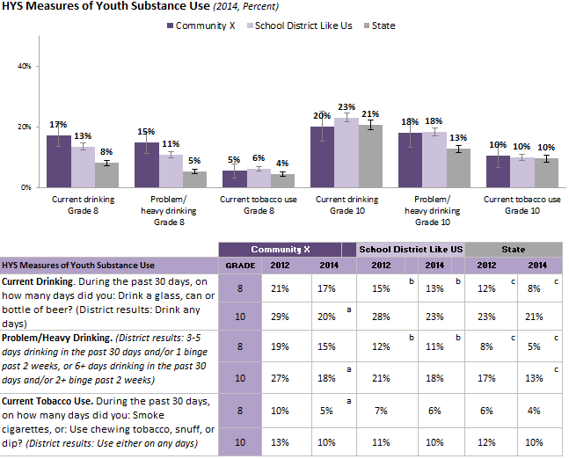
Data Book Templates: Regular

Slide 15
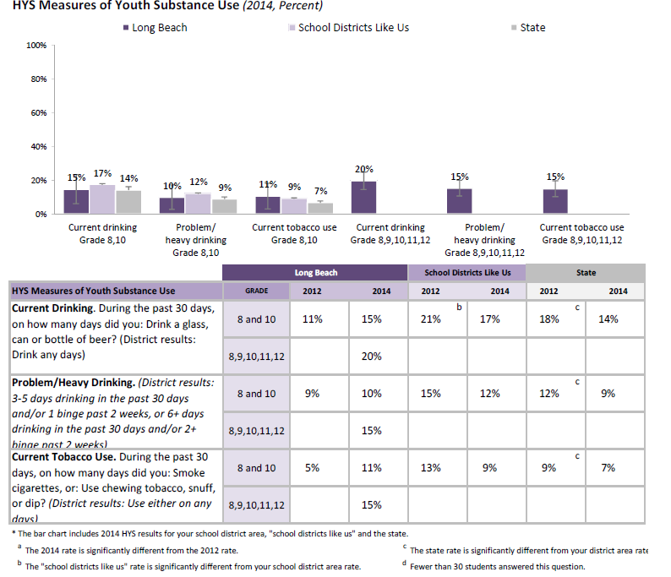
Data Book Templates: Small Community
Community X

Slide 16

Why bother with two templates?

Slide 17
Learning Objectives
Describe the contents of this data book and articulate how the data relate to the CPWI logic model.
Describe the two different templates of the data book.
Understand the types of data presented in the data book.
Understand the new data elements in the data book.
Apply data analysis skills to interpret tables and charts included in the data book.
√
√
√

Slide 18
Types of Data
Most recent data
Healthy Youth Survey – 2012 and 2014
CORE data – 2 years
Trend data
Demographic profile

Slide 19
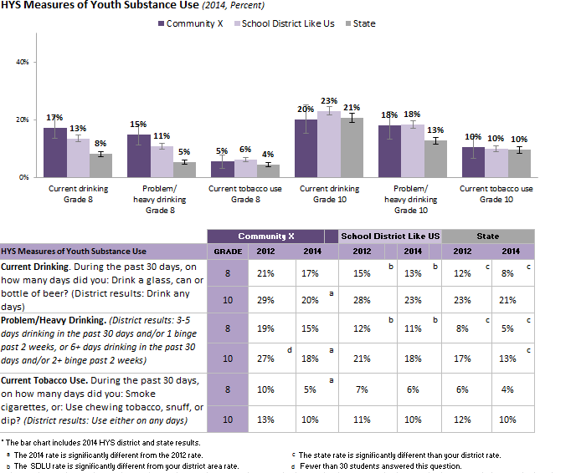
Most Recent Data: HYS
Charts compare 2014 community, SDLU, and state results
CI
Tables present community and state rates, by grade and year
Table notes
Notes:
Both the CI and the notations provide information about whether important changes have happened. (Details explained in later slides for the afternoon workshop).

Slide 20
New this year: SDLU
What is “school districts like us” (SDLU)?
SDLU are communities that share similar demographic and socioeconomic characteristics as yours
Similar characteristics in
Race/ethnicity
Poverty level
Population density
Relationship between school district and community (% levy approved)

Slide 21
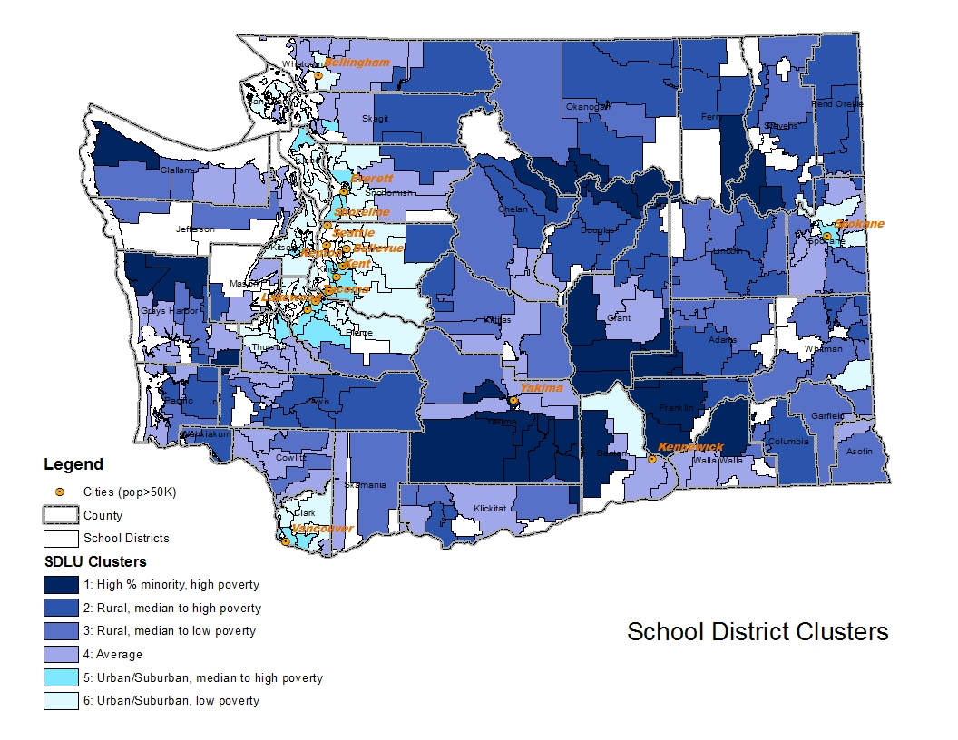

Slide 22
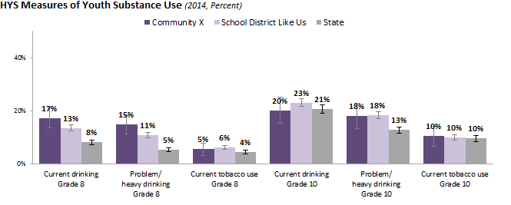
Interpret HYS Data Chart
Notes:
Data chart shows 2014 data
By grade
Community, SDLU, State comparisons

Slide 23
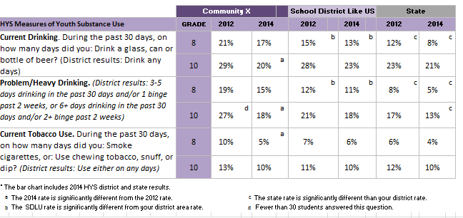
Interpret HYS Data Tables
a. Community 2014 rate is significantly different from the 2012 rate.
c. State rate is significantly different from the community rate.
d. Fewer than 30 students answered the question. Interpret with caution.
b. SDLU rate is significantly different from the community rate.
Table notes
Notes:
Talking about the different elements of the data tables, including the notations, and how to make comparisons between community vs. state; 2010 vs. 2012

Slide 24
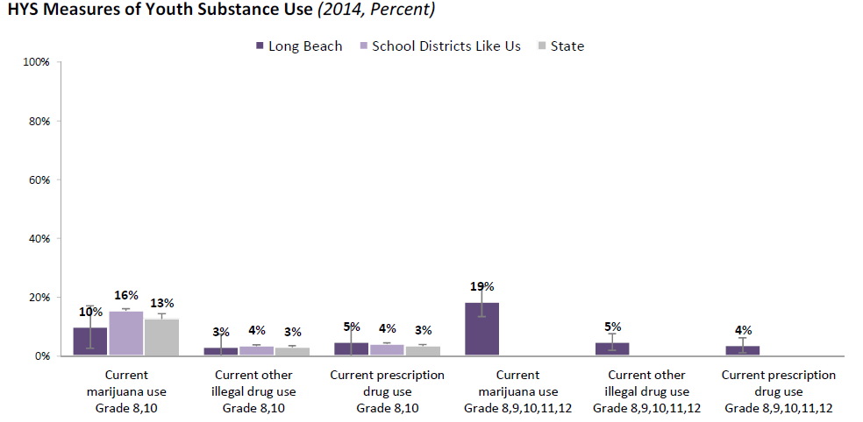
Interpret HYS Data Chart
Community X
Notes:
How to use the 8th +10th combined – for comparison across years, with state and SDLU
How to use the 8th – 12th combined – example - for cross-sectional comparison for different types of drugs
In the future – 8th – 12th grade trends will be available

Slide 25

Why combining results for small communities
Past 30-day alcohol use in Community X
10th grade only
N= 79, CI=+/-10.7%
8th and 10th combined
N= 166, CI=+/-6.6%
All grade 8th - 12th combined
N= 339, CI=+/-5.2%

Slide 26
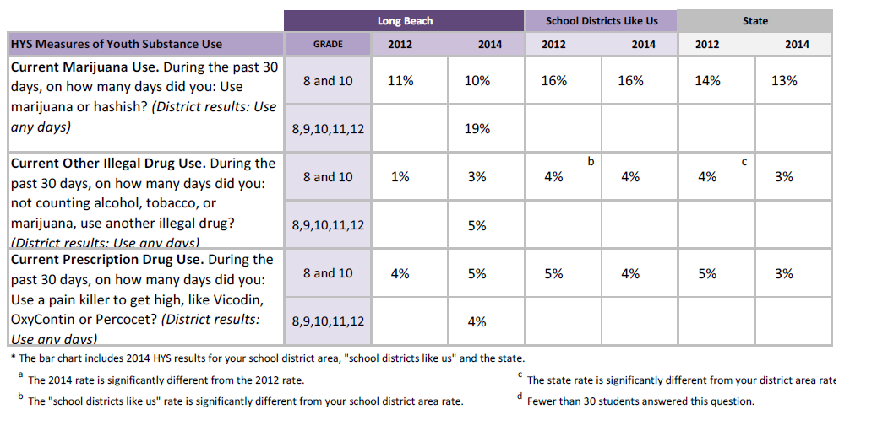
Interpret the HYS Data Tables
8th and 10th grades combined, compared with SDLU and State rates
Community X
All grades 8th to 12th combined for 2014

Slide 27
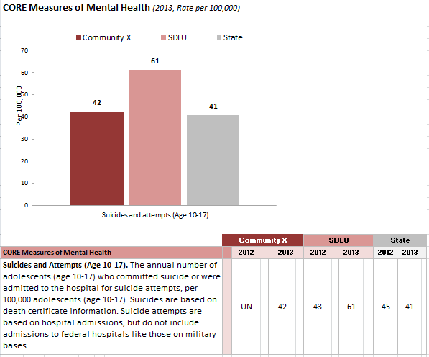
Interpret CORE Data Charts and Tables
Community rate
SDLU rate
State rate
Denominators may be different for different measures
No confidence intervals
May have missing data
SDLU rate is presented in table; county rate can be found in trend charts
Notes:
CORE GIS data – no CI, may have missing value

Slide 28
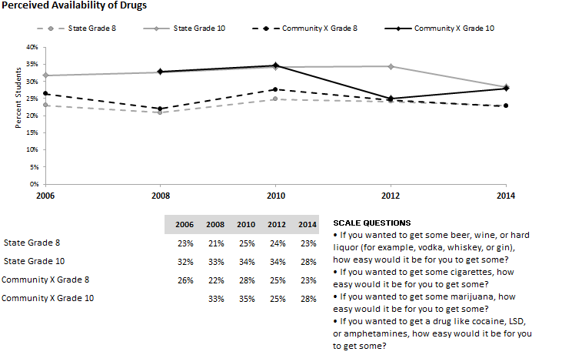
Trend Data: Large Communities
Notes:
Talks about the elements of the trend lines

Slide 29
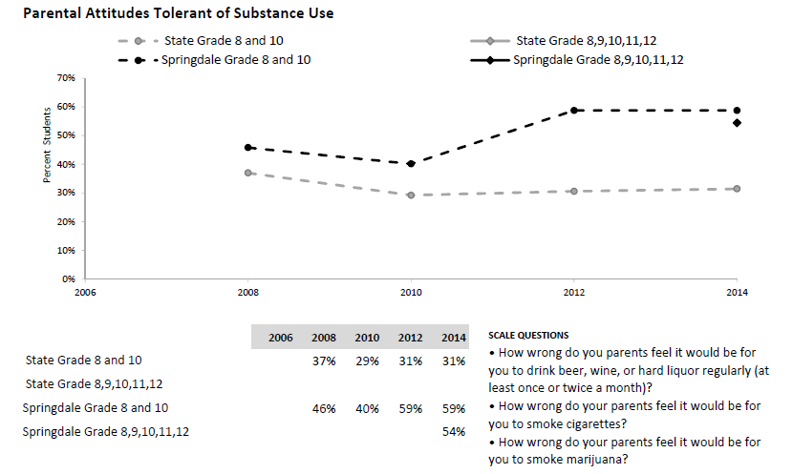
Trend Data: Small Communities
Community X
Community X
Community X
Community X
Notes:
No combined

Slide 30
How to Interpret Trends: HYS Data
Trend lines present state and community results by grade
Unconnected lines indicate gap in data
Notes:
Talks about the elements of the trend lines

Slide 31

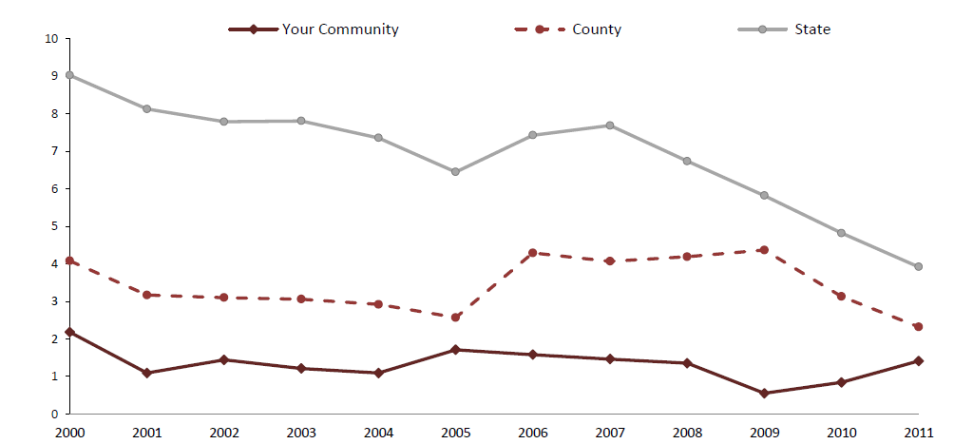
How to Interpret Trends: CORE Data
Check the units of measurement.
County level data presented here
Notes:
Talks about the elements of the trend lines

Slide 32
Demographic Profile
Race/Ethnicity (count/percent)
Age Composition (count/percent)

Slide 33
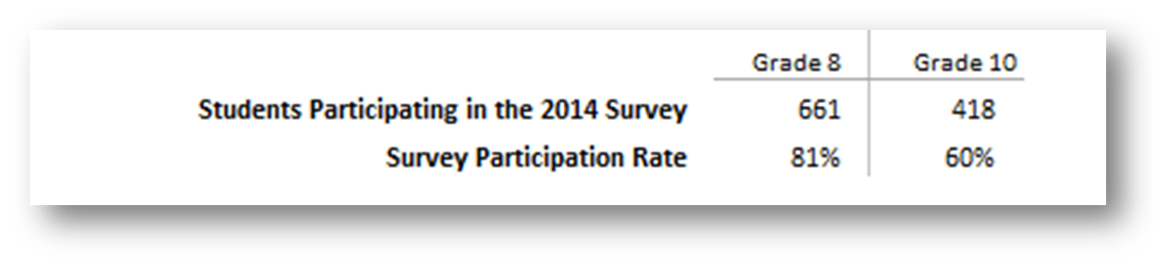
HYS Participation Rate
Located on the inside cover of the data book
Good participation if rate >70%
Data not reported if participation rate <40%

Slide 34
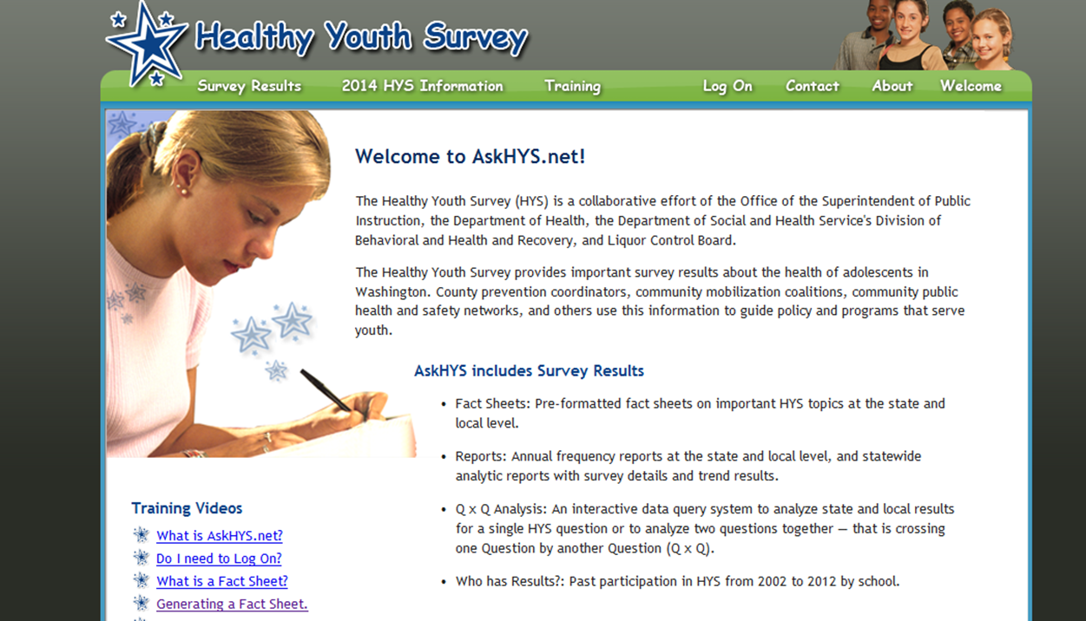
Other Sources of HYS Data: AskHYS.net

Slide 35
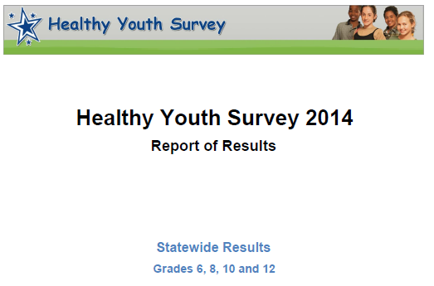
School District Frequency Report

Slide 36
Additional HYS Data
Additional Marijuana Questions | Local Report Item #
Lifetime Use | 18
Ways of use, source, DFC questions | 54 - 60
Driving under the influence | 114-115
Perception of risk, norms, other risk factors | 166, 168, 173, 198, 218, 219, 227, 231
Additional Prescription Drug Questions
Parental and peer norms | 63, 64
Perception of risk | 65
Use prescription drug not prescribed to you | 37
How to get access - http://www.askhys.net/Home/GetAccess

Slide 37

Frequently Asked Questions

Slide 38
Which Topic Should We Cover Next?
A. How to interpret confidence intervals
B. More details about “School District Like Us”
C. Why are data missing in my data book
D. More details about risk and protective factors in the data book
E. How are HYS results combined across grades

Slide 39
How to Interpret Confidence Intervals

Slide 40
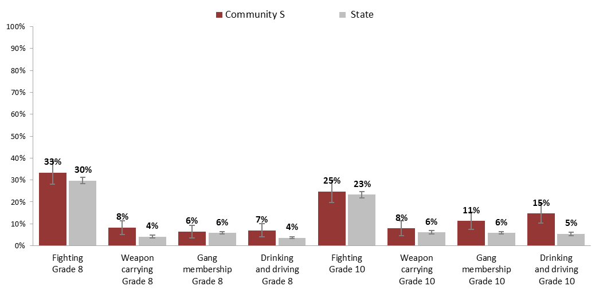
Interpret Confidence Interval
2012 community rate
2012 state rate
95% confidence intervals
95% CI
Notes:
Talking about the different elements of the bar chart, and what we can learn from the graph.

Slide 41
Q.
Why do you need confidence intervals?
  It’s unlikely that 100% of your students participated in the survey
  The reported value is unlikely to be exactly the same as the “true” value for all your students
  The confidence intervals account for the random variation due to sampling
  The confidence intervals help you compare your results to others and over time

Slide 42
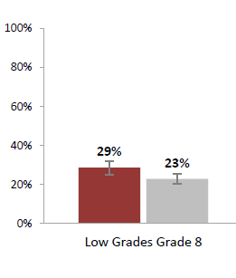
Q.
How do we talk about the results with the confidence intervals?
  Between 25% and 32% of the 8th grade students in our community had low grades in school.
  OR
  About 29% of the 8th grade students who took the survey reported low grades in school.

Slide 43
Non-significant Difference
Notes:
Not statistically significant

Slide 44
Significant Difference
Notes:
Statistically significant

Slide 45
Significance Inconclusive
Notes:
Inconclusive

Slide 46
When are data not reported?

Slide 47
Understand Missing Data
. - | Data are not available.
S - | Fewer than 15 students in the grade took the Healthy Youth Survey OR the response rate was lower than 40%. In the section "Additional Healthy Youth Survey Data" starting on page 24 suppressed data points are shown as gaps in the trend lines and blank cells in the tables.
NR - | Not reliable due to non-reporting of police jurisdictions data.
UN - | Unreliable conversion of events to report geography.
SP - | Suppressed by agreement with data provider when denominator is below 100.
SN - | Small Number Sample. Geography has less than 30 events in the denominator.
Notes:
S – HYS
UN – Weighted reliability <50%
NR – crime data
SP – death data
SN - ???

Slide 48
HYS Data Suppression Rules
Fewer than 15 surveys returned in any grade
Response rate is lower than 40%
In results combining multiple grades: missing data from any grade

Slide 49
What is “School Districts Like Us”?

Slide 50
Cluster Analysis
Cluster analysis is the grouping of a set of objects in such a way that objects in the same group (called a cluster) are more similar (in some sense or another) to each other than to those in other groups (clusters).
Characteristics are selected from factors associated with substance use outcomes.
Characteristics must not be prevention work outcomes (e.g. school performance).
This cluster analysis is not an evaluation of school districts.

Slide 51
Analysis Variables
Race/ethnicity: % Hispanic, % White, % Asian students in K-12 school enrollment
Poverty level: % of students eligible for free/reduced lunch
Urban/rural proxy: population density
Relationship between school district and community: % school levy approved

Slide 52
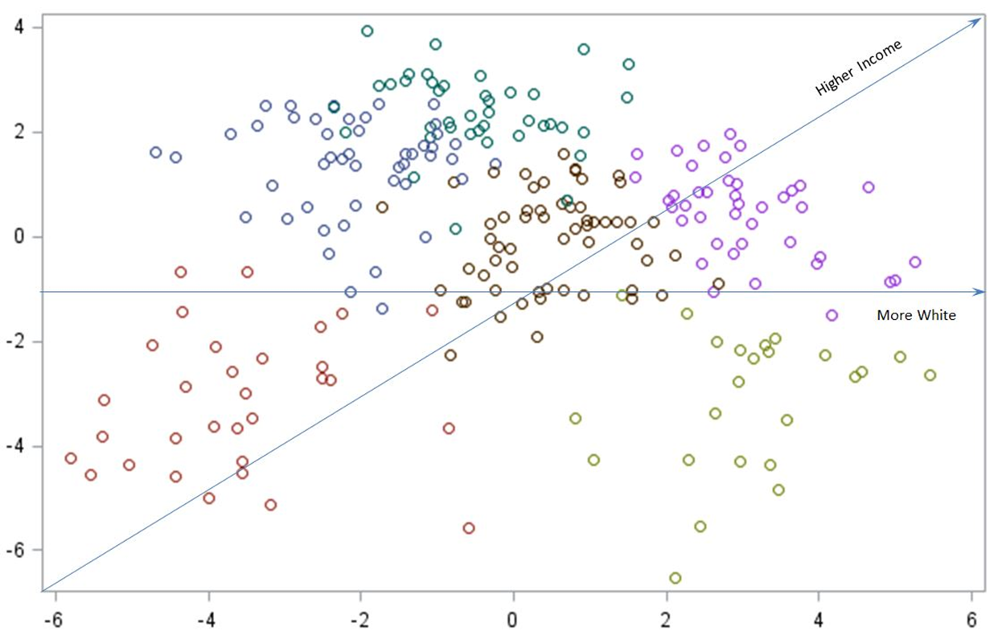
Results
Notes:
S – HYS
UN – Weighted reliability <50%
NR – crime data
SP – death data
SN - ???

Slide 53
Results: Groups of Communities
High % of minorities, high poverty;
Rural, median to high poverty;
Rural, median to low poverty;
Average;
Urban/suburban, median to high poverty; and
Urban/Suburban, low poverty.

Slide 54
Results: Cluster Means
 | 1 | 2 | 3 | 4 | 5 | 6
K-12 enrollment | 2,410 | 455 | 723 | 2,928 | 15,085 | 7,354
Population density | 151 | 13 | 12 | 139 | 2,576 | 692
% Student white | 21% | 80% | 84% | 73% | 50% | 78%
% Student Hispanic | 59% | 12% | 8% | 18% | 19% | 8%
% Student Native American | 16% | 3% | 2% | 3% | 2% | 1%
% Eligible for lunch program | 79% | 62% | 36% | 50% | 51% | 26%
% Levy approved | 40% | 57% | 70% | 85% | 92% | 97%
N of communities | 31 | 48 | 39 | 59 | 23 | 44
  1. High % of minorities, high poverty; 2. Rural, median to high poverty; 3. Rural, median to low poverty; 4. Average; 5. Urban/suburban, median to high poverty ; 6. Urban/Suburban, low poverty

Slide 55
Risk and Protective Factors

Slide 56
Risk and Protective Factors
Risk factor - research-based psychosocial predictors of substance use
Protective factor – characteristics that buffer individuals from the effects of risk factors
Measured using scales (multiple questions) in HYS
“At risk” – student at risk for substance use based on the factor
“Protected” – student less likely to use substance based on the factor

Slide 57
Intervening Variables
Notes:
What are intervening variables

Slide 58
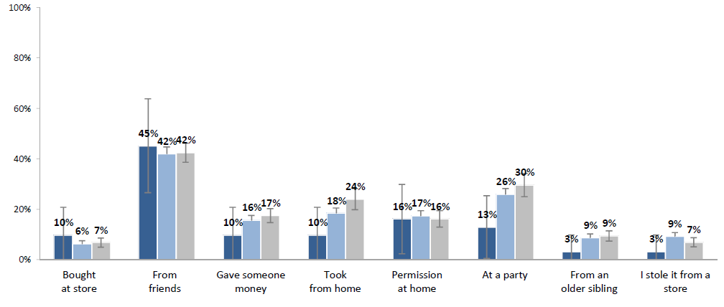

Availability of Alcohol (Retail or Social Access)
Q.
During the past 30 days, where did you usually get alcohol (if student used alcohol)?

Slide 59
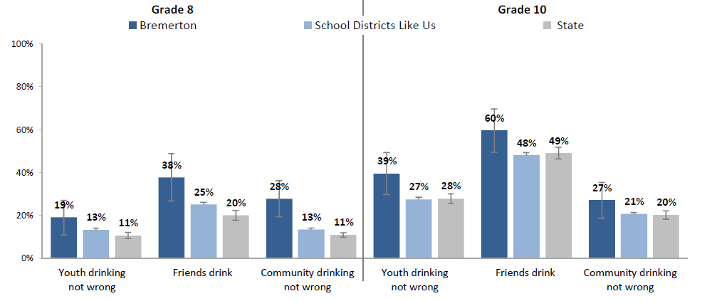
Norms
Community X

Slide 60
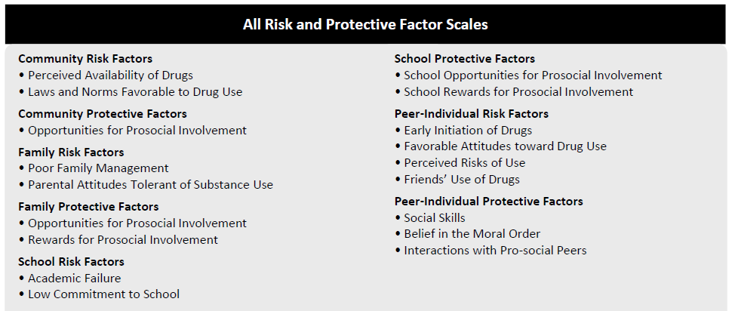
All Risk and Protective Factors

Slide 61
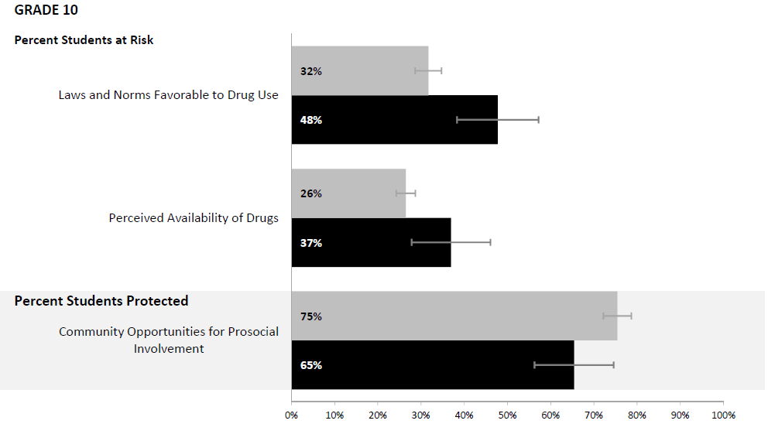
Risk and Protective Factor Scales

Slide 62
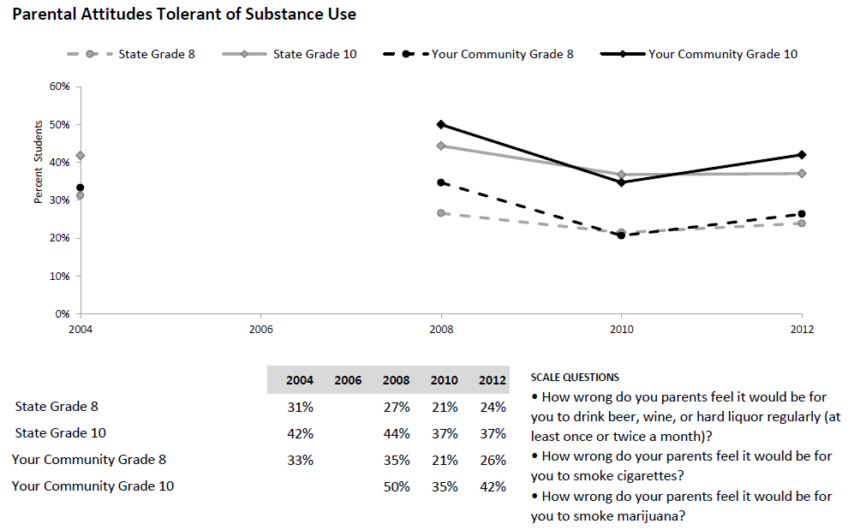
Risk and Protective Factor Scales

Slide 63
Combining HYS Results Across Grades

Slide 64
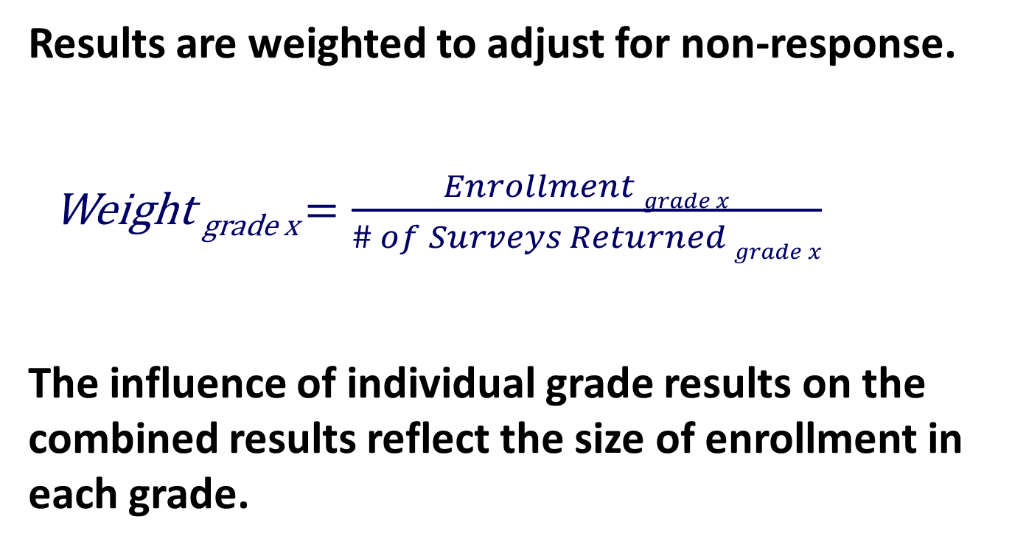
Methods
Results are weighted to adjust for non-response.
  Weight _{grade x} $=\frac{Enrollment grade x}{\# of Surveys Returned grade x}$
The influence of individual grade results on the combined results reflect the size of enrollment in each grade.

Slide 65
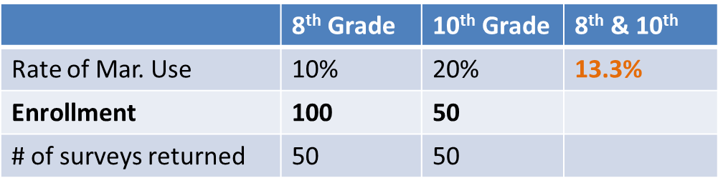
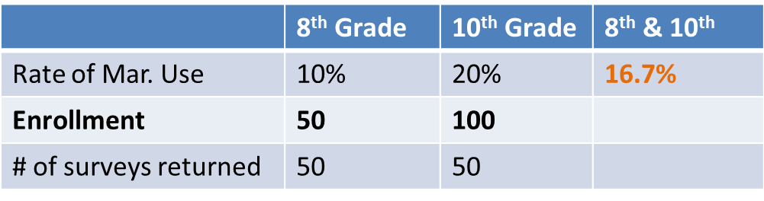
Examples of Weighted Results
  Example 1
  Example 2

Slide 66
Additional Resources
Healthy Youth Survey:
www.AskHYS.net
CORE reports:
https://www.dshs.wa.gov/sesa/research-and-data- analysis/community-risk-profiles

Slide 67
Contacts
Data book questions:
  Grace Hong, Ph.D., M.P.P., DBHR/DSE
  grace.hong@dshs.wa.gov
  School Districts Like US
  James Hu, Ph.D., DBHR/DSE
  hujs@dshs.wa.gov

