Slide 1
Alcohol & COVID-19: A Dangerous Mix
Interactive Dialogue
Hosted by the U.S. Alcohol Policy Alliance

Slide 2
Dialogue Guidance
This session is being recorded. The recording includes the chat box comments. If you are unwilling to be recorded, please feel free to drop off the session at this time.
Please have patience with the technology – there are 300 of us!
We have limited capacity to solve audio or video issues while in session.
When not in the virtual breakout rooms, please use the chat function if you have a question or comment. We will be monitoring and trying to incorporate as many questions as possible.
Unfortunately, we will not be able to get to everyone’s questions.
If you have already spoken please leave room for others.
Please disagree respectfully.

Slide 3
Alcohol and COVID-19: A Dangerous Mix
David H. Jernigan PhD
Professor, Boston University School of Public Health

Slide 4
What do we know: Alcohol and health in the U.S.
Fourth leading actual cause of death
Alcohol use is rising, along with use disorders
Biggest increases among women, older adults, racial/ethnic minorities, individuals with lower educational levels and family incomes
So are harms:
Between 2000—2016, death rates from alcohol more than doubled.
ED visits involving alcohol increased by 61.6%, costing $15.3 billion, from 2006-2014
From 1999-2016, annual deaths from liver cirrhosis increased by 62%; liver cancer deaths doubled.
Age-adjusted death rates for alcoholic liver disease up by 40.6% 1999-2017; increase higher among women and young people
Source: JAMA Psychiatry 74(9):911-923, 2017
Source: White et al. 2020
Source: White et al., ACER, 2018
Source: Tapper & Parikh 2018
Source: Woolf and Schoomaker, JAMA, 2019

Slide 5
Alcohol use, COVID-19 and health
The World Health Organization’s advice:
Alcohol consumption is associated with a range of communicable and noncommunicable diseases and mental health disorders, which can make a person more vulnerable to COVID-19. In particular, alcohol compromises the body’s immune system and increases the risk of adverse health outcomes. Therefore, people should minimize their alcohol consumption at any time, and particularly during the COVID-19 pandemic.

Slide 6
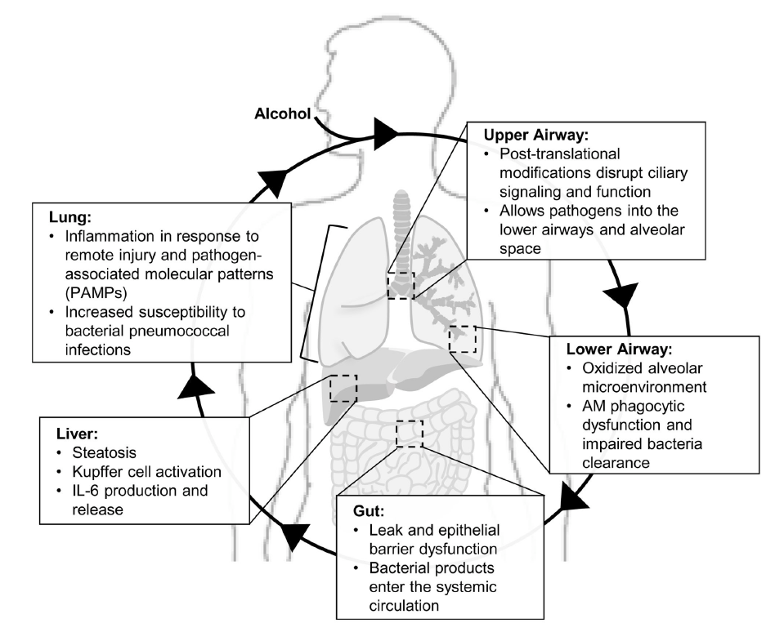
Alcohol, the immune system, and the lungs
Persons with an alcohol-use disorder have increased susceptibility to respiratory pathogens and lung injury, including two to four times greater risk of acute respiratory distress syndrome (ARDS), a key cause of death in COVID-19.
Yeligar SM, Chen MM, Kovacs EJ, Sisson JH, Burnham EL, Brown LAS. Alcohol and lung injury and immunity. Alcohol (Fayetteville, NY). 2016;55:51-59.

Slide 7
What has happened to alcohol consumption in the wake of COVID-19?
Changes in alcohol availability:
Bars, restaurants closed; off-premises largely open and “essential”; home delivery and carryout cocktails normalized
Economic crisis leads to less money available to buy alcohol
Likely outcome: People buy more, buy cheaper
Changes in alcohol sales data:
Off-premise sales of alcoholic beverages jumped by 55% for the week ending March 21 compared to the same week a year earlier
Ready-to-drink cocktails rose by 106%, while consumers purchased 90% more 24 and 30-packs of beer. Sales of 3-liter boxed wine and online alcohol sales also up substantially.
A week later, overall sales were still up by 22%.
Stockpiling or stoking consumption?

Slide 8
Public health implications of changes in alcohol availability
Evidence from prior events suggests people are laying in drinking patterns now that will linger and affect them and those around them into the future.
Shift from on-premise to off-premise consumption likely to be associated with increase in violence due to unsupervised drinking.
Police reports: 18 of 22 police departments surveyed by NBC News reported an increase in domestic violence calls in March.
Confinement, unemployment, economic instability and alcohol consumption increase risk of child abuse, at same time that usual avenues for reporting (teachers, social workers, pastors) are shut down from contact with the children.

Slide 9
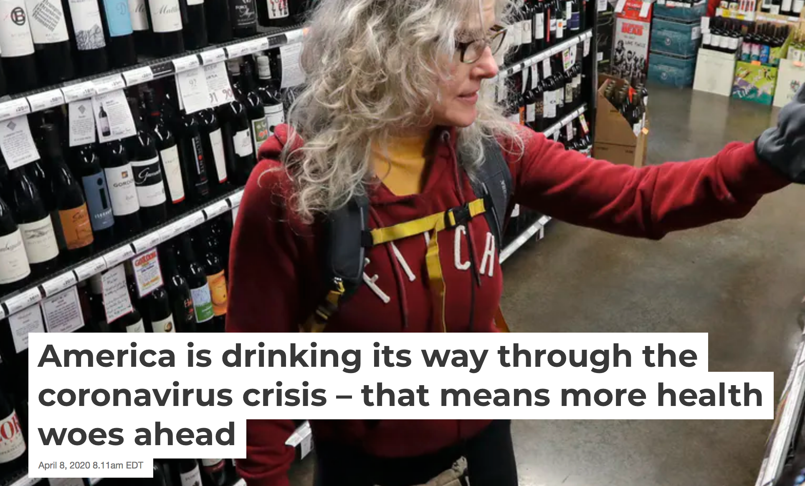
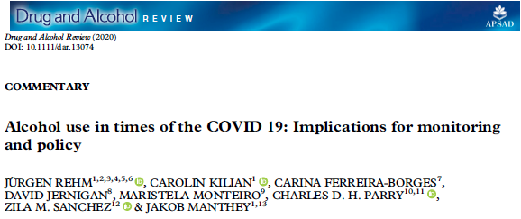
Communicating

Slide 10
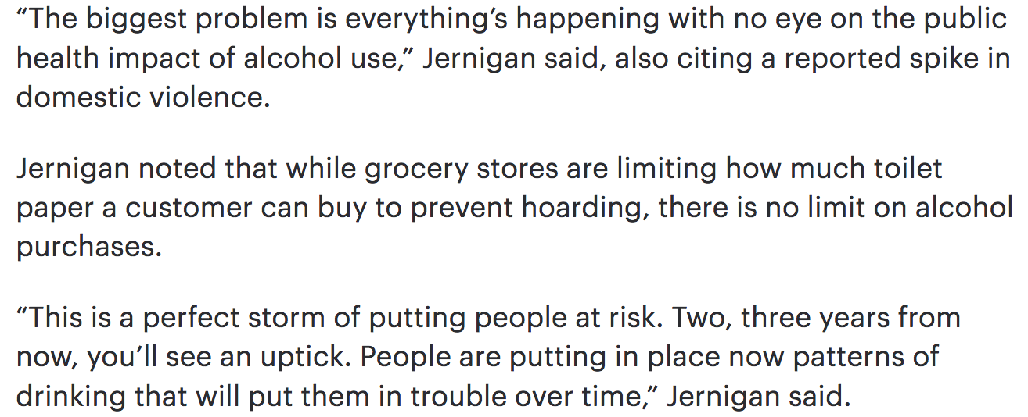
THE BOTTOM LINE

Slide 11
Alcohol Regulation
CASSANDRA GREISEN DIRECTOR, PUBLIC POLICY
Notes:
Who NABCA is…
The National Alcohol Beverage Control Association is a trade association with primary membership comprised of alcohol regulators from across the country.
Our governing board members are those states that are not only state alcohol regulatory agencies, but are market participants, meaning they sell at least one beverage category at wholesale (meaning they distribute the product to retailers) and/or at retail. These states are known as control jurisdictions.
Beyond our governing board members of control jurisdictions, we have a large tent of membership, including representatives from all sectors of the beverage alcohol industry, government agencies, prevention, public health organizations, law enforcement and other public safety organizations as well as international members.
We work to strike the delicate balance between our many members, by keeping our focus on being a repository of reputable data, science, and expertise on all topics related to beverage alcohol.

Slide 12
Notes:
As the pandemic escalated and governors issued executive orders instituting social distancing requirements and closing businesses’ on-premise operations, headlines painted a grim picture regarding the economic impacts these orders were having on the beverage alcohol industry.
With orders coming out daily, and in some cases by the hour, and the fact that our primary members of alcohol regulators were being asked to issue guidance pertaining to the executive orders, we recognized we needed to create a tracking system to digest these operational changes state by state to better understand the full picture and landscape in order to help inform our members.

Slide 13
Notes:
You’re going to hear me discuss this presentation as “Before the Pandemic” and “After the Pandemic”
We want to paint a picture for you about what was occurring before COVID19 in terms of deregulation of alcohol impacting access and availability.
We have found several factors driving many changes impacting the alcohol marketplace and as a result the regulatory landscape.
These drivers of change include, but are not limited to:
The craft movement of small, local producers known as craft breweries, distilleries and wineries that have begin to change the standard three-tier system of alcohol distribution by carving out exceptions to be both the producer and the retailer.
The trend toward one-stop shopping at big box stores, such as Costco and Walmart, leading to a desire to sell all commodities, including beverage alcohol.
And the push for consumer conveniences, such as home delivery of alcohol through 3rd party delivery apps and a general move toward e-commerce that has reshaped how distribution of alcohol takes place in many states through mobile apps.

Slide 14
Notes:
Here is a traditional picture of the distribution players in the three-tier system. Producers, Wholesalers and Retailers. The idea here is an independent and closed three-tier system where no tier can have ownership of another to prevent monopolies over the market, tracking of tainted alcohol products and efficient tax collection.

Slide 15
Notes:
However, today this is what the three-tier system look like; it’s a much more complicated picture than it once was in years past.
These are the conditions and the backdrop in which we entered the current crisis.

Slide 16
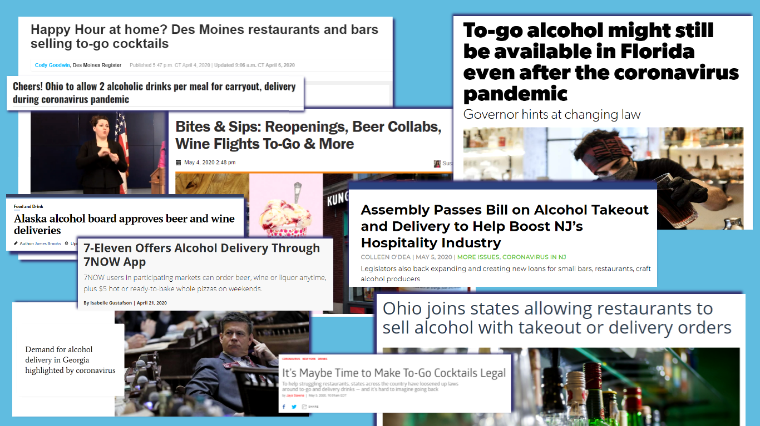
Notes:
As we saw headlines documenting these operational changes being afforded to nearly all tiers of the beverage alcohol industry, we knew we had to begin document, collecting and tracking these changes.
Fortunately, there were many industry trade associations already tracking these data along with public health and policy institutes that served as primary sources while we also cross-referenced discrepancies within these data to the executive orders and other guidance documents as well.

Slide 17
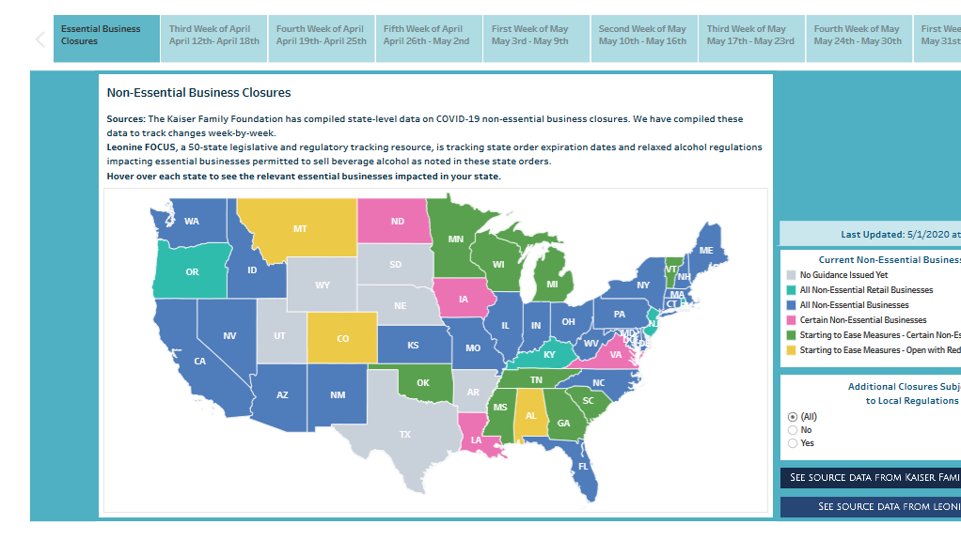
Non-Essential Business Closures
Find out when orders expire and extend and hover over each state to see retail channels deemed essential
Notes:
Walking through these dashboards which can be found on the homepage of our website…www.nabca.org, we wanted to document changes at a high level first.
This dashboard tracking non-essential businesses does 2 things:
It tracks week by week when executive orders will expire or in some cases are extended.
It also tracks which alcohol retail channels (e.g. grocery stores, convenience stores) are deemed essential and can remain open. You can see that list by hovering over each state.

Slide 18
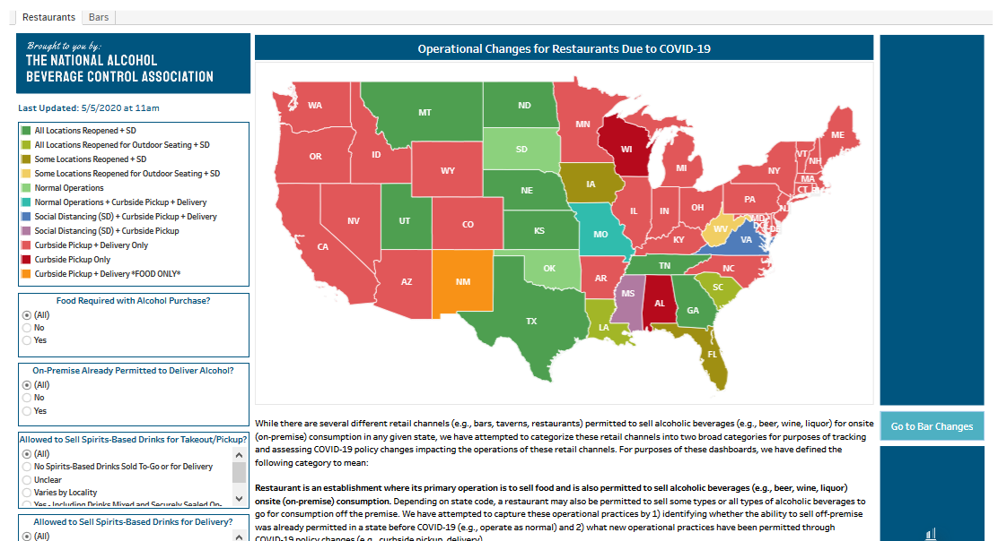
Restaurants
See how executive orders have impacted operations at restaurants in your state
Notes:
The next dashboard focuses on on-premise retail channels, which are restaurants and bars. There is no possible way we can explain all the variables being tracked in the allotted time on this webinar, but we can tell you that you can find information on what the requirements are for social distancing, whether curbside, delivery and if food purchases are required to get alcohol with order and whether mixed drinks to go are permitted and under what conditions, such as must be provided in a resealable container.
Further, it also helps the user see whether home delivery of alcohol was already permitted in the state before the pandemic.

Slide 19
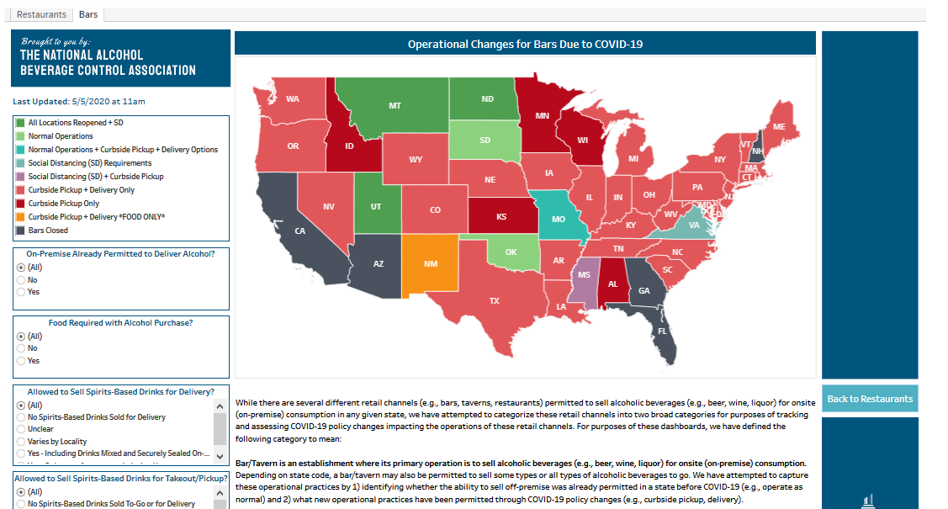
Bars
See whether food is required with alcohol purchase, if mixed drinks to go are permitted and whether your state is subject to local regulations
Notes:
On the “bars” tab of the on-premise operational changes dashboard, you will see similar variables as you do for restaurants, including whether regulations that impact these retail channels also vary by locality.

Slide 20
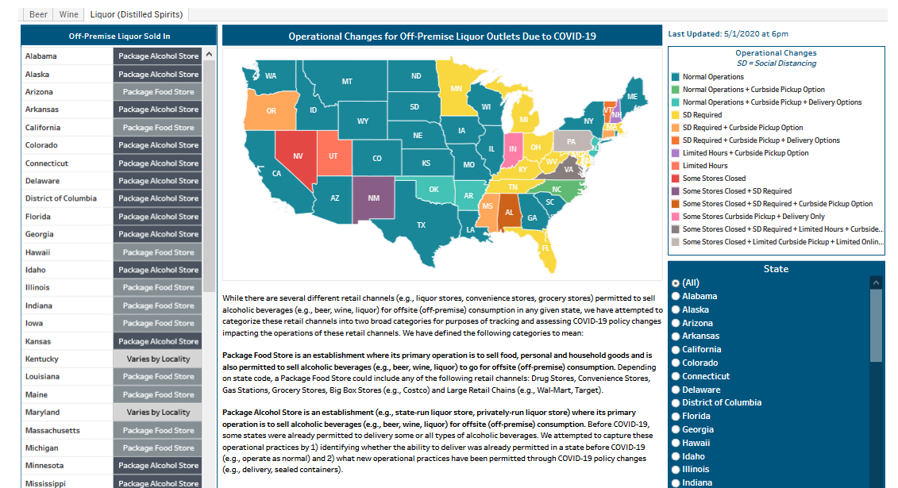
Off-Premise Liquor
Traditionally, states place stronger regulations on liquor, and this has remained true during the pandemic
Notes:
For the off-premise operational changes dashboard, it’s important to note that executive orders only identify the retail channel impacted not the beverage category, yet states regulate alcohol by beverage category, meaning they permit different types of beverage alcohol in different retail channels and exclude them from others; therefore we had to do the following:
First, we lumped retail channels into two broader categories for comparison purposes. These categories are distinguished by whether the primary purpose of the retail channel is to sell alcohol which is identified as a “Package Alcohol Store” or whether the primary purpose of the retail channel is to sell other goods and its alcohol sales are secondary to its function which is identified as a “Package Food Store”.
We then categorized the state to determine where each beverage category is permitted. For example, if liquor is permitted to be sold in grocery, convenience and gas stations, then the state was categorized as a Package Food Store. However, if liquor sales are NOT permitted in grocery, convenience or gas stations then the state was categorized as a Package Alcohol Store.

Slide 21
Notes:
Please consider us a resource.
We hope you continue to check in on our resources on covid19 as we will continue to make updates everyday M-F to track these operational changes impacting the alcohol marketplace.
Beyond the dashboards, we also have other resources including a message from our General Counsel on TTB’s guidance on trade practice violations and resource links to each state alcohol regulatory authorities' guidance on covid19.

Slide 22
Questions and Next Steps
For more information and to forward your notes from the breakout room discussion please contact:
info@alcoholpolicy.org
Additional information on the U.S. Alcohol Policy Alliance can be found at:
www.alcoholpolicy.org
Facebook: US Alcohol Policy Alliance
Twitter: @USAlcoholPolicy

