Slide 1
Coalition Sustainability
Don’t Leave Your Change to Chance
Dave Shavel, CADCA
May 28, 2020

Slide 2
Working with communities to address the opioid crisis.
SAMHSA’s State Targeted Response Technical Assistance (STR-TA) grant created the Opioid Response Network to assist STR grantees, individuals and other organizations by providing the resources and technical assistance they need locally to address the opioid crisis .
Technical assistance is available to support the evidence-based prevention, treatment, and recovery of opioid use disorders.

Slide 3
Working with communities to address the opioid crisis.
The Opioid Response Network (ORN) provides local, experienced consultants in prevention, treatment and recovery to communities and organizations to help address this opioid crisis.
The ORN accepts requests for education and training.
Each state/territory has a designated team, led by a regional Technology Transfer Specialist (TTS), who is an expert in implementing evidence-based practices.

Slide 4
Contact the Opioid Response Network
To ask questions or submit a technical assistance request:
Visit www.OpioidResponseNetwork.org
Email orn@aaap.org
Call 401-270-5900

Slide 5
Substance Abuse and Mental Health Services Administration (SAMHSA)
Funding for this initiative was made possible (in part) by grant no. 6H79TI080816 from SAMHSA. The views expressed in written conference materials or publications and by speakers and moderators do not necessarily reflect the official policies of the Department of Health and Human Services; nor does mention of trade names, commercial practices, or organizations imply endorsement by the U.S. Government.

Slide 6
Approach: To build on existing efforts, enhance, refine and fill in gaps when needed while avoiding duplication and not “re-creating the wheel.”

Slide 7
Overall Mission
To provide training and technical assistance via local experts to enhance prevention, treatment (especially medication-assisted treatment like buprenorphine, naltrexone, and methadone), and recovery efforts across the country addressing state and local - specific needs.

Slide 8
Sustainability: Don’t Leave Your Change to Chance

Slide 9
Objectives
Describe why fostering sustainability is important
Assess your coalition or initiative’s ability to:
Create a strong volunteer and membership base
Build a credible planning process and organization infrastructure
Ensure relevance to community concerns
Develop a diversified funding strategy
Develop specific “next steps” to mobilize members to focus on sustainability

Slide 10
Definition of Coalition Sustainability
A sustainable coalition has enough resources to intervene at the community level and can maintain these resources long enough to see community-level outcomes.

Slide 11
Four Things Coalitions Must Sustain
Strong volunteer & membership base
A credible process
Relevance to current community concerns
The financial and other resources required to do the work

Slide 12
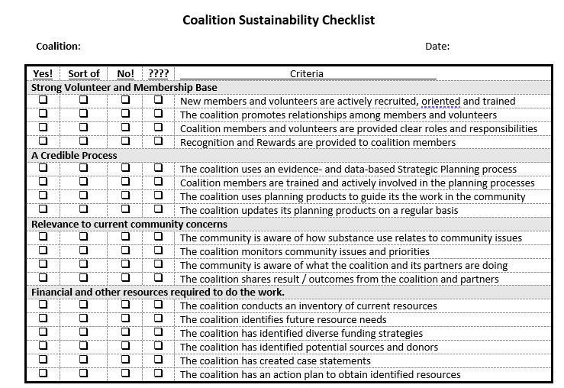
Sustainability Checklist

Slide 13
1. Strong Volunteer and Membership Base
Recruiting involves providing:
Specific opportunities for involvement
Orientation and training
Positive relationships and experiences

Slide 14
1. Strong Volunteer and Membership Base
Retaining coalition members involves building long-term relationships with individuals and organizations through the 6 R’s:
Relationships
Role
Respect
Recognition
Rewards
Results

Slide 15
1. Strong Volunteer and Membership Base
Assessment: How does your coalition recruit and retain members?

Slide 16
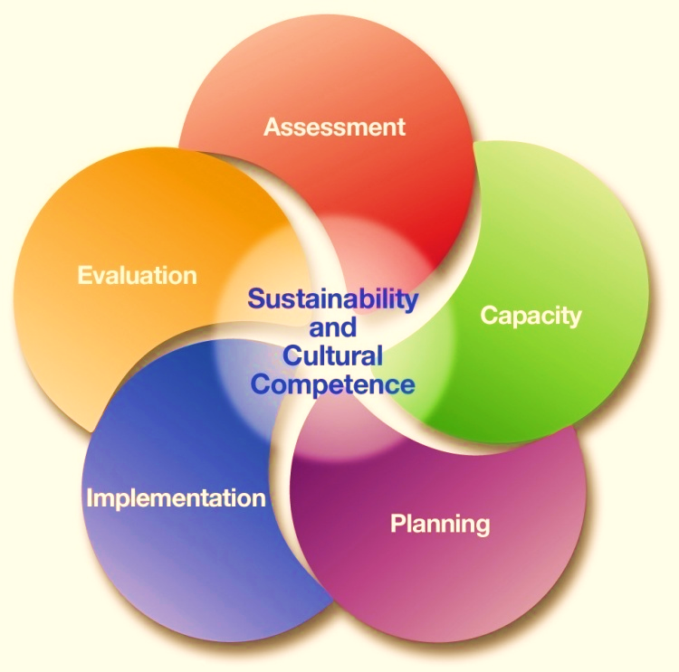
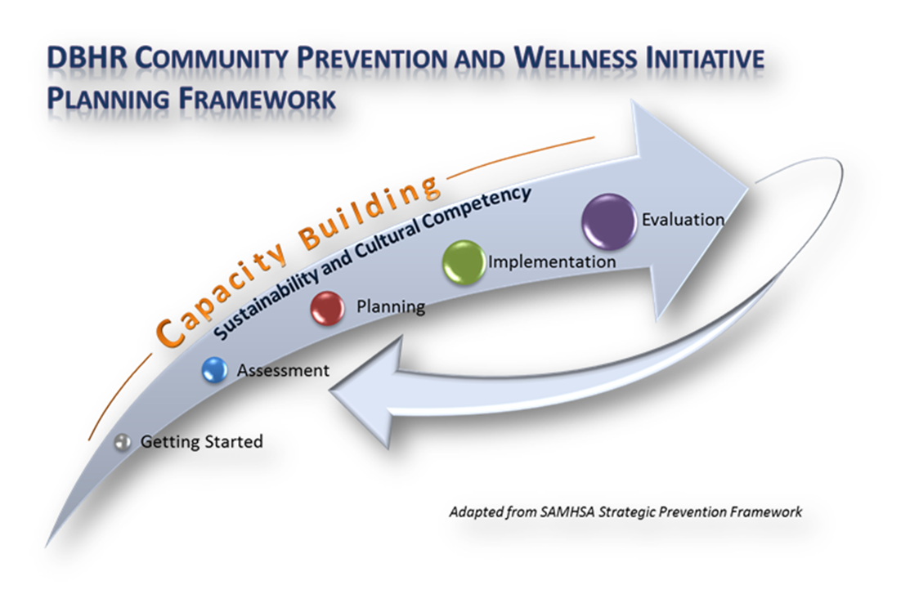
Four Things Coalitions Must Sustain:
Strong volunteer & membership base
A credible process

Slide 17
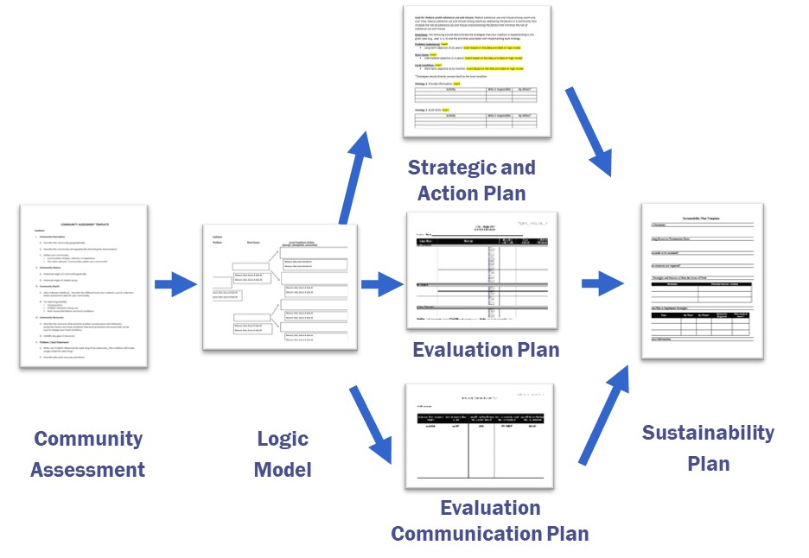
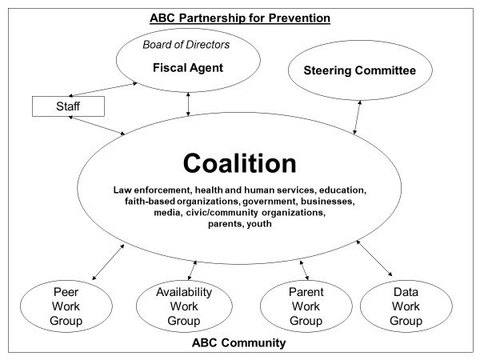
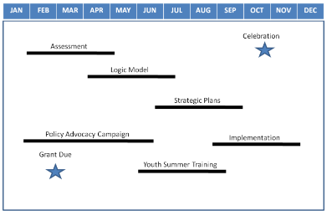
2. A Credible Process
What is the process?
What are the products?
Who will do the work?
When will the work be done?

Slide 18
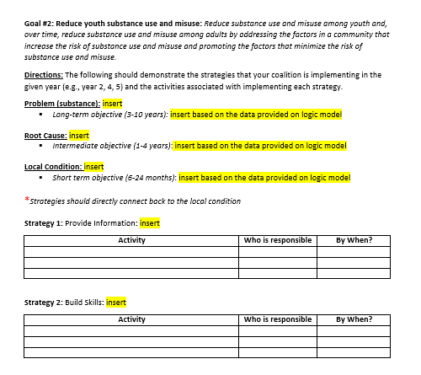
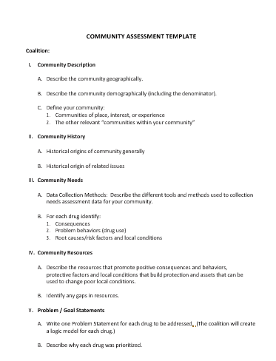
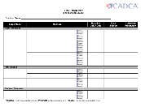
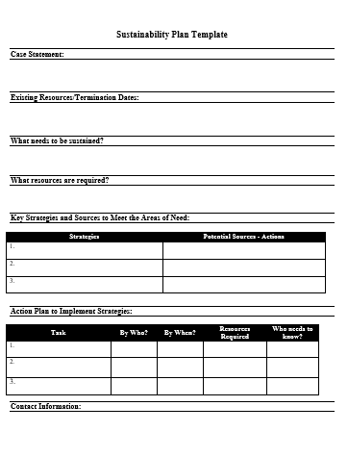
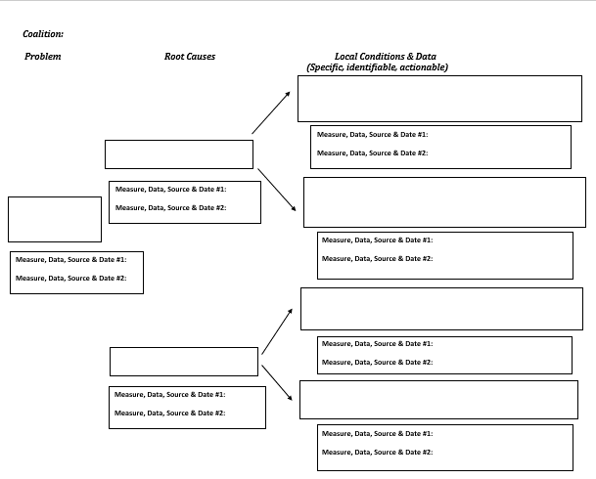
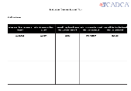
Coalition Products
Strategic and Action Plan
Evaluation Plan
Community
Assessment
Logic
Model
Sustainability
Plan
Evaluation Communication Plan

Slide 19
2. Credible Coalition Processes
Assessment: How does your coalition use its planning process effectively?

Slide 20
Four Things Coalitions Must Sustain:
Strong volunteer & membership base
A credible process
Relevance to current community concerns

Slide 21
3. Relevance to Community Concerns
Public Safety
Substance Use and Misuse
Education
Jobs and Employment
Community
Housing and Homelessness
Healthcare & Insurance
COVID-19
Potholes
Sports and Entertainment
Economy

Slide 22
3. Relevance to Community Concerns
To build the community’s awareness of the coalition by
clarifying the Coalition’s:
Vision
Mission
Strategies
Actions
Accomplishments
Outcomes

Slide 23
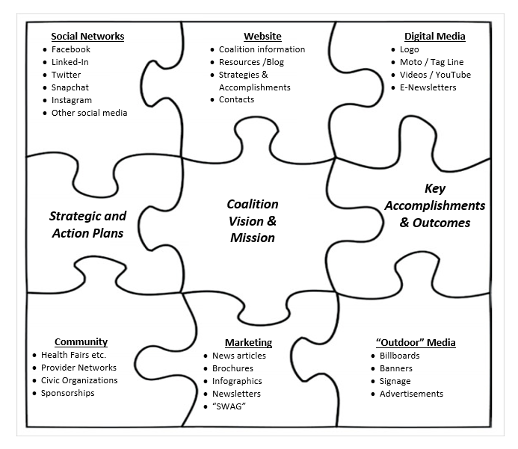
3. Relevance to Community Concerns
Share the coalition “story” through with a comprehensive mix of branding and marketing strategies including:
Social Networks
Web Presence
Digital Media
Community Outreach
Marketing
“Outdoor” Media

Slide 24
3. Strong Volunteer and Membership Base
Assessment: How does your coalition “frame” its work in the community?

Slide 25
Four Things Coalitions Must Sustain:
Strong volunteer & membership base
A credible process
Relevance to current community concerns
The financial and other resources required to do the work

Slide 26
4. The financial and other resources required to do the work
Sustainability Planning Process
To create a Sustainability Plan:
Create a Case Statement
Identify what must be sustained & resources needed
Identify future resource needs
Select funding strategies
Identify potential sources and donors
Action plan for contacts and requests

Slide 27
Six-Step Sustainability Planning Process
Step 1: Create a Case Statement
A written answer to key questions:
Why is the coalition needed?
How will it make a difference?
Who is involved and supporting?
Is the coalition cost effective?
“Why should I share my resources with the coalition?”

Slide 28
Six-Step Sustainability Planning Process
Step 2: Identify what must be sustained:
The coalition
Specific strategies

Slide 29
Six-Step Sustainability Planning Process
Step 2: Identify Resources Needed:
Identify the resources needed to run the coalition. Examples of resources include:
Staff
Volunteers / Partners
Space
Supplies
Technology
Communication
Training
Transportation

Slide 30
Six-Step Sustainability Planning Process
Step 3: Identify future resource needs
Determine what your coalition’s future resource needs will be in … 5 years:
BIGGER
The Same
Smaller
2020:
Current needs in $ and in-kind:
$200,000
2025:
Current needs in $ and in-kind:
$??

Slide 31
Six-Step Sustainability Planning Process
Step 4: Select Funding Strategies
Share
Asset Sharing
In-Kind Contributions
Leverage Shared Positions
Ask
Grants
Fundraisers
Individual Donors
United Way/Payroll Giving
Planned Giving
Charge
Fee for Service
Fine/Penalty Revenue to Prevention
Line Item in a Government Budget
Line Item in a Nonprofit Budget
Membership Dues
Acquire Tax Revenue
Earn
For-Profit business
Business planning
Partial ownership of For-Profit enterprises

Slide 32
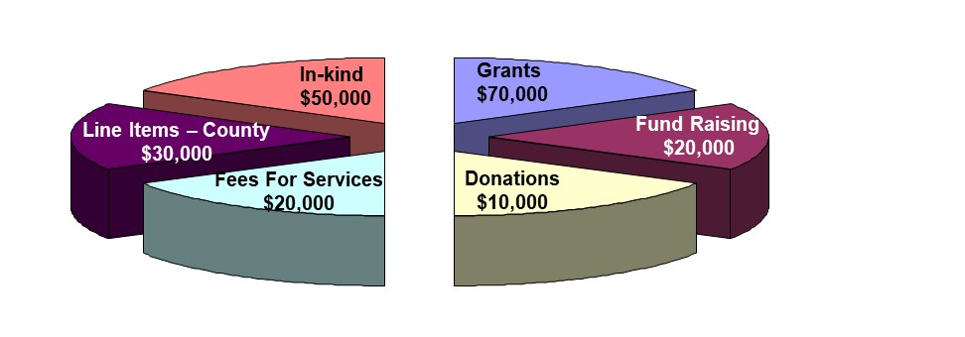
Six-Step Sustainability Planning Process
Step 4: Select funding strategies
Develop a Diversified Funding Plan
Resources Needed in 2025: $200,000

Slide 33
Six-Step Sustainability Planning Process
Step 5: Identify potential sources and donors
Build relationships with:
Individuals and organizations have an interest in achieving the coalition’s goals
Foundations and grantors are funding coalitions and “capacity”
Coalition members have connections to these individuals and organizations
Start with a handshake …not a handout!

Slide 34
Six-Step Sustainability Planning Process
Step 6: Action plan for contacts and requests
Identify what coalition members will do NOW to begin building relationships with FUTURE donors.
Develop plans to:
Engage coalition members
Publicize the coalition’s successes
Connect with potential donors

Slide 35
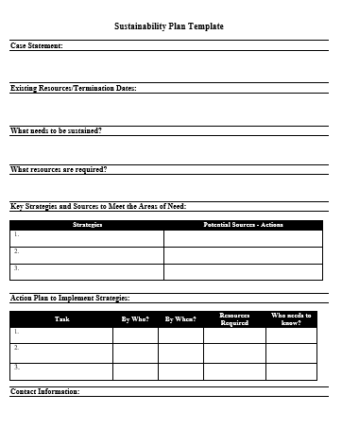
Develop a Sustainability Plan
Sustainability Plan Template

Slide 36
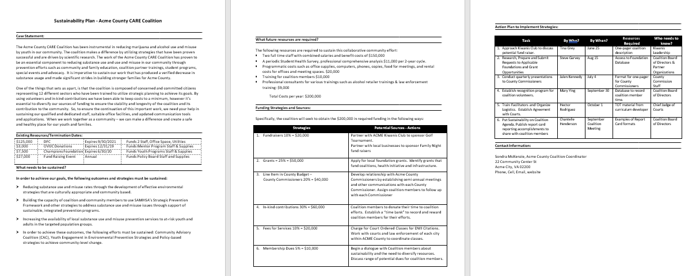
4. Financial and Other Resources to do the Work
Sustainability Plan - Example

Slide 37
4. Financial and Other Resources to do the Work
Assessment: How will your coalition develop a Sustainability Plan?

Slide 38
Sustainability Checklist

Slide 39
Sustainability – Next Steps
Next steps to engage your coalition:
Use the Sustainability Checklist
Identify the elements that are most relevant to the coalition
Determine how the coalition will implement each element
Develop a Sustainability Plan
Identify additional training and T/A

Slide 40
Resources
CADCA — Community Anti-Drug Coalitions of America
www.cadca.org
CADCA National Community Anti-Drug Coalition Institute – Coalition Development Support:
800-54CADCA x240
training@cadca.org

