Slide 1
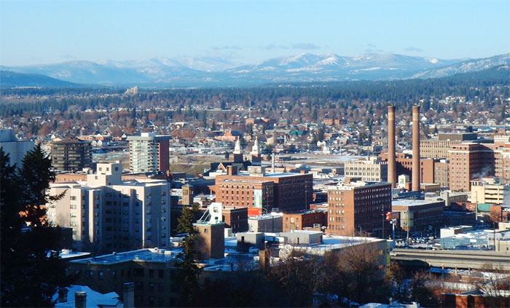
Carrie Ulvestad, Executive Director
Washington Poison Center
culvestad@wapc.org, 206-517-2357

Slide 2
Plan for Today
What is the Washington Poison Center?
Current state of affairs in WA with drugs of abuse
E-cigarettes
Marijuana
Prescription Pain Killers
What trends are we seeing?
Savvy marketing techniques
Emerging and concerning trends
Take Action!

Slide 3
Our History
2006: Hire New Med Dir. replacing Dr. R.
2010: Receive SCHIP funding
2014: Oper’l Study; New E.D., Med Dir & Clin. Mging Dir; Cancelled VetPets
1992: DOH recommends PC consolidation
2000: CDC helps fund PCs
2012: Lauch Vet Pets
16 PCs in WA
1950s -1960s
1970s -1980s
1990’s
2000-2010
2010 - 2012
2013-2015
1993: RCW 18.76 creates WAPC as 501c3 non-profit; Led by Dr. Robertson
2012: Lewin Study Published, Values PC
6/2013: Renew Bldg Lease w/ 45% reduction
Economic Pressure;
4 PCs remain in WA
2008: Public Law 110-377
2008/9: Budget 36% cut; Layoffs
2014-5: Launch Toxic Trend Rpts (Cannabis, E-Cig), Agency Collaboration “FreakNight”
“Resolution”
2005: WAPC participates in HRSA; Hire Exec Dir.

Slide 4
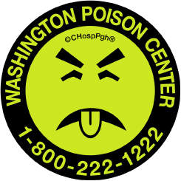
Our Washington Poison & Drug Information Center Mission:
To prevent harm from poisoning through expertise, collaboration, professional, and public education
FREE
24/7/365
RCW 18.76 Poison Information system. Statewide Program Public Law 110-377 Primary poison defense for U.S. (1993)
Public Law 110-377 “Poison Center Support, Enhancement, and Awareness Act of 2008”

Slide 5
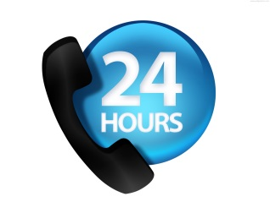
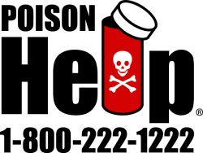
RCW 18.76 Poison Information system. Statewide Program Public Law 110-377 Primary poison defense for U.S.
(1) Twenty-four hour emergency telephone management and treatment referral of victims of poisoning and overdose incidents, to include determining whether treatment can be accomplished at the scene of the incident or transport to an emergency treatment or other facility is required, and carrying out telephone follow-up to assure that adequate care is provided; (2) Providing information to health professionals involved in management
of poisoning and overdose victims;
(3) Coordination and development of community education programs designed to inform the public and members of the health professions of poison prevention and treatment methods and to improve awareness of poisoning and overdose problems, occupational risks, and environmental exposures; and
(4) Coordination of outreach units whose primary functions shall be to inform the public about poison problems and prevention methods, how to utilize the poison center, and other toxicology issues.

Slide 6
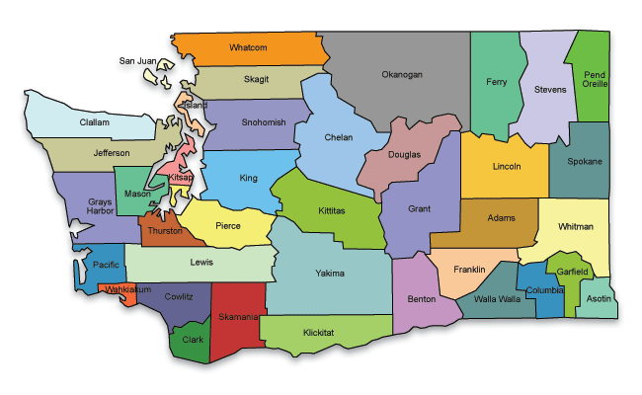
Who Do We Serve?
7.06 million people
22.9% under the age of 18 years
6.4% under the age of 5 years
13.6% 65 years and over
98 acute care hospitals
EMTs/Paramedics
Law Enforcement
Federal/State/County Departments of Health and Agencies
Medical/Pharmaceutical Teaching Institutions
And more…

Slide 7
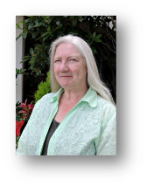
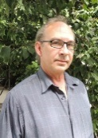
On-Call Toxicologists
24 hour access to board-certified toxicologists with backgrounds in emergency medicine and pharmacology
On-Call:
Dr. Melissa Halliday
Dr. Thomas Martin (independent)
Dr. Suzan Mazor (Seattle Childrens)
Dr. Carl Skinner (Madigan)
Certified Specialists in Poison Information
Dr. Chen
Dr. Garrard
Dr. Valento
PharmDs, RNs, PIPs with a combined 280+ years of experience

Slide 8
WAPC by the numbers
63,728 inbound calls to WAPC in 2014
54,715 were human exposures
Over 57,000 follow-ups on patients completed
Over 90% managed at home
Trip to hospital or physician avoided – cost savings!
Approximately 75% originate from households
56% of calls involve children under 6 years of age
WAPC is a Non-Profit (one of only 3 poison centers that are non-profits)
Primarily funded by state and federal funds as well as donations, grants and studies

Slide 9
Landscape of Drug Use in WA

Slide 10
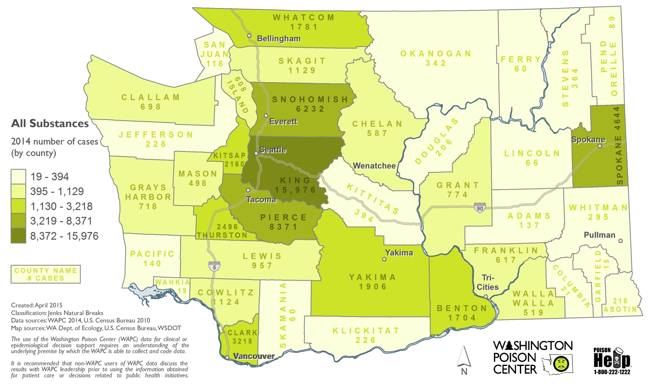
All Poisonings in WA

Slide 11
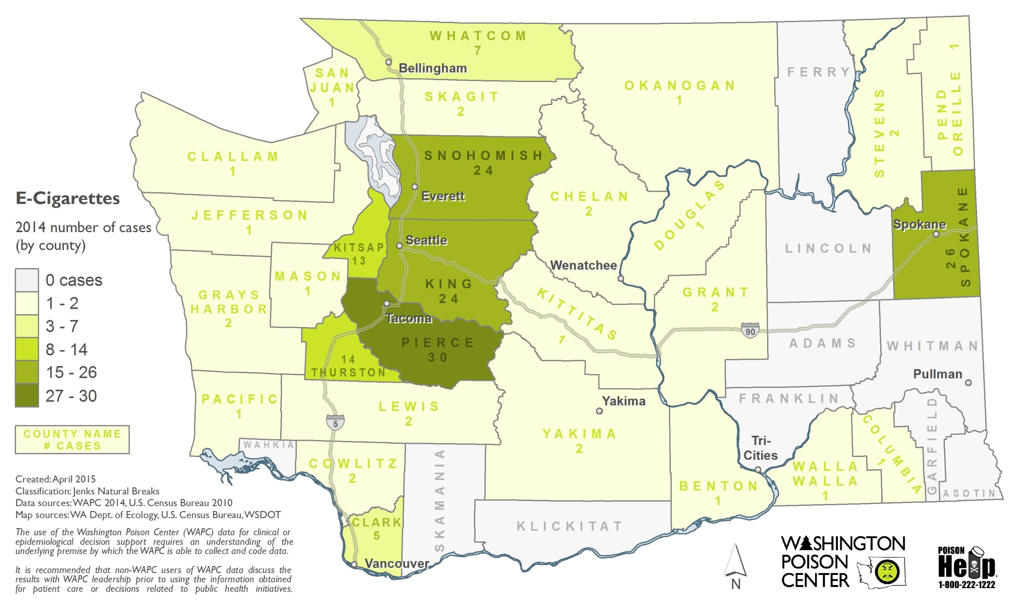
E-Cigarettes in WA

Slide 12
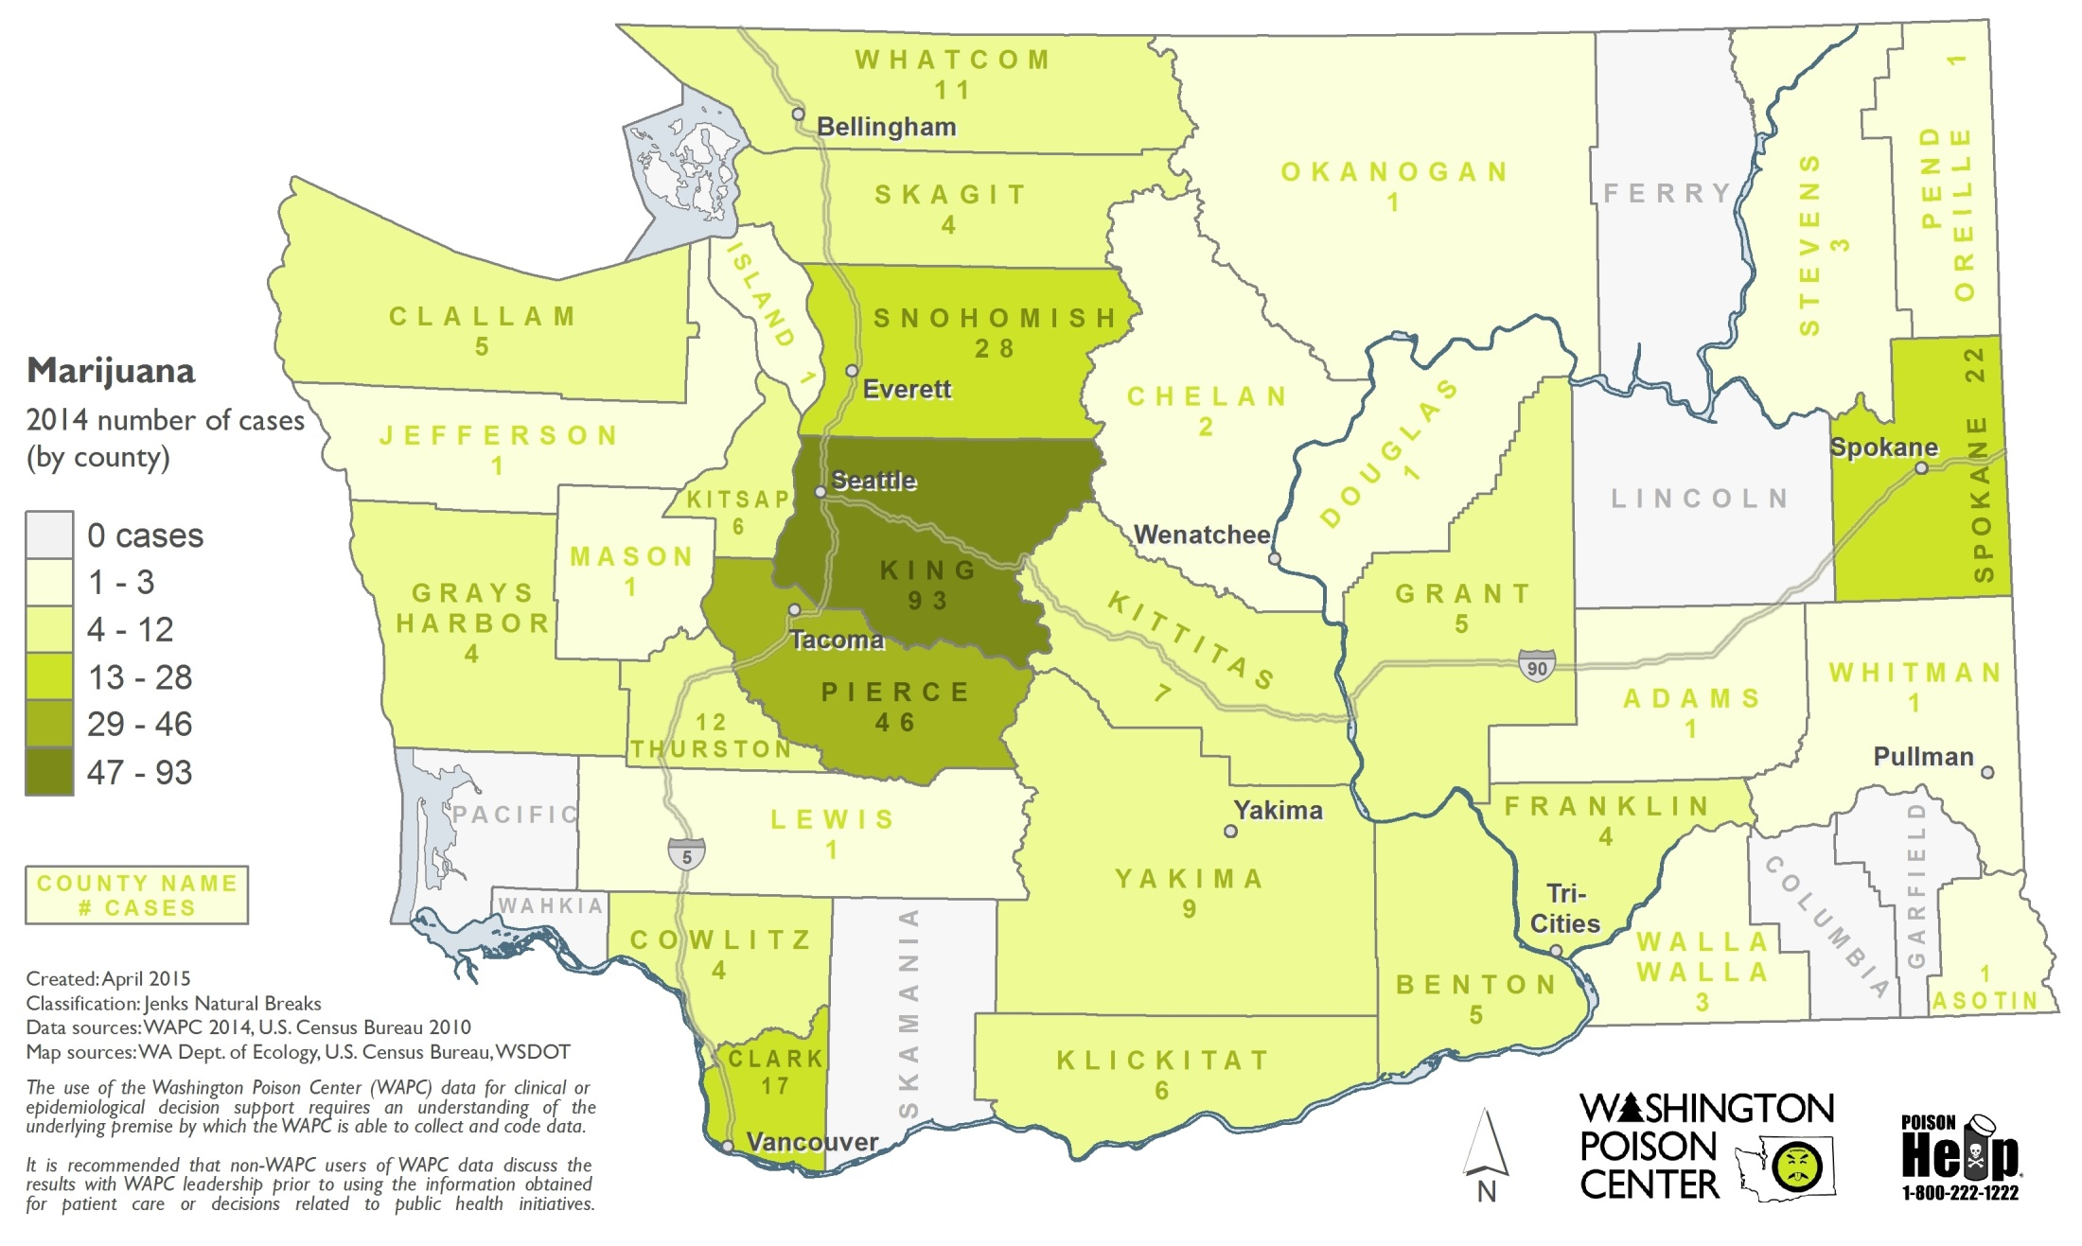
Marijuana in WA

Slide 13
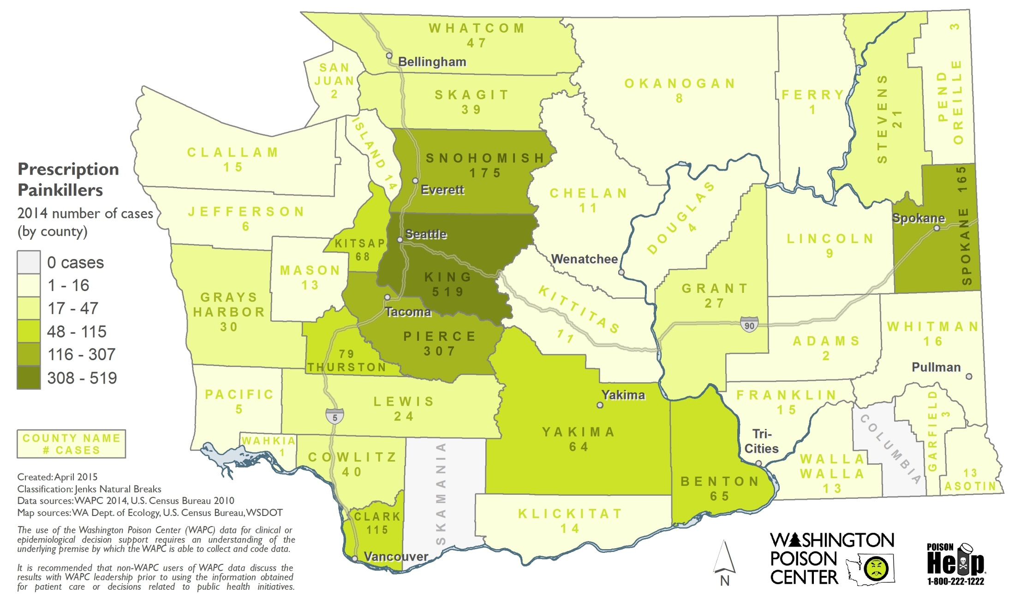
Rx Pain Killers in WA

Slide 14
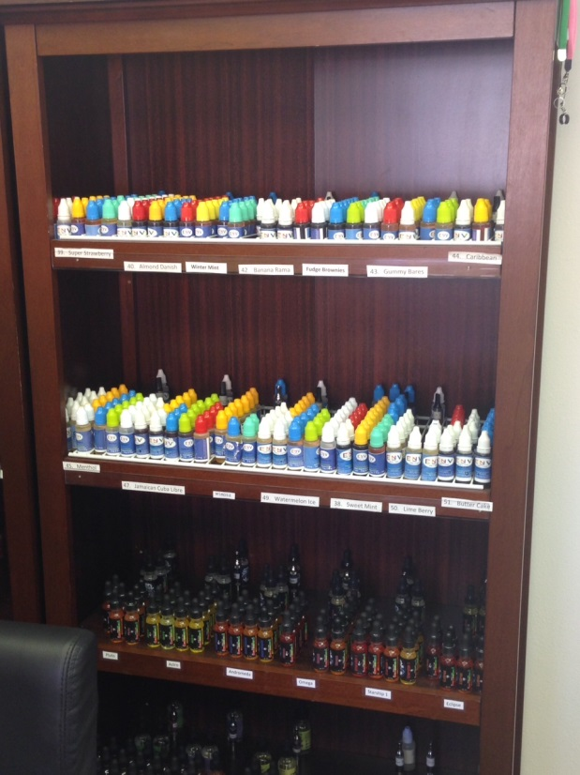
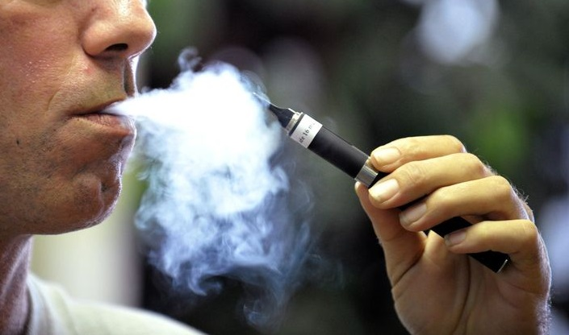
What are E-Cigarettes?
A noncombustible product employing a device containing a mechanical heating element, battery, or circuit which is used to heat a liquid contained in cartridges for the purpose of direct inhalation of the resultant vapor (as defined by HB 5124)
Unregulated by the Federal Food, Drug and, Cosmetic Act (Chapter V)
Contains highly concentrated liquid nicotine, up to 36 mg/mL in 15 mL bottle
1 gallon refill bottles also available
Highly toxic in kids in small amounts
Less than a mouthful

Slide 15
Deal or No Deal?
29,155 cigarettes
at 13 mg of nicotine
per cigarette
1,456 cigarette packs
1 gallon = 3,785 mLs = 378,500 mg of pharmaceutical grade nicotine

Slide 16
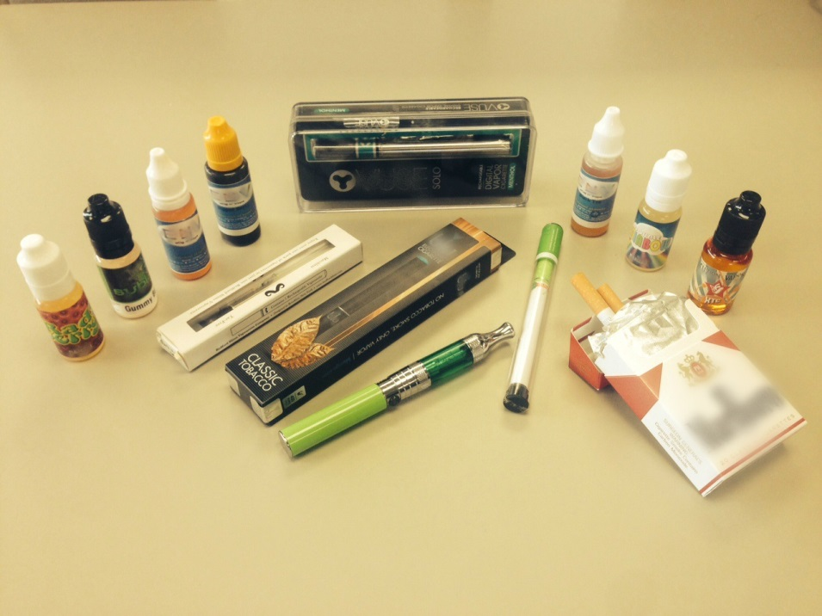
Clinical Symptoms of Nicotine Toxicity
Symptoms can range from…
Nausea and vomiting
Agitation
Racing heart
High blood pressure
Seizures
Coma
Death
IV injection
Ingestion
First death from ingestion in 11/2014 in a 1 year old in NY
Recent cases in WA with teens addingliquid nicotine into sodas

Slide 17
Formaldehyde in E-Cigarettes
Study from Portland State Univ.
Published in New England Journal of Medicine
E-cigs release higher concentrations of chemicals containing formaldehyde
IARC Group 1
Asbestos
Arsenic
Benzene
Jensen RP, Luo W, Pankow JF, Strongin RM, Peyton DH. Hidden formaldehyde in e-cigarette aerosols. N Engl J Med 2015;372:392-4.

Slide 18
Many Unknowns with E-Cigarettes
Long-term health impacts not known at this time so unclear how much “safer” they are
Do e-cigarettes actually assist with smoking cessation or do they expose people to nicotine at a younger age and possibly serve as a gateway to combustible cigarettes?

Slide 19
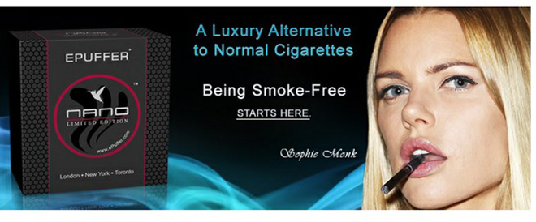
Why Are Teens and Adults Using E-Cigarettes?
Lower cost of entry (~ $20.00/starter kit)
Readily availability at convenience stores, gas stations, independent vape shops
Only need to be 18 years old to purchase (if ID is checked)
Liquid Nicotine flavors & names that appeal to teens and young adults (candy, liquor, drugs “ecstasy”, minty, etc.)
Devices have a high-tech design and advertising (including social media and celebrity endorsement) is targeted directly to teen/young adult market
Enhances athletic performance?
Easy to conceal its use in school or other public places
Electronic cigarettes being used to vaporize cannabis oil

Slide 20
Easy access
Babysitter
Homegrown
Parents
Friends
Gas stations
Smoke shops
School
Parties
Siblings
Grandparents

Slide 21
HYS: Tobacco/E-Cigarettes
Overall rate of smoking dropped significantly in past 12 years but…
40,000 youth aged 11 – 17 currently smoke
32 youth start smoking each day
With advent of e-cigarettes, more youth being exposed to nicotine at a younger age
1 in 5 10th graders have vaped in the past 30 days
17% of 10th graders use more than one substance
Cigarettes, e-cigarettes, marijuana, alcohol, etc.

Slide 22
Advertising Aimed at Youth

Slide 23
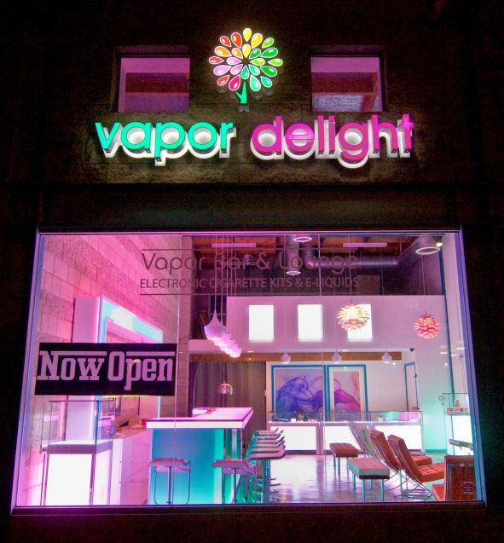
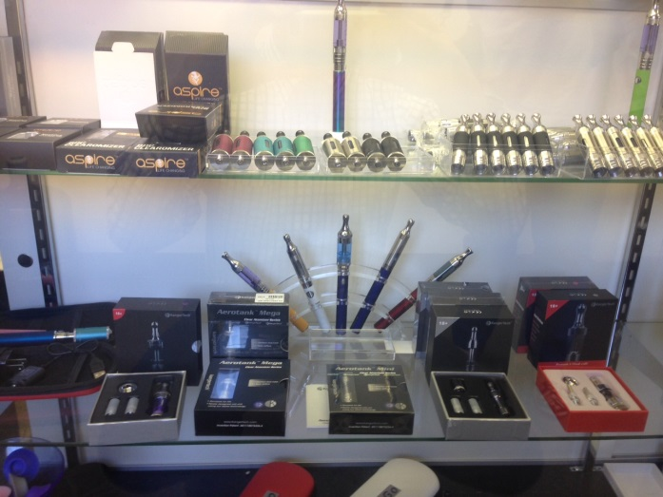
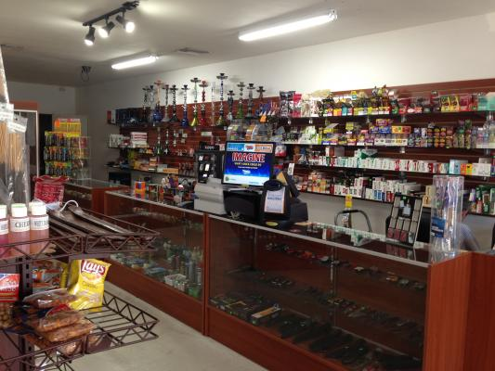
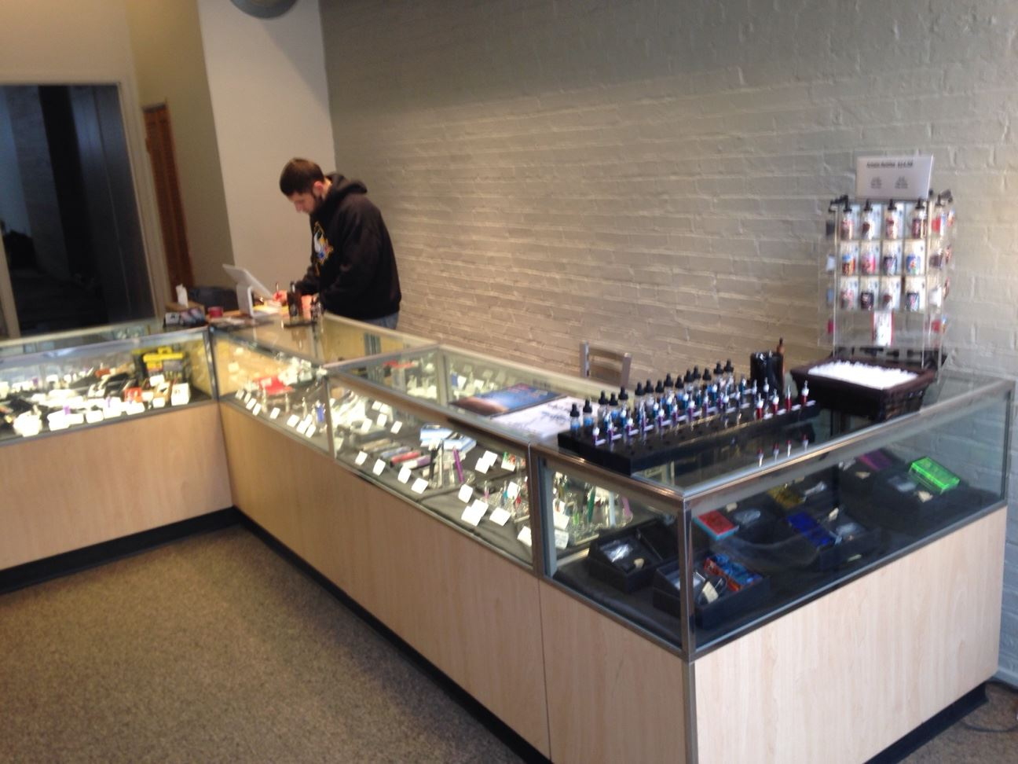
Vape Shops

Slide 24
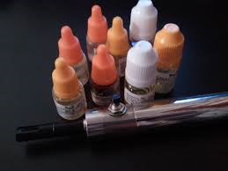
Disturbing Trend in Washington State
24 cases in 2015 so far…

Slide 25
WAPC E-Cig Exposure Data

Slide 26
WAPC E-Cigarette Data

Slide 27
WAPC E-Cigarette Data

Slide 28
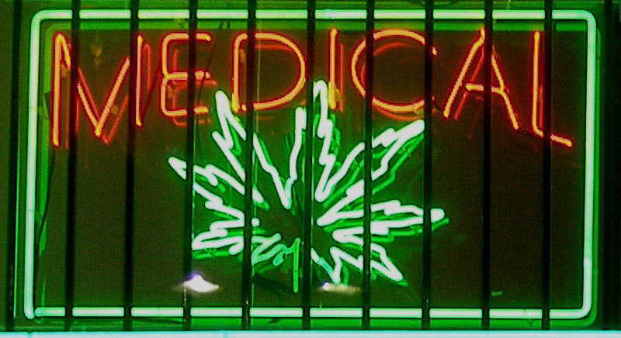
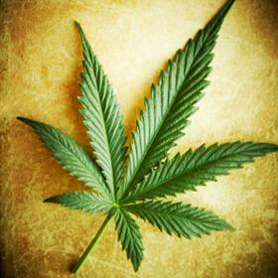
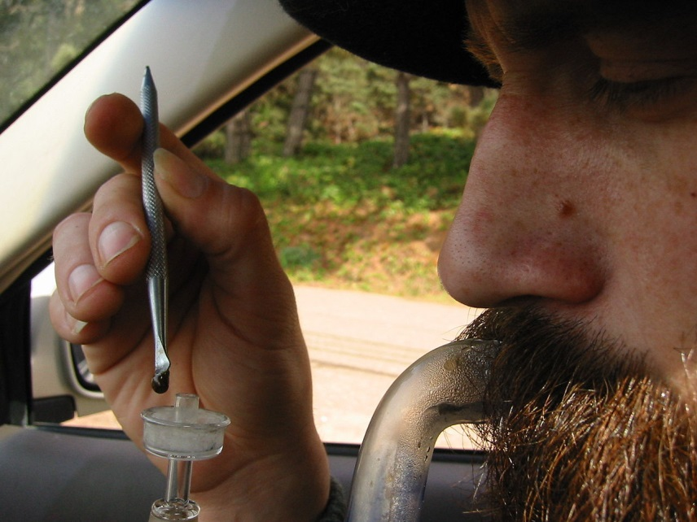
Let’s Shift Gears

Slide 29
Marijuana in WA State
I-502 (passed 2012) legalized recreational marijuana use
Removed state-law prohibitions against production, processing and selling of marijuana
Allowed limited possession of marijuana for 21+
Established a system of taxing marijuana
Individuals 21 years and older may possess and use…
1 ounce of usable marijuana
16 ounces of marijuana-infused product in solid form; or
72 ounces of marijuana-infused product in liquid form.
Marijuana-related drug paraphernalia.
I-692 permitted patient with certain medical conditions to use medical marijuana (passed 1998)
Technically illegal under WA and federal law to possess, buy or sell medical marijuana
Provides an affirmative defense to criminal prosecution if a qualified patient possesses the allowable amount

Slide 30
Location, Location, Location
334 current retail outlets allotted for recreational marijuana
King County: 61 shops
Pierce County: 31 shops
Snohomish County: 35 shops
Clark County: 15 shops
120 retail shops reporting sales
Estimated 1,100 medical dispensaries operating in the state

Slide 31
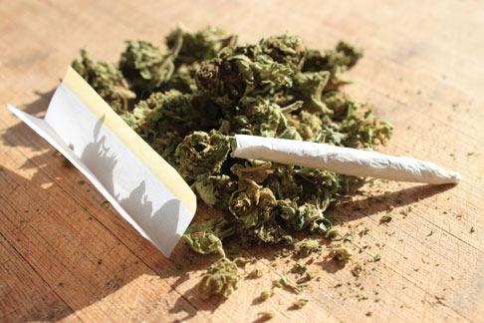
HYS: Marijuana
Most youth do not use marijuana
1 in 5 10th graders use
1 in 4 12th graders use
Most youth smoke marijuana followed by eating it
8th graders: 66% smoke marijuana and 15% eat it
Attitudes are changing towards marijuana and risk
10th graders: 36% versus 46% in 2012
Risky behavior and marijuana
1 in 5 10th graders and 1 in 4 12th graders rode in a car with a driver who was high

Slide 32
Marijuana Edibles
Recreational highly regulated i.e. few edibles
Medical marijuana largely unregulated with many different edibles
Approximately 250 medical marijuana dispensaries in Seattle
No standardized packaging, labeling, warning labels
Product branding attractive to pediatrics
Gummy Bear, Cookies, Brownies and familiar “product” identicals like pop tarts, candy bars, etc.

Slide 33
Marijuana over 15 years

Slide 34
Staggering Trend in Exposures
Q1 2014 = 54
Q1 2015 = 72

Slide 35
Marijuana Highlights

Slide 36
Marijuana Effects in WA

Slide 37
How are people using marijuana?

Slide 38
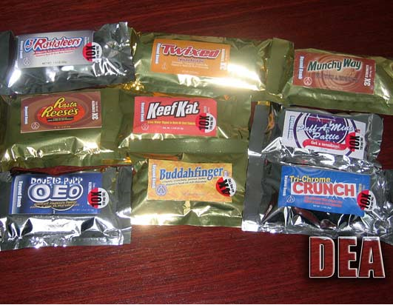
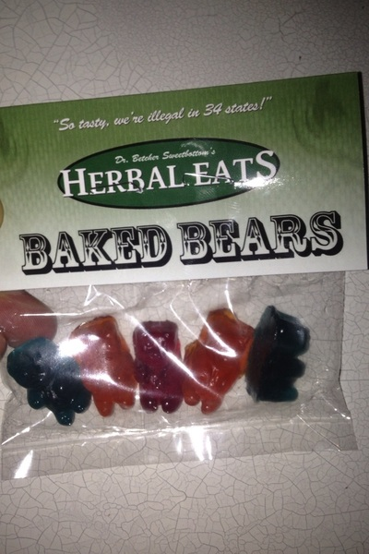
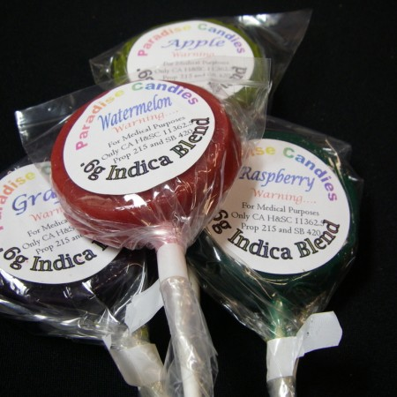
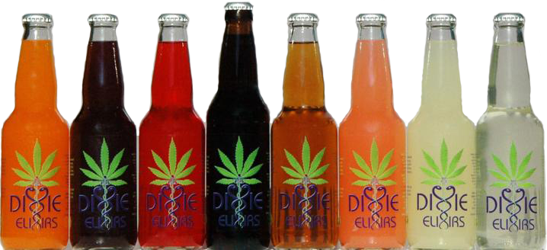
Marijuana Advertising & Branding

Slide 41
What you can do?
Contact your legislator!!!
http://app.leg.wa.gov/DistrictFinder/
Firstname.lastname@leg.wa.gov ex: david.frockt@leg.wa.gov
Follow e-cigarette bills in this legislative session
HB 1645 (misdemeanor to sell under 18, prohibited on school, campus, licensed sellers, labeling and packaging)
HB 2211 (tax on vapor products)
HB 1458 (raise age to purchase to 19)
Educate yourself through the Department of Health website
http://www.doh.wa.gov/
Educate on the Good Samaritan Law www.stopoverdose.org
“A person acting in good faith who seeks medical assistance for someone experiencing a drug-related overdose shall NOT be charged or prosecuted for possession of a controlled substance or penalized.”
Critical for teenagers to know as their friends may in trouble and they’re afraid to seek help

Slide 42
How do we talk to kids about drugs?
Set up a talk event
Mr. Yuk stickers can be a point of discussion
Ask scenario based questions regarding how they would take care of their friends or “stay above the influence”
“If you’re ever in a situation where your friend has taken something and is in trouble…”
Let them know the poison center is available
Free and confidential
Judgment free discussion
“Just Say No” doesn’t work with millennials anymore
They want information and to be able to make decisions
Inability to make a risk determination

Slide 43
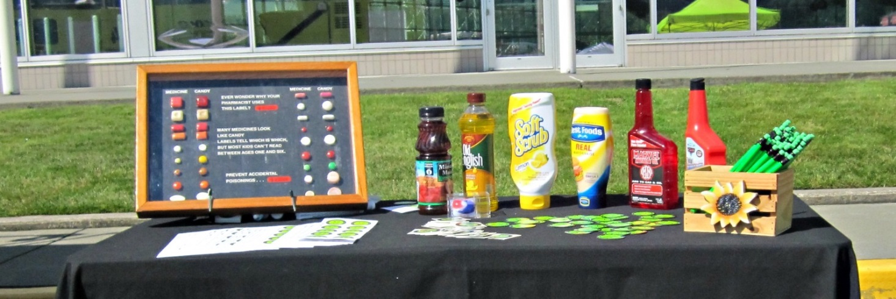
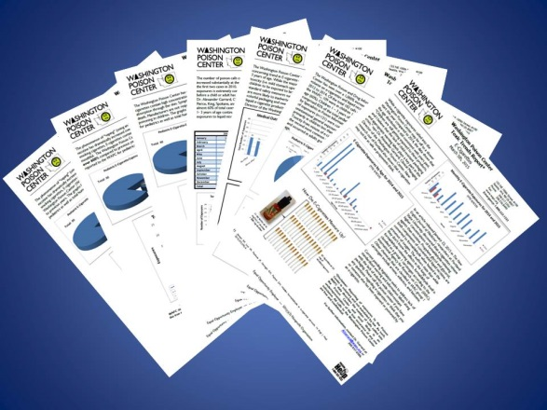
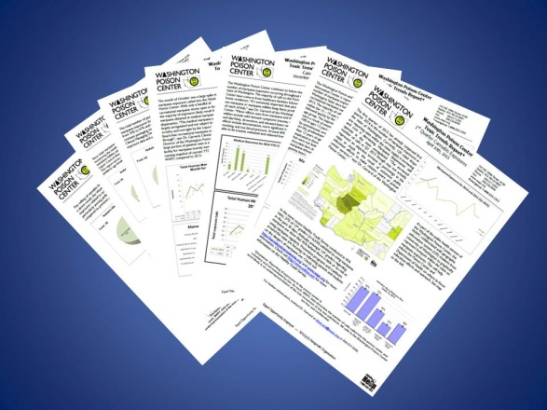
Prevent injuries by checking out a Yuk Box and giving a presentation
Subscribe to our Toxic Trend Reports and Seasonal Health Alerts by visiting our website: wapc.org

Slide 44
Program Your Cell Phone!
1-800-222-1222
Toll-free, Confidential Poison Center Number

