Slide 1
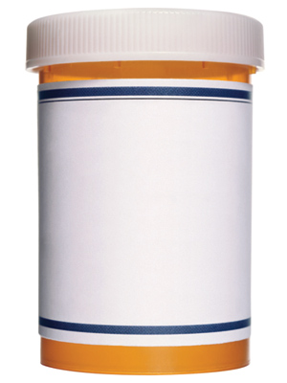
RX DRUG DISPOSAL
SAFELY DISPOSE MEDICATIONS at:
Omak Police Dept.
8 N. Ash St Omak, WA 98841
24 hours-a-day
Oroville Police Dept.
1306 Ironwood Oroville, WA 98844
*M-F 9a.m. – 4p.m.
Twisp Police Dept.
118 S. Glover Twisp, WA 98856
24 hours-a-day
www.okcommunity.org

