Slide 1
The Good? The Bad? The Ugly?
Marijuana one of the most misunderstood drugs of our time.
Washington State Spring Youth Forum
May 22, 2014

Slide 2
What is Marijuana?
Marijuana is a green-brown mixture of dried, shredded leaves, stems, seeds, and flowers of the hemp, or cannabis, plant
It goes by many different names—pot, herb, weed, grass—and stronger forms include hash oil
All forms of marijuana that contain THC are mind-altering (psychoactive), they change how the brain works
Marijuana contains more than 400 chemicals, including THC (delta-9-tetrahydrocannabinol) and CBD (Cannabidiol)

Slide 3

Marijuana Impacts on the Brain
Notes:
thejointblog.com (picture source)

Slide 4
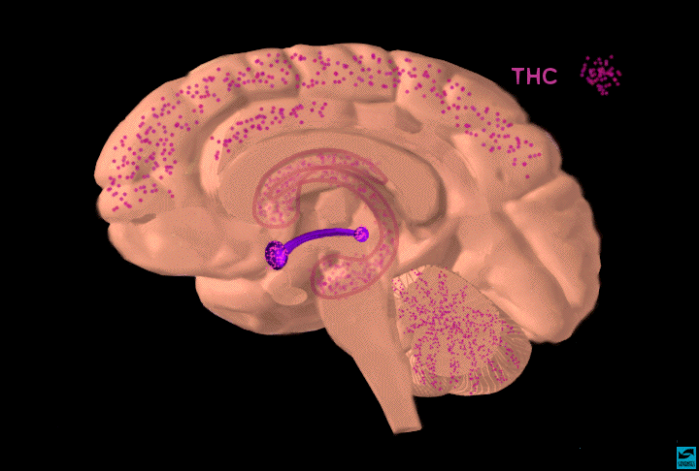
Notes:
THC binds to these areas in the brain with a large amount of cannabinoid receptors
Addictive drugs provide a shortcut to the brain’s reward system by flooding the nucleus accumbens with dopamine. The hippocampus lays down memories of this rapid sense of satisfaction, and the amygdala creates a conditioned response to certain stimuli. (Euphoric Recall)
SOURCE:
http://headsup.scholastic.com/articles/endocannabinoid (picture source)

Slide 5
Neurotransmitter - Anandamide
Your brain has groups of cannabinoid receptors concentrated in several different places
Cannabinoid receptors are activated by a neurotransmitter called anandamide
anandamide is a cannabinoid, but one that your body makes
THC mimics the actions of anandamide, meaning that THC binds with cannabinoid receptors and activates neurons
Notes:
This causes adverse effects on the mind and body as it interferes with the natural cannabinoids as shown on the next slide
Focus on Nucleus accumbens: dopamine release
Addictive drugs provide a shortcut to the brain’s reward system by flooding the nucleus accumbens with dopamine. The hippocampus lays down memories of this rapid sense of satisfaction, and the amygdala creates a conditioned response to certain stimuli. (Euphoric Recall)
Anandamide ( -arachidonoylethanolamine) is a brain chemical that activates the same cell membrane receptors that
are targeted by tetrahydrocannabinol, the active ingredient in marijuana and hashish. The pharmacological effects of
anandamide suggest that it may play important roles in the regulation of mood, memory, appetite, and pain
perception. It may act as the chief component of a novel system involved in the control of cognition and emotion.
Physiological experiments show, in fact, that anandamide may be asimportant in regulating our brain functions in
health and disease as other better-understood neurotransmitters, such as dopamine and serotonin. The research
objective is to understand the physiological roles of anandamide and the biochemical mechanisms of its synthesis and
inactivation.

Slide 6
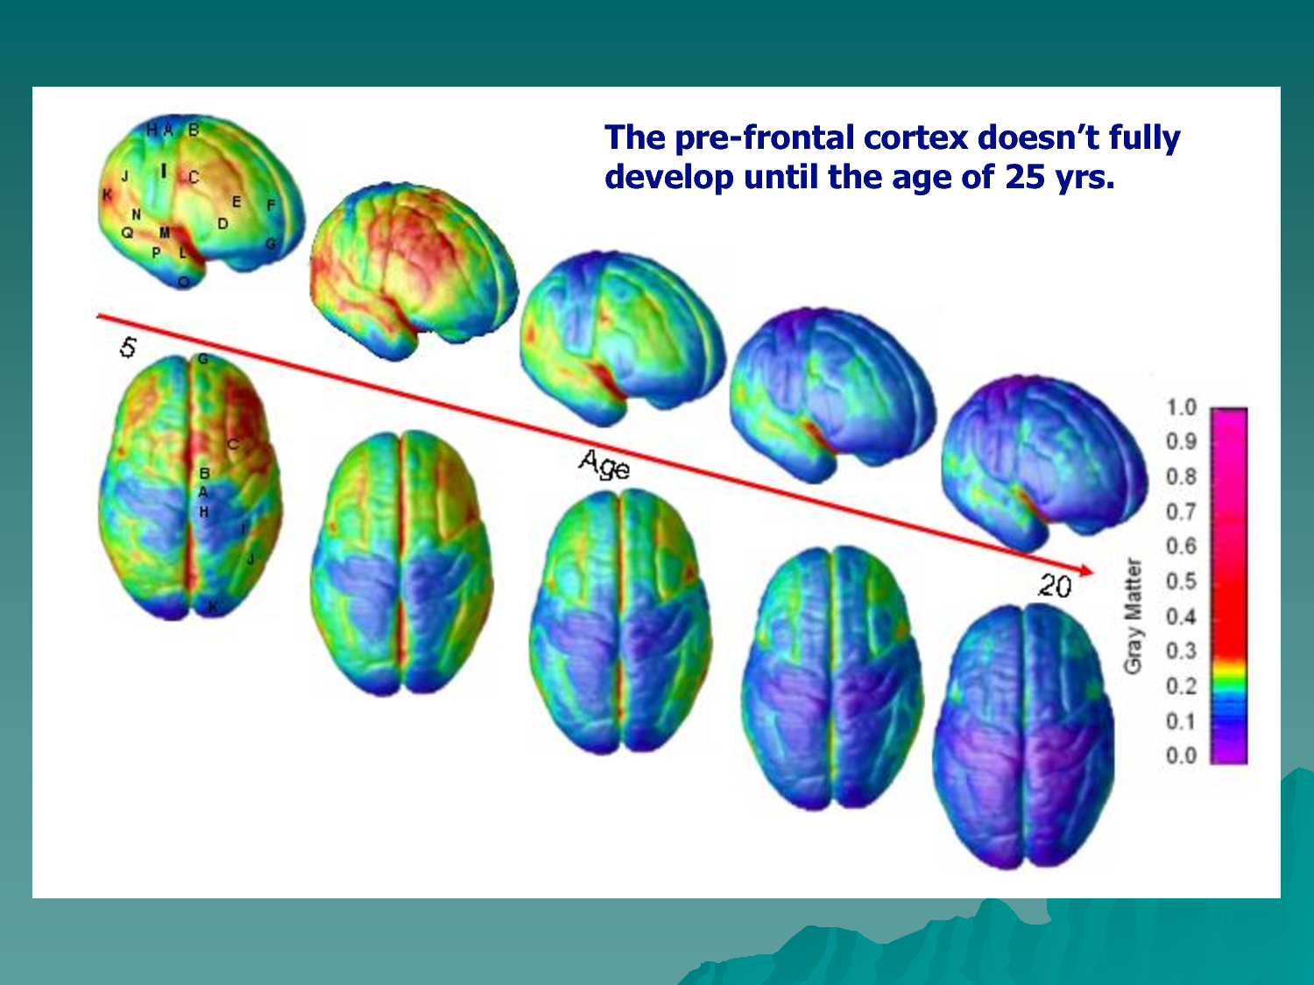
Adolescent Brain
The teenage brain is not just an adult brain with fewer miles on it.
Notes:
personality expression, decision making, and moderating social behavior

Slide 7
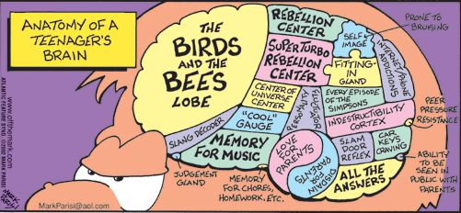
Adolescent Brain
The teenage brain is not just an adult brain with fewer miles on it.
Notes:
The teenage brain is not just an adult brain with fewer miles on it.

Slide 8
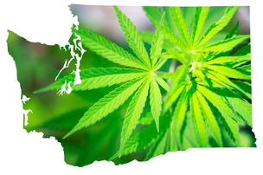
The Good? The Bad? The Ugly?
Medical Marijuana
Retail Marijuana
Popular Culture Glamorizing the use
Forms Marijuana is being consumed

Slide 9
The Good?
Medical Marijuana Uses
  Nausea and Vomiting (CINV)
  HIV/AIDS (anorexia)
  Pain (Neuropathy, Fibromyalgia, Rheumatoid Arthritis)
  Multiple Sclerosis (Muscular Spasticity)
  Seizures (Dravet Syndrome)
Notes:
CINV---can be effective
HIV/AIDS—can be effective
Pain---Somewhat possibly effective, if pain associated with neuropathy, fibromyalgia and rheumatoid arthritis
Multiply Sclerosis—objective post-treatment assessments do not reveal significant change.
Seizures—CBD on preps have been found to reduce severity and frequency of seizure activitiy

Slide 10
The Good?......Cont.
Medical Marijuana Patients Profile
30 and below | 29%
31-50 | 39%
51 and above | 32%
Severe pain | 94%
Muscle spasms | 13%
Nausea | 10%
Cancer | 3%
Seizures | 2%

Slide 11
The Good?
AMA Statement: Medical Marijuana
The AMA calls for further adequate and well-controlled studies of marijuana and related cannabinoids in patients who have serious conditions for which preclinical, anecdotal, or controlled evidence suggests possible efficacy and the application of such results to the understanding and treatment of disease.

Slide 12
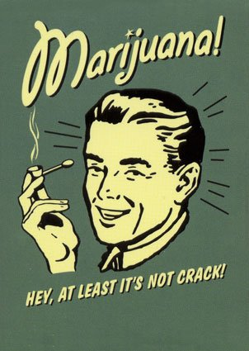
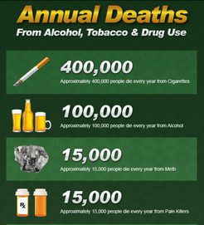
The Bad?
Marijuana use is gaining acceptance:
  “As has been well documented, I smoked pot as a kid, and I view it as a bad habit and a vice, not very different from the cigarettes that I smoked as a young person up through a big chunk of my adult life. I don’t think it is more dangerous than alcohol,"

Slide 13

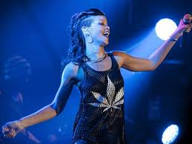

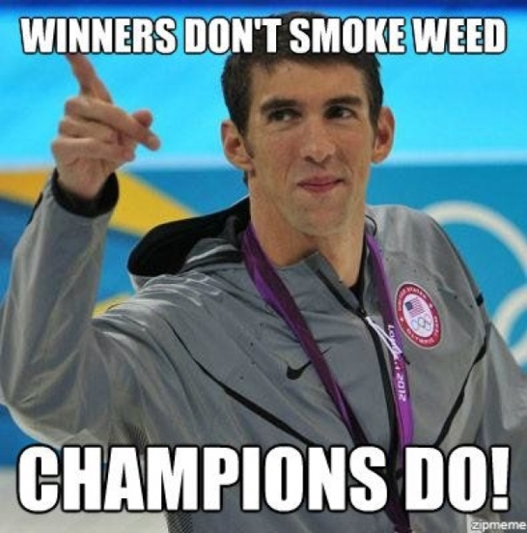
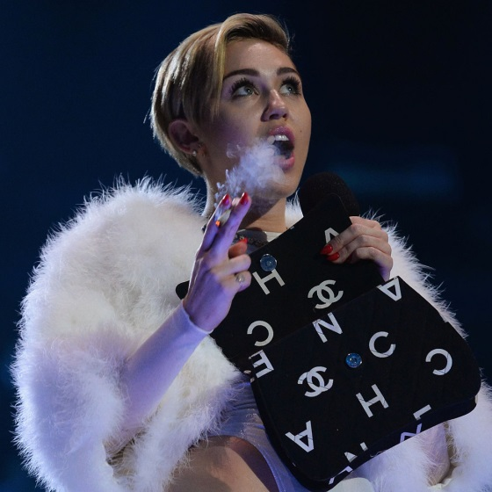
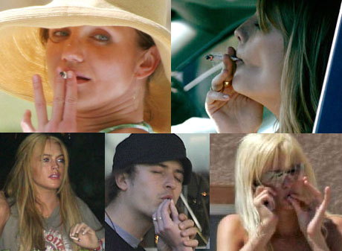
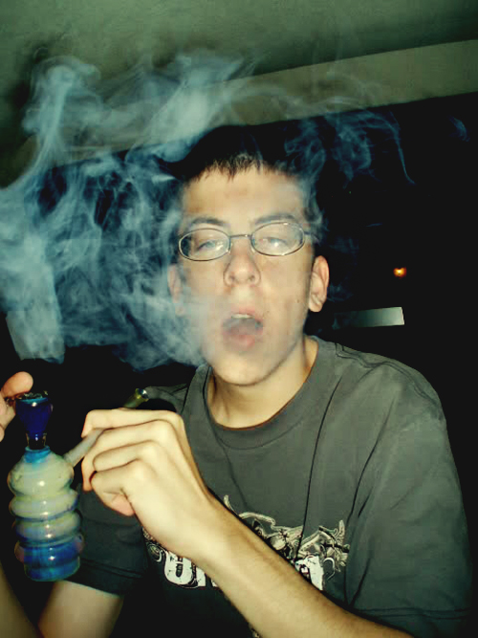

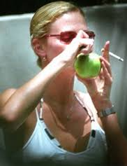
Marijuana is Popular in Our Culture
http://www.google.com/search?hl=en&sugexp=les%3B&gs_rn=5&gs_ri=psy-ab&cp=13&gs_id=1e&xhr=t&q
Notes:
All pictures from Google Images.

Slide 14
The Bad?....Cont.
Not your parents weed!
Since 1972, the average THC content of marijuana has soared from less than 1% to an average of 13% today.
It’s not the same DRUG!!!!!

Slide 15
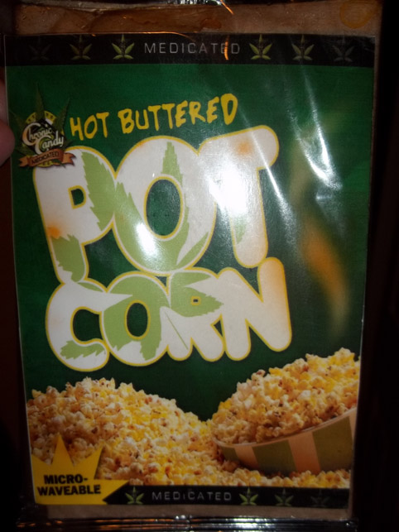
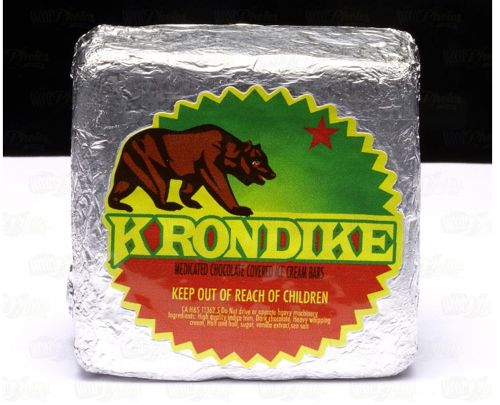
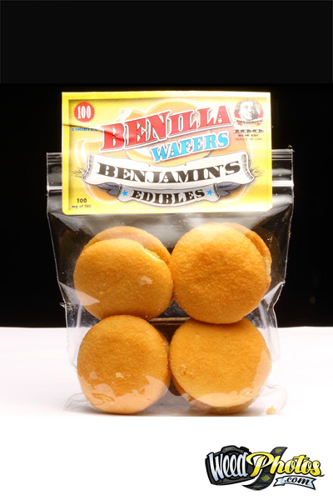
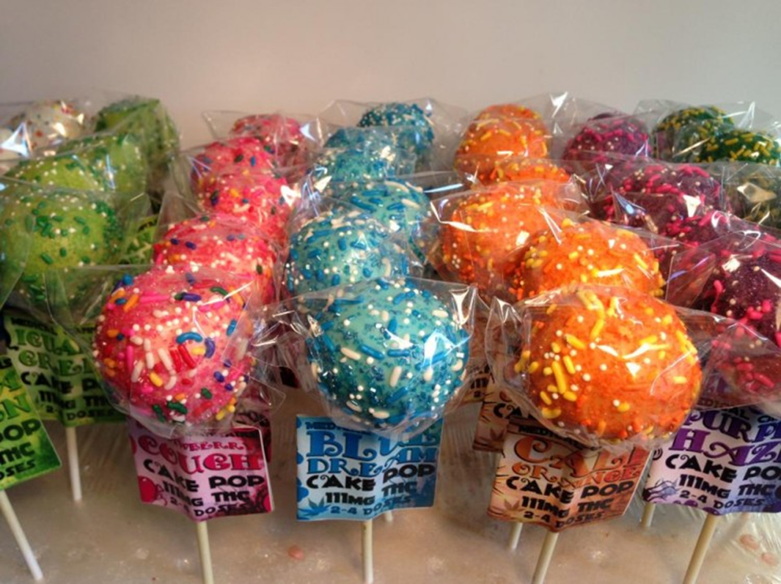
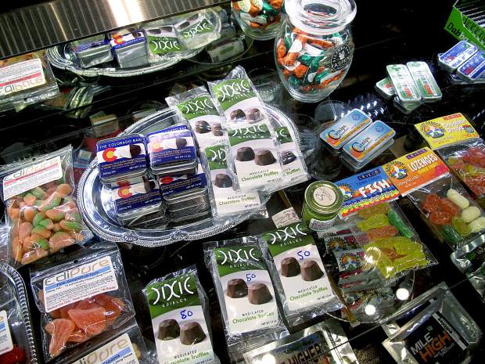
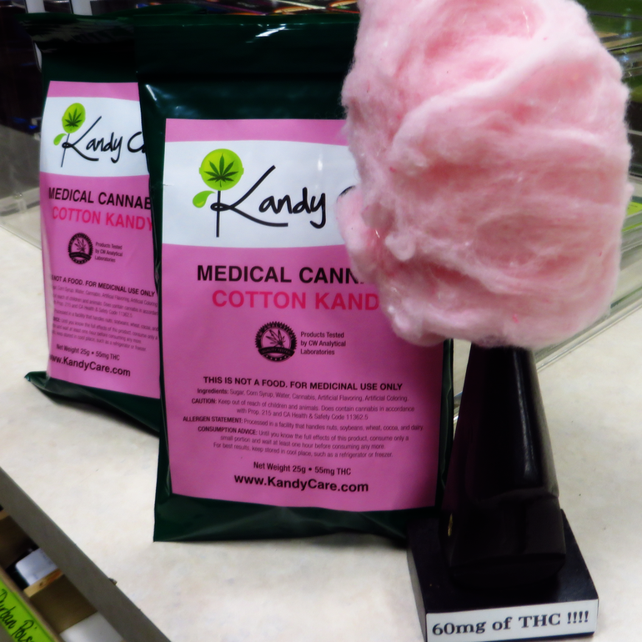
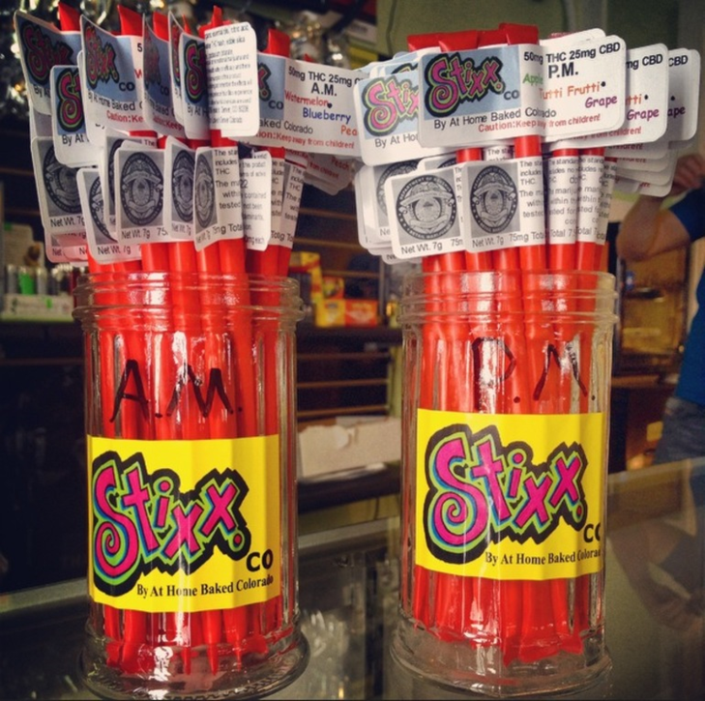
The Ugly?
Marijuana is legal both Medicinally (I-692) and Recreationally (I-502)
Edibles, Edibles, Edibles!!!!

Slide 16
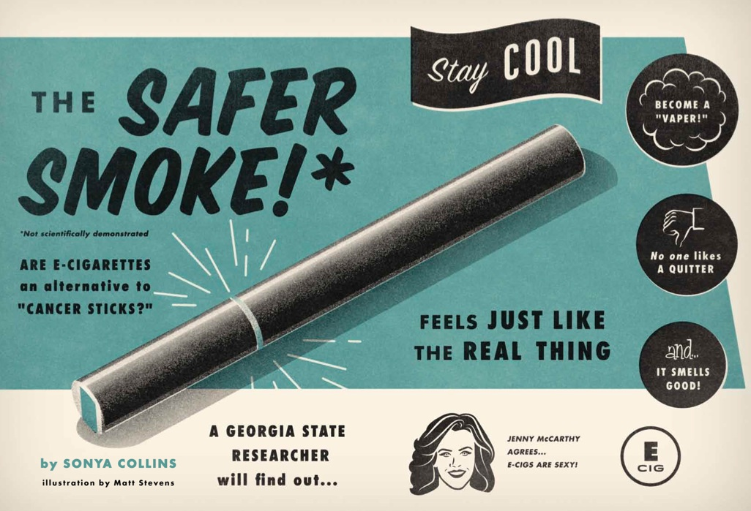
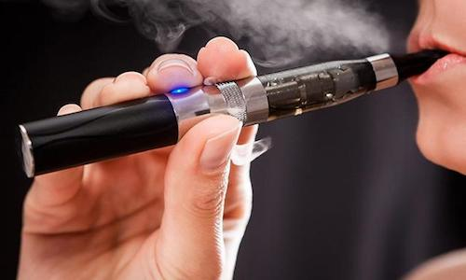
The Ugly?
Electronic Smoking Devices

Slide 17
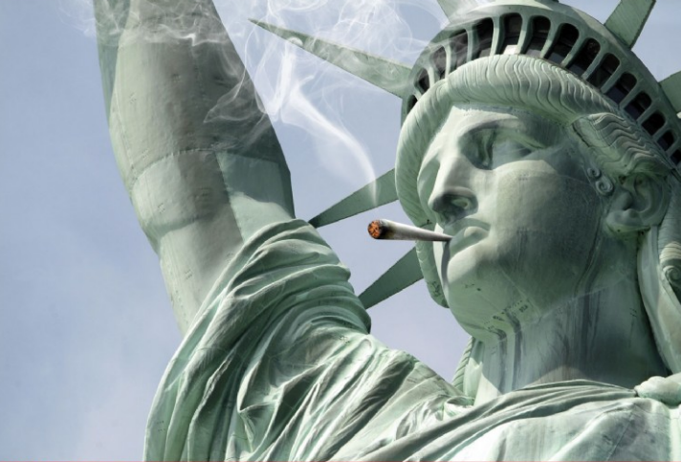
Where do we go from here?
Notes:
With an understanding of how marijuana impacts the adolescent brain, let’s take a look at the trends we see among adolescents in our state

Slide 18
Address the Real Problem
Question Time:
Do you think that Marijuana is a problem?
If Marijuana was eradicated today, would that take care of a large portion of substance abuse in your community?

Slide 19
Address the Real Problem
People take drugs because they want to change something about their lives.
  To fit in
  To escape or relax
  To relieve boredom
  To seem grown up
  To rebel
  To experiment
  Misinformation
They think drugs are a solution. But eventually, the drugs become the problem.

Slide 20
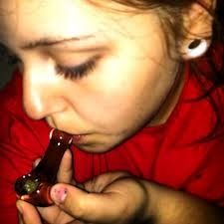
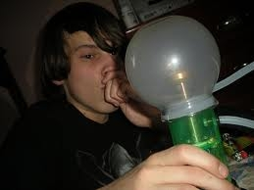
Perception of Approval
34.3% of Washington youth feel that they would be seen as cool if they had smoked marijuana at least once in the past 30 days.
58.0% of Washington youth think their parents would not feel that it would be wrong, for them to have smoked marijuana at least once in the past 30 days.
Notes:
In addition, 55.6% of Washington youth feel that they would be seen as cool if they smoke marijuana at least once in their lifetime and 77.1 % of Washington youth think their parents would not feel that it would be wrong, for youth to smoke marijuana at least once in their lifetime.

Slide 21
What Can We Do
Ask your teen’s views
Be HONEST!!!
Discuss reasons not to abuse drugs
Consider media messages
Discuss ways to resist peer pressure
Be ready to discuss your own drug use
Don’t be afraid that talking about drug use will put the ideas of using in your teen’s head.
Notes:
Here are some tips for talking with your teen about drugs:
Ask your teen's views. Avoid long, boring lectures. Instead, listen to your teen's opinions and questions about drug use. Observe your teen's nonverbal responses to see how he or she feels about the topic. Encourage your teen to talk by making statements instead of asking questions. For example, saying, "I'm curious about your point of view" might work better than "What do you think?"
Discuss reasons not to abuse drugs. Avoid scare tactics. Emphasize how drug use can affect things important to your teen — such as sports, driving, health and appearance. Explain that even a teen can develop a drug problem.
Consider media messages. Some television programs, movies, websites or songs glamorize or trivialize drug use. Talk about what your teen has seen or heard.
Discuss ways to resist peer pressure. Brainstorm with your teen about how to turn down offers of drugs.
Be ready to discuss your own drug use. Think ahead about how you'll respond if your teen asks about your own drug use. If you chose not to use drugs, explain why. If you did use drugs, share what the experience taught you.

Slide 22
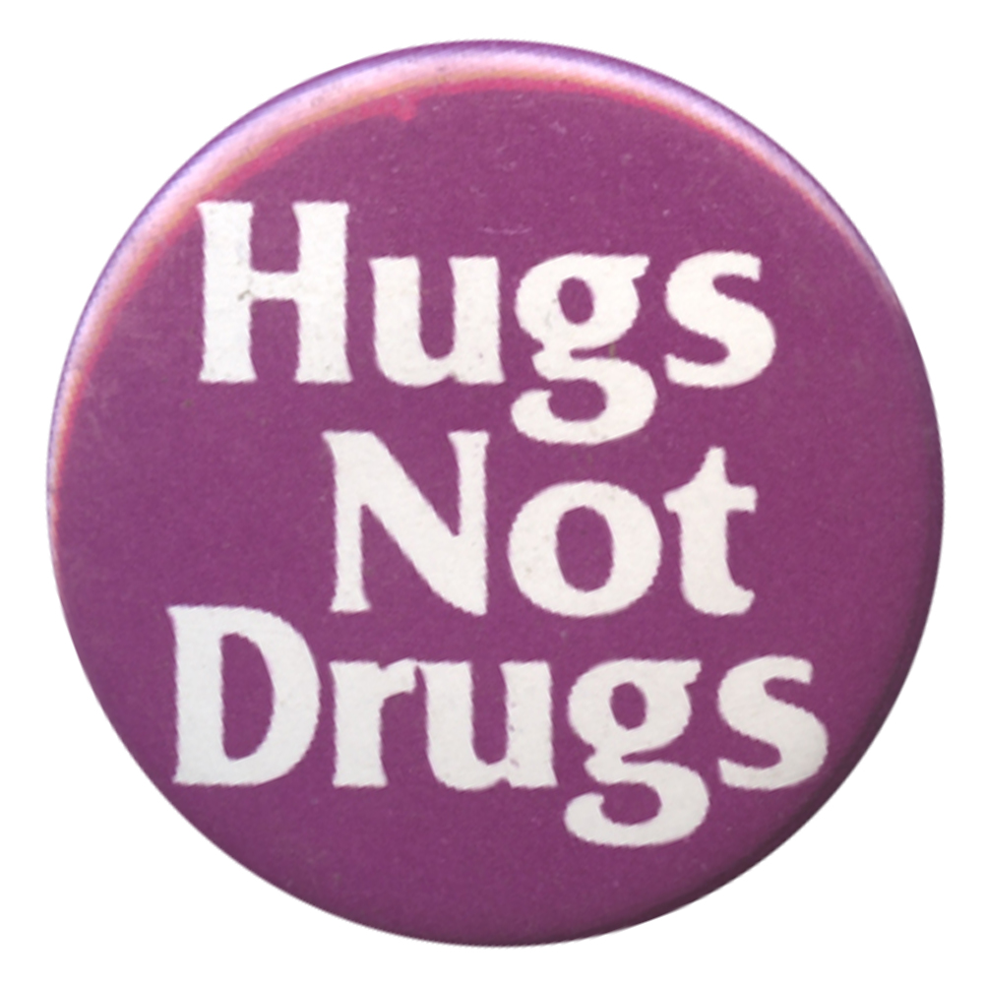
What Can We Do
Know your teen’s activities
Establish rules and consequences
Know your kid’s friends
Provide support
Set a good example

Slide 23
Questions?
Scott McCarty, Prevention Systems Project Manager, Division of Behavioral Health and Recovery
  Scott.McCarty@dshs.wa.gov
  360-725-1497

