Slide 1
IMPACTS AND EFFECTS OF DRUGS AND ALCOHOL ON VICTIMS OF HUMAN TRAFFICKING
Washington Prevention Summit
October 20, 2014
Presented by: Emma Catague
and Former Rep. Velma Veloria

Slide 2
What is Human Trafficking
Human Trafficking: The use of force, fraud or coercion to compel a person into any form of work against his or her will.
Federal Definitions
Labor Trafficking: Using force, fraud or coercion to recruit, harbor, transport, obtain or employ a person for labor or services in involuntary servitude, debt bondage or slavery
Sex Trafficking: Commercial sex act induced by force, fraud or coercion, or in which person performing the act is under age 18

Slide 3
History of Human Trafficking in Washington State
1995 murders inside the KC Courthouse
-Phoebe Dison, Victoria Laureta, Suzanna Blackwell (mail order bride)
1999 Murder of Anastasia King (mail order bride)
2001 1st U.W. Women's Center conference on HT
-study OCVA study Does HT exist in WA
2003 HB 1175-making human trafficking a crime
2003 Joint Oversight Committee on Trade Policy (impact to global workforce)

Slide 4
Root causes
Poverty
Natural Disasters
International Free Trade Policies
Greed
Notes:
4

Slide 5
Who are the victims?
Men, women and children
Various ages and educational backgrounds
Documented and undocumented migrants

Slide 6
Who are the traffickers?
Women & Men
Friends
Family
Neighbors
Village Leaders
Religious Leaders
Government Officials
(i.e. diplomats)
Agricultural Landowners / Farmers
Owners of small/medium size businesses
Organized crime
Individuals unknown to the victim(s)
Notes:
6
Again, a trafficker could be just about anyone. We actually see many cases in which women are the traffickers – particularly with foreign national cases. Many times the trafficker is someone known to the victim – a family member or friend of the family. Sometimes it’s a stranger introduced to the victim by someone he or she knows. It’s important to note that family members can be traffickers and to not dismiss something that doesn’t seem right because it involves a family member. Sometimes relatives have more power to control a victim than strangers do. With domestic sex trafficking cases, often the trafficker is the “boyfriend” of the victim – or at least that is how the victim refers to him. Generally speaking in those cases, we are seeing a female victim and a male pimp or trafficker – sometimes there are girls who work for the trafficker to sort of enforce his rules on the other girls – these are generally called the “bottom” or “main” girl. This person may be responsible for recruiting new girls as well.

Slide 7
Local Manifestations
Sex and Labor Trafficking –American Citizens vs. Foreign Nationals
Under 18 yrs old runaways
Drug and alcohol abuse

Slide 8
Runaways
Disproportionately involved in commercial sexual exploitation;
Average entry is 12-14 yrs for girls; 11-13yrs for boys;
75% are controlled by their traffickers;

Slide 9
Intersections of Human Trafficking and Drug and Alcohol Abuse
Recruitment: use drugs to target those who are already; to entice non users into recruitment;
Control: keep victim in a trafficking situation; used as a way to punish, reward,decrease victims will to escape;
Coping: victims use drugs to dull the pain;
Drug Purchase and Sell: traffickers may ask for drugs in exchange for victim; use victim to traffick or sell drugs.

Slide 10
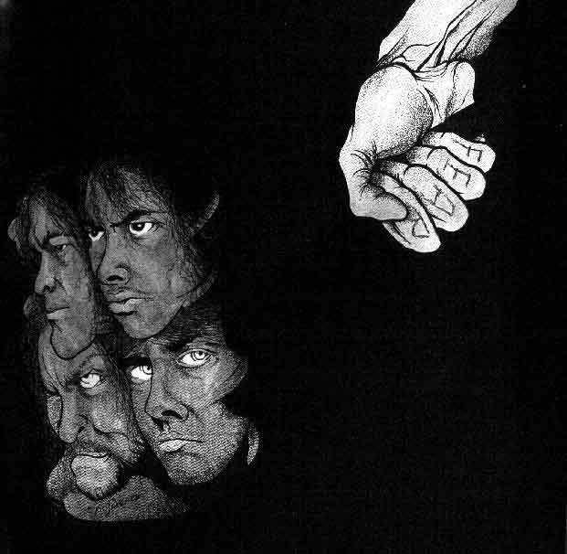
VICTIM IDENTIFICATION
Signs to Observe
Abusive or Forced Labor
Underage Commercial Sex
Forced/Coerced Commercial Sex
Servile Marriage
Control , Fear, Submission
Language/Cultural barriers
Control of documents
Ability to come and go
Work conditions
Voluntariness of work
Living conditions
Debt
Threats
Notes:
These are some things you can listen or look for when you are working with someone who may be a victim of trafficking. It’s important to note that poor working conditions and even no pay are not enough alone - the question really is whether or not the potential victim had the ability to leave the work situation. Again, this may not be obvious at face value – they may not be physically prevented from leaving but the threats and coercion that traffickers use may be what makes a victim feel like they cannot leave. Also, with sex trafficking we often hear victims say they do it because they want to, it’s their own choice but when you start asking questions about who gets the money from the sex work it becomes more obvious that they are not in control or making their own choices. We cannot force victims to come forward or to admit they are victims – we can simply offer assistance and hope they will accept it.

Slide 11
Suspect someone is a victim of human trafficking?
What are your working or living conditions like?
Has anyone forced you to do something you did not want to do?
Can you leave your work or job situation if you want?
When you are not working, can you come and go as you please?
Where do you sleep and eat?
Do you have to ask permission to eat, sleep or go to the bathroom?
Have you been threatened if you try to quit?
Notes:
11
Use this slide only for service providers (not community members) This is a list of questions you can use as a guide. I’m not going to go through each one but wanted you to have them for your reference. This list is not exhaustive and it’s more important to try to establish the freedom of choice the person has related to the work they are doing.

Slide 12
Serving Survivors of Trafficking
Trauma Informed Approach
Build Trust
We are here to help you.
Our first priority is your safety.
We can find you a safe place to stay.
We can help get you what you need.
You are entitled to assistance. We can help you get assistance.
Confidentiality
Sensitivity – trauma, culture, language
Check in with client: explanations, understanding, permission, comfort, questions, informed decisions
Notes:
12
Use this slide only for service providers (not community members) Now I’m going to move into the way that we serve victims of trafficking. If you identify someone who is a victim of trafficking, you can certainly call us for assistance. You can refer the case directly to us or we are happy to provide guidance to you as you serve the client. I know that many of you are victim advocates so I’m not going to go into every detail of serving victims, just some of the things that apply to victims of trafficking from our experience.
All of the clients we have served have been traumatized by their trafficking experience – whether it was 3 months of exploitation or 20 years. I can tell you that each and every one of our clients demonstrate their trauma in different ways. Some are very emotional, some show very little emotion, some talk a lot, and with some it is really difficult to get them to talk. We try really hard to explain what is happening to our clients so that they feel comfortable with us and the situation. We have never had someone come to us and say “I am a victim of trafficking, please help me.” They almost never self-identify – even after we’ve identified them. The way I explain who we are is to say that we try to help immigrants who are caught in a situation they did not expect and have little control over. We try to check in with the client to make sure he or she understands what we are saying. Checking in with someone who’s first language is not English usually means more than saying “Do you understand?” because often our clients will say “yes” to be polite. If we are communicating in English, I will usually say, can you tell me what I just told you or can you tell me what you understand.

Slide 13
Working with Interpreters
Prior experience
Not family member or friend
Independent and neutral
Language accuracy
Confidentiality
No expression of opinions or beliefs
Respectful and courteous
Notes:
13
Use this slide only for service providers (not community members) One thing that is very important when working with immigrant victims of trafficking is using interpreters. Sometimes a client can communicate in English but it is not always possible or the best way for the client to truly understand everything he or she needs to understand. I really suggest developing relationships with reliable interpreters in your area – before you need them. It is always important to check for conflicts between the interpreter and the client to ensure that the interpreter does not know anyone involved in the trafficking situation. We have actually had interpreters tell clients not to talk to us during an interview, or tell them they are lying and should go back to the abusive situation. It can be really bad. You should be totally willing to talk to the interpreter in advance and say “I want you to strictly interpret what I say and what the client says. I do not want you to add any commentary or have any discussion with the client outside of strict interpretation.” It may sound rude or condescending but the client has to be our first priority. I also recommend having the interpreter sign a confidentiality agreement to reinforce that nothing he or she hears will be repeated.
I realize that resources are tight and that it’s not always possible to pay a court certified interpreter. Usually for service provision that does not include in depth legal language, a non-certified interpreter can work fine so long as there is no conflict and they are very clear about their role and your expectations. If at any time the client appears uncomfortable with the interpreter, you can stop and check in with the client to see if all is ok. Use your powers of observation to try to detect anything that may be amiss.

Slide 14
Cultural Considerations
Culture
Shared experiences, background, values, history, ethnicity, race
Cultural identity
Cultural Misinformation
Assumptions based on race, geography, socio-economic status, behavior, prior experience
Prejudice
Racism
Notes:
14
Use this slide only for service providers (not community members) Being aware of cultural differences is really important when working with all victims of trafficking – both immigrants and domestic victims. I do not share a lot of cultural experience with a 16-year-old street-involved youth. So culture is more than just ethnicity. I don’t agree with the term “cultural competency” because I don’t believe any of us can be completely competent in someone else’s culture. But we can be sensitive to it. We can try to understand that culture may create difficult communications. We can ask about someone’s culture – what kind of food can you eat; are there restrictions that would prevent you from staying at a certain housing facility – we had a client who unexpectedly started asking to be sent home and we couldn’t figure out why. It turned out that people were cooking with pork in the shelter kitchen where she was staying and instead of bringing that up, she just asked to go home. Having that information allowed us to serve her real needs.

Slide 15
Washington Anti trafficking Response Network (WARN)
Services
-Urgent & Long-Term Response:
24-hour victim assistance line: 206.245.0782
Physical and mental health treatment
Access to safe housing, food and clothing
Intensive Case Management
Criminal justice-system/ victim rights advocacy
Safety awareness/planning
Using the bus; grocery shopping; public benefits
Immigration advocacy and legal assistance
Interpretation services
English classes and job readiness training
Repatriation, if desired by client
Notes:
15
This a very brief overview of the types of services WARN offers to victims of trafficking. We work with clients to figure out what their needs are and we find ways to provide for them. We may pay for housing for someone for several months while they seek immigration relief, we pay for all their basic needs like food and clothing. And we also help them through working with attorneys and the legal system. We support them as victims in the criminal justice system as well.

Slide 16
Washington State Crime Victim Services
Office for Crime Victim Advocacy (OCVA)
-Provides funding to 56 crime victim service centers covering all counties across Washington state
-Advocates on behalf of victims obtaining needed services and resources;
-Administers grant funds for community programs working with crime victims;
-Assist communities in planning and implementing services for crime victims;
- Advise local and state government agencies of practices, policies, and priorities which impact crime victims
Notes:
16
WARN works closely with crime victim service centers across the state to provide technical assistance to victim advocates and give/receive case referrals depending on where the survivor is located

Slide 17
GAPS in Services
Lack of all types of housing (emergency, under 18yrs and over 18)
Drugs and alcohol prevention programs sensitive to the needs of victims (detox, inpatient and outpatient)
Mental health (psychiatric, outpatient and inpatient)
Culturally relevant training for all professionals
Notes:
17
First responders, etc.

Slide 18
What can you do?
Raise Awareness:
Spread the word with your family, friends, church and school groups, businesses and the public – host training
Encourage Govt. Agencies to develop policies that protect and prevent children and adults from becoming victims
Notes:
18

Slide 19
What can you do?
Make Conscious Consumer Choices:
-Look for “sweat shop free” clothing and fair trade products – productsofslavery.org
Support policies for the prevention of human trafficking:
-corporate responsibility bill; international fair trade policies
-Assets seized from drug bust to fund drug abused victims of human trafficking

Slide 20
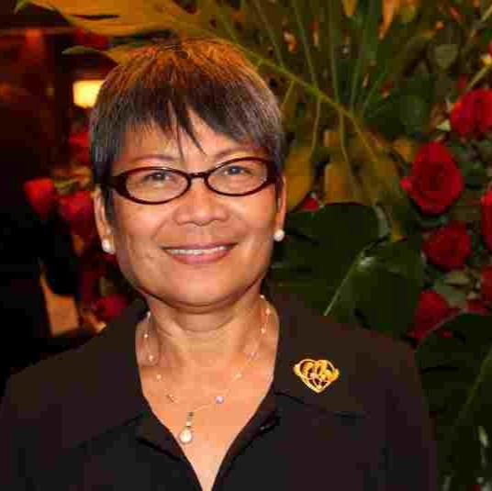
THANK YOU

