Slide 1
HYS 201.
Digging Deeper Into Your HYS Results
March 20th, 2013

Slide 2
Training Overview
Statistical issues
Data analysis with the Q x Q
Message communication

Slide 3
HYS Statistical Issues

Slide 4
Generalizability
Can we “generalize” from the survey to the population?
Challenges to generalizability:
Response rates (why 70%?)
Are different for schools, districts, counties
Need to consider how these challenges affect interpretation of the results

Slide 5
Do I need to generalize?
Yes, if you want to apply the results to a larger population.
8th graders in our district said….
Yes, if you want to compare to others or results over time
No, if you want to just describe the students surveyed, in that moment, without confidence intervals:
Students at our school who took the survey said….

Slide 6
Understanding N’s
“N” is shorthand for “number” --- the number of students who took this survey or who answered a survey question.
There are multiple reasons why different questions have different “N’s”:
Maybe a question is near the end of the survey…
Maybe a question is difficult to answer, or too personal…

Slide 7
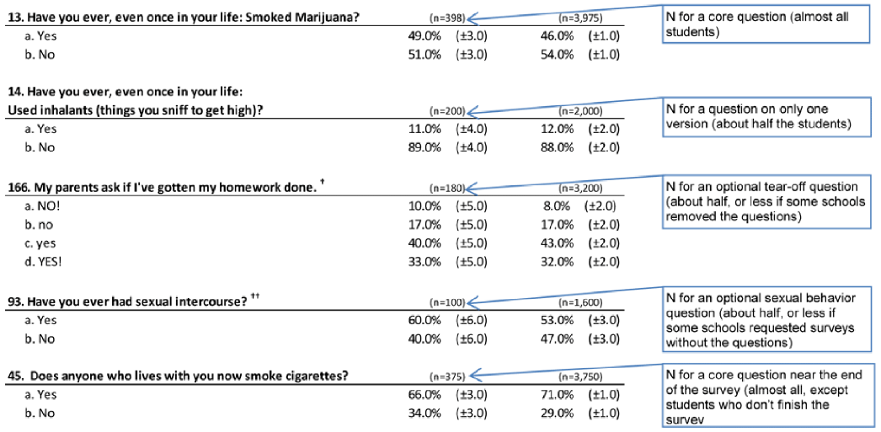
So many N’s….

Slide 8
Converting N’s into students
Each question has an “N” for the number of students who answered it.
Using your “N”, you can translate your point estimate (%) into the number of students
For example,
If 10% of students in your district used inhalants,
200 10th graders ,
Then 20 students in your district used inhalants (20 X 0.10)

Slide 9
Confidence intervals

Slide 10
What are “confidence intervals”?
±
±
HYS results include a “±” after the number for each answer in the survey results.
It is unlikely that the point estimate (%) is exact. Confidence intervals (CI) describe uncertainty.
Results are different than the “true” value.
“We are 95% sure that….”
±
±
±

Slide 11
Why do we need confidence intervals if data are valid?
CIs account for variability, NOT the validity of the data.
Variability causes uncertainty in the results.
CIs allow for the comparison of results to others and to ourselves over time.

Slide 12
“Doubt is not a pleasant condition, but certainty is absurd.”
– Voltaire

Slide 13
Why are confidence intervals different sizes?
The size of a confidence interval is affected by:
Number of students.
In general, the more students surveyed, the smaller the confidence interval.
Inherent variability.
If most students answer a survey question in the same way, then there is less variability. The more variable the answers, the wider the CIs.

Slide 14
Using results with large confidence intervals
If you are a small school, district or county your CIs will be large...
The estimate may be good, but only of the students who took the survey this year.
CIs don’t take participation rates into account:
Low participation – there may be additional bias
High participation – you can feel more confident in your point estimates.

Slide 15
Statistical significance

Slide 16
What is “statistical significance”, and when does it matter?
The probability that differences in results are not due to chance alone.
When using 95% confidence intervals, a difference between two groups is considered statistically significant if chance could explain it only 5% of the time or less.

Slide 17
Using confidence intervals
CIs help you decide if the difference between your students and the state are statistically significant.
Example, your students report 25% ±5%.
So your CI is between 20% and 30%
Math: 25% - 5% = 20%, 25% + 5% = 30%

Slide 18
1: Significant or non-significant?
Your students report 25% ±5%
So your point estimate is 25% your CI is between 20% and 30%
Students statewide report 36% ±3%
So the point estimate is 36% your CI is between 33% and 39%
The CIs don’t overlap, so the difference is significant

Slide 19
2: Significant or non-significant?
Your students report 25% ±5%
So your point estimate is 25% your CI is between 20% and 30%
Students statewide report 28% ±3%
So the point estimate is 28% your CI is between 25% and 31%
The CI for your students overlaps the point estimate for students statewide, so the difference is not significant

Slide 20
3: Significant or non-significant?
Your students report 25% ±5%
So your point estimate is 25% your CI is between 20% and 30%
Students statewide report 36% ±3%
So the point estimate is 36% your CI is between 33% and 39%
The CIs overlap, but don’t include the other point estimates, so we don’t know if they are different…

Slide 21
Tool for testing significance
If you need to know for sure, there is a “Tool” to test for significance at: www.AskHYS.net/Training
The spreadsheet tests the difference between two point estimates and their 95% CI to compute a p-value.
If your p-value is less than 0.05, then your difference is significant.
Only use this test if you have at least 30 students.
Don’t use this test if you have 0% or 100%

Slide 22
Example – Comparing to the state
Since we couldn’t tell if there was a difference by using our CIs – let’s try the “Tool”:
Your students: 25.0% (±5.0)
Students statewide: 36.0% (±3.0)
25.0
36.0
5.0
3.0
Your students
Statewide
0.0002177
P-value is less than 0.05, so there is a significant difference.

Slide 23
Example – Comparing grades
Are their differences in drinking 2 or more sodas between 10th and 12th graders?
10th grade: 15.3% (±1.7)
12th grade: 14.7% (±1.9)
P-value is greater than 0.05, so there is no difference between 10th and 12th graders.

Slide 24
Example – Comparing gender
Are their differences in drinking 2 or more sodas between male and female 10th graders?
Male: 20.5% (±2.3)
Female: 10.5% (±1.9)
P-value is less than 0.05, so 10th grade males are more likely to drink 2 or more sodas, compared to females.

Slide 25
Comparisons over time
A few things to think about first:
Did the survey change?
Were challenges to generalizability similar?
Response rates
Groups of students missing
Do you expect a change?

Slide 26
Trends
Fact sheets do provide data back to 2002 for some questions – but do not provide trend results (only year to year comparisons)
To measure trends you need statistical software
Free software from the National Cancer Institute – uses your point estimates and confidence intervals:
http://surveillance.cancer.gov/joinpoint

Slide 27
Questions?

Slide 28
QxQ Online Data Query System

Slide 29
Q x Q = Question by Question
What can you do with it?
Run frequencies: responses to individual questions. Just like the results in your Frequency Reports.
Run crosstabs: looking at the relationship between two questions - crossing one question by the second question.

Slide 30
Availability and access
What is available?
Grades 6, 8 , 10 and 12
Years from 2002 to 2012 (2012 almost ready….)
Locations with results (must meet minimum qualifications)
Anyone can access:
State, Educational Service District, and County results
A username/password are required to access:
School District and Building results
(permission provided by District Superintendent)

Slide 31
Before you start, ask yourself…
What do you want to know?
Do you have results to analyze?
Check Past Participation
Can the questions you’re interested in be crossed?
Check the Crosswalk

Slide 32
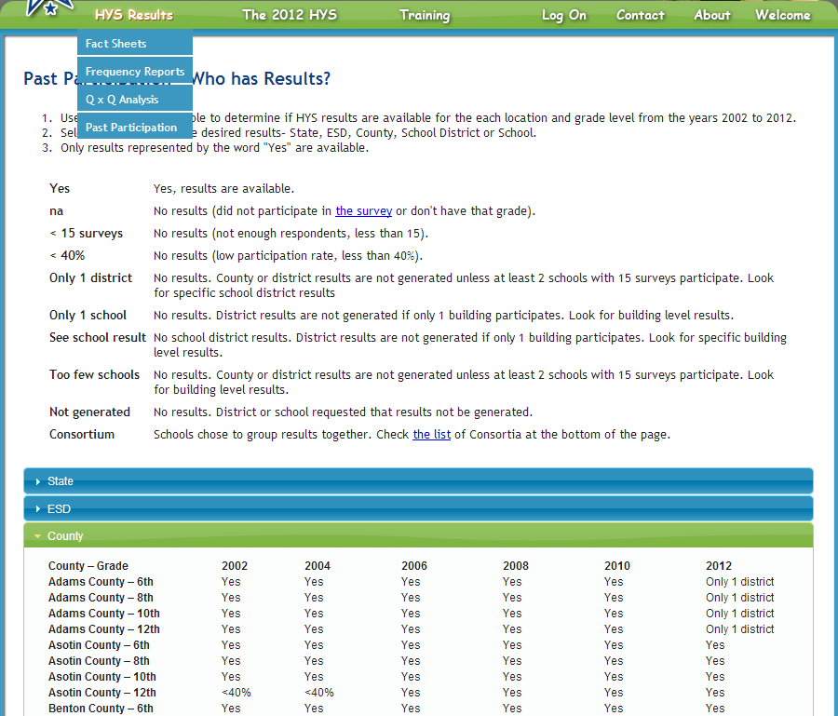
Past participation

Slide 33
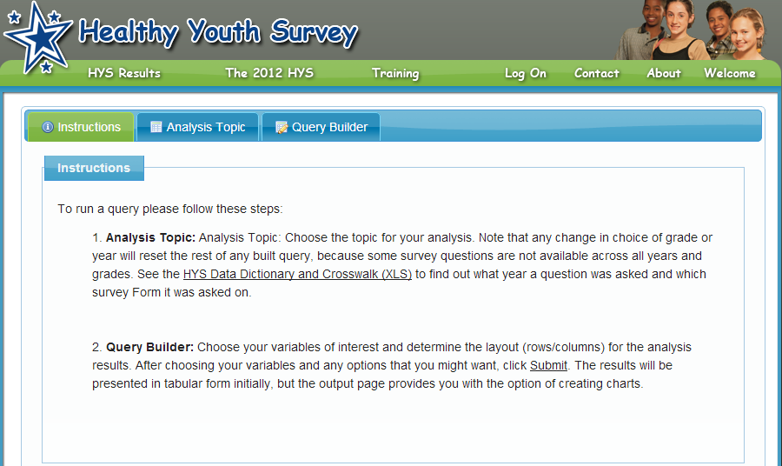
Opening the Q x Q www.AskHYS.net/Analyzer
Fact Sheets
Frequency Reports
QxQ Analysis
Past Participation

Slide 34
Opening the Q x Q www.AskHYS.net/Analyzer

Slide 35
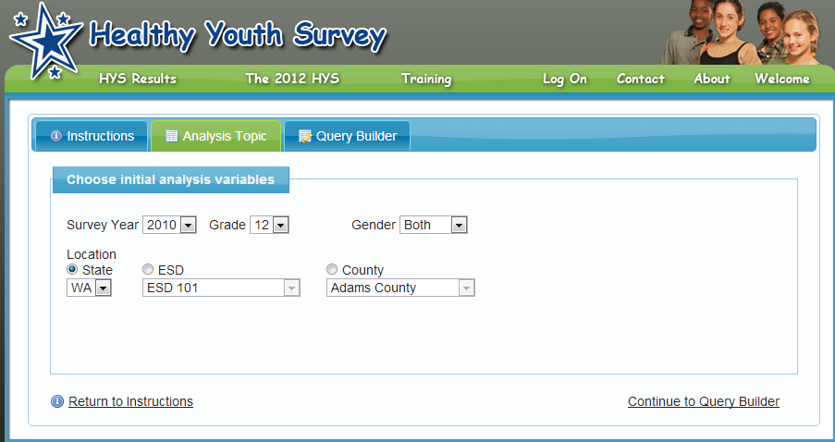
Opening the Q x Q www.AskHYS.net/Analyzer

Slide 36
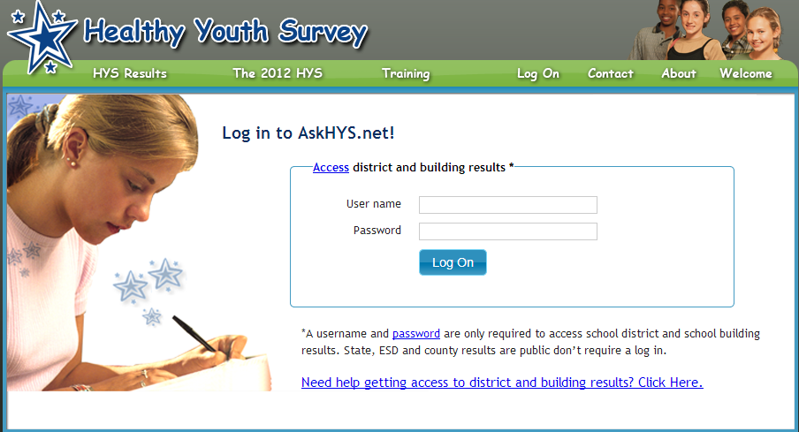
For district and building queries
susan@rainiertheory.com
********

Slide 37
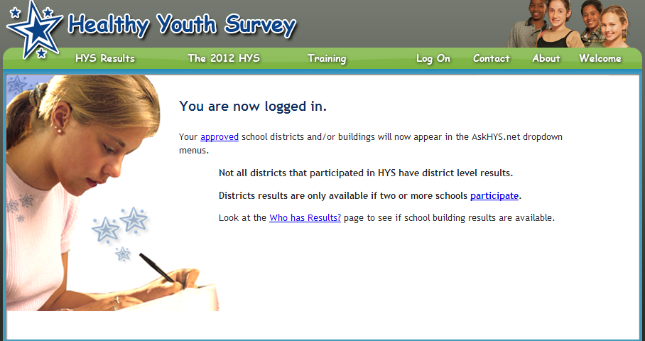
For district and building queries

Slide 38
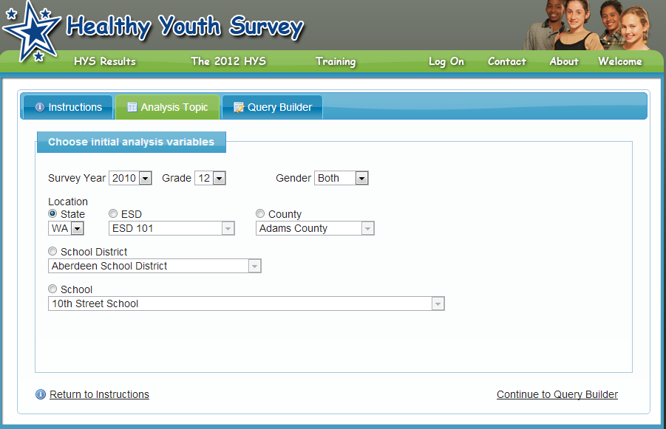
For district and building queries

Slide 39
Run a frequency

Slide 40
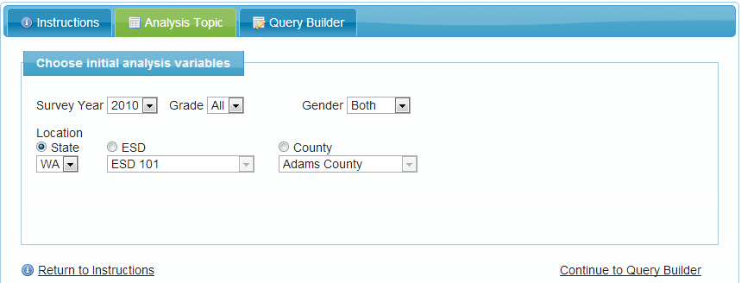
Frequency - Selecting analysis variables

Slide 41
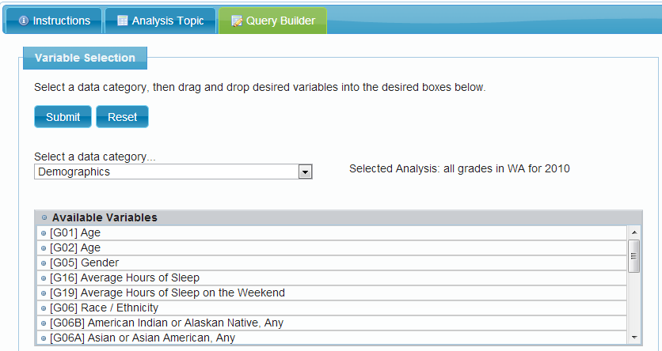
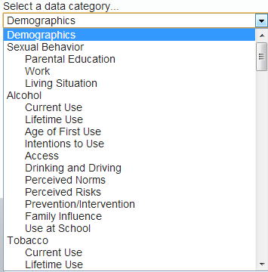
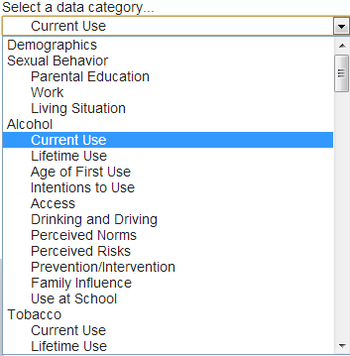
Frequency - Question selection

Slide 42
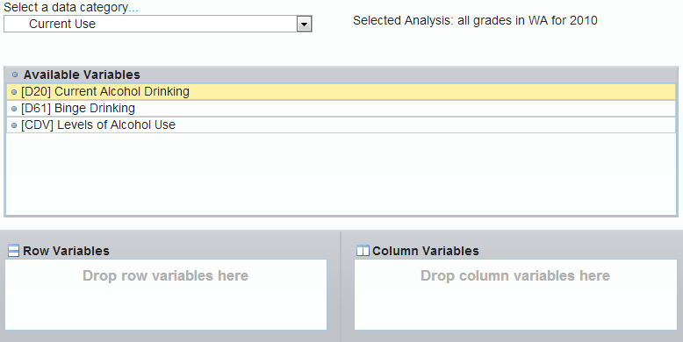
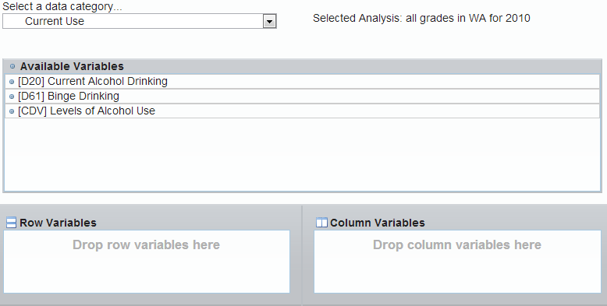
Frequency - Drag and drop

Slide 43
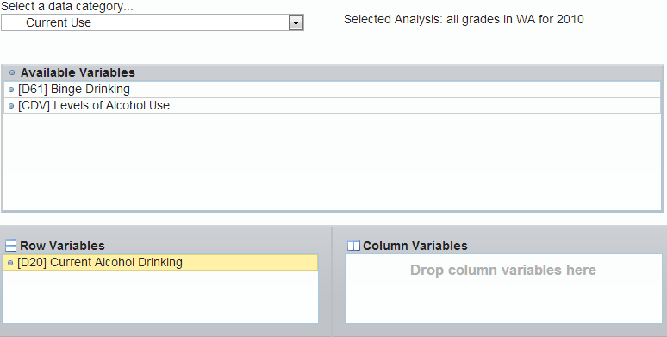
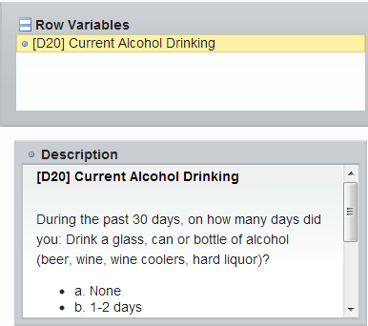
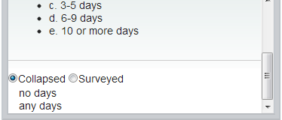
Frequency - Response selection

Slide 44
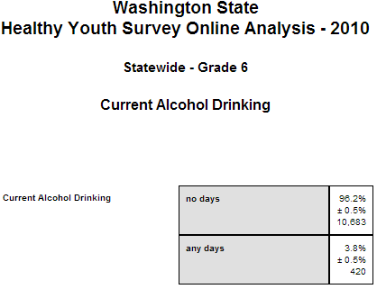
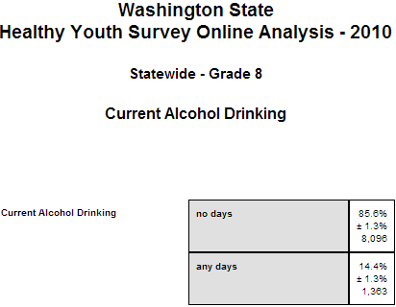
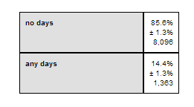
Frequency output

Slide 45
What are crosstabs

Slide 46
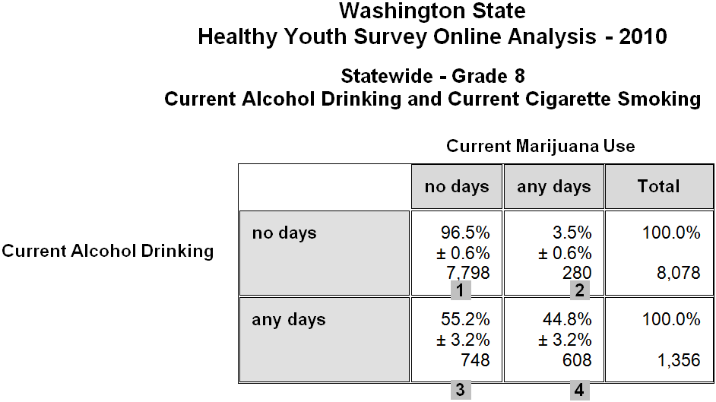
Relationship between drinking and marijuana
Among kids who drank:
44.8% used marijuana (cell 4)
Among kids who didn’t drank:
3.5% used marijuana (cell 2)
Current Alcohol Drinking and Current Marijuana Use

Slide 47
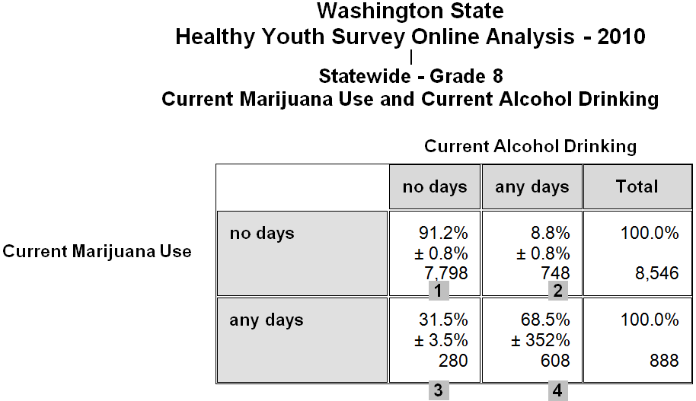
Relationship between marijuana and drinking
Among kids used marijuana:
68.5% drank (cell 4)
Among kids who didn’t use marijuana:
8.8% drank (cell 2)

Slide 48
HYS crosstab requirements
Cell size
State level minimum 5 per cell.
Sub-state level minimum 10 per cell.
**NOTE**
The squares that have results in them are the “cells”.
The number of respondents in each cell is called the “n”, or also the “cell size”.

Slide 49
Cell size error message
“At least one cell in the results table contained a count of less than 10.” Output is suppressed.”
Cell size limitations can be frustrating!
If your results are suppressed because of cell size:
Select the “collapsed” answer option instead of the “surveyed” option.
Re-run your crosstab at a higher geography – like county rather than district.

Slide 50
Survey form error message
“No surveys contained responses to all the selected variables”.
Form A
½ students
Form B
½ students
Core
All students

Slide 51
Run a Crosstab

Slide 52
1: Choose analysis variables

Slide 53
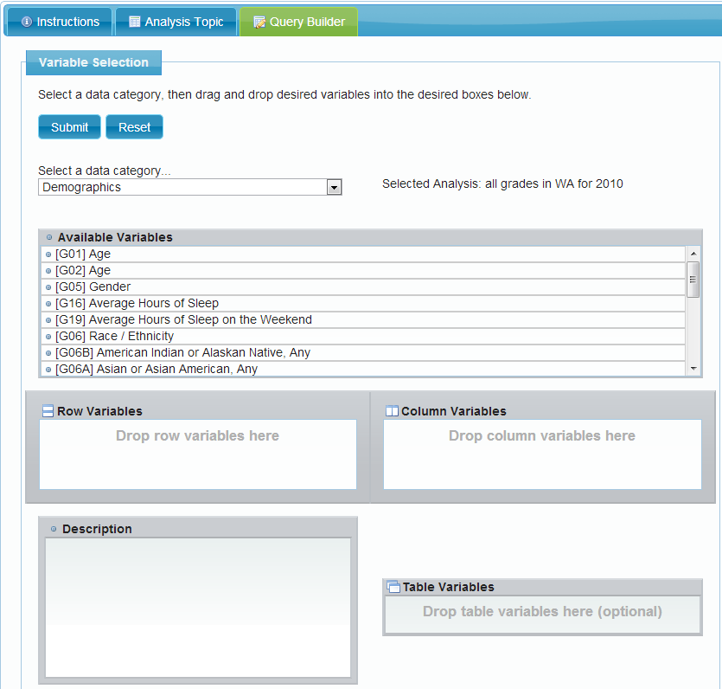
2: Populate query builder

Slide 54
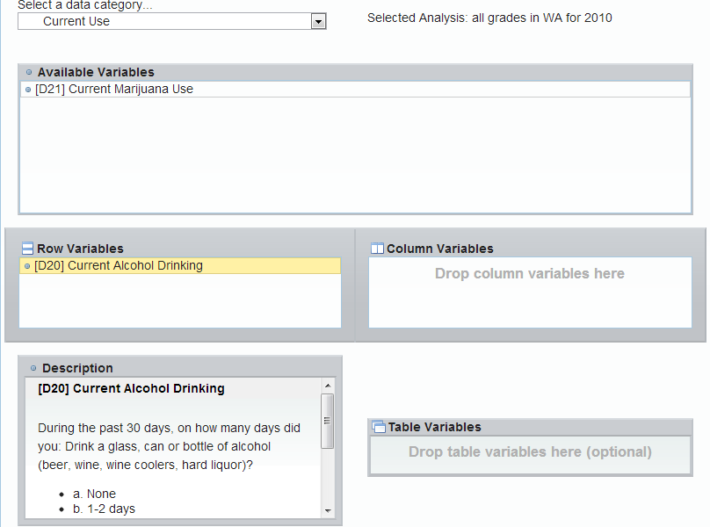
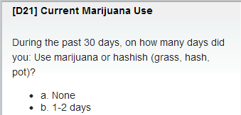
3: Add row and column variables

Slide 55
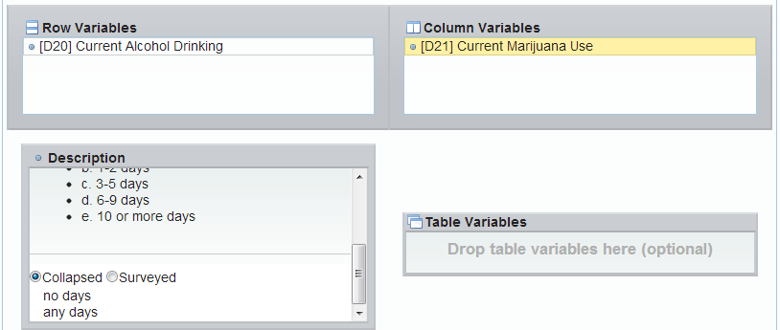
4: Choose response options & run

Slide 56
Alcohol and marijuana example
Row Variable = Current Alcohol, Column Variable = Current Marijuana
Year=2010, Grade=8
Among kids who didn’t drank:
3.5% used marijuana (cell 2)
Among kids who drank:
44.8% used marijuana (cell 4)
Current Alcohol Drinking and Current Marijuana Use

Slide 57
Right way - Race and bullying
Bullied
Row Variable = Race,
Column Variable = Bullying
Year=2010, Grade=8
Among Asian or Pacific Islanders:
29.1% were bullied
Among Whites:
30.9% were bullied
 | no days | any days | Total
API | 70.9% ± 2.4% 701 | 29.1% ± 2.4% 288 | 100.0% 989
AI/NA | 71.7% ± 5.7% 185 | 28.3% ± 5.7% 73 | 100.0% 258
Black | 74.8% ± 4.2% 351 | 25.2% ± 4.2% 118 | 100.0% 469
Latino | 73.3% ± 3.1% 911 | 26.7% ± 3.1% 331 | 100.0% 1,242
White | 69.1% ±1.8% 3,163 | 30.9% ± 1.8% 1,417 | 100.0% 4,580
Multi-Other | 67.0% ± 2.5% 1,001 | 33.0% ± 2.5% 494 | 100.0% 1,495
Race

Slide 58
Wrong way - Race and bullying
Row Variable = Bullying, Column Variable = Race,
Year=2010, Grade=8
Among Asian or Pacific Islanders:
10.6% were bullied
Among Whites:
52.1% were bullied
Race
 | API | AI/NA | Black | Latino | White | Multi-Other | Total
no days | 11.1% ± 2.8% 701 | 2.9% ± 0.5% 185 | 5.6% ± 1.5% 351 | 14.4% ± 1.3% 911 | 50.1% ± 5.4% 3,163 | 14.9% ± 1.3% 1,001 | 100.0% 6,312
any days | 10.6% ± 2.8% 288 | 2.7% ± 0.7% 73 | 4.3% ± 1.3% 118 | 12.2% ± 3.4% 331 | 52.1% ± 5.2% 1,417 | 18.2% ± 1.8% 494 | 100.0% 2,721
Bullied

Slide 59
Two ways to look at it
Row Variable = Weapons at School,
Column Variable = Grades Last Year,
Year=2010, Grade=8
47.5% of youth who carried weapons at school had low grades (C-D-F’s)
24.5% of youth who did not carry weapons at school had low grades (C-D-F’s)
Row Variable = Grades Last Year,
Column Variable = Weapons at School,
Year=2010, Grade=8
3.8% of youth who had high grades (A-B’s) carried a weapon at school
10.0% of youth who had low grades (C-D-F’s) carried a weapon at school
Grades Last Year
Weapon at School
 | Mostly A-B’s | Mostly C-D-F’s | Total
no days | 75.5% ± 2.5% 6,521 | 24.5% ± 2.5% 2,111 | 100.0% 8,632
any days | 52.5% ± 4.6% 259 | 47.5% ± 4.6% 234 | 100.0% 493
 | no days | any days | Total
Mostly A-B’s | 96.2% ± 0.7% 6,521 | 3.8% ± 0.7% 259 | 100.0% 6,780
Mostly C-D-F’s | 90.0% ± 1.1% 2,111 | 10.0% ± 1.1% 243 | 100.0% 2,345
Weapon at School
Grades Last Year

Slide 60
Check you Q x Q results
You can compare your Q x Q frequency results with your Frequency Reports (www.AskHYS.net/Reports)
Page 4 in your reports includes crosstabs by gender
Ask someone to review your results
**NOTE** There may be slight differences because of the way different statistical programs round numbers.

Slide 61
Questions?

Slide 62
Thank you!
From the Joint Survey Planning Committee
DASA-DBHR: Linda Becker, Steve Smothers, Grace Hong
OSPI: Dixie Grunenfelder
Commerce: Ramona Leber
DOH: Kevin Beck, Vivian Hawkins, Lillian Bensley, Juliet VanEenwyk
Liquor Control Board: Mary Segawa
Looking Glass: Joe Kabel
Rainier Theory: Susan Richardson

Slide 63
Questions?
About this training:
Linda Becker: BeckeLG@dshs.wa.gov
Dixie Grunenfelder: Dixie.Grunenfelder@k12.wa.us
Susan Richardson: susan@rainiertheory.com
Other HYS questions:
healthy.youth@doh.wa.gov
www.AskHYS.net

