Slide 1

HYS 101.
What your HYS results say
and how to talk about them
March 6th, 2013

Slide 2
Overview of Training
Survey
Results
=
~
Share

Slide 3
HYS Background

Slide 4
Past Youth Surveys
U Student Alcohol and Drug Use Survey
W Washington State Adolescent Health Behaviors
Y Youth Risk Behavior Survey
H Healthy Youth Survey

Slide 5





Support for HYS
+ Schools, ESDs, Local Health
& Community Partners!

Slide 6
2012 HYS Administration

Slide 7
2012 HYS participation
Almost 205,000 students…
In all 39 counties…
In 225 school districts…
In 1,001 schools took the 2012 HYS.

Slide 8
HYS sampling
State sample
2012 counties with samples
2012 counties
without samples
King
Pierce
Snohomish
Spokane 6th grade
Thurston
6th grade
San Juan
Whatcom
Island
Okanogan
Ferry
Pend
Oreille
Kitsap
Skagit
Clallam
Stevens
Jefferson
Chelan
Douglas
Lincoln
Grays
Harbor
Mason
Kittitas
Grant
Adams
Whitman
Pacific
Lewis
Yakima
Franklin
Garfield
Benton
Columbia
Cowlitz
Walla Walla
Asotin
Wahkiakum
Clark
Skamania
Klickitat

Slide 9
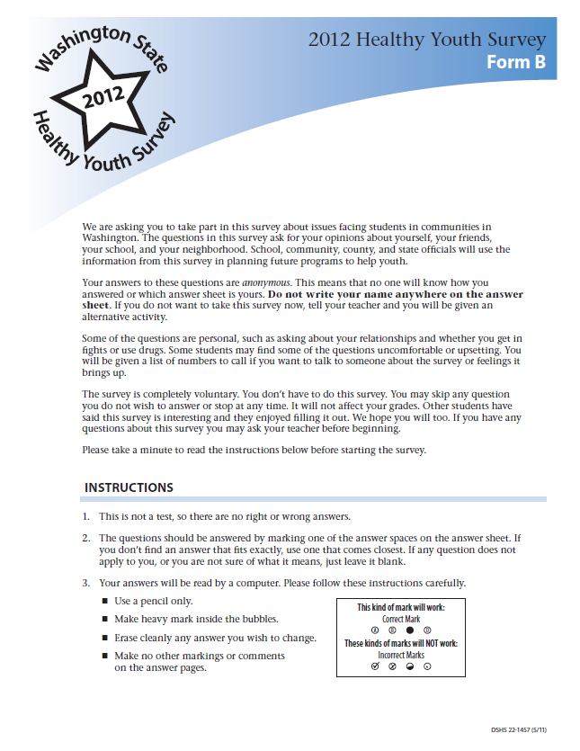
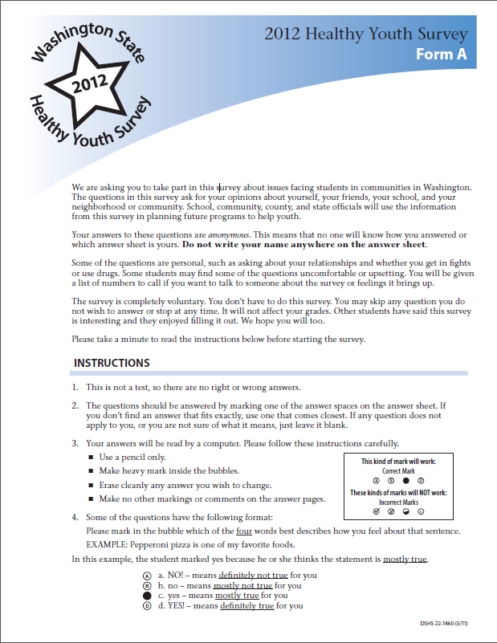
Interleaved survey forms for
8th, 10th and 12th graders

Slide 10
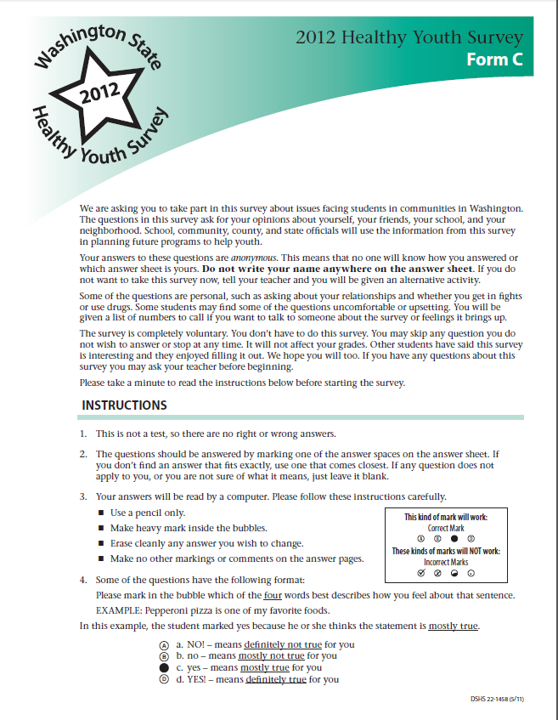
Survey form for 6th graders

Slide 11
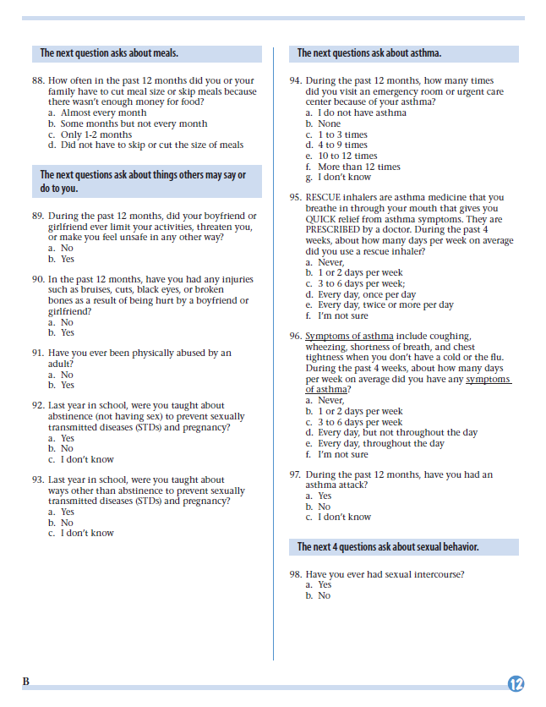
Optional questions
(tear-off)

Slide 12
Survey content
Form A
½ students
Form B
½ students
Core
All students
Form C
All 6th graders

Slide 13
Are youth telling the truth?
Can we trust our HYS results?

Slide 14
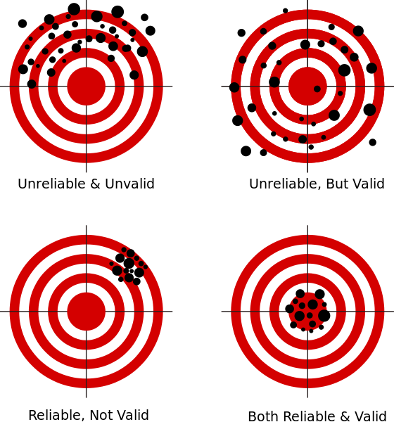
Generalizing
Validity and reliability
Validity is accuracy.
Questions from established surveys
Data cleaning procedures
Reliability is consistency.
Standard survey administration procedures
Image from Wikipedia

Slide 15

Questions?

Slide 16
Frequency Reports

Slide 17
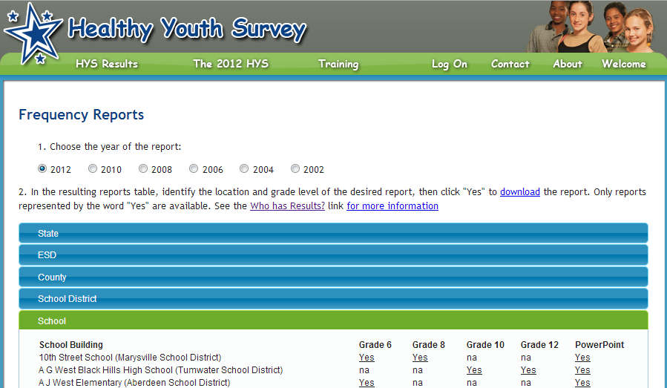
Opening a frequency report www.AskHYS.net/Reports
School Building Grade 6 Grade 8 Grade 10 Grade 12 PowerPoint
My Middle School < 15 surveys Yes na na Yes
My High School na na Yes Yes Yes

Slide 18
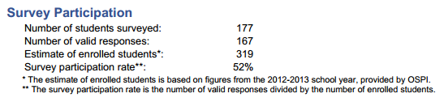

It is important to know your schools’ “response rate”

Slide 19
What’s great about a 70% response rate?
Why require minimum 40% response rate?
40%
70%

Slide 20

Frequency results
During the past 30 days, on how many days did you:
29. Use marijuana or hashish (grass, hash, pot?)
(n=400) (n=9,000)
None
1-2 days
3-5 days
6-9 days
10 or more days
Any use in past 30 days
82.0% (±2.0) 78.0% (±1.0)
10.0% (±2.0) 9.0% (±1.0)
6.0% (±2.0) 9.0% (±1.0)
1.0% (±2.0) 3.0% (±1.0)
1.0% (±2.0) 1.0% (±1.0)
18.0% (±2.0) 22.0% (±1.0)
Between 16% and 20%:
18% - 2% = 16%, low
18% + 2% = 20%, high

Slide 21
Frequency with chart
29. Use marijuana or hashish (grass, hash, pot?)
(n=400) (n=9,000)
None
1-2 days
3-5 days
6-9 days
10 or more days
Any use in past 30 days
92.0% (±2.0) 78.0% (±1.0)
5.0% (±2.0) 9.0% (±1.0)
1.0% (±2.0) 1.0% (±1.0)
1.0% (±2.0) 1.0% (±1.0)
1.0% (±2.0) 1.0% (±1.0)
18.0% (±2.0) 22.0% (±1.0)
16% 20%
18%

Slide 22
Quick confidence interval summary
CI’s tell you how much variability you have.
Other uses:
To determine if there is a difference---say, between this year and last year, or between your school and the state.
To protect you---say, from exaggerated claims.

Slide 23
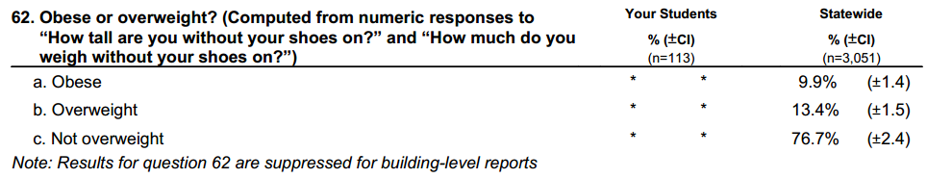
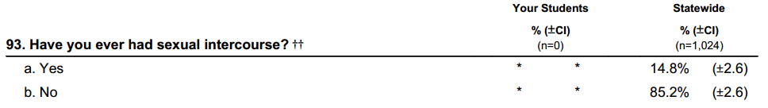
Why are their asterisks?
(n=6,000)
4.0% 10.0%

Slide 24
Report extras
Highlights
Risk and protective factor – changes over time, scale results and charts, and individual questions
Questions by topic
Core questions

Slide 25
Questions?

Slide 26
PowerPoint Slides

Slide 27
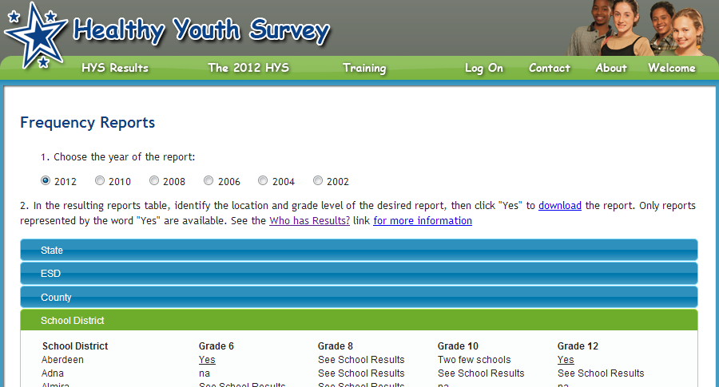
Opening PowerPoint slides
School District Grade 6 Grade 8 Grade 10 Grade 12 PowerPoint
My School District <15 surveys Yes Yes Yes Yes

Slide 28
Slide topics
Tobacco
Alcohol
Marijuana & Other Drugs
School & ATOD
School Environment & Safety
Community & Safety
Nutrition & Physical Activity
Health & Mental Health
ATOD & Community Norms
ATOD & Access
ATOD & Perceived Risk

Slide 29
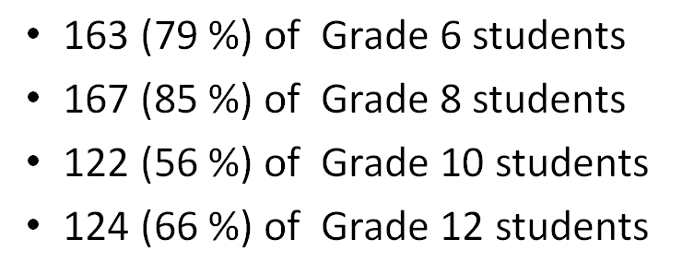
Participation rates provided

Slide 30
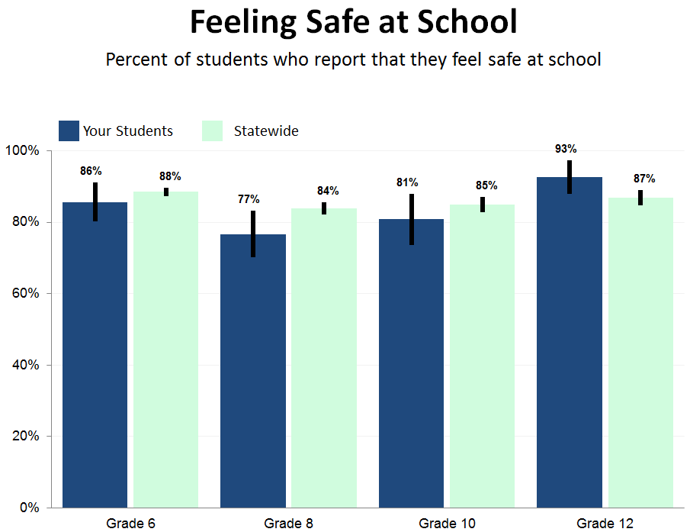
Example of a typical slide

Slide 31
Questions?

Slide 32
Fact Sheets

Slide 33
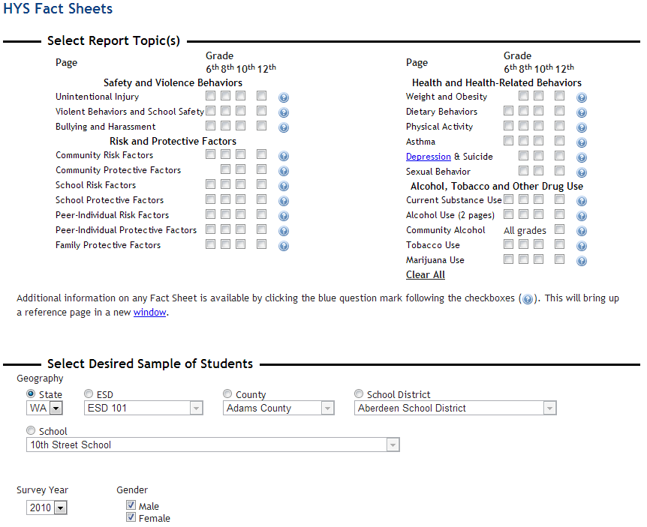
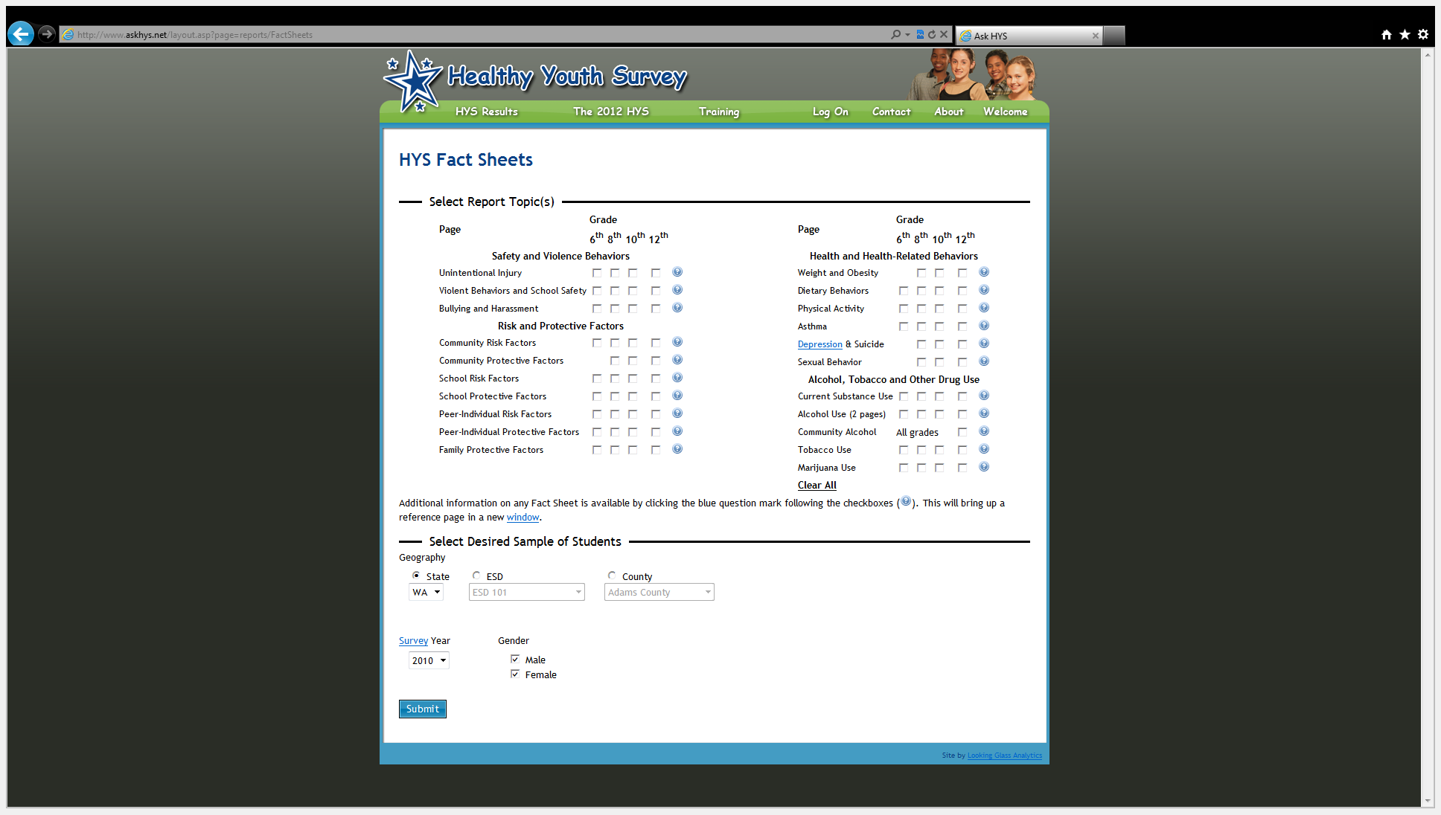
Opening a fact sheet
√

Slide 34
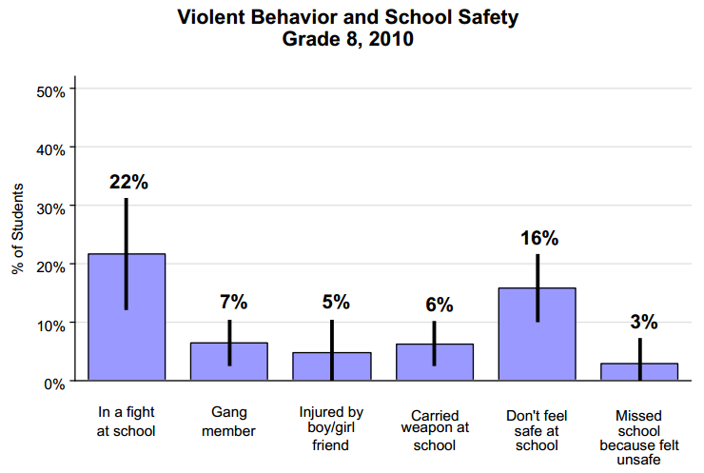
2010 Chart

Slide 35
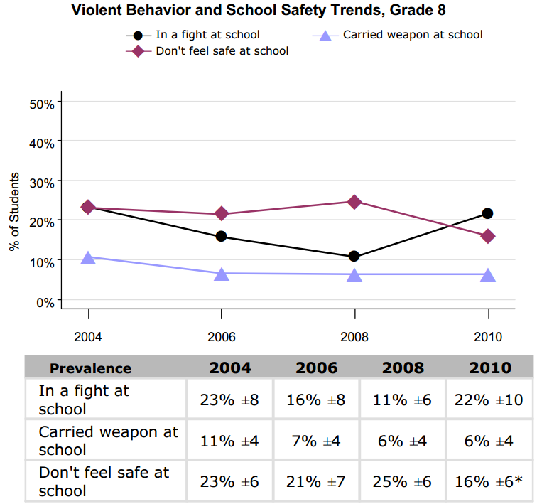
Trend chart and table

Slide 36
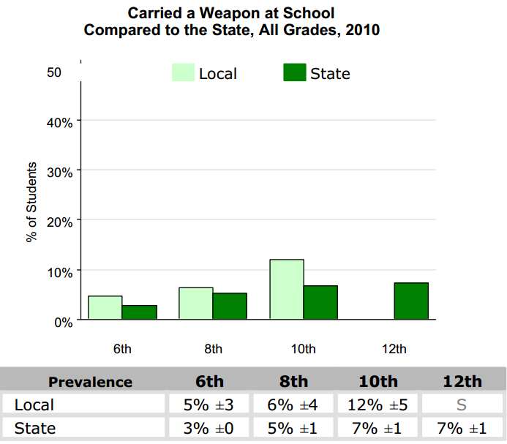
State comparison chart
*

Slide 37
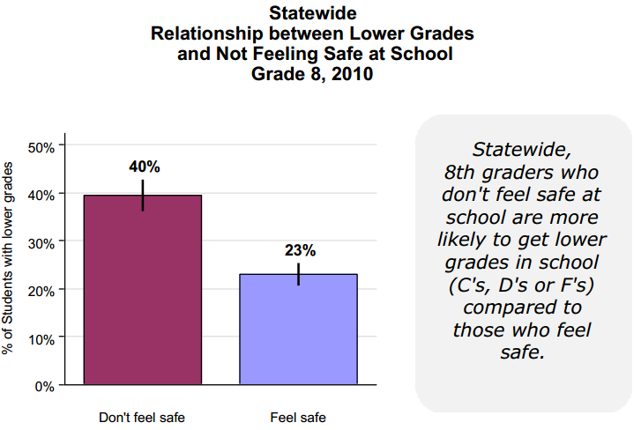
Academic achievement association

Slide 38
Questions?

Slide 39
Data Speak

Slide 40
Why do you want to talk about your results?
Share information about our kids
Try to change or open people’s minds
Help plan or make decisions
Help evaluate effectiveness
Ask for help, a change, or money

Slide 41
Consider your audience
Administration
Parents
Reporters
Grant application reviewers

Slide 42
Talking about survey results
Survey results are estimates
  Round to a whole number
  Say “about”
  Carefully include your confidence interval
    If 75.3% (5), between 70 and 80 percent
    Plus or minus 5 percent
  Acknowledge low participation – “among those who took the survey”

Slide 43
Ways to talk with numbers
Painful: 75.3% (±5.1) of 8th graders feel safe at school.
Less painful:
  About 75 percent
  About 3/4ths
  3 out of 4
Turn it around, if that is the point you need to make:
  About 25% of 8th graders don’t feel safe
  1 in 4
  If you have 200 8th graders, turn it into the number of students, 50 of our 8th graders don’t fell safe

Slide 44
Use visuals
There are charts in your PowerPoint slides and fact sheets
Create other types of charts or visuals:
7 ½ out of 10 students…

Slide 45
Be able to back your talk
Know your facts about HYS
  How, when and to who it was administered
  Details about the questions
Do the numbers make sense?
Are you using them in an appropriate context?
What else is needed to tell the whole story?
  Additional data sources
  Information from informed people

Slide 46
Talking tips
Keep it short and simple
Double check your numbers
Run it past a few people, especially a critic
Don’t speculate. Remember your limitations
It’s ok to say “I don’t know, I’ll get back to you”
Be compassionate - these numbers are actually kids

Slide 47
Practice: Using your results
Ideas for improving school safety is the main topic on the school board meeting.
You’ve been looking at your new HYS results.
What do you want to share with the board?

Slide 48
Where do you start?
What information do you have?
HYS reports, slides, fact sheets.
What/Who else can help you:
  Are other data available? (e.g. school discipline data)
  Are there other people who have information?

Slide 49
What are your findings?
What do your 2012 HYS results say?
What HYS questions address school safety?
How do your results compare to the state results?
Do you have HYS results from previous years?

Slide 50
Developing your talking points
If you could only make one point –
what would it be?
Are their specific opinions you need to influence?
What do you want the board to ultimately do?

Slide 51
Questions?

Slide 52
Next Webinar
HYS 201.
Digging deeper into your HYS results
March 20th from 9am to 10:30am
Statistical issues associated with HYS.
Determine significant differences.
Try out the online data query system (QxQ).

Slide 53
Thank you!
From the Joint Survey Planning Committee
DASA-DBHR: Linda Becker, Steve Smothers, Grace Hong
OSPI: Dixie Grunenfelder
Commerce: Ramona Leber
DOH: Kevin Beck, Vivian Hawkins, Lillian Bensley, Juliet VanEenwyk
Looking Glass: Joe Kabel
Rainier Theory: Susan Richardson

Slide 54
Questions?
About this training:
Linda Becker: BeckeLG@dshs.wa.gov
Dixie Grunenfelder: Dixie.Grunenfelder@k12.wa.us
Susan Richardson: susan@rainiertheory.com
Other HYS questions:
healthy.youth@doh.wa.gov
www.AskHYS.net

