Slide 1
Facebook for Public Outreach
Presented by Derek Belt
Social Media Specialist, King County (Wash.)
derek.belt@kingcounty.gov Follow me: @derekbelt

Slide 2
A little about me
My role:
Communications
Customer service
Strategy
Teacher/coach
Social media at King County:
180+ pages with 267,000 fans and followers.
500+ email and newsletter topics with 332,000 subscribers.
12.3 million emails and 5.1 million texts sent in 2015.

Slide 3
How Facebook works
200 friends
30-40 friends
We don’t see posts from all of our Facebook friends. f WHY NOT?!!
Facebook decides for us what we get to see.
Roughly 20% of our friends see content we share.
20%

Slide 4
Reach vs. engagement
Reach = the number of people who see our posts.
Social media: Does it show up in their Facebook news feed?
Email: Does it arrive in their inbox?
Engagement = the number of “actions” a post generates.
Social media: Facebook likes, shares, clicks on links, etc.
Email: Open rates, clicks on links in emails.
Engagement is the goal, but first we need to reach people.

Slide 5
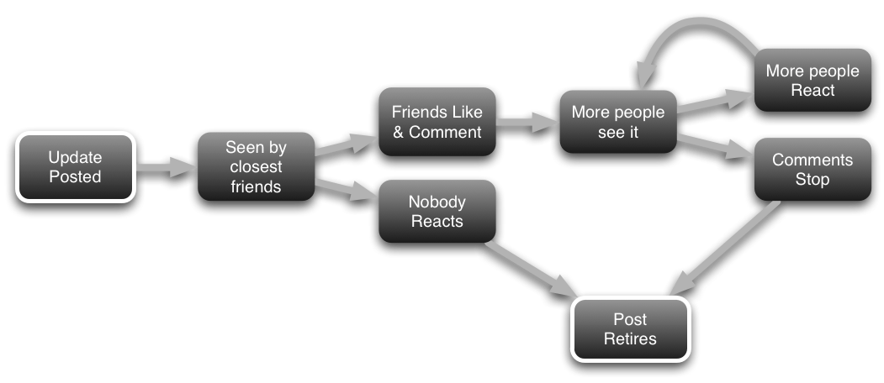
Getting through to your fans
The goal with every post is to get here.
Sweet spot!
The 20% of fans who see your post need to click on something or the post is retired. This happens in a matter of hours.

Slide 6
Simple tips for sharing good content
Photos and videos get more engagement.
Ask your fans a question: What’s the biggest issue you face in talking to kids about marijuana? Facebook is an excellent community resource for stuff like this.
Tell people what to expect if they have to click on something. If you’re sharing a video, tell them what’s in it.
Provide inside access. Give fans information they can’t get elsewhere.
Fill-in-the-blanks generate up to 90% more engagement because ______ .

Slide 7
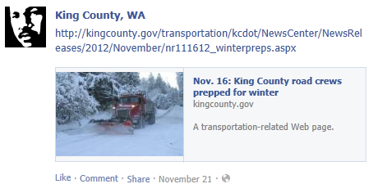
Optimizing your Facebook posts
Example 1: Standard cut and paste with just the link. This is not the ideal way to share content on Facebook.

Slide 8
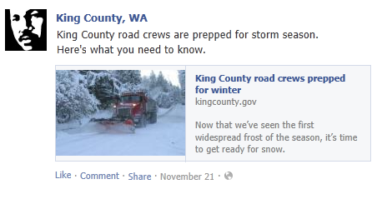
Optimizing your Facebook posts
Example 1: Standard cut and paste with just the link. This is not the ideal way to share content on Facebook.t on Facebook.
Example 2: Write a clear message and customize the copywriting to make the post more meaningful.

Slide 9
Optimizing your Facebook posts
Example 1: Standard cut and paste with just the link. This is not the ideal way to share content on Facebook. effective way to share content on Facebook.
Copy (make it clear)
Headline (make it count)
Sub-head (use the first sentence)

Slide 10
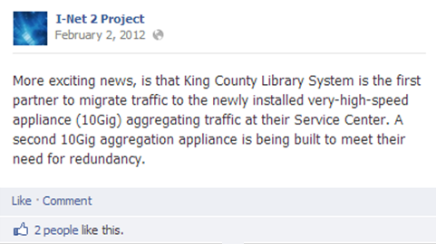
Photos are a smart play
Text-only posts aren’t very compelling.

Slide 11
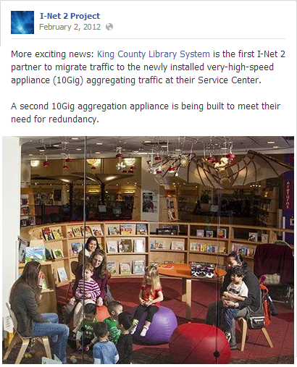
Photos are a smart play
Photos get more interactions because they’re flat-out easier to see in the News Feeds.

Slide 12
The best Facebook tip I can give you
Page | Page Fans | Reach Per Post | % Reached | % Engaged
Metro Transit | 4,655 | 1,116 | 24% | 4%
Animal Services | 2,940 | 872 | 30% | 4%
Public Health | 2,876 | 797 | 28% | 7%
Parks | 3,003 | 457 | 15% | 5%
KC News | 5,506 | 912 | 17% | 4%
Prosecuting Attorney | 454 | 1,707 | 376% | 20%
Now we’re talking!!!

Slide 13
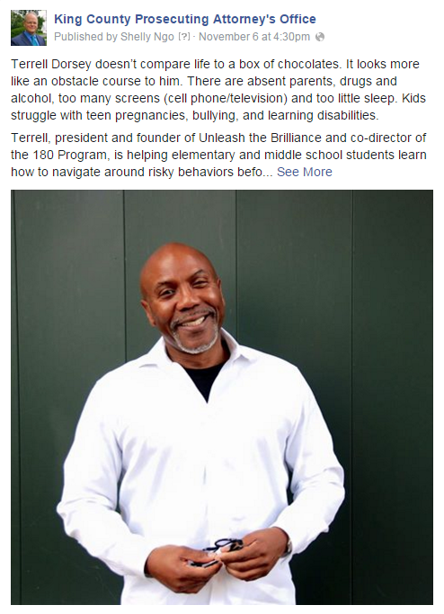
So what is our Prosecuting Attorney doing differently?
This page averages 992 “other clicks” on its top posts, all of which contain a “See More” option to read the full length story.
Average word count on these posts is 245.
Best practices suggest a max count of just 100-200 characters!!!
But these posts are longer, and they are working—BIG TIME!

Slide 14
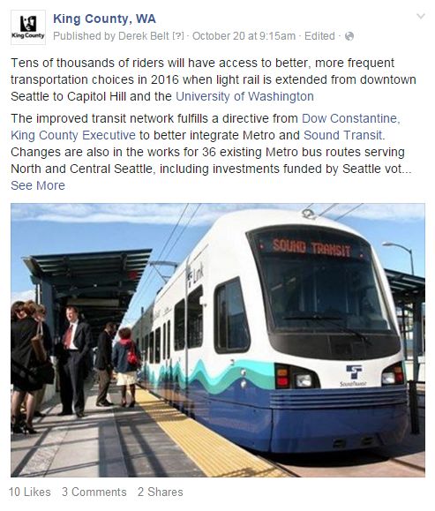
I’ve tested this with a few posts on the main King County page, and it works just as well.
This post reached 3X as many people despite getting only a handful of interactions. How? It netted 98 “other clicks.”
Those “other clicks” helped teach Facebook’s algorithm that this was a popular post.
Because of this, it showed the story to more people, driving up my post’s reach.

Slide 15
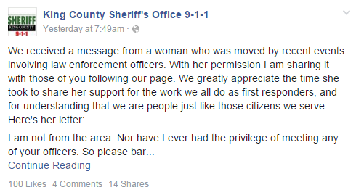
King County’s 9-1-1 page has 1,791 fans.
This post reached 5X their average.

Slide 16
Facebook just wants clicks
Facebook uses clicks to learn more about our personal interests.
Clicks help Facebook to build user profiles, which it uses to sell advertisements.
Facebook leverages this info to select and target content for us in the News Feed. This includes regular stuff and advertising.
Any click counts, including the ones on a “See More” link.
Click activity guides the computer algorithm and teaches Facebook what is popular and worth showing to other users, thus driving up your posts’ reach.

Slide 17
Lessons learned
Don’t think you have to be concise. Research shows longer, blog-like stories are quite effective.
Embrace the “See More” option that people have to click on to read the full story.
Photos are super important.
Choose imagery that catches people’s attention. Remember, we are competing with EVERYTHING in the News Feed.
Personal stories and anecdotes are best-case scenarios.

Slide 18
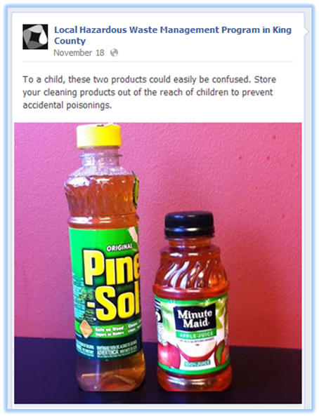
Lessons learned
Don’t think you have to be concise. Research shows longer, blog-like stories are quite effective.
Embrace the “See More” option that people have to click on to read the full story.
Photos are super important.
Choose imagery that catches people’s attention. Remember, we are competing with EVERYTHING in the News Feed.
Personal stories and anecdotes are best-case scenarios.

Slide 19
Facebook ads for public outreach
Reach people by zip code, personal interest, and in languages other than English.
Project-based engagement:
Get more/better survey responses.
Drive visits to project websites.
Supplement other outreach efforts, print materials, and in-person public meetings.
Never pay more than your allotted budget. Facebook won’t charge you more than $100 if that’s your limit.

Slide 20
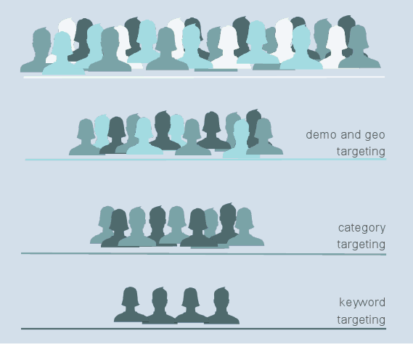
How Facebook ads work
Targeting is the key feature of Facebook ads.
Drill down to people in your geographic area.
Filter by age, gender, language, more.
Reach people who are interested in specific topics such as parenting.

Slide 21
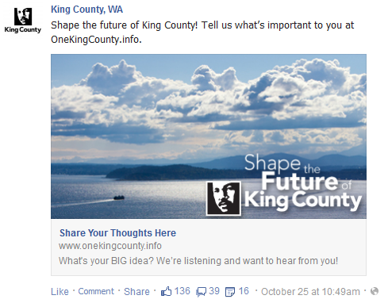
Case Study: Strategic Plan update
King County’s 2014 Strategic Plan update asked residents to tell us their priorities.
Public outreach strategy:
Public meetings
Libraries and community partners
Ethnic media outreach
Traditional media advertising (online)
Facebook ads

Slide 22
Case Study: Strategic Plan update
SeattleTimes.com Ads
Impressions: 1.8 million
Clicks to website: 2,232
Total spent: $12,000
KIROTV.com Ads
Impressions: 5.3 million
Clicks to website: 2,740
Total spent: $12,000
Facebook Ads
Impressions: 1.9 million
Clicks to website: 2,658
Total spent: $1,500
Same number of clicks to our survey page for 10th of the cost.

Slide 23
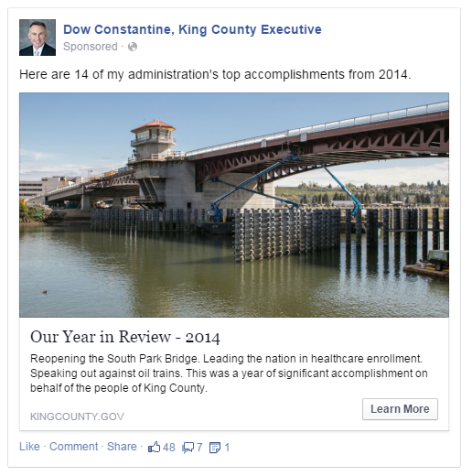
Facebook ads vs. Regular posts
Metric | Regular Posts | Facebook Ads
Posts | 16 | 1
People reached | 3,791 | 15,709
Clicks to slideshow | 53 | 313
Spent | Free | $100
Cost per click | Free | $0.32
!!!
5X as many people clicked on this Facebook ad, compared to the 16 regular posts we made.

Slide 24
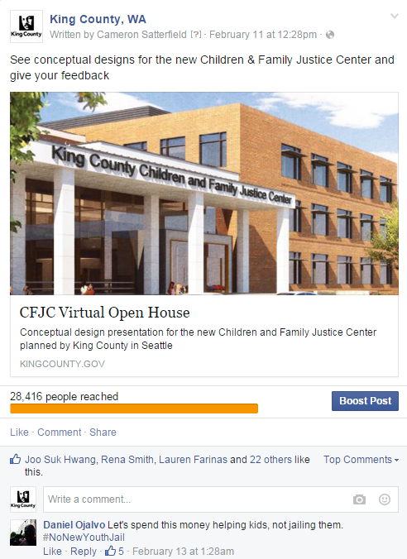
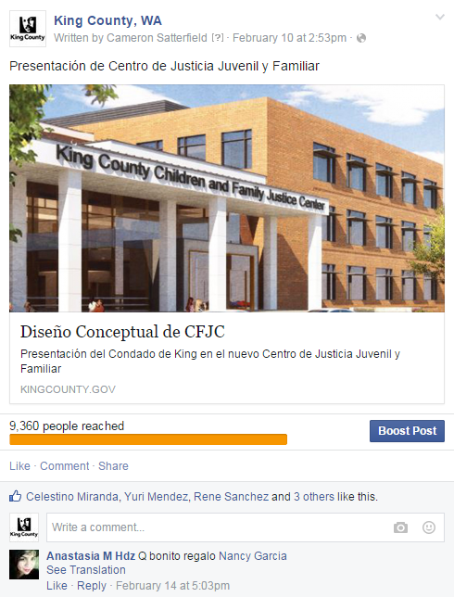
Supplementary public outreach
English
Metric | English | Spanish
People reached | 71,965 | 12,036
Clicks to website | 1,216 | 154
Click-through rate | 0.9% | 1.2%
Spent | $175 | $75
Cost per click | $0.14 | $0.49
Spanish
1,200 clicks to the project website, leading to hundreds of video views and new survey responses.

Slide 25
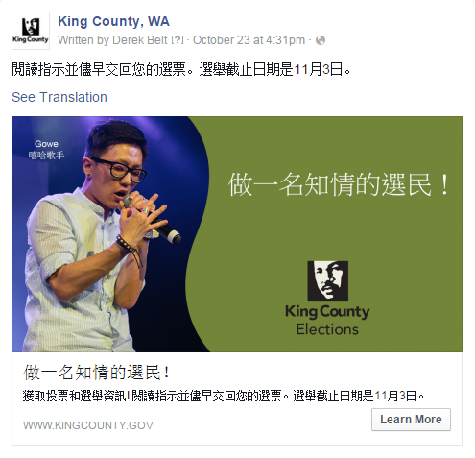
Multi-language outreach
Metric | Chinese
People reached | 4,803
Clicks to website | 88
Click-through rate | 1.14%
Spent | $50
Cost per click | $0.57
This Chinese-language ad featured Gowe, a local hip-hop artist.
Drove nearly 100 clicks to our Chinese-language website.

Slide 26
8 steps to getting started w/ FB ads
Start/end dates of your campaign.
Budget—a little bit of money goes a long way.
Decide how to allocate the funds:
$50/day over 5 days for a $250 budget.
$100/day over 10 days for a $1,000 budget.
Where do you want to link people from this ad?
Survey / Project website / Multimedia—video, etc.
Don’t put extra clicks in front of people. If you only need survey feedback, link to the survey instead of a project page.

Slide 27
8 steps to getting started w/ FB ads
5. Choose a photo—it needs to be compelling.
Write your advertising copy—keep it very simple.
25-character limit for headlines, 90-character limit for body.
Choose a call to action button → Options are: Learn More, Sign Up, Download, or you can leave this blank.
Targeting—smaller, niche audiences are more expensive but well worth it considering their value.
Age
Gender
Race
Marital status, kids, etc.
Location
Personal interests
Group affiliations
What pages they like

Slide 28
Thank you!
Derek Belt Social Media Specialist, King County (Wash.) derek.belt@kingcounty.gov @derekbelt
See our stories @ kingcounty.gov/connect

