Slide 1
OCCC – Prescription Drug Prevention Program
Needs assessment and strategic planning

Slide 2
Data used when writing the original Drug Free Communities application (Jan-Mar 2010)
94% decrease between 2010 and 2014

Slide 3
56% increase between 2008 and 2010
94% decrease between 2010 and 2014

Slide 4
Local Conditions:
Where are they getting it?
2010 8th Grade HYS - Omak

Slide 5
Local Conditions:
Where are they getting it?
2010 10th Grade HYS - Omak

Slide 8
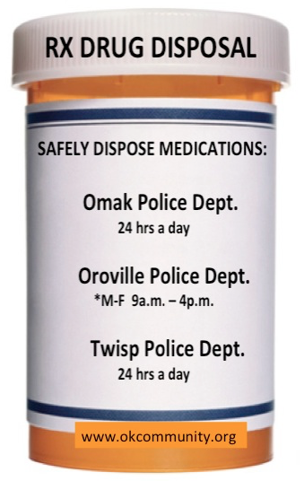
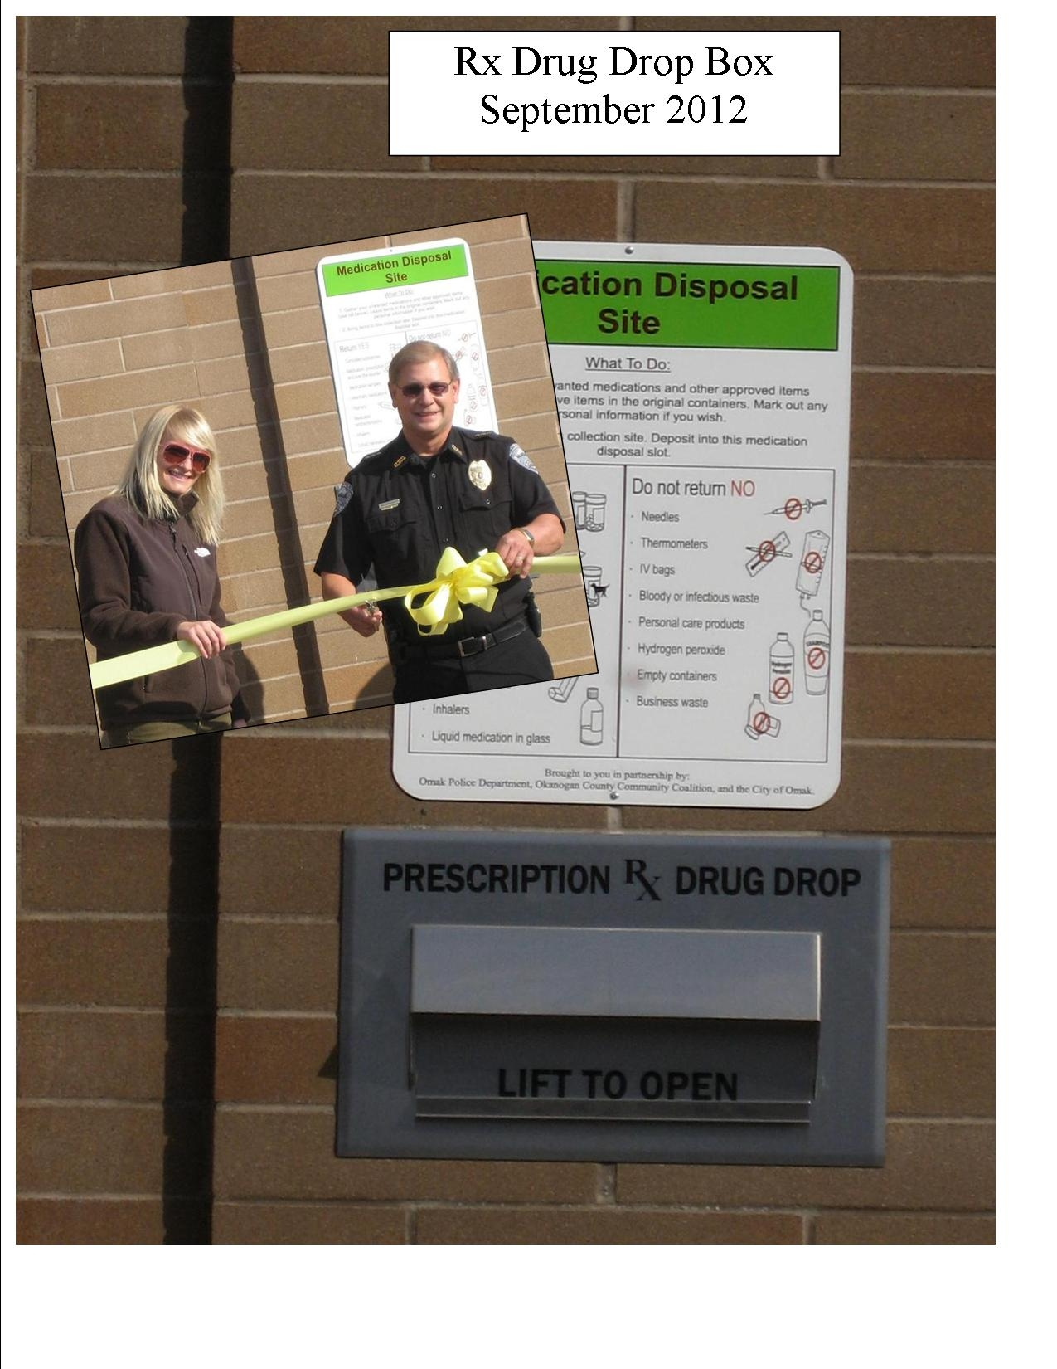
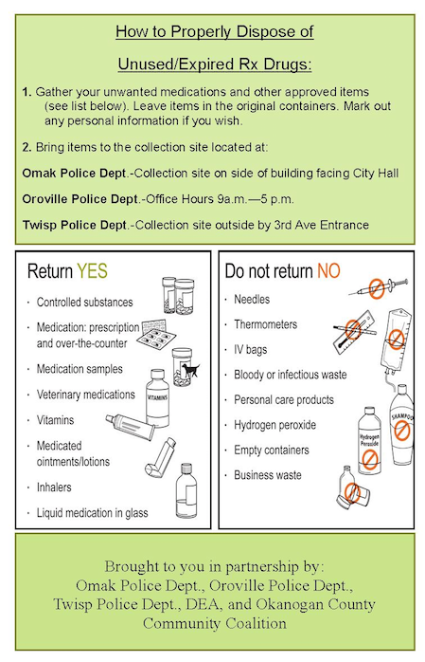

Slide 9
86% Decrease between 2010 and 2012
94% decrease between 2010 and 2014

Slide 10
94% decrease between 2010 and 2014

Slide 11
Andi Ervin
Executive Director
(509) 322-8436
occcandi@yahoo.com
www.okcommunity.org

