Slide 1
Getting access to your
2012 Healthy Youth Survey results
February 20th, 2013

Slide 2
Goals for this presentation
Participation in this training does not guarantee you access to local (school or district) results. It just describes the process.
We will explain:
How to get Healthy Youth Survey reports;
About the different levels of access and how to obtain them;
What is available on www.AskHYS.net

Slide 3
Availability
What, when, where, and how?
Notes are available for this presentation.
To use them, open up the PowerPoint in “Notes View”

Slide 4
What and when?
We are going to be talking about frequency reports for the 2012 Healthy Youth Survey.
These reports will be available for internal use, and then publically after a statewide press release.
The date for the statewide press has yet to be determined, but in will occur in March 2013.
Notes:
Throughout this presentation we refer to “frequency reports” and use that term interchangeably with the word “reports” or “results”.
The reports that we are talking about now are frequency reports.
Those reports will include every question in the survey without any analysis.
They will simply include the number of people who answered each question and what their answers were.
Later we will talk about other types of reports and data access.

Slide 5
There are different levels of access
County reports will be available to everyone.
School district and school building HYS reports are available only with the permission of the superintendents’ offices.
Several slides will explain how to get this permission later in this PowerPoint

Slide 6
HYS Reports will be available on AskHYS.net
School district and school building HYS Reports be posted on www.AskHYS.net on March 1st, 2013
County reports will be emailed to JSPC partner agency stakeholders on March 1st, 2013. County reports will be on AskHYS.net the morning of the press release.
            BEFORE the Press Release, all reports are “embargoed”.
Notes:
For school districts and buildings:
The 2012 reports will only be reported on AskHYS this year. In the past, they were mailed to school superintendents on a CD.
They will be posted online at www.AskHYS.net on March 1st at the latest, but we are hoping we can get them up earlier.
For counties:
Each JSPC agency will receive a copy of the county and ESD reports. Then the agencies will send the reports out to their stakeholders. For example, if DBHR invited you to this Webinar, then they will probably be sending the appropriate reports to you or someone in your agency. They may go out by email, regular mail, or posted on a secure website. They will let you know.
On the day of the press release county reports will be posted on the AskHYS website.
Using reports during the embargo:
As soon as the reports are posted you can use them on a limited basis – they are embargoed until the day of the press release.

Slide 7
What embargo?
  The goal of the embargo period is to give school districts and stakeholders some time to understand their data before people from the press come to you with questions about the HYS data.
  Results may be shared internally before the formal release for planning and messaging.
Notes:
During the embargo:
School districts and buildings can look at their results and share them internally.
The embargo is intended to provide you with time to go through your results, think about what they mean, think about what questions you may be asked, and how you want to respond to them. Results can be used for planning, even with some external partners as long as they agree to abide by the embargo. Results can be used in state and federal grant applications. The results should not go out to the general public or to any media.
Once the embargo is lifted, then school districts and buildings can share their results however they see fit. The Joint Survey Planning Committee that oversees HYS, considers school district and building results to belong to the schools. They do hope you will be open to sharing your results with your community.
We will send out another email when we have all of the details.

Slide 8
How is this different?
School building and districts:
  In the past, results were always mailed to the Superintendent and they decided who to share results with.
  Now, with electronic posting, permission is required to access the reports, and it is password protected.
Counties
  May need to go through a different process to access district and building results.
  Get permission now!
Notes:
We are having this Webinar primarily because of the change in how reports will be distributed this time.
For school districts and buildings, you may be used to getting access to your reports from your superintendent.
Counties may be used to contacting their school district for results.
Now reports will be posted online on AskHYS – but you need permission to access school district and building reports.
For counties, you may want to check with the JSPC agency stakeholder to ensure someone is sending you county reports, and you may need to get permission from the school district if you need district or school reports.
If you need school district or building level reports – please make sure you get permission now.

Slide 9
askhys
Access to your HYS
results

Slide 10
What is www.AskHYS.net?
Location for HYS results
  Years 2002 to 2012
  As reports, fact sheets, and do you own data analysis
Other HYS-related information
  Training
  Contacts
  Background information
    Internet browsers – currently, Internet Explorer
    works the best to access the reports.
Notes:
Since the reports will be posted on AskHYS, we want to quickly walk through the website.
Currently, AskHYS only fully functions with Internet Explorer.
You may be able to see most of the content on AskHYS with other internet browsers, (like Google Chrome, Moxilla-Firefox, or Safari), but you won’t be able to open the actual reports.
We apologize for the inconvenience and are hoping to have this updated in the near future.

Slide 11
www.AskHYS.net Welcome page
Fact Sheets
Frequency Reports
Q x Q Analysis
Notes:
To find your 2012 HYS reports, select HYS Results, then Frequency Reports from the dropdown menu.

Slide 12
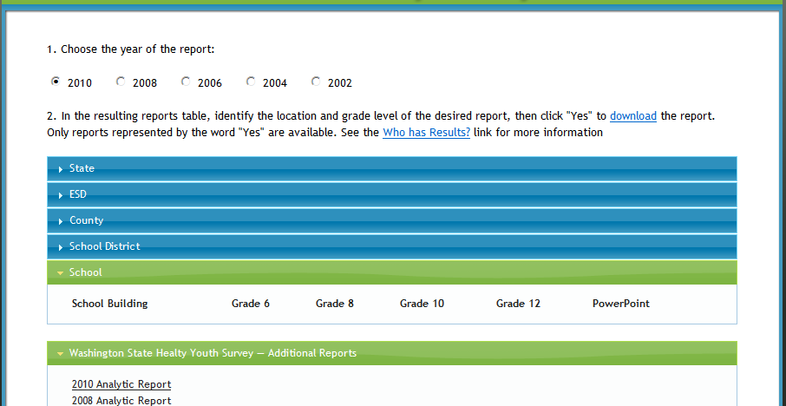
Frequency reports page
School
Notes:
This is what is on the Frequency Report webpage:
Year - currently, reports are available from 2002 to 2010. The option for 2012 will be added when the reports are posted.
Locations – there are dropdown menus for State, ESD and county, school district and school-level reports.
Additional Reports are also included below. The 2010 Analytic Report includes past results by topic and includes trend results.
If you click on the blue County bar it will turn green. You can see the list of reports that are available by grade.

Slide 13
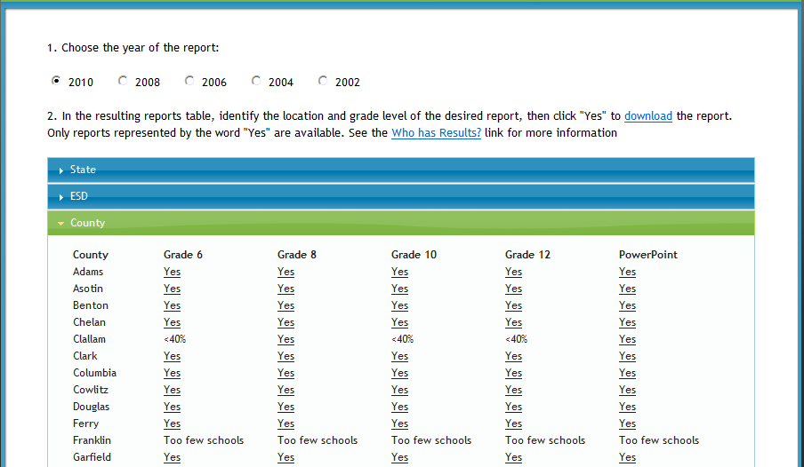
County frequency reports
Notes:
To open a report, click on the word “Yes”.
Some counties may not have results due to low participation.

Slide 14
School frequency reports
Notes:
If you click on the blue School bar, you shouldn’t see any schools listed.
If you click on the blue School District bar, you will only see a list of a few Seattle health planning areas (since they were made public).
If your district is interested in making their data public on AskHYS, please let us know.

Slide 15
Report availability summary
County results = Public
School District and Building results = Need Permission
Qualifications for generating reports were met
Notes:
In summary:
State, county and ESD reports are available to the public. They will be posted on AskHYS if they meet the qualifications for generating a report.
For example, counties need to have at least a 40% response rate and include results from two or more school districts*.
*Some counties with only one school district have county results. This is because the school district gave the Washington State Department of Health to use their district/building results for a county-level report.

Slide 16
Welcome page – Log on
Notes:
If you already have permission for school district and/or building results, you will have an AskHYS user id and password.
Go back to main page and click on Log On.

Slide 17
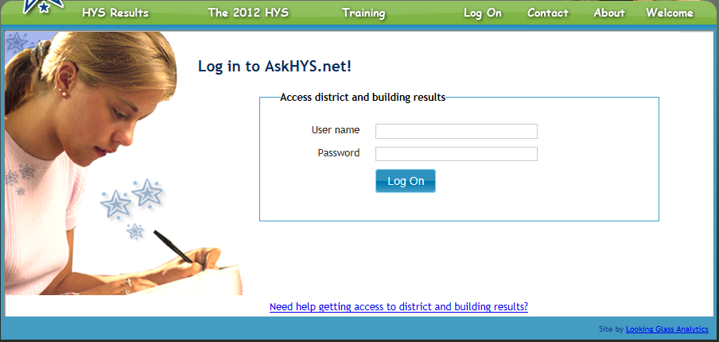
Log On page
Notes:
If you don’t have a user name and password, you can click on the link below, “Need health getting access to district and building results?” to find out more information about how to get them.

Slide 18
Who can get school district reports?
During the recruiting for the HYS, school districts are told that their data will be provided only to them and to those who they choose to share it with.
  Some school districts make their HYS reports available to the public.
  Many---perhaps most---will share their reports with members of the community who are working with youth. But you have to ask!

Slide 19
How to ask for district and building access
Notes:
The instructions provided walk you through the process for obtaining a log in for AskHYS school district and/or building results.
1. Before you attempt to get results, you may want to make sure results are available.
There are a number of reasons you might not be able to get results for the location/grade/year you’re looking for.
They may not have participated or met the requirements for producing a report.
For example, smaller school districts with only one high school will not have district results for 10th and 12th grade. School building results were only generated for that district.
2. You need to get permission from the school district administration.
Some of you may already work with the district and have a relationship, so asking for permission may be easy.
If you don’t, you’ll want to explain who you are and what you will be using their results for – build up a relationship so the school district will be comfortable sharing with you.
If you’re not sure who to contact, there is a link to OSPI’s school district directory.
3. After you receive district permission, the process may vary a little.
Ultimately, you need to receive a log in with school district and/or building HYS access through OSPI’s EDS (Educational Data System). District Security Managers oversee this access and can set you us with your log in. A link to the list of Security Managers is provided. They will most likely email you information about how to sign into the EDS system and activate your AskHYS user name and password.

Slide 20
Log On page – Signing in
susan@rainiertheory.com
●●●●●●●●
Notes:
Now that you have your user name and password, you can log on.

Slide 21
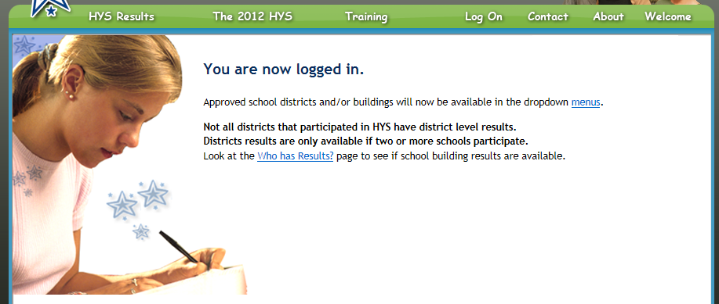
Successful log on
Notes:
If you successfully logged on, you will receive this message.
There is a note her to remind you that district results may not be available for many smaller districts. Be sure to look for school building results if district results are not available.

Slide 22
logged in
Looking at a report

Slide 23
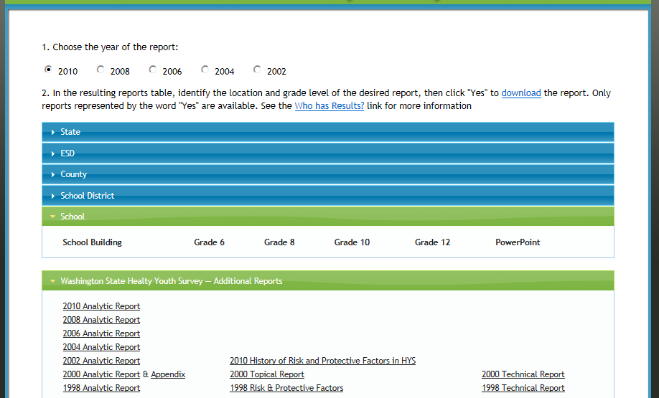
School-level frequency reports
  My Middle School <15 surveys Yes na na Yes
  My High School na na Yes Yes Yes
Notes:
Now lets go back to the Frequency Report webpage.
If we selected the School blue bar, we now see some schools in the dropdown menu.
Notice that not all schools have results.
In this example, My School District is small. The 6th and 8th graders at My Middle School participated, but there were enough students in the 6th grade to receive a report.
The format for the 2012 frequency reports was updated, so let’s quickly look at the first few pages of the 0th grade report for My High School.

Slide 24
Sample report – Title
My High School
Notes:
The title gives you the year, the school name and the grade level of the report.

Slide 25
Sample report –Participation
My High School
205
200
235
85%
Notes:
Page 2
Let’s you know about number of students who participated in the survey, the number of valid responses (the responses used to generate this report), the estimated number of students, and the overall participation response rate.
There is also information about how to interpret your response rate and some cautions about potential bias.

Slide 26
Sample report - Highlights
My High School Grade 10
NA
Notes:
Page 3
Provides results for just a few popular HYS questions and a chart that compares your results to the statewide sample results.

Slide 27
Sample report – Results by Gender
n=200
NA
n=200
NA
n=200
NA
n=200
NA
n=200
NA
n=200
NA
n=200
NA
n=200
NA
Notes:
Page 4
Includes results by gender for just a few popular HYS questions.
The results for both females and males are provided for your students and for students statewide.
The results of a statistical test to determine if the results between females and males are statistically significant are provided as a p-value.
If the p-value is less than 0.05, then the difference between females and males is significant.
To run results by gender (or by any other measure), a minimum number of respondents is required.
Many schools, districts and smaller counties – we may not be able to report their results by gender. More information about this is provided on the page.
If you don’t have results by gender, the statewide results may give you an idea if there is generally a difference.

Slide 28
Sample report – Interpreting Results
Notes:
Pages 5 and 6
These two pages are new. They are designed to help you interpret your results.
Page 5 explains “N’s”, that is the number of students who took the survey or answered a particular survey question.
Depending on the question, the N can change – so information about the reasons for changing N’s is provided.
Information about interpreting and using confidence intervals is provided on page 6 All of the results in your report include confidence intervals.
Links to further information to help you interpret your results are also included.

Slide 29
Sample report – Frequency results
My High School Grade 10
(n=200)
NA
(n=200)
NA
(n=200)
NA
Notes:
Starting at page 7 – the actual results for each question and response students could select are provided.
The results for each question include the percent of students who selected a response and their confidence interval, and the N (number of total respondents for the question).

Slide 30
What else is on askhys?
Quick walk through

Slide 31
Fact Sheet page
Notes:
Topical factsheets for 2012 will be available soon.
These fact sheets include key measures for specific topics, trend results and comparisons to state results.

Slide 32
Other information on Welcome page
Notes:
The Contacts page provides you a email addresses and phone numbers for a person at each JSPC agency.
It also includes each agencies website.
The About webpage provides some background about HYS.
The Training webpage will include this presentation and past HYS-related trainings.
This presentation will be posted on the Training webpage after the Webinar.

Slide 33
Want more training?
There will be a two-part Webinar series on understanding and communicating your HYS results:
HYS 101 - March 6th from 9:30 to 11am.
HYS 201 - March 20th from 9:30 to 11am.

Slide 34
Training details
HYS 101 will help you become familiar with the survey and how it’s implemented; the source of the questions, etc. It will also introduce you to the frequency reports, PowerPoint slides and fact sheets on AskHYS, and how to talk about your HYS results.
HYS 201 will include information about interpreting your results (confidence intervals, significance, trends, etc), using the AskHYS QxQ, and how to use HYS results in a powerful way to communicate clearly about our youth.
  Clock hours and CEUs will be available for those who complete both HYS 101 and 201 (a total of 3 hours).
  If you received an invitation to this webinar, you will be sent invitations to the next two. You can also register on the AskHYS website, www.AskHYS.net on the Training webpage.

Slide 35
Thanks for participating in this Webinar!
If you have any questions, please contact:
Susan Richardson – susan@rainiertheory.com
Linda Becker - Linda.Becker@dshs.wa.gov
Dixie Grunenfelder - Dixie.Grunenfelder@k12.wa.us

