Slide 1
Parity and aca: next steps
Carol McDaid
Capitol Decisions, Inc.
December 5, 2013 NASADAD Board Meeting

Slide 2
Overview of the Presentation
Parity & ACA: Opportunities & Challenges
Parity
Federal parity implementation: a chronology
Why is parity important to states?
Key provisions in final MHPAEA rule
Parity lawsuits
Tools for providers: MHPAEA implementation & enforcement
Parity & the Affordable Care Act
Affordable Care Act
Medicaid expansion
The Exchanges

Slide 3
Opportunities
Largest expansion of addiction coverage and reimbursement in a generation
Medicalization of substance use disorders
Stigma and discrimination reduced
Equitable reimbursement and provider networks for addiction providers

Slide 4
Challenges
Like building and flying an airplane at the same time

Slide 5
Challenges in Detail
Tech problems plaguing federally run exchanges (healthcare.gov)
As of 11/22, 30 states expanding Medicaid (will be 31 w/VA)
Highly politicized environment in state-federal structure
Less than ½ of states fully implementing ACA
Very few states have issued parity compliance guidance
Much of the promise of parity & ACA based on state decision-making
Landmark laws historically take decades for full implementation

Slide 6
Implications
Laws are not self-implementing
Coordinated effort between states, advocates & industry to fully implement & enforce groundbreaking laws
Requires well coordinated networks at state & federal level with common messaging
Sharing effective ACA & parity implementation strategies & replicating successes
Strategy: Urge providers & consumers to engage in parity education

Slide 7
Parity & ACA Chronology
The Mental Health Parity & Addiction Equity Act (MHPAEA) becomes law; fully effective 1/1/2011
EHB rule requires SUD as 1 of the 10 essential benefits. Parity applied in & out of exchanges to non-grandfathered plans
CMS issues guidance applying parity to MMCOs & CHIP unless state plan permits discriminatory limits
2008
2010
2013
MHPAEA final rule released on 11/8/13; applies to commercial plans but not MMCOs, CHIP & ABPs
The Affordable Care Act (ACA) becomes law
Notes:
2008 –The Mental Health Parity & Addiction Equity Act (MHPAEA) becomes law; fully effective 1/1/2011
Requires large group plans to cover addictive disorders on par with other medical illnesses; not a mandate
2010 –The Affordable Care Act (ACA) becomes law
Requires “new” individual & small group plans in & outside of the “exchanges” to cover addiction & comply with MHPAEA; is a mandate

Slide 8
Why is parity important to states?
Coverage ≠ access
MHPAEA requires parity in care management; only OR state parity law does
Parity provides a rationale for equitable use of MAT for SUD
Without parity, behavioral health cost shift from private to public sector continues while federal funding drops due to ACA
Rationale for equal use levels & types of care
Strategy: Encourage DOI to do annual MHPAEA compliance audit

Slide 9
MHPAEA Final Rule: Who & When
The rule does not apply to Medicaid managed care, CHIP and alternative benefit plans (more guidance is coming) but law does
Continues to allow local & state self-funded plans to apply for an exemption from MHPAEA
Applies to the individual market (grandfathered & non-grandfathered plans)
Effective for plan years on or after 7/1/14 (1/1/15)

Slide 10
MHPAEA Does Not Apply To
Medicare
Traditional fee-for-service Medicaid
FEHBP
TRICARE
VA

Slide 11
MHPAEA Final Rule: Scope of Service
Big win for intermediate services (IOP, PHP, residential)
Clarified scope of service issue by stating:
6 classification benefits scheme was never intended to exclude intermediate levels of care
MH/SUD services have to be comparable to the range & types of treatments for medical/surgical within each class
Plans must assign intermediate services in the behavioral health area to the same classification as plans or issuers assign intermediate levels for medical/surgical

Slide 12
MHPAEA Final Rule: NQTLs
Strikes provision that permitted plans to apply limits if there was a “clinically recognized standard of care that permitted a difference”
NQTLs are expanded to include geographic location, facility type, provider specialty & other criteria (i.e can’t let patients go out of state for med/surg treatment and not MH/SUD)
Maintains “comparably & no more stringently” standard without defining the term
Confirms provider reimbursement is a form of NQTL

Slide 13
MHPAEA Final Rule: Disclosure & Transparency
Requires that criteria for medical necessity determinations be made available to any current or potential enrollee or contracting provider upon request
Requires the reason for a denial be made available upon request
Final rule now requires plans to provide written documentation within 30 days of how their processes, strategies, evidentiary standards & other factors were used to apply an NQTL on both med/surg & MH/SUD

Slide 14
MHPAEA Final Rule: Enforcement
Final rule clarifies that, as codified in federal & state law, states have primary enforcement over health insurance issuers
DOL has primary enforcement over self insured ERISA plans
DOL, HHS & CMS will step in if a state cannot or will not enforce the law

Slide 15
Lawsuits Alleging MHPAEA Violations
C.M. vs. Fletcher Allen Health Care
U.S. District Court of VT found plans, rather than patients, have the burden of proof to provide clinically appropriate standards of care to justify treating MH/SUD claims differently than medical
APA & CT Psychiatric Society filed suit against Anthem in CT
Anthem agreed to use proper CPT codes but other parity issues still pending
Class action suit filed by NY State Psychiatric Association against UnitedHealth (dismissed based on suing wrong party)
Key issue: More stringent medical management (NQTL violation)

Slide 16
Resources
Resources available at www.parityispersonal.org:
URAC parity standards
Massachusetts parity guidance
Maryland parity laws
Nebraska parity compliance checklist
Milliman employer & state guide to parity compliance
Toolkit for appealing denied claims

Slide 17
Additional Resources
States & public plans
CMS Center for Consumer Insurance Information & Oversight (CCIIO)
877-267-2323 ext 61565
E-mail: Phig@cms.hhs.gov
Employer plans
DOL Employee Benefits Administration
866-444-3272
www.askebsa.dol.gov

Slide 18
Affordable Care Act & Parity
On 1/1/14*, ACA expands MHPAEA & will apply to:
Benefits provided in new “exchanges”
Benefits provided by non-grandfathered small group & individual plans
Benefits provided to new Medicaid population
These plans will have to offer a MH/SUD benefit
*The Administration is allowing canceled plans (that didn’t meet these requirements) to continue to be offered in 2014; adherence will vary by state

Slide 19
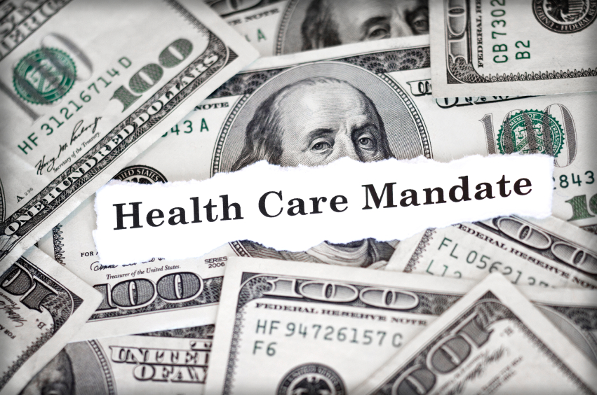
Controversial ACA Provisions
“If you like your plan, you can keep it”
Medical device tax
2.3% tax on health plans
Individual mandate & fines
Coverage for contraceptives

Slide 20
Who is expected to enroll in the exchanges?
65 percent previously uninsured
More than one-third have not had a check-up for more than two years
Lower income than those currently covered by private insurance
More racially diverse than the those who currently have private insurance
One in four Exchange enrollees speak a language other than English at home
77 percent of people enrolled through Exchanges have a high school diploma or less

Slide 21
State Exchanges Faced Technical Difficulties on Debut
Oregon’s exchange cannot determine whether people qualify for federal subsidies or Medicaid
Updated
11/14/2013
Initial Exchange Enrollment and Issues by State
WA
Customers are unable to pay for plans because of technical problems
MT
ND
ME
VT
OR
MN
ID
WY
NY
NH
MA
SD
WI
Technical difficulties decreased enrollment
MI
RI
CA
CT
NE
IA
PA
NJ
NV
UT
OH
IL
IN
DE
DC
CO
KS
WV
VA
MD
MO
KY
NC
AZ
NM
OK
AR
TN
SC
State-run exchanges with limited technical difficulties
MS
AL
GA
Hawaii’s website went live mid-Oct., and has avoided major issues since the release
AK
TX
LA
State-run exchanges with technical difficulties and limited enrollment
FL
State-run exchanges with extreme technical difficulties and no enrollment
HI
Analysis
Federal exchanges weren’t the only ones hampered by technical difficulties; as of Nov. 13 Oregon, for example, has not enrolled a single person
Enrollment in state exchanges may increase as technical issues are resolved, but these difficulties killed critical momentum during the exchanges’ debut.
States covered by federal exchange

Slide 22
Less Than 1% of Site Visitors, Callers Enrolled in Exchanges
Breakdown of Health Insurance Exchange Enrollment Numbers
Oct. 1 – Nov. 2, 2013
30,034,963
Visited federal or state exchange sites or called federal or state exchange call centers
1,509,883
Applied for coverage
1,081,592
Notified of eligibility for a marketplace plan
106,185
Selected a marketplace plan
Analysis
The administration reported unexpectedly low enrollment in the new health insurance exchange marketplaces in the first month of the exchanges’ debut, with only 106,185 Americans enrolling in a marketplace plan
Technical problems with the exchange website were expected to contribute to low enrollment, but the Nov. 13 report—indicating enrollment was only at 20% of goal for October—has lawmakers on both sides of the aisle considering amendments to the Affordable Care Act (Administration set goal of enrolling 7 million by March 2014)

Slide 23
What can you “buy” on the exchanges?
“Qualified Health Plans” (QHPs)
Private insurance plans
Must cover “essential health benefits”
Must offer certain levels of value (“metal levels”)
Must include “essential community providers,” where available, in their networks
Must have provider network sufficient to ensure access to MH/SUD services without “unreasonable delay”
Must comply with ACA insurance reforms
Strategy: Get copies of QHP benefit packages & verify packages are ACA & MHPAEA compliant

Slide 24
How MHPAEA Applies to Exchanges
24
Plans offered in the exchanges will be required to offer a mental health & addiction benefit at parity
“New” individual & small group plans (plans not in existence on 3/23/10) will also have to offer mental health and addiction at parity
ACA data regs require plans to report on quantitative treatment limitations
MHPAEA guidance requires reporting of NQTLs
Strategy: Make sure exchange requires QHP reporting of BH financial & other treatment limits

Slide 25
Parity & Medicaid Expansion
January 2013 Medicaid parity guidance
Medicaid MCO plans must comply w/parity unless state plan allows discriminatory limits
Benefits for the “newly eligible” Medicaid population must include MH/SUD at parity
Parity final rule does not apply to MMCOs, CHIP & ABPs
PIC asking for new guidance on application of final rule within 6 months or by 7/1/14
CMS guidance available at: http://www.medicaid.gov/Federal-Policy-Guidance/Federal-Policy-Guidance.html
Strategy: Advocate for CMS parity guidance applying final rule by 7/1/14

Slide 26
Questions?
Carol McDaid
cmcdaid@capitoldecisions.com

