Slide 1
Evidence-based Practices
Evaluated programs to help address need and make change.
March 25, 2015
Julia Havens BS, CPP
Prevention Systems Development Manager
Division of Behavioral Health & Recovery

Slide 2
What we will cover today…
Why do we value EBPs?
What are the various databases and definitions?
DBHR’s current Substance Abuse Prevention criteria.
Where to find the current DBHR Prevention EBP list?
How to search for programs to match your needs?
How to work with coalitions to determine the best fit program?

Slide 3
What we aren’t reviewing today…
The Youth Marijuana Prevention EBP , RBP and Promising lists.
2015-17 prevention contract requirements.

Slide 4
Before we get started
Poll

Slide 5
Value of tested & effective programs
Able to replicate.
Save time and resources.
Increase effectiveness in making change.
Well designed and evaluated studies.
Demonstrated results among diverse populations.

Slide 6



Slide 7

Variety in definitions and lists
Multiple websites categorize programs as “evidence-based.”
  SAMHSA’s National Registry of Evidence-based Programs and Practices (NREPP).
  Blueprints for Healthy Youth Development.
  Crime Solutions
  Department of Education
  Others?
Notes:
NREPP is hosted by SAMHSA
Blueprints is hosted by the Center for the Study and Prevention of Violence (CSPV), at the Institute of Behavior Science, University of Colorado Boulder. Funding is from the Annie E. Casey Foundation.
Crime Solutions is hosted by Office of Justice Programs
Other ideas:

Slide 8
NREPP Evidence-based criteria
Based in Theory
Undergone Scientific Evaluation
Evidence-based Approach
Notes:
Takes traditional, conventional, beliefs, or anecdotal evidence to the next level with evaluation practices.

Slide 9
NREPP review criteria summary
Positive behavioral outcomes in mental health or substance abuse among individuals, communities, or populations. Significant differences between groups over time must be demonstrated for each outcome.
Outcome(s) has been demonstrated in at least one study using an experimental or quasi-experimental design.
  Studies with single-group, pretest/posttest designs do not meet this requirement.
Studies published in a peer-reviewed journal / professional publication or comprehensive evaluation report.
Implementation materials, training and support resources, and quality assurance procedures available.
Notes:
Comprehensive evaluation reports must include the following sections or their equivalent: a review of the literature, theoretical framework, purpose, methodology, findings/results (with statistical analysis and p values for significant outcomes), discussion, and conclusions. Information must be included to enable rating of the six Quality of Research criteria.

Slide 10
Definition of study designs
  Experimental:
    Most rigorous of the three types of designs (experimental, quasi-experimental, & pre-experimental).
  The intervention is compared with one or more control or comparison conditions;
  Subjects are randomly assigned to study conditions; and
  Data are collected at both pre-test and post-test or at post-test only.

Slide 11

Quality of Research (QOR)
Reviewers independently evaluate the Quality of Research for an intervention's reported results in 6 areas:
    1. Reliability of measures
    2. Validity of measures
    3. Intervention fidelity
    4. Missing data and attrition
    5. Potential confounding variables
    6. Appropriateness of analysis
0.0
4.0
QOR Score
Notes:
What makes this more complicated is NREPP's Quality of Research ratings are indicators of the strength of the evidence supporting the outcomes of the intervention. Higher scores indicate stronger, more compelling evidence. Each outcome is rated separately because interventions may target multiple outcomes (e.g., alcohol use, marijuana use, behavior problems in school), and the evidence supporting the different outcomes may vary.

Slide 12
Blueprints criteria
Reviewed by evaluation experts and determined to meet a clear set of scientific standards.
Demonstrate at least some effectiveness for changing targeted behavior and developmental outcomes.
  Promising programs meet the minimum standard of effectiveness.
  Model programs meet a higher standard and provide greater confidence in the program’s capacity to change behavior and developmental outcomes.
Notes:
Programs are rated as either Promising or Model.
Reviewed by evaluation experts and determined to meet a clear set of scientific standards.
Programs meeting this standard have demonstrated at least some effectiveness for changing targeted behavior and developmental outcomes. Promising programs meet the minimum standard of effectiveness. Model programs meet a higher standard and provide greater confidence in the program’s capacity to change behavior and developmental outcomes.
Promising Programs meet the following standards:
Intervention specificity: The program description clearly identifies the outcome the program is designed to change, the specific risk and/or protective factors targeted to produce this change in outcome, the population for which it is intended, and how the components of the intervention work to produce this change.
Evaluation quality: The evaluation trials produce valid and reliable findings. This requires a minimum of (a) one high quality randomized control trial or (b) two high quality quasi-experimental evaluations.
Intervention impact: The preponderance of evidence from the high quality evaluations indicates significant positive change in intended outcomes that can be attributed to the program and there is no evidence of harmful effects.
Dissemination readiness: Available for dissemination and has the necessary organizational capability and other support required for implementation with fidelity.

Slide 13
Promising and model programs
Promising Programs minimum standards:
Intervention specificity
Evaluation quality
Intervention impact
Dissemination readiness
Model Programs meet these additional standards:
A minimum of (a) two high quality randomized control trials or (b) one high quality randomized control trial plus one high quality quasi-experimental evaluation.
Positive intervention impact is sustained for a minimum of 12 months after the program intervention ends.

Slide 14
Crime Solutions criteria for review
Must be evaluated with at least one randomized field experiment or quasi-experimental research design (with a comparison condition).
The outcomes assessed must relate to crime, delinquency, or victimization prevention, intervention, or response.
The evaluation must be published in a peer-reviewed publication or comprehensive evaluation report.
The date of publication must be 1980 or after.

Slide 15
Crime Solutions rating matrix
Evidence Rating* when implemented with fidelity | Study Classification
 | Class 1 - Strong Evidence of Positive Effect | Class 2 - Some Evidence of Positive Effect | Class 3 - Strong Evidence of Negative Effect | Class 4 - Strong Evidence of Null Effect | Class 5 - Insufficient Information
Effective Strong evidence to indicate they achieve their intended outcomes. | Must have at least 1 study in Class 1 | May have up to 2 studies in Class 2 | Must have 0 studies in Class 3 | May have up to 1 study in Class 4 | Studies do not determine Evidence Rating
Promising Some evidence to indicate they achieve their intended outcomes. | Must have 0 studies in Class 1 | Must have at least 1 study in Class 2 | Must have 0 studies in Class 3 | May have up to 1 study in Class 4 | Studies do not determine Evidence Rating
No Effects Strong evidence indicating that they had no effects or had harmful effects. | Must have 0 studies in Class 1 | Must have 0 studies in Class 2 | Must have at least 1 study in either Class 3 or Class 4 |  | Studies do not determine Evidence Rating

Slide 16
Washington State Institute for Public Policy (WSIPP) Inventory criteria summaries
Evidence-based Program:
Tested in heterogeneous or intended populations;
multiple randomized and/or statistically-controlled evaluations, or one large multiple-site randomized and/or statistically controlled evaluation;
demonstrates sustained improvements in at least one outcome;
has procedures to allow successful replication in Washington and; and
when possible, has been determined to be cost-beneficial.

Slide 17
Washington State Institute for Public Policy (WSIPP) Inventory criteria summaries
Research-based Program:
Tested with a single randomized and/or statistically-controlled evaluation; and
demonstrates sustained desirable outcomes; or where the weight of the evidence from a systematic review supports sustained outcomes as identified in the term “evidence-based” in RCW (EBP definition) but does not meet the full criteria for “evidence-based.”

Slide 18
Washington State Institute for Public Policy (WSIPP) Inventory criteria summaries
Promising Practice Program:
Based on statistical analyses or a well-established theory of change, shows potential for meeting the “evidence-based” or “research-based” criteria, which could include the use of a program that is evidence-based for outcomes other than the alternative use.

Slide 19


Questions?

Slide 20
Learning objectives…
Why do we value EBPs?
What are the various databases and definitions?
DBHR’s current Substance Abuse Prevention criteria.
Where to find the current DBHR Prevention EBP list?
How to search for programs to match your needs?
How to work with coalitions to determine the best fit program?

Slide 21
DBHR’s Prevention EBP criteria
Outcome(s) in intended results demonstrated in at least two published studies;
All programs listed include ‘substance abuse prevention’ as an area of interest; and
Strategies come from at least one of the following primary resources:
  Substance Abuse and Mental Health Services Administration’s (SAMHSA) National Registry of Evidence-based Programs and Practices (NREPP);
  A separate list of programs identified as evidence-based by the State of Oregon; or
  “Scientific Evidence for Developing a Logic Model on Underage Drinking: A Reference Guide for Community Environmental Prevention.” Pacific Institute for Research and Evaluation (PIRE).
Notes:
We have an MOU to partner with Oregon Health Authority to maintain the list.

Slide 22
Learning objectives…
Why do we value EBPs?
What are the various databases and definitions?
DBHR’s current Substance Abuse Prevention criteria.
Where to find the current DBHR Prevention EBP list?
How to search for programs to match your needs?
How to work with coalitions to find the best fit program?

Slide 23
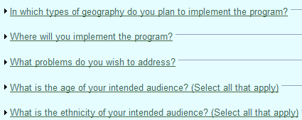
Excellence in Prevention (EIP) Strategy List
A database of programs that DBHR considers “EBPs” for substance abuse prevention SAPT Block Grant and PFS funding.
Searchable to help you narrow your program or strategy choices to match these considerations:

Slide 24
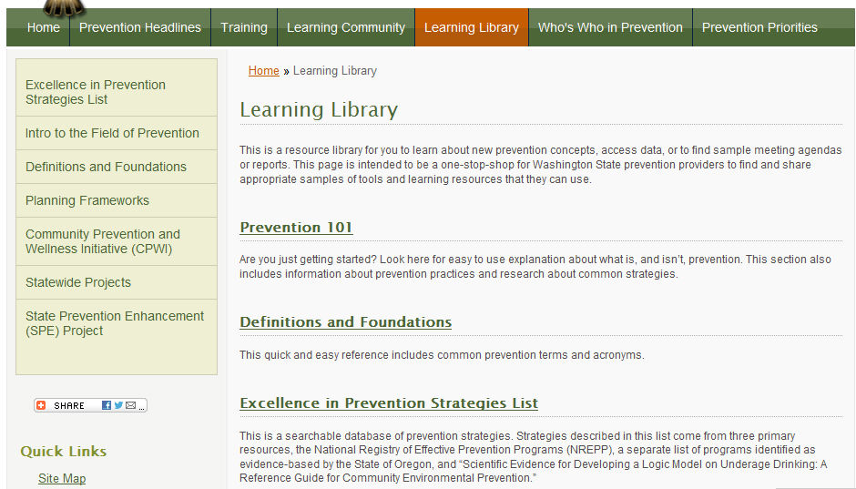
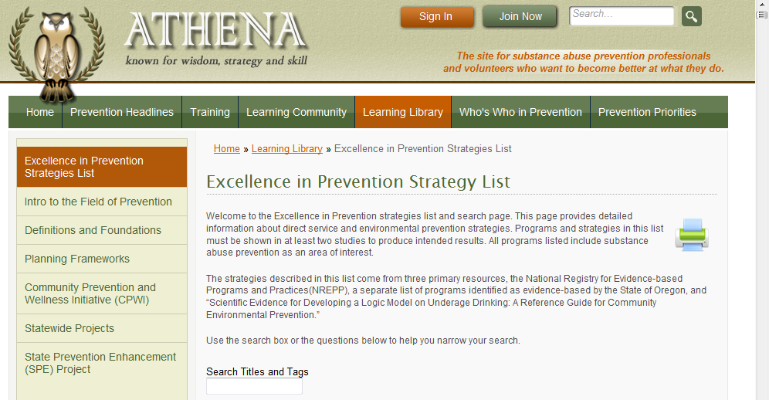
Where is the EIP on Athena?

Slide 25
Learning objectives…
Why do we value EBPs?
What are the various databases and definitions?
DBHR’s current Substance Abuse Prevention criteria.
Where to find the current DBHR Prevention EBP list?
How to search for programs to match your needs?
How to work with coalitions to determine the best fit program?

Slide 26

[SAMPLE] Coalition Logic Model
Long-Term Outcome
Consequences
Behavioral Health Problems
(Consumption)
Intervening Variables
(Risk/Protective Factors)
Local Conditions and Contributing Factors
Strategies &
Local Implementation
Evaluation Plan
(10-15 years)
(5-10 years)
Outcomes
(2-5 years)
(6 months – 2 years)
Action
What is the problem?
Why?
Why here?
But why here?
What are we doing about it?
So what? How will we know?
…with these common factors…
…specifically in our community…
…can be addressed thru these strategies…
…and we will use these tools to measure our impact…
Engaging parents and youth with providers in local decisions.
These problems…
School performance (% of courses passed)
(HYS Academic)
Youth Delinquency
(either HYS Perception of Risk, or Alcohol related arrests of 10-17 year olds, depending on coalition’s strategy)
Mental Health
(HYS depression)
These types of problems…
Any Underage Drinking
(10th grade 30-day use)
Underage
Problem and Heavy Drinking
(10th grade)
Community Disorganization/ Community Connectedness
Community engagement/Coalition development:
Happy People Coalition
Low enforcement in public locations
Community engagement/Coalition development :
Annual Coalition Survey
Sustainability Documentation
Alcohol Availability: Social Access
Alcohol Laws: Enforcement; Youth Perception
Inconsistent consequences for offenders.
Public Awareness:
Media Advocacy for more or improved enforcement
Limited communication b/t enforcement and judiciary.
Environmental Strategies:
Enforcement Roundtable
Party Patrol
Public Awareness:
Process measures Community Survey
School Bonding
Social Skills
Friends who Use
Kids who are not performing at school tend to be those with substance use issues
Environmental Strategies:
Process measures Community Survey; HYS
Risk & Protective Factors:
Poor Family Management
Favorable Attitudes towards Drug Use
Intentions to Use
Lack of consistent and clear consequences at home.
School-based P/I Services:
Student Assistance Program - Happy Town MS
Prevention/ Intervention Services: pre/post
Youth think they would be viewed as “cool” if they drink
Direct Services:
Guiding Good Choices
Life Skills Training
Direct Services: Assigned Program pre/post and process measures; HYS
Youth exposure to favorable alcohol messages from their peers.
State Assessment
Local Assessment
Plan/Implementation
Reporting/Eval

Slide 27
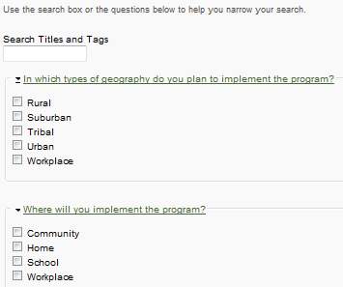
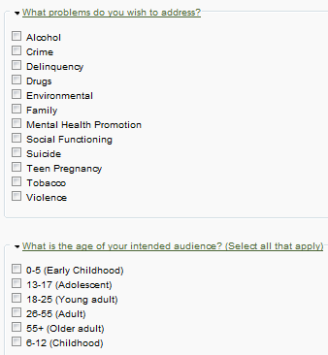
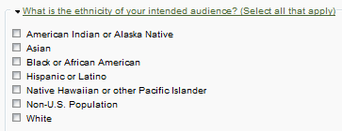
Narrow your search
Notes:
Enter title key words, click on specific considerations of which the program has been studied and found to be effective in and click “Apply”

Slide 28
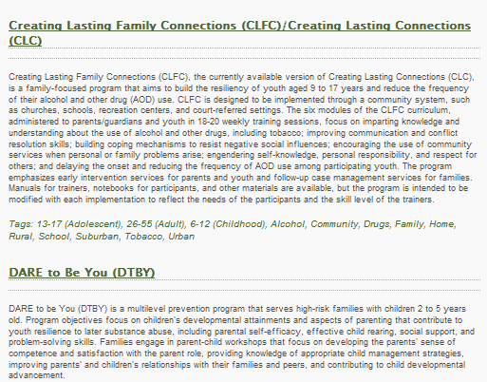
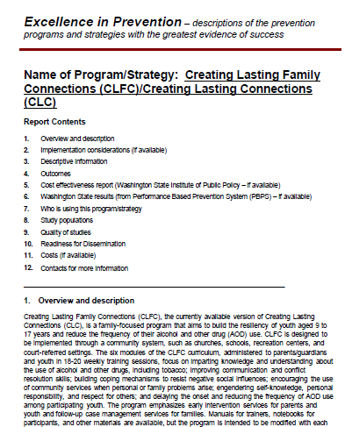
Learn about the program
To print information about a specific program click on link
Save/print PDF.

Slide 29
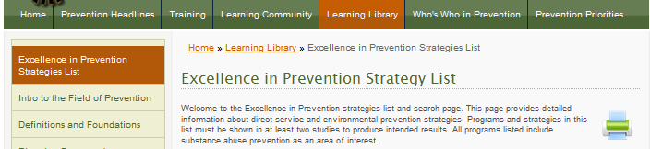
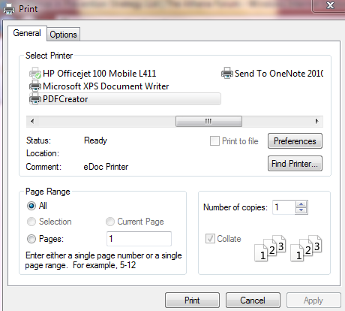
Save your search results
Search the complete list by scrolling and not narrowing search or narrow search then,
Click this printer image to print or save search to PDF using PDF
To print information about specific program(s_ click on like and save/print PDF.

Slide 30
Learning objectives…
Why do we value EBPs?
What are the various databases and definitions?
DBHR’s current Substance Abuse Prevention criteria.
Where to find the current DBHR Prevention EBP list?
How to search for programs to match your needs?
How to work with coalitions to determine the best fit program?

Slide 31

[SAMPLE] Coalition Logic Model
Long-Term Outcome
Consequences
Behavioral Health Problems
(Consumption)
Intervening Variables
(Risk/Protective Factors)
Local Conditions and Contributing Factors
Strategies &
Local Implementation
Evaluation Plan
(10-15 years)
(5-10 years)
Outcomes
(2-5 years)
(6 months – 2 years)
Action
What is the problem?
Why?
Why here?
But why here?
What are we doing about it?
So what? How will we know?
…with these common factors…
…specifically in our community…
…can be addressed thru these strategies…
…and we will use these tools to measure our impact…
Engaging parents and youth with providers in local decisions.
These problems…
School performance (% of courses passed)
(HYS Academic)
Youth Delinquency
(either HYS Perception of Risk, or Alcohol related arrests of 10-17 year olds, depending on coalition’s strategy)
Mental Health
(HYS depression)
These types of problems…
Any Underage Drinking
(10th grade 30-day use)
Underage
Problem and Heavy Drinking
(10th grade)
Community Disorganization/ Community Connectedness
Community engagement/Coalition development:
Happy People Coalition
Low enforcement in public locations
Community engagement/Coalition development :
Annual Coalition Survey
Sustainability Documentation
Alcohol Availability: Social Access
Alcohol Laws: Enforcement; Youth Perception
Inconsistent consequences for offenders.
Public Awareness:
Media Advocacy for more or improved enforcement
Limited communication b/t enforcement and judiciary.
Environmental Strategies:
Enforcement Roundtable
Party Patrol
Public Awareness:
Process measures Community Survey
School Bonding
Social Skills
Friends who Use
Kids who are not performing at school tend to be those with substance use issues
Environmental Strategies:
Process measures Community Survey; HYS
Risk & Protective Factors:
Poor Family Management
Favorable Attitudes towards Drug Use
Intentions to Use
Lack of consistent and clear consequences at home.
School-based P/I Services:
Student Assistance Program - Happy Town MS
Prevention/ Intervention Services: pre/post
Youth think they would be viewed as “cool” if they drink
Direct Services:
Guiding Good Choices
Life Skills Training
Direct Services: Assigned Program pre/post and process measures; HYS
Youth exposure to favorable alcohol messages from their peers.
State Assessment
Local Assessment
Plan/Implementation
Reporting/Eval

Slide 32
Determine the best program fit
Using a strategy selection workgroup is a good idea to save time as large group.
Narrow your search for programs using search considerations or tag key words,
Review Program/Strategy description PDFs for programs that are shown to have outcomes on your intervening variables and address your local conditions.

Slide 33

What to bring back to coalition
Identify programs that meet your needs.
Identify programs found to be effective among the races and ethnicities you will be serving.
Quality of study for outcomes.
Identify costs of program, training, coalition capacity and replication/adaptation abilities.
Identify a workgroup member to report back to the full coalition.
Provide options of a few strategies for each local condition prioritized.
  What are some ways that you prioritized strategy selection with the coalition?

Slide 34
Today we covered…
The value of EBPs.
The various databases and definitions.
DBHR’s current Substance Abuse Prevention criteria.
Where to find the current DBHR Prevention EBP list.
How to search for programs to match your needs.
How to determine the best fit program.

Slide 35

Questions?
Thank you.
Julia Havens,
Prevention Systems Development Manager
Division of Behavioral Health & Recovery
julia.havens@dshs.wa.gov
509.220.4752

Slide 36
Content Resources
www.blueprintsprograms.com
www.nrepp.samhsa.gov/
www.crimesolutions.gov/
www.theathenaforum.org/learning_library/ebp
http://www.wsipp.wa.gov/Reports
RCW 71.24.025
http://www.communitiesthatcare.net/

