Slide 1
Partnership for Success Secure Medicine Take-Back Projects CPWI Presentation August 26, 2015
Ferndale – Amy Hockenberry
Republic – Janine Koffel
Hoquiam – Wilma Weber
Shelton – Ben Johnson
Prosser – Jennifer Dorsett

Slide 2
PFS Enhancement Project
Lummi Tribal Health Center
Take Back Program
Ferndale CPWI
Contact: Amy Hockenberry – 360.778.6052 or ahockenb@co.whatcom.wa.us

Slide 3
Establishment a Permanent Take Back Program
November 2014 – June 2015
Partnership established with Lummi Health Center Director
Insights from City of Bellingham & Ferndale to learn
Creation of protocol for collection of waste residential pharmaceuticals
LOA established between the County Health Department & Lummi THC
Approval granted by the Lummi Tribal Business Council
Set up collections with disposal agency – Clean Harbors
Purchase of equipment
Development and printing of promotional materials
Protocol training with pharmacy staff
Article and ads in local newspapers
Contact: Amy Hockenberry – 360.778.6052 or ahockenb@co.whatcom.wa.us

Slide 4
Magnet
Poster
Contact: Amy Hockenberry – 360.778.6052 or ahockenb@co.whatcom.wa.us

Slide 5
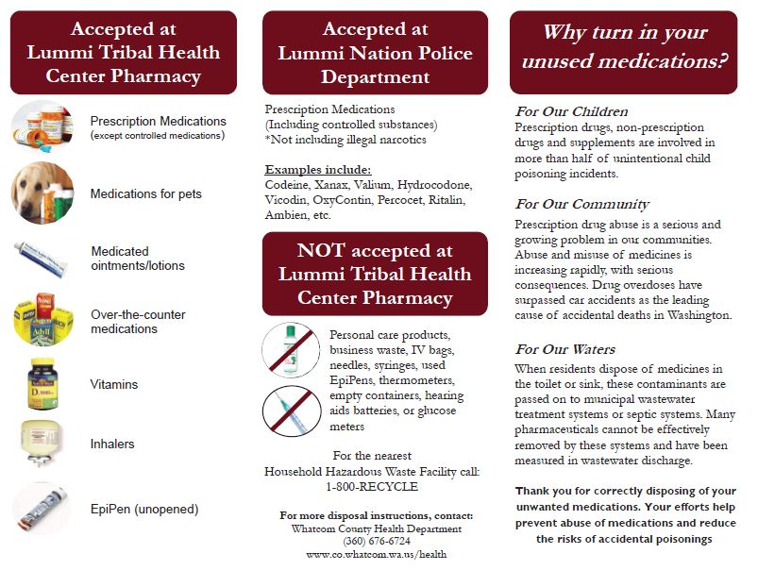
Brochure
Contact: Amy Hockenberry – 360.778.6052 or ahockenb@co.whatcom.wa.us

Slide 6
Count It! Lock It! Drop It!
A progress report on the RRAD Secure Medicine Take-back Campaign, funded by a PFS Targeted Enhancement grant
ALLPPT.com _ Free PowerPoint Templates, Diagrams and Charts

Slide 7
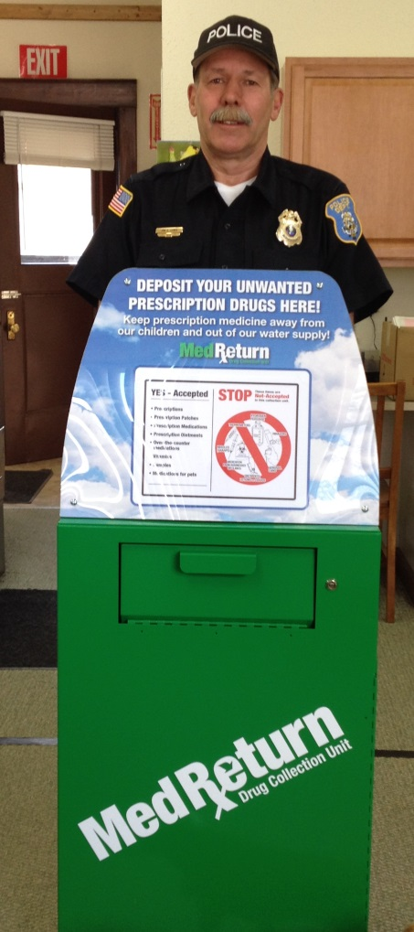
Policies Established
Republic Police Department
Proposed a procedure and policy for the adoption and implementation of a prescription drug take-back program, October 6, 2014.
Secure Medicine Drop-box
Installed at Republic Police Department, April 2, 2015.
Available for Rx deposits Monday-Friday, 8-4

Slide 8
Outcomes
April-July, 2015
32 pounds of medications collected
May, 2015
Rx Drug Town Hall Meeting with 40 attendees
Ongoing: Home Medication Boxes
50 personal LOCKMED boxes purchased for distribution to ‘at-risk’ individuals or families

Slide 9
Outcomes
News Coverage
Flyer: What do these drugs have in common? distributed in monthly Ferry County View Extra publication, 2,600 circulation
Flyer: Rx Drug Town Hall Meeting distributed in monthly Ferry County View Extra publication, 2,600 circulation
Town Hall Meeting and Drop-Box Installation coverage in the Colville Statesman-Examiner, 6,800 circulation, the Okanogan Chronicle, 6,800 circulation, Silverado Express, 49,000 circulation

Slide 10
Educational Materials
Count It! Lock It! Drop It!
Rx Drug Workgroup approved purchase of media campaign materials including:
Are your meds secure? Sticky note used by Republic Drug Store
Count It! Lock It! Drop It! Window cling distributed to 60 businesses
Count It! Business cards with drop-box location and operation hours

Slide 11
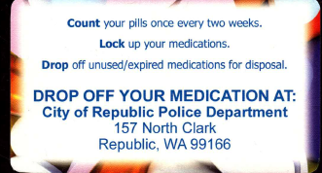
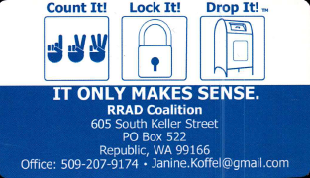

Slide 12
Educational Materials
Opioid Overdose brochure
Customized trifold, double-sided educational brochure detailing symptoms of opiate overdose, naloxone treatment, and opiate overdose risks
Continuously distributed with Drop It! business cards or Good Samaritan Law business cards
Provided to Ferry County Emergency Medical Services District #1 for distribution as appropriate

Slide 13
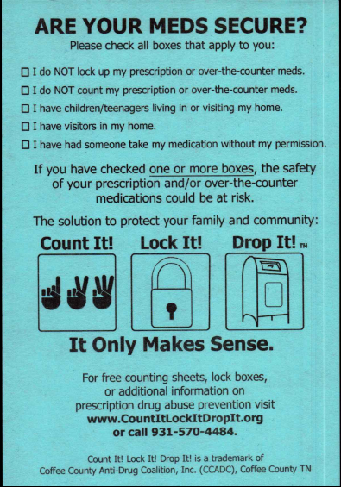
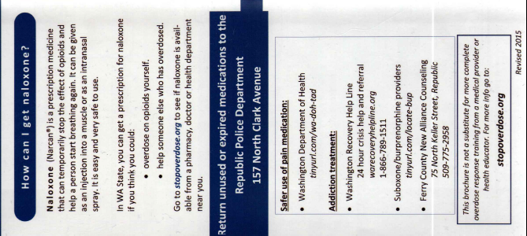

Slide 14
On the Horizon
August, 2015
Continued work by the Rx Drug workgroup to explore the provision of Narcan training for county EMS personnel
Technical assistance to the Ferry County Hospital District #1 for the establishment of a protocol for an opiate overdose response utilizing Narcan
Explore need for formal Disposal of Narcotics policy for County Coroners and/or Ferry County Sheriff Deputies
Partner with the Ferry County Sheriff to promote and conduct the National DEA drug-take back day

Slide 15
Janine Koffel
RRAD Coalition Coordinator
509-207-9174
Janine.Koffel@gmail.com

Slide 16
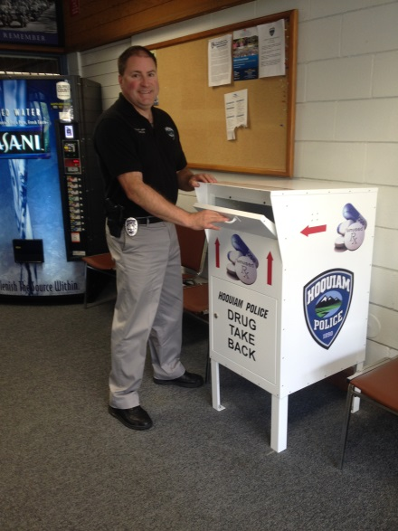
Hoquiam’s Story
Drop Box Acquisition October 2014
Policy Developed November 2014
My TOWN participation March 2015
Current State April 2015

Slide 17
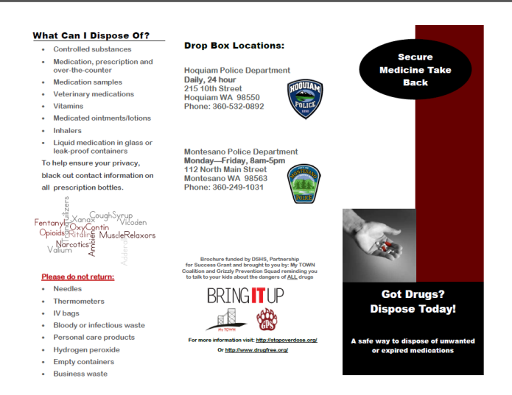
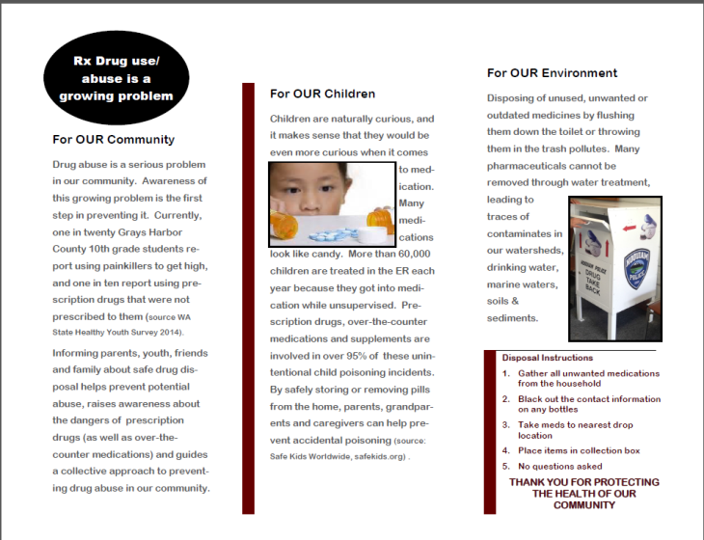
Resources Developed:
Brochure:
2000 copies produced and distributed to over 13 local providers including nursing home; assisted living; pharmacies; chiropractic; dental; family practice; syringe exchange; health department and outpatient drug treatment facilities.
Poster:
Largely produced for pharmacies – distributed far and wide throughout Hoquiam and Aberdeen

Slide 18
My TOWN Coalition
Wilma Weber, Coalition Coordinator
Grays Harbor Public Health Department
wweber@co.grays-harbor.wa.us
360.500.4069

Slide 19
Shelton Safe Medicine Take-Back Targeted Enhancement Project
Ben Johnson
Coalition Coordinator

Slide 20
January: 2015
Belfair Fire Station: 40.99lbs
Shelton MCSO: 71.80lbs
Total collected: 112.79lbs

Slide 21
July 2015 Belfair: 39.96lbs Shelton: 85.75lbs Total: 125.71lbs

Slide 22
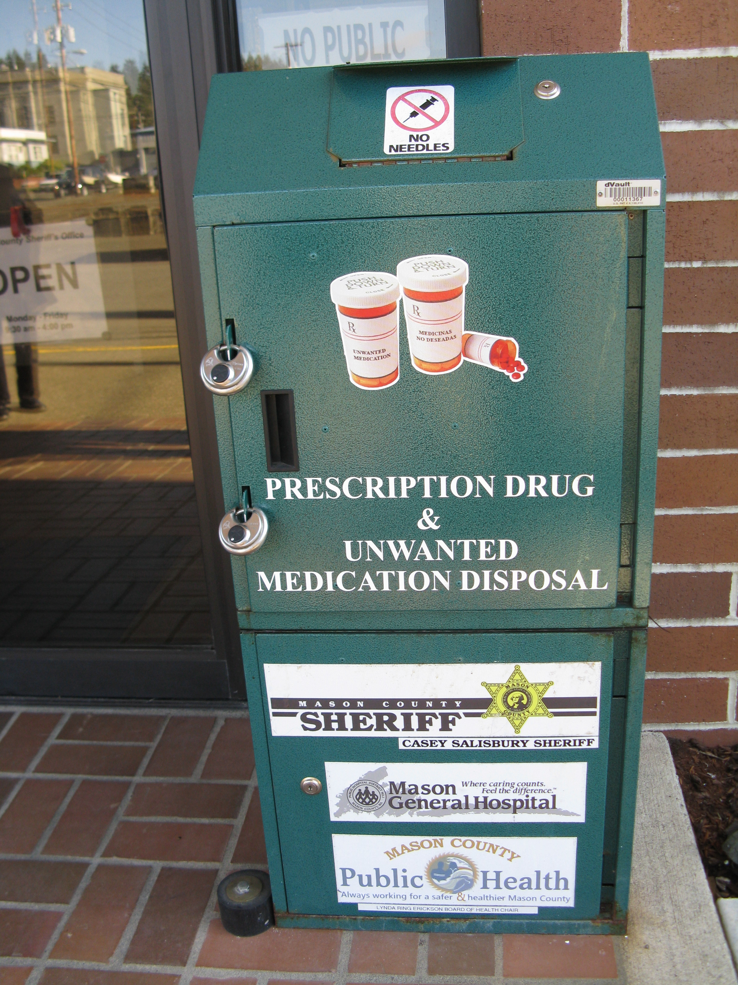

Slide 23
Placed in all Pharmacies and Medical clinics

Slide 25
Street Banners
Three locations for 3 weeks

Slide 26
2000 Coffee Sleeves
Sleeves used at most popular shop in town!

Slide 27
105 RADIO ADS
2015 PSA
April is Prescription Drug Take Back Month
Did you know that thousands of pounds of prescription drugs end up in landfills, flushed down the toilet or not used as prescribed every year? But there is an easy way to safely discard old or unused prescription drugs.
Anybody can take unused or out of date drugs to the Mason County Prescription drug drop boxes for free. Boxes are located at the Mason County Sheriff’s Office on 3rd Street in Shelton and at the North Mason Region Fire Authority in Belfair off the Old Belfair Highway.
No sharps, syringes or liquids are accepted but all other medications can be dropped at these locations.
Help keep our community safe and healthy. Lock up medications and use your local take-back boxes!
This message is brought to you by Mason County Public Health, Mason County Sheriff’s Office, the Shelton High School SADD Club and The Division Of Behavioral Health and Recovery.

Slide 28
Media Outlets
Mason County Transit 26 Busses
Mason County Journal Newspaper
KMAS RADIO 105
Squaxin Tribal newsletter
Skokomish Tribal Newsletter
Local Cable TV
Coffee News
The Shopper Weekly
Senior News

Slide 29
Community Presentations
Board of Health
Shelton School Board
Mental Health Coalition
Substance Abuse Coalition
Criminal Justice Meeting
League Of Woman's Voters
Senior Center
Radio Interview Morning Show

Slide 30
Contact Information:
Ben Johnson, BS
Mason County Public Health
Shelton Mental Health/Substance Abuse Coalition Coordinator
(360) 427-9670 x 545
BenJ@co.mason.wa.us

Slide 31
Prosser CIA

Slide 32
Our Partners
Local pharmacy
Local hospital
Neighboring Police Department
Coalition Partners
City
Chamber
Safe Kids
School District

Slide 33
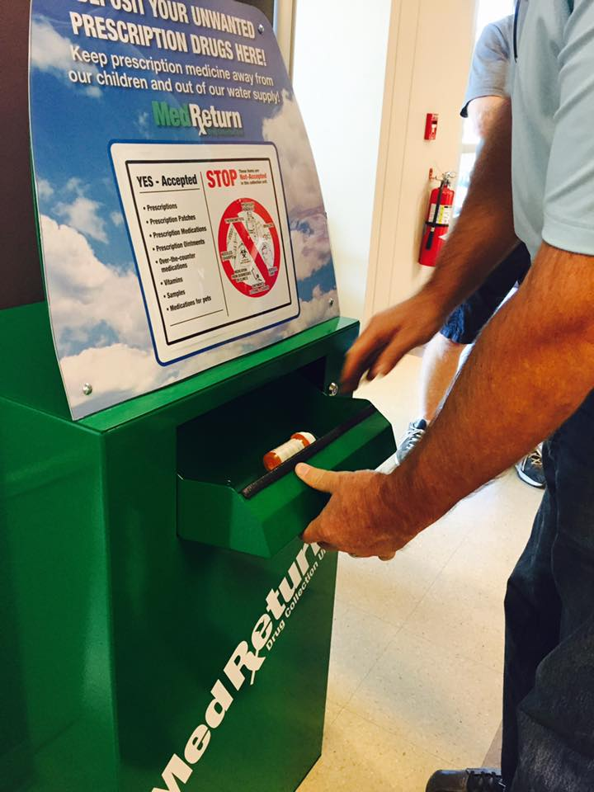
Prescription Take Back Program
Challenges:
Contracts
Policy
Bags
Location
THE BOX
Disposal
Sustainability

Slide 34
How’d It Go?!
Policy in place at PMH Medical Center
Pharmacy distributes bags to customers
Newsletters, social networking, TV News (3)
Ribbon Cutting June 5th
50lbs by July 1
150lbs to date
Building other partnerships and support

Slide 35
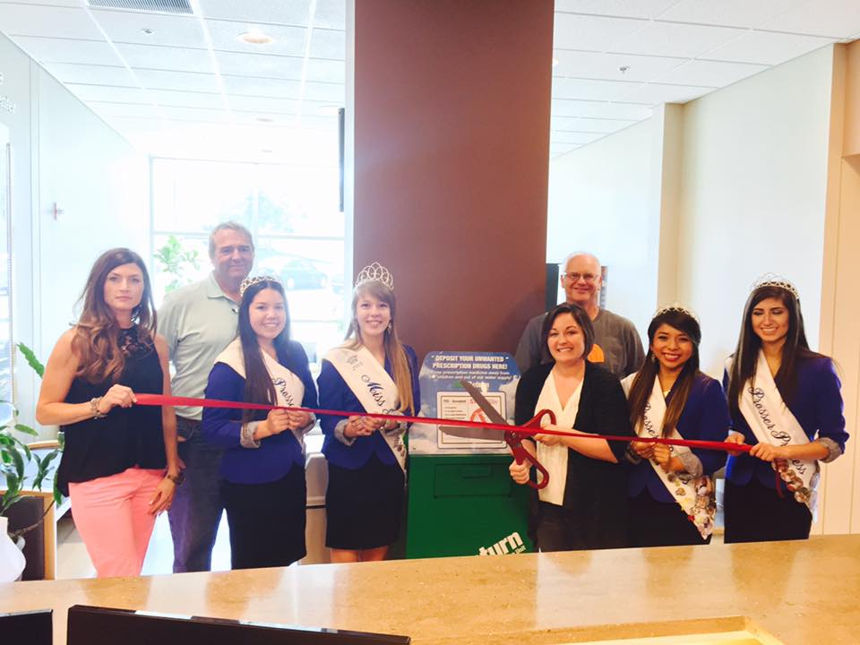
Ribbon cutting

Slide 36
Contact Information:
Jennifer Dorsett
CPWI Community Coordinator
Email: jennifer.dorsett.sac@gmail.com
Phone: 509-851-1348

