Slide 1
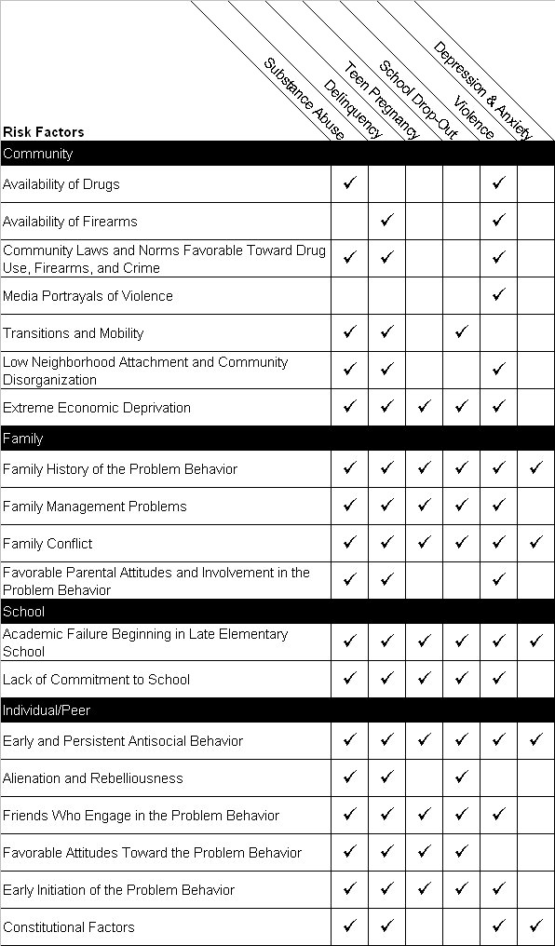
Risk factors exist in different environments:
Practice Wisdom to Prevention Science: Advances in Preventing Health and Behavior Problems among Young People, J. David Hawkins, Social Development Research Group, University of Washington, 2006
Community
Family
School
Individual/Peer
Notes:
Research has also identified factors that can interrupt the process of positive social development. These are called risk factors. Studies of young people growing up have identified risk factors for a wide range of youth health and behavior problems (Biglan, Brennan, Foster, & Holder, 2004). These risk factors have been found in neighborhoods and communities, families, schools and peer groups, as well as individuals themselves. These factors increase the probability of delinquency, violence, substance abuse, teen pregnancy, dropping out of school, and other behavior problems in young people. (Slides 6,7,8,9). The risk factors shown here have been found in at least two high quality studies to predict later health and behavior problems in young people. These factors are important because they are potential targets for preventive action. Many of these risk factors predict multiple problems.

