Slide 1
Cohort 2
Prevention Redesign Initiative (PRI) Cohort 2 - Workshop Series
Resources Assessment Clinic
Workshop 1 – Conducting a Resources Assessment & Gap Analysis
Division of Behavioral Health and Recovery
February 2013
Presented by:
Julia Greeson, Prevention System Manager
Sarah Mariani, Prevention Systems Integration Manager
Notes:
The background for the PowerPoint slides is what we at DBHR are required to use. You are not required to use this background in your work with your local coalition and data work group.
Please feel free to customize the background and colors used in the slides to those that are traditionally used in your presentations, etc. Also, feel free to insert your coalition logo, if you have one, or other information that you think helps to localize the presentation so it feels more “local” and familiar.
We think the content and sequence of content are important. So we ask that you contact us at pritraining@dshs.wa.gov to discuss any proposed changes before you actually present the information.
Thanks. And great success to you!

Slide 2
Introduction
Before we start…

Slide 3
Chat
Please type your answer into the chat box.
What is the value-added to your coalition’s strategic planning in completing a resources assessment?

Slide 4
Workshop 1: Training Objectives
Participants will:
Understand Resources Assessment key elements and purpose.
Understand what information to collect on existing resources that addresses priorities identified during needs assessment.
Get tools and examples for Resources Assessments.
Discuss how to identify gaps in resources which address priority risk and protective factors.
Plan next steps.

Slide 5
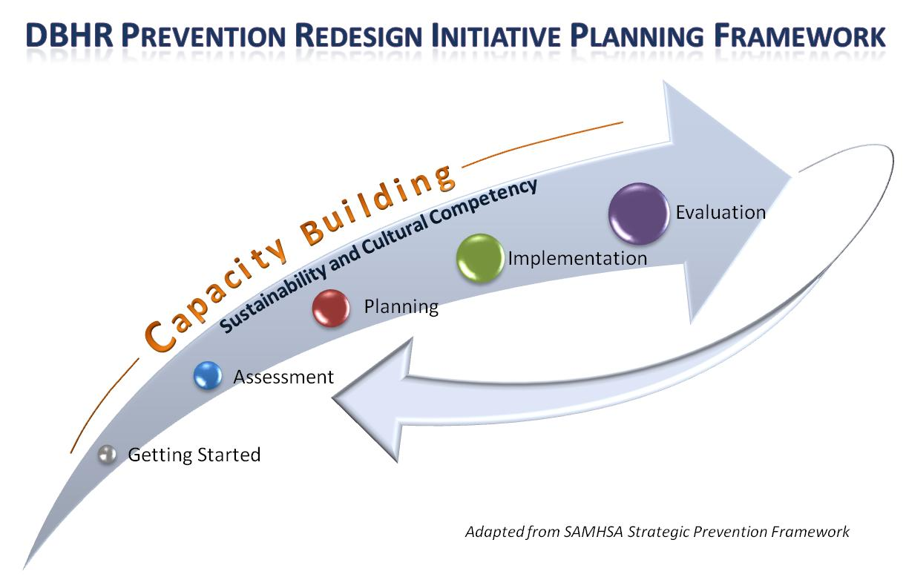
PRI Planning Framework
Notes:
The PRI is generally following the Strategic Prevention Framework (SPF) as the overall planning framework for this process. Based on our learning from the Strategic Prevention Framework State Incentive Grant (SPF-SIG) process, for the purposes of PRI, we have added a “Getting Started” section and have included “Capacity” as an ongoing step throughout the process. It is expected that all tasks associated with PRI will be conducted in a culturally competent and sustainable manner. This is not expected to be linear process.
EMPHASIZE – sustainability and cultural competence as well as capacity building.

Slide 6
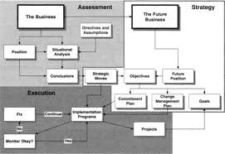
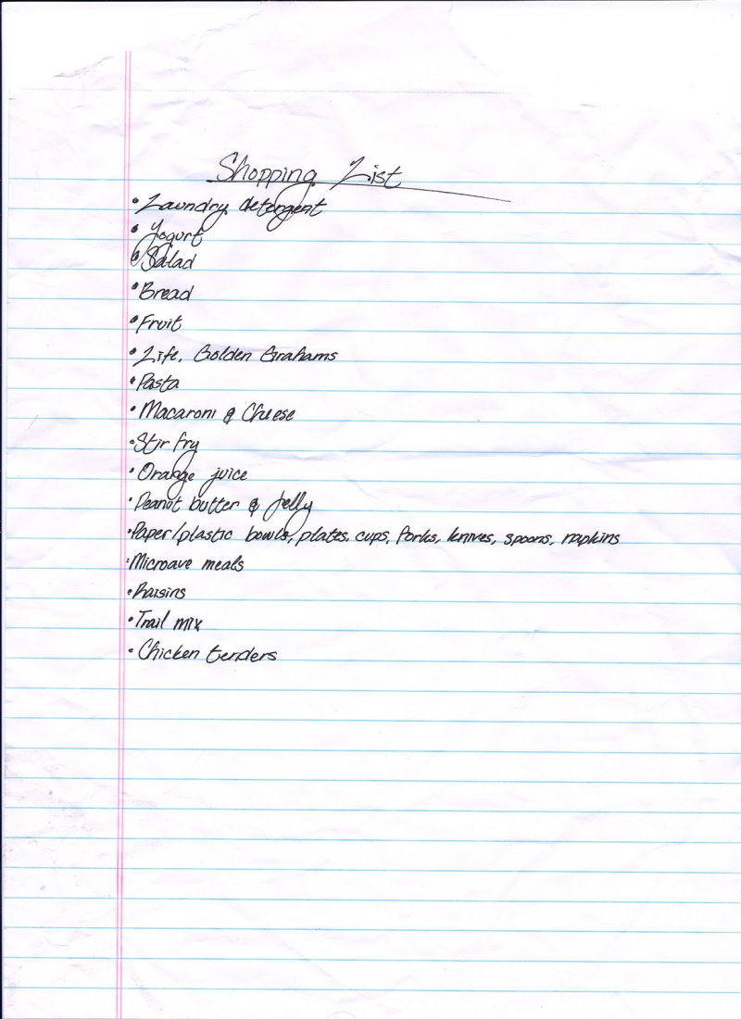
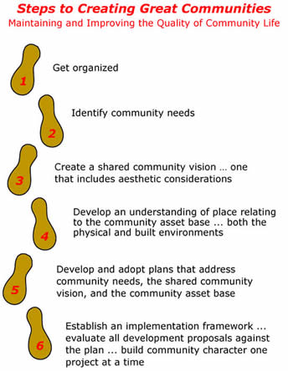
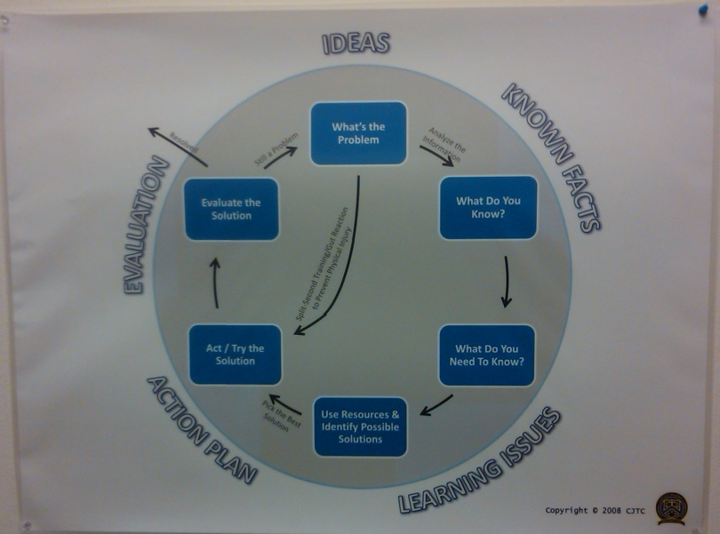
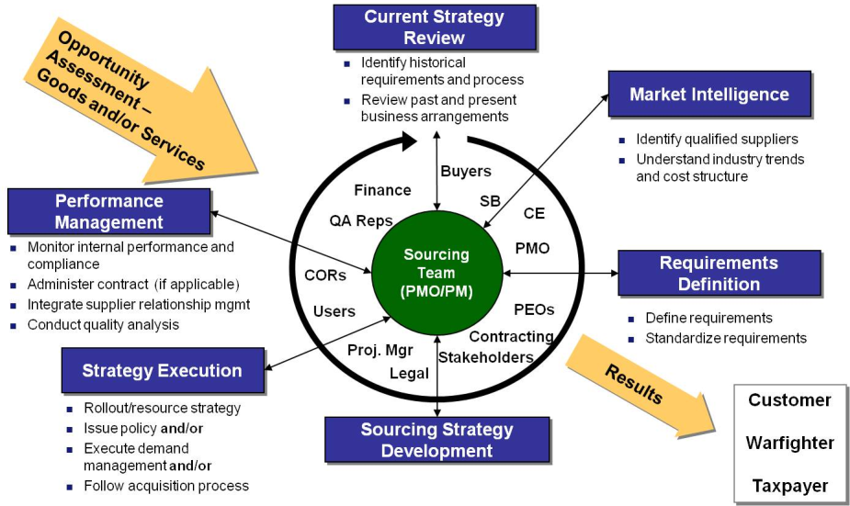
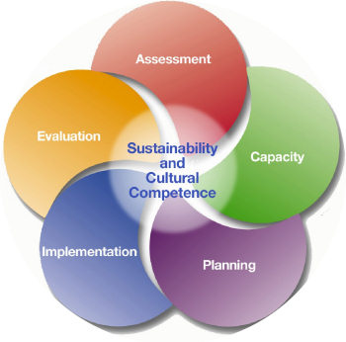
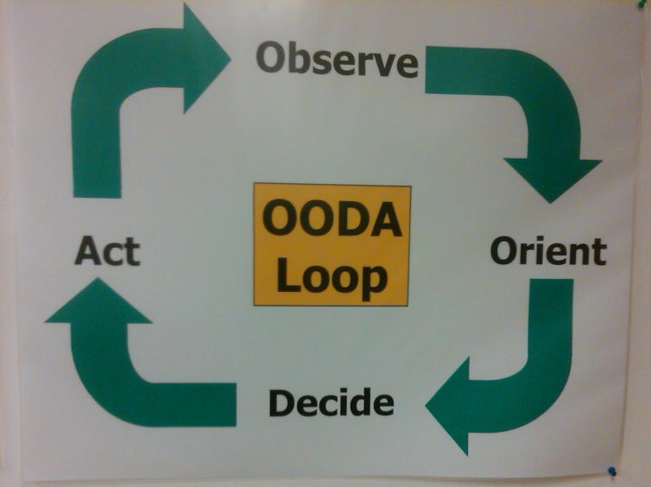
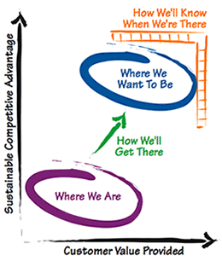
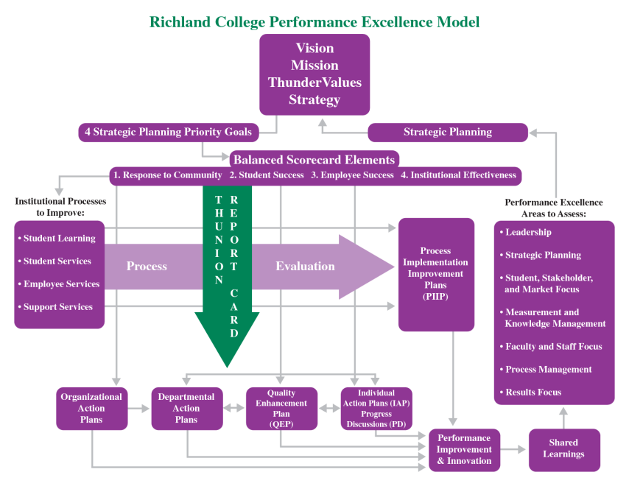
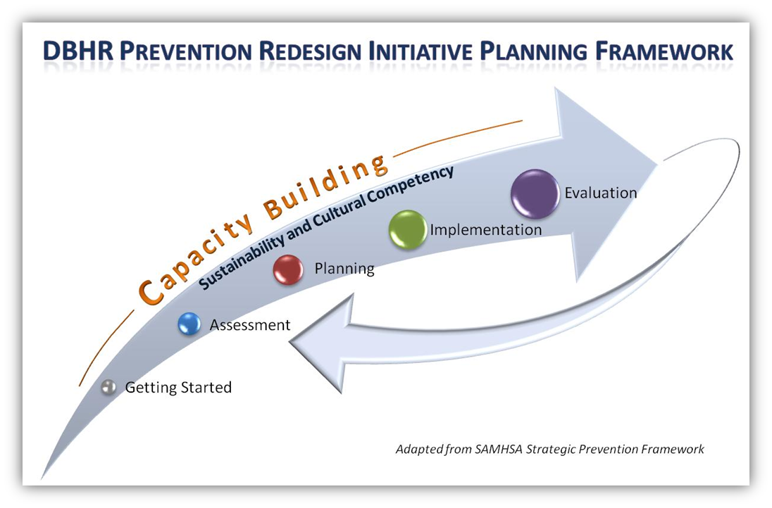
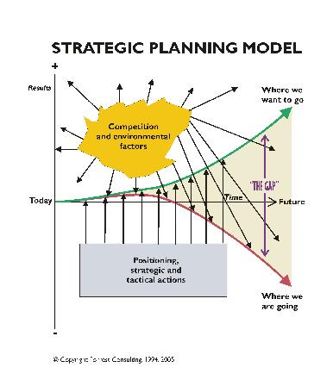
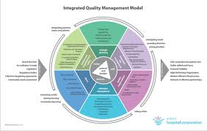
Side note: We all plan
Notes:
Side note: It is all the same process – learn how the other professionals in your coalition under strategic planning and use that to meet them where they are at….
Credits:
2008 Criminal Justice Training Center – Pictures 1 and 2
http://www.cooperwww.com/consultant.html - steps
2007-2010 Forrest Consulting - http://www.strategic-plan.com/strategicplanningmodel.html – line graph
SPF
http://www.wpafb.af.mil/shared/media/document/AFD-110926-022.pdf
http://www.docstoc.com/docs/45751195/Richland-College-Performance-Excellence-Model
http://yukonhospitals.ca/Documents/IntegratedQualityMgmtModel_Nov2010.pdf
http://pesona.mmu.edu.my/~wruslan/SPICT1/CourseHome/index.htm
http://www.lightbryan.com/strategy/whatisstrategy.html

Slide 7
Elements of a good Assessment
Needs
Resources
Gaps
We are here

Slide 8
Completing a
Resources Assessment
Workshop 1:
Process
Findings
Workshop 2:
Analysis and Prioritization (Feb. 26)
Today we will cover these parts.

Slide 9
Process
Who? What? DO.
Part One:

Slide 10
What is a Resources Assessment?
Definition: A resource assessment is a systematic process for examining the current resources in your community which are reducing risk factor and increasing protective factors.
"What's already going on in my community?" … “and what is missing?”

Slide 11

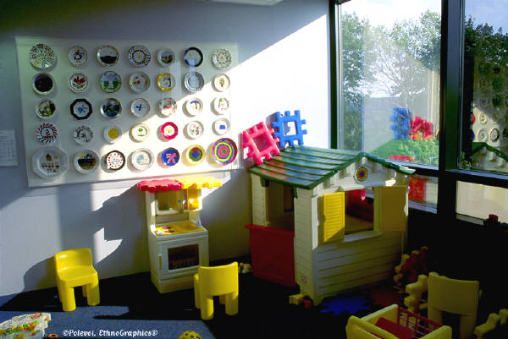


What is a “Resource”?
“Resources” are funding, program, policy, initiative, people, and/or services that:
Can be activated to reduce the likelihood of alcohol, tobacco, and other drugs misuse/abuse.
Promote healthy communities.
Address local conditions.
“Can be directed toward solving the specific problems identified as top community concerns.” - CADCA, Coalition Academy
Notes:
Ask the group for examples.

Slide 12
Benefits of a Resources Assessment
A community resource assessment will assist you to:
  Identify key resources needed to support your Strategic Plan.
  Build collaboration among service providers.
  Recognize the EBP’s and environmental efforts currently available in your community.
  Identify gaps in services and avoid duplication in services.
  Promote the work and efforts on the coalition to build capacity and sustainability.
Notes:
More than a list of resources.

Slide 13
Benefits of a Resource Assessment
So that..
  Ensure you are putting your time and money where it will have the greatest impact
  Ensure you are creating a comprehensive prevention strategy for your community
  Ensure you are effectively impacting your priority risk and protective factors

Slide 14
[Name] Coalition Logic Model
Long-Term Outcome
Consequences
Behavioral Health Problems
(Consumption)
Intervening Variables
(Risk/Protective Factors)
Local Conditions and Contributing Factors
Strategies &
Local Implementation
(10-15 years)
(5-10 years)
Outcomes
(2-5 years)
(6 months – 2 years)
What is the problem?
Why?
Why here?
But why here?
What are we doing about it?
…with these common factors…
…specifically in our community…
…can be addressed thru these strategies…
These problems…
School performance (% of courses passed)
(HYS Academic)
Youth Delinquency
(either HYS Perception of Risk, or Alcohol related arrests of 10-17 year olds, depending on coalition’s strategy)
Mental Health
(HYS depression)
These types of problems…
Any Underage Drinking
(10th grade 30-day use)
Underage
Problem and Heavy Drinking
(10th grade)
[Add Yours Here]
Community Disorganization/ Community Connectedness
[Add Yours Here]
Community engagement/Coalition development:
[Coalition Name]
[Add Yours Here]
Needs Assessment
Alcohol Availability: Retail or Social Access
Promotion of Alcohol
Alcohol Laws: Enforcement; Penalties; Regulations
[Add Yours Here]
[Add Yours Here]
Public Awareness:
[Add Yours Here]
Environmental Strategies:
[Add Yours Here]
Low Commitment to School
Favorable Attitudes
Friends Who Use
Perception of Harm
[Based on individual assessment]
[Add Yours Here]
School-based Prevention/ Intervention Services:
Student Assistance Program
Risk & Protective Factors:
[Add Yours Here]
[Add Yours Here]
Direct Services:
[Add Yours Here]
State Assessment
Local Assessment
Plan/Implementation

Slide 15
[Name] Coalition Logic Model
Long-Term Outcome
Consequences
Behavioral Health Problems
(Consumption)
Intervening Variables
(Risk/Protective Factors)
Local Conditions and Contributing Factors
Strategies &
Local Implementation
Resources Assessment
(10-15 years)
(5-10 years)
Outcomes
(2-5 years)
(6 months – 2 years)
Action
What is the problem?
Why?
Why here?
But why here?
What are we doing about it?
What resources do we have, that we want to include in our plan?
What resources do we need in order to impact the local conditions we want to change?
…with these common factors…
…specifically in our community…
…can be addressed thru these strategies…
These problems…
School performance (% of courses passed)
(HYS Academic)
Youth Delinquency
(either HYS Perception of Risk, or Alcohol related arrests of 10-17 year olds, depending on coalition’s strategy)
Mental Health
(HYS depression)
These types of problems…
Any Underage Drinking
(10th grade 30-day use)
Underage
Problem and Heavy Drinking
(10th grade)
[Add Yours Here]
Community Disorganization/ Community Connectedness
[Add Yours Here]
Community engagement/Coalition development:
[Coalition Name]
[Add Yours Here]
Alcohol Availability: Retail or Social Access
Promotion of Alcohol
Alcohol Laws: Enforcement; Penalties; Regulations
[Add Yours Here]
[Add Yours Here]
Public Awareness:
[Add Yours Here]
Environmental Strategies:
[Add Yours Here]
Low Commitment to School
Favorable Attitudes
Friends Who Use
Perception of Harm
[Based on individual assessment]
[Add Yours Here]
School-based Prevention/ Intervention Services:
Student Assistance Program
Risk & Protective Factors:
[Add Yours Here]
[Add Yours Here]
Direct Services:
[Add Yours Here]
State Assessment
Local Assessment
Plan/Implementation

Slide 16
Completing a Resources and Gaps Assessment
Five Steps…
Establish your process.
Identify, collect, and compile information on each existing resources which address the priority risk and protective factors.
Determine gaps in resources.
Determine key findings.
Integrate information into Strategic Plan.

Slide 17
Poll
Which of these steps do you feel particularly strong in your ability to complete?
Which of these steps do you think might challenge you?

Slide 18
Step 1:
Establish your process
Gather coalition members to work on Resources Assessment.
Be clear about your goals and objectives for your Resources Assessment.
Decide on what information you want to collect.
Decide on how you will collect information.
Establish timeframe for collection.
Go forth and collect! ...

Slide 19
Poll
How are coalition members involved in your Resources Assessment?
  Collect Information
  Develop collection tool
  Review information
  Present information
  Write summary of Resources Assessment for Strategic Plan

Slide 20
Step 1:
Creating your Collection Tool
What do you want to know?
At the end how do you want to present information?
What information supports determining local conditions and strategy selection?
What information will support implementation of strategies?
Notes:
Pair down info to what is helpful to you…..and add something that is important to your community.

Slide 21
Step 2:
Collecting Information
Types of information to be collected:
Resource/Provider contact info
Funding sources and duration
Program/Activity – description, location, when service is offered, type of service, participant cost
What risk/protective factors and local conditions are addressed
Target populations - populations served, numbers served
Type of prevention strategy – CSAP strategies, domain, sector
Evaluation results
Notes:
INDIRECT and DIRECT resources

Slide 22
Step 2:
Collecting Information
Use the following to identify resources:
Coalition members
Directories - Human services, Telephone, Helpline/Crisis Clinic, health department
City halls (especially in small towns)
One-stop centers / Food banks
Medical providers - community health clinic
Key informants / prevention service providers
Surveys
What else???

Slide 23
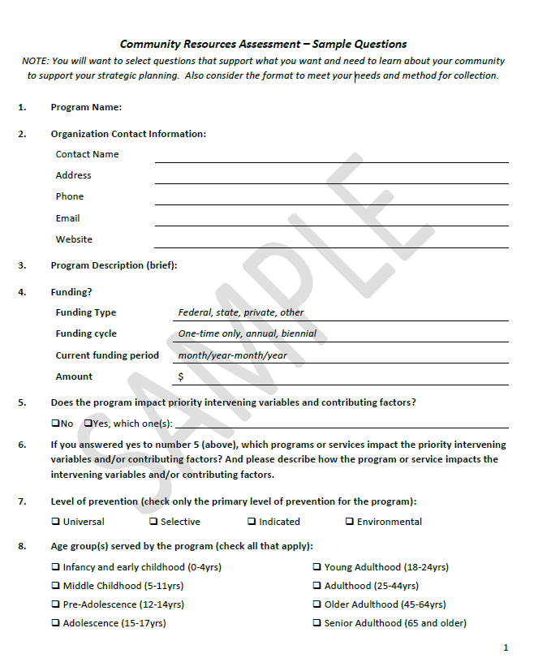
Step 2:
Collecting the Information

Slide 24
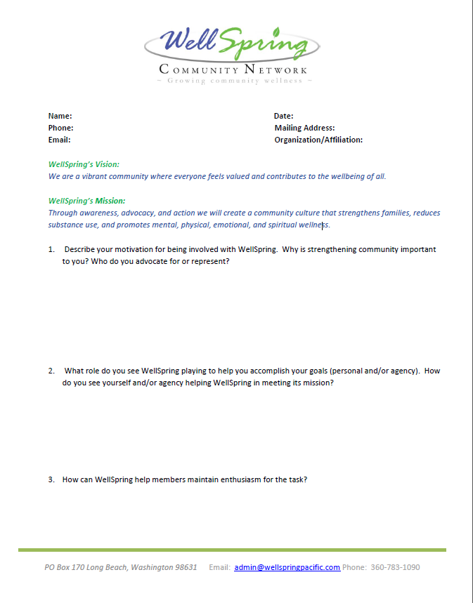
Step 2:
Collecting the Information
Notes:
-----------------------------
http://www.surveymonkey.com/s/MC83JL2
Attached is our member survey document that we used to interview all existing members back in 2010. The new member application and survey is at the survey monkey link above. We have members complete this as part of their application. Our capacity team reviews the new member applications as they come in to make recommendations for membership and then also to categorize new resources and link new member into volunteer opportunities.
Per:
Katie Lindstrom
Deputy Director
Pacific County Health & Human Services
7013 Sandridge Road
Long Beach, WA 98631
360-642-9300 ex 2648 or 875-9343
Fax: 360-875-9323

Slide 25
Step 2:
Collecting Information
Interviewing a community resource provider:
Deliver the 1 minute opening comments.
      Introduce yourself
      Coalition you are representing
      Prevention Redesign Initiative Planning Process
      Resource and Gaps Assessment
      Information being collected about resources
      Importance/relevance of the information
Ask if they would like to participate in the effort.
Ask questions to gather information on their resource(s).
Thanks!

Slide 26
Poll
How difficult have you found it to collect your resources information?
  Very difficult
  Somewhat difficult
  Not too difficult
  Not difficult at all

Slide 27
Step 2:
Compiling your Information
What do you want to know in the end?
How will you display information in a way that helps you make decisions?
  Information listing (Directory)
  Charts and graphs
  Maps
Notes:
Displaying information in a way that helps you make decisions.

Slide 28
Chat
Please type your answer into the chat box.
What methods have you used or will likely use to display your information?

Slide 29
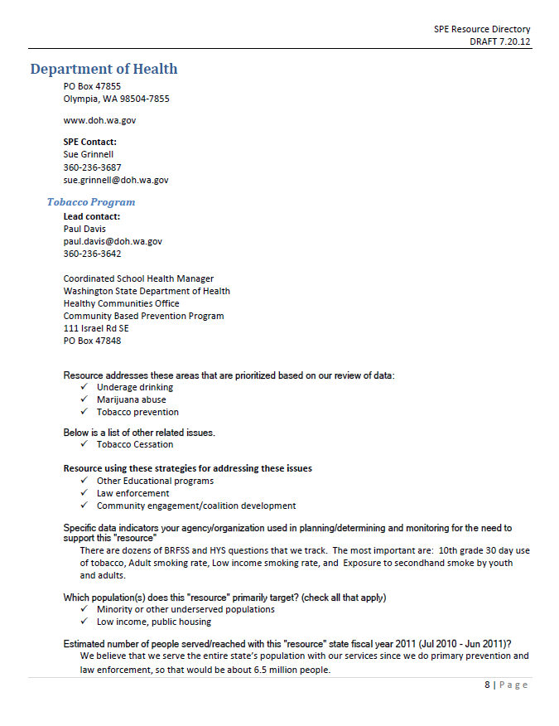
Step 2:
Information Listing

Slide 30
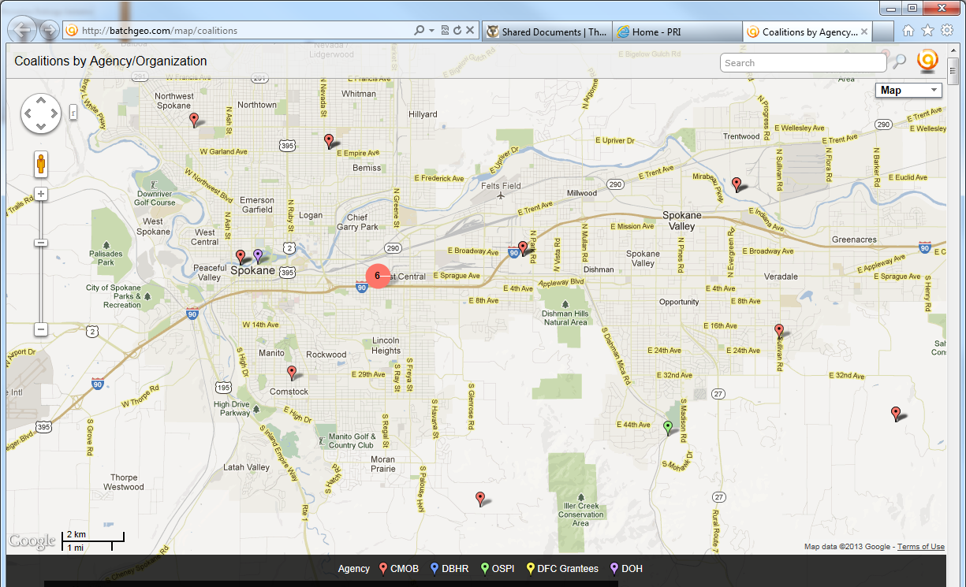
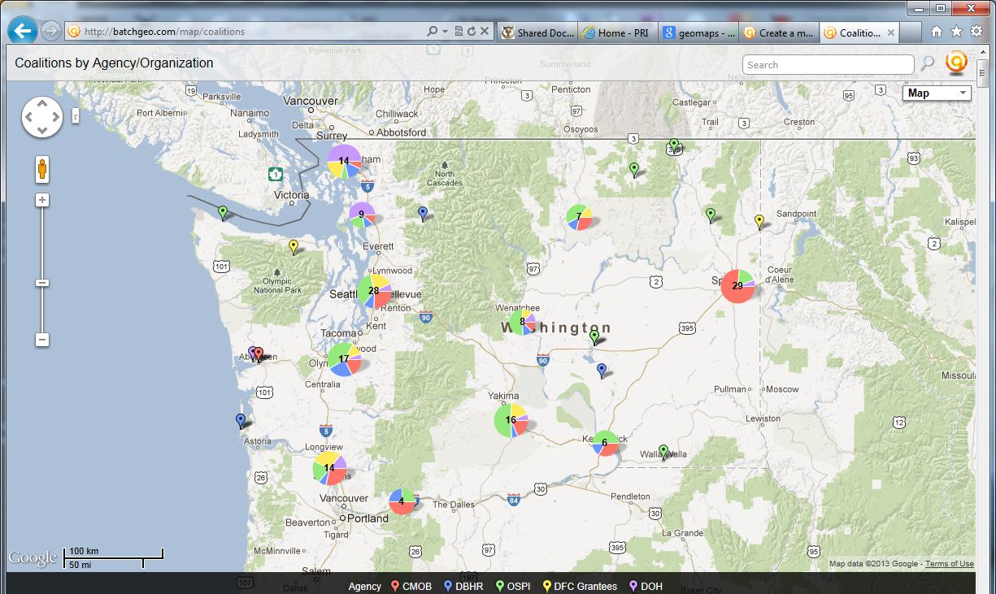
Step 2:
Mapping

Slide 31
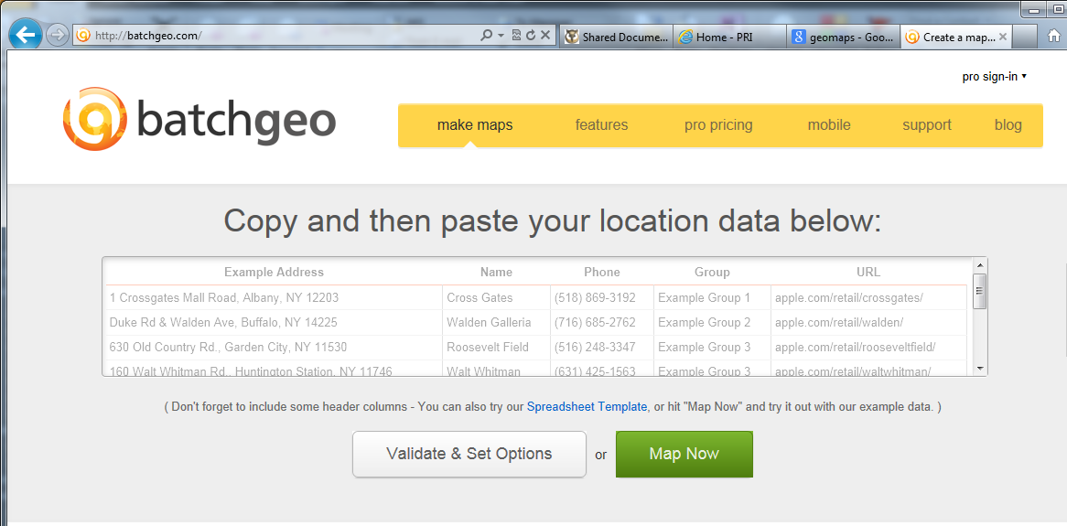
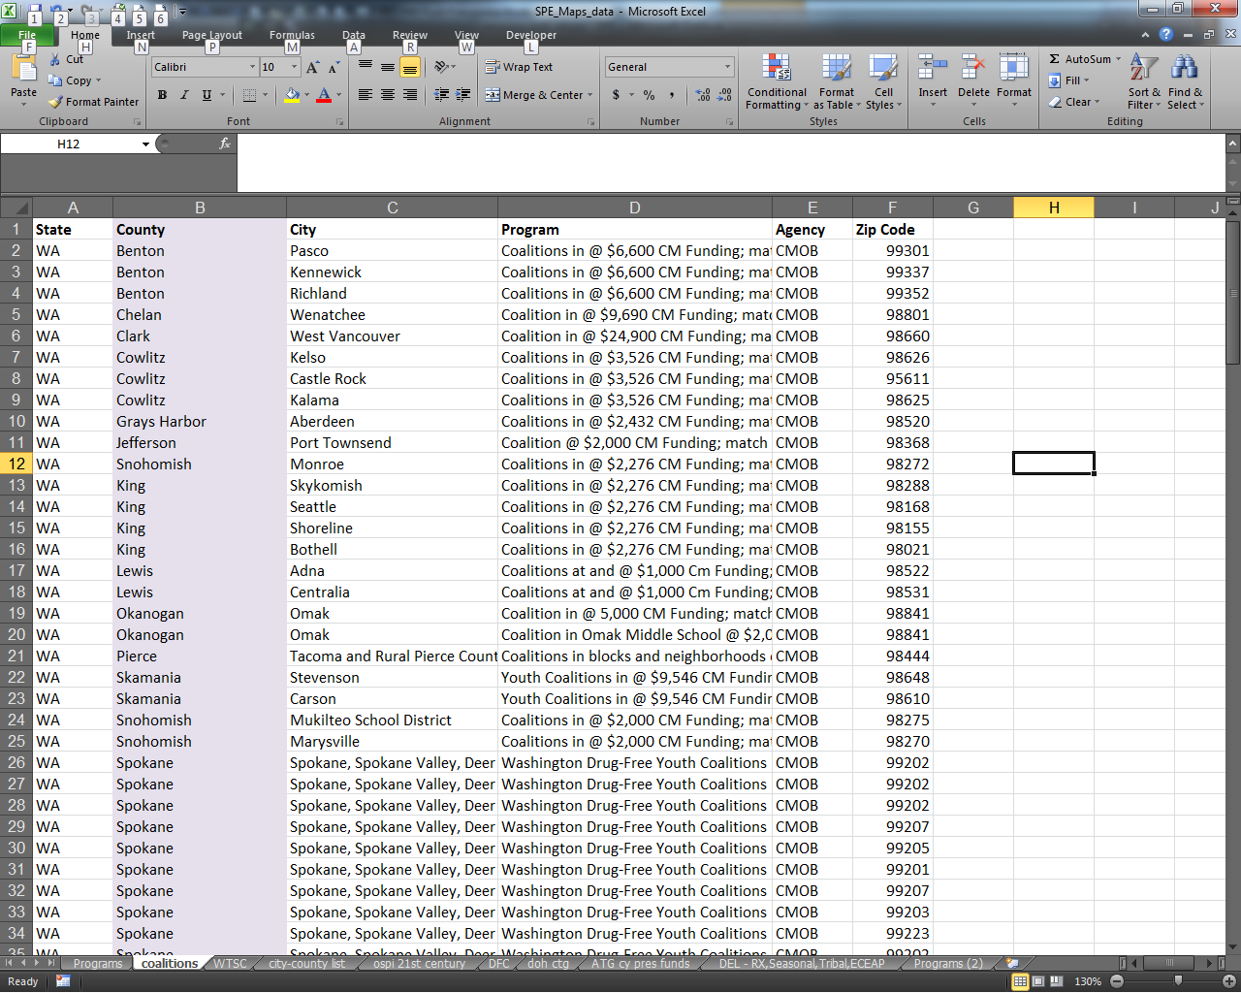
Step 2:
Mapping
http://batchgeo.com/

Slide 32
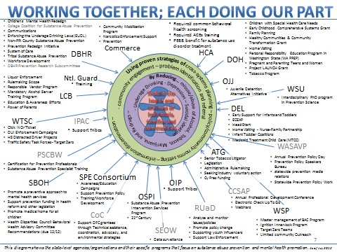
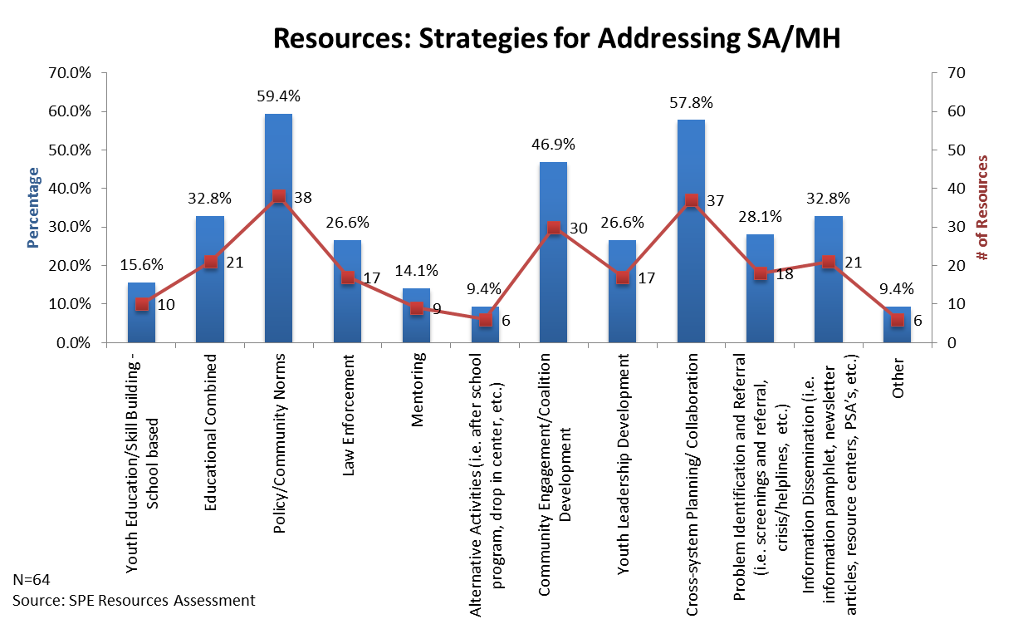
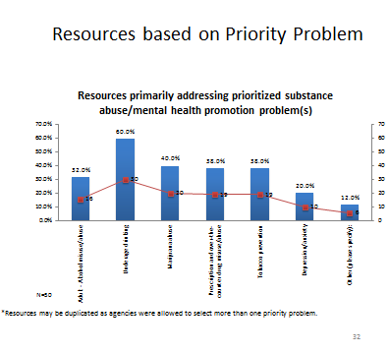
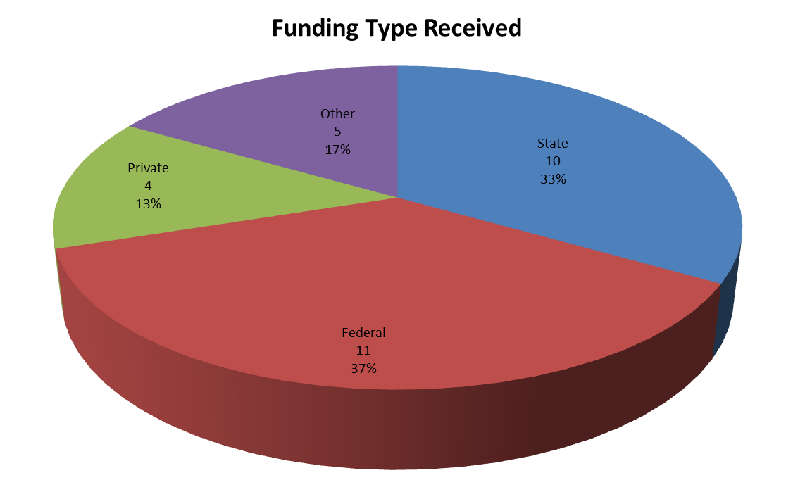
Step 2:
Charts and Graphs

Slide 33
Step 2:
Examples from Cohort 1
Well Spring Community Network –
  Human Capital
  Community Collaboration and small town political ties
  Agency support and other service providers
  Alternatives
  Funding and in-kind donations
  Training and Technical Assistance
  Partnerships
  (See p. 14-16)

Slide 34
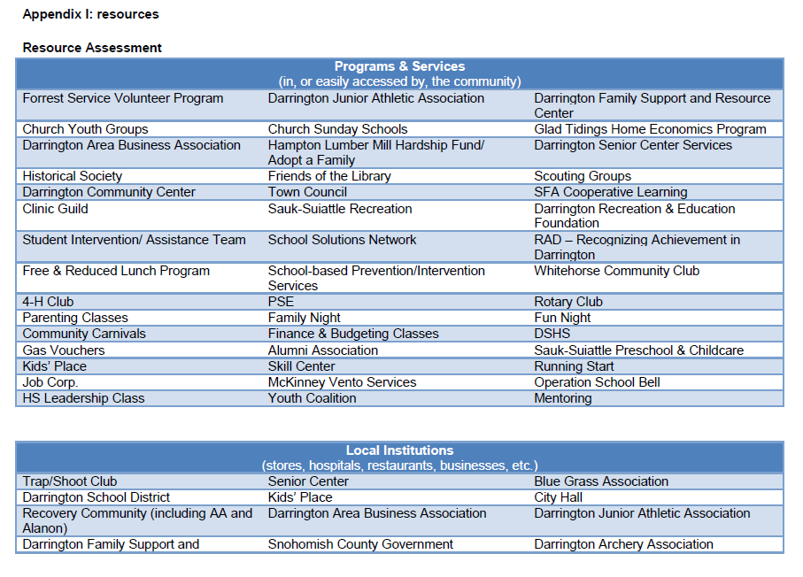
Step 2:
Examples from Cohort 1
Darrington Prevention Intervention Community Coalition–
The Darrington Family Support and Resource Center - The Resource Center is the “go to” social services agency in town, tackling everything from mentoring, youth coalition coordination, and parenting classes to hosting family dinners open to the public and arranging for afterschool and summer activities for the community.
The Darrington Clinic - Darrington’s only Primary Care facility is also a regional trauma center managed by a prevention-minded Physician licensed to administer Nalproxone. Dr. Gary Schillhammer and his staff are key partners in a Primary Care Integration Demonstration project awarded to the community.
The Sauk-Suiattle Indian Tribe Health and Human Services Department - The Tribe provides a full complement of Human Services to Sauk-Suiattle Tribal members and Darrington Residents.
Snohomish County Sheriff’s Department - Current staff is reversing public perception of resistance to enforcing underage drinking laws.
  (See p. 19-20 and Appendix I)
Categories:
Programs & Services
Local Institutions
Natural wonders
Individuals
Cultural resources
Notes:
Darrington Prevention Intervention Community Coalition - Data-driven anti-drug coalition formed as a result of the PRI selection process. The DPICC enjoys broad community support and has realized many early successes as a result of their ability to mobilize the community.
Darrington Town Council - Legislative body for Darrington. Mayor Dan Rankin is an active member and supporter of the Coalition.
Educational Service District 189 - PRI partner agency that provides ongoing technical assistance, funding opportunities and the School District’s Prevention/Interventionist.
Snohomish County Human Services Department - Contracts for prevention services within the community and provides coordination to the community’s anti-drug coalition.

Slide 35
Step 2:
Examples from Cohort 1
Ferndale Prevention Redesign Initiative

Slide 36
Resource Assessment –
Challenges
Challenges which may arise during the resource assessment process include:
Service providers are hesitant to cooperate: “Is this an audit?”
Difficulty in collecting the information.
Difficulty in analyzing information.
Collecting too much information.
Paralysis by analysis (too much information, no clear process for decision-making).
Running out of time.
What else???
So how do you get past these???
Notes:
CADCA – it is still necessary to limit the idea so that the coalition can functionally identify resources and bring them to bear on key community problems. The coalition is not looking for every conceivable resource during the assessment process. Rather the coalition is seeking those resources that can be directed toward solving the specific problems identified as top community concerns. P 49 week one.

Slide 37
Summary:
Resources Assessment Process
So far we…
…discussed what a resource assessment is and why it is important
…identified programs and services in your community that impact your prioritized intervening variables and/or contributing factors
…discussed collecting information for the gaps assessment about the resources in the community

Slide 38
Key Findings
So what?
Part two:

Slide 39
Elements of a good Assessment
Needs
Resources
Gaps
We are here

Slide 40
Step 3:
What is a Review of
Resource Gaps?
At its core are two questions: "Where are we?" and "Where do we want to be?“
A review of resource gaps is a process that compares actual conditions with ideal conditions.
A review of resource gaps starts with the prevention resources that are available in the community, and compares that to what will be needed to address the issues that emerged in the needs assessment phase of the planning process.
Notes:
Gaps analysis or gap assessment is actually a tool or process that was originally designed for business and economics to help companies compare actual performance with potential performance. If a company or organization does not make the best use of current resources, or forgoes investment in capital or technology, it may perform below its potential.
Gap analysis identifies gaps between the optimized allocation and integration of the inputs (resources), and the current allocation level. This reveals areas that can be improved. Gap analysis involves determining, documenting, and approving the variance between business requirements and current capabilities.
Gap analysis naturally flows from benchmarking and other assessments. Once the general expectation of performance in the industry is understood, it is possible to compare that expectation with the company's current level of performance. This comparison becomes the gap analysis. Such analysis can be performed at the strategic or operational level of an organization.
And a big thank you to Wikipedia for this background information!

Slide 41
Step 3:
Benefits of a
Review of Resource Gaps
A community review of gaps will assist you to:
Identify gaps in services.
Avoid duplication in services.
Build collaboration among service providers.
Ensure you are putting your time and money where it will have the greatest impact.
Ensure you are creating a comprehensive prevention strategy for your community.
Ensuring you are effectively impacting your priority intervening variables and contributing factors.

Slide 42
Poll
Have you completed your review of resource gaps yet?
  Just starting.
  In the middle.
  Mostly finished, still finalizing it.
  All done.
  Already put in our plan.
Do you want to share a success?

Slide 43
Step 3:
What is a “Gap”?
In prevention, program and service gaps exist in a variety of forms.
Most common gaps include:
Evidence-based programs, polices & practices
Geographic restrictions
Population (demographic) limitations such as whether there are language-specific curriculum materials available
cont.
Notes:
Ask the group for examples.

Slide 44
Step 3:
What is a “Gap”?
cont.
Developmental gaps in the continuum of services
Implementation fidelity issues
Saturation concerns
Funding limitations
Source: Cady & Associates Prevention Science Consulting & Training,
2006
What else???
Notes:
Ask the group for examples.

Slide 45
Step 3:
Determine Gaps In Resources
Types of gaps in resources:
Developmental gaps – are services available at the appropriate developmental age?
Geographic gaps – are services available throughout the community?
Population/Demographic gaps – are services reaching all potential participants appropriately?
Intervening variable/contributing factor gaps – is the intervening variable and/or contributing factors being adequately addressed?

Slide 46
Step 3:
Determine Gaps In Resources – Sample
Priority intervening variable:
Family Management
Resource gaps:
No parenting classes for parents of 12 – 14 year olds.
No parenting classes provided in Spanish.
Existing parenting classes are not evaluated for effectiveness
Existing parenting classes are not filled to capacity – not reaching “hard to reach parents”
No family crisis counseling provided 24/7
Lack of skilled parenting instructors in the community
No existing parenting classes teach appropriate skills to promote attachment with newborns
Notes:
Use this to set the stage for local conditions. Explain how Res. Asst. informs planning by helping determine local conditions.

Slide 47
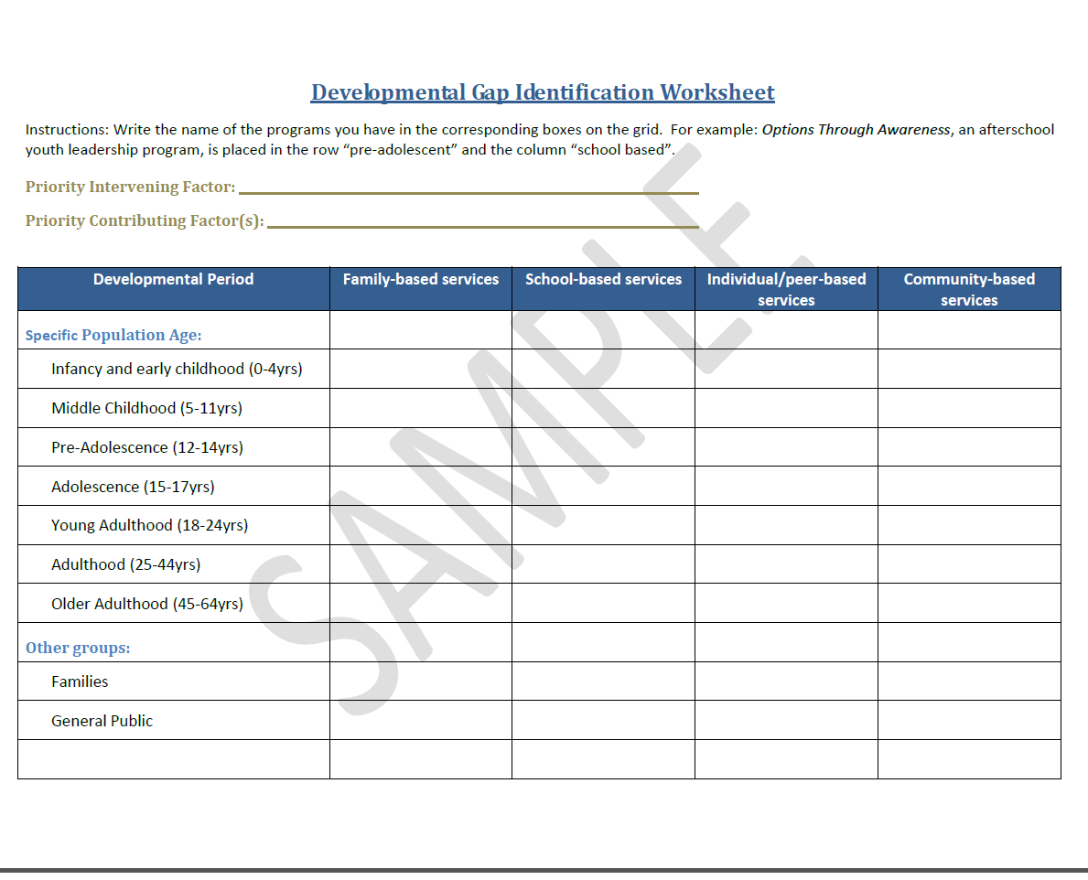
Step 3:
How do you find Gaps?
Table it…
Notes:
NOTE:
Role of coordinator is to set up the conversation – not make decisions. Maybe not facilitate it. Think about using a workgroup to prep stuff.

Slide 48
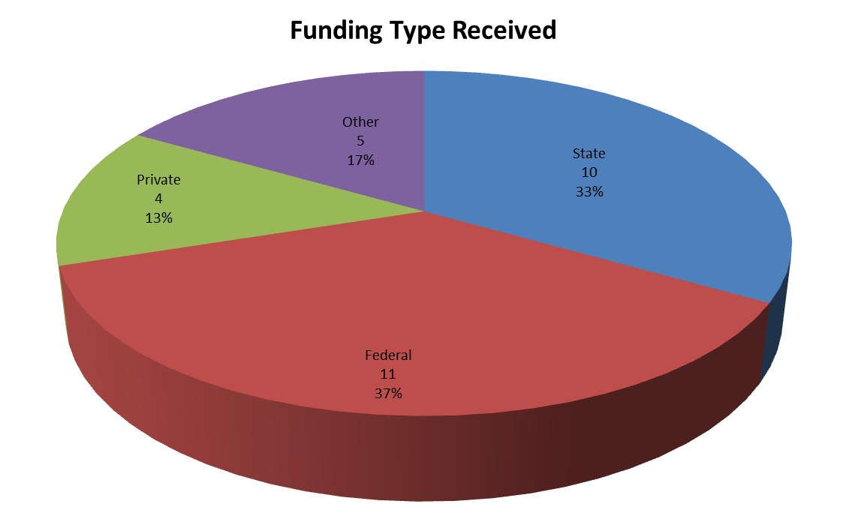
Step 3:
How do you find Gaps?
Chart it…

Slide 49
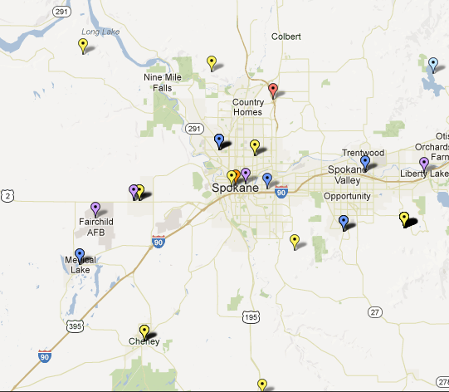
Step 3:
How do you find Gaps?
Map it…
Notes:
Using the same resource assessment data collection form, have the pairs complete the reverse side of the form for geographic, population and intervening variable gaps. Again, debrief their experience with the full group, identifying specific challenges they encountered to determine whether to say the other gaps exist. Where possible, have each pair agree about how they will address similar challenges.
Have the pairs complete Gaps Identification Forms for each of their resource assessment data collection forms. When they complete a Gaps Identification Form, they will pass the completed form – along with the associated resource assessment data collection– to the pair to their right.

Slide 50
Step 3:
How do you find Gaps?
Are there services in multiple languages for our families?
What do we see in our community that help youth?
What neighborhoods aren’t getting any services?
What do you think is missing here to support families?
What is happening on weekend for youth?
What evidence-based programs do we have in the school?
Are we doing enough of that to make a difference?
Discuss it…
Notes:
NOTE:
Role of coordinator is to set up the conversation – not make decisions. Maybe not facilitate it. Think about using a workgroup to prep stuff.

Slide 51
Step 3:
Review of Resource Gaps– Challenges
Challenges which may arise during the review of resource gaps assessment process include:
Lack of information.
Too much information.
Lack of diverse representation in the decision making process.
Lack of detail in identifying the gaps.
Lack of enough resources to address all of the gaps.
What else???
So how do you get past these???
Notes:
NOTE: just because there is a gap and need, doesn’t mean that you will be able to implement this year. How to document the gap and note that the coalition will work towards building capacity for strategy.

Slide 52
Step 4:
Summarizing Key Findings
At a coalition meeting:
  Review information
  Coalition discussion …
    What are some critical resources that are having positive outcomes on our local conditions that we have that we want to collaborate with and include in our plan?
    What key resources are missing from our community that we need in order to impact the local conditions we want to change?

Slide 53
Step 4:
Summarizing Key Findings
What does your Resources Assessment information tell you?
What we have…
What we need…
Ages served
Times offered
Locations
Evidence-based
Addressing local conditions
Culturally appropriate
Ages served
Times offered
Locations
Evidence-based
Addressing local conditions
Culturally appropriate

Slide 54
Step 4:
Summarizing Key Findings
Example 1:
  “After reviewing information collected from our resources assessment we determined that we have significant and effective resources available for children ages 5-12, however there are limited programs for youth ages 13-15…”
HAVE
NEED

Slide 55
Step 4:
Summarizing Key Findings
Example 2:
  “After reviewing information collected from our resources assessment we understand that the Go Kids Youth Center provides valuable programs for youth (10-18) in our community however these services are underutilized and we need to reach out to more diverse populations such as providing information and communication in multiple languages…”
HAVE
NEED

Slide 56
Step 4:
Summarizing Key Findings
Example 3:
  “Needs assessment shows elevated social availability of alcohol with a low youth perception of Law Enforcement impacting underage drinking. Community is ready to act to reduce underage drinking. Resource Assessment information shows that policies are in place and prosecuting attorney is engaged and ready to move forward however, law enforcement lacks officer training for party patrol and controlled party dispersal strategy…”
HAVE
NEED

Slide 57
Step 4:
Summarizing Key Findings
Include in Strategic Plan:
  What are the significant community partnerships in-place or that need to be developed?
  Identify important and/or significant information that demonstrates areas to focus substance abuse efforts (for example, lack of fidelity of programs being implemented to address a specific local condition; lack of services being provided for a local condition).
  Provide summary of the key data and information findings that led to the selection of the Coalition priorities. Include the detailed data and information reviewed in the appendix of the Plan.

Slide 58
Summary:
Resources Assessment Findings
Today we covered…
…the types of resource gaps and why identifying gaps is important.
…identifying resource gaps for each intervening variable.
…summarizing key findings from Resources Assessment.

Slide 59
Next up
Next week we will cover step 5 for the Analysis and Prioritization section of your Strategic Plan.

Slide 60
Discussion Questions
What experience do you have to offer to the learning community around Resources Assessment?
What questions do you have as you work on these tasks?
What challenges have you encountered?
What have you done that worked really well?
What additional clarification is needed, if any, in order to move forward?

Slide 61
Resources
Strategic Plan Requirements Guide
The Athena Forum
Prevention System Managers
Cohort 1 Coordinators

Slide 62
Wrap up
Questions???
Follow up survey will be sent via email following this webinar. Please take a moment to complete it. It helps us continue to improve our trainings.

Slide 63
Questions?
If you would like additional technical assistance please contact your Prevention System Manager or email PRItraining@dshs.wa.gov.

