Slide 1
Selecting, Implementing, and Evaluating Environmental and Population-Based Prevention Strategies How To Use Science in Practice
Harold D. Holder, Ph.D.
Prevention Research Center
Berkeley, California

Slide 2
Goals
Goal 1: Learn about population-based prevention approaches and “environmental strategies”
Goal 2: Learn what local prevention need to do in assessing, implementing, and evaluating environmental strategies, i.e., strategic planning.
Goal 3: Learn how to evaluate environmental strategies

Slide 3
What are some popular beliefs about environmental prevention strategies?
Environmental strategies are difficult to implement. Too costly.
2. Environmental strategies will not work in our community.
3. We are already doing environmental strategies.
4. ATOD abuse is more an individual problem and environmental strategies are not relevant.
5. Environmental strategies can not be evaluated.
6. Environmental strategies do not work with children and pre-teen youth.

Slide 4
Biggest Current Mistakes in Prevention?
Doing many things that have little or no effect….
“Not incorporating best prevention research into assessment, planning, and evaluation”

Slide 5
Current Challenges and Opportunities for Prevention
Public Requirement of Outcomes
Recommendation: Develop outcome data to show results
Health Care Reform
Recommendation: Take advantage of emphasis on prevention and outcomes in Health Care Reform documentation
State Budget Cutbacks
Recommendation: Demonstrate cost-effectiveness

Slide 6
Just What Is Environmental Prevention, Anyway?
Environmental strategies in a community seek:
To bring about system-level change (including physical space, local community policies, availability of drugs and alcohol, etc.)
in order
To reduce substance abuse problems at the population level. That is Public Health.
Both conditions must be met.

Slide 7
Outcomes-Based Prevention
Substance-related consequences and substance use
Intermediate variables
Programs/ policies/
practices
Implementing the Strategic Prevention Framework
Planning, Monitoring, Evaluation, and Replanning
Notes:
The project is organized around outcomes-based prevention principles
This perspective identifies
-what you are trying to affect- outcomes
What you do to affect it -strategies
What the intervening mechanisms are that you might change-intervening variables

Slide 8
States are familiar with logic models: Tools for assessing, planning, implementing, and evaluating prevention.

Slide 9
Logic models are composed of:
1. Prevention goal, i.e., specific ATOD outcome to be reduced or changed
2. Intermediate variables or factors, which need to be changed (or considered) in order to achieve the goal
3. Intervention strategies to change intermediate variables.

Slide 10
Example Logic Model for Substance Abuse Prevention
What is wrong with this picture?
Substance-Related Consequences
Substance
Use
Intermediate Variables
Strategies
Underage and Young Adult
Binge Drinking
School Bonding for Youth
Number of DUI Arrests
School Drug Resistance Training
Alcohol-Related Traffic Crashes
Among 15- to 24-Year-Olds
Underage and Young Adult
Driving After Drinking
Highly Visible DUI Enforcement
Awareness of Risk of Drinking
Increased Abstinence
Low Personal
Self-Esteem
Youth 30-Day Cannabis Use
Public Education About Drinking and Driving Risks
Family Training
Youth and Young Adult Lifetime Drinking
Perceived Risk of Drinking and Driving Enforcement
Responsible Beverage Service To Reduce Overserving
Youth Frequent Exposure to Internet

Slide 11
Alcohol Sales and Service Regulations, Enforcement, and Sanctions
DUI Enforcement
Alcohol-Related Motor Vehicle Crash Model
Public Awareness of Drinking/Driving Enforcement
Alcohol Serving and Sales Practices
Price
Retail Availability
Community Norms– Drinking and Driving
Perceived Risk of DUI Arrest
Drinking
Driving After Drinking
Alcohol-Related
Motor Vehicle Crashes
Community Norms– Drinking
Individual Factors
Social Availability
Research Evidence
Strong Relationship
Moderate Relationship
Drinking Context
Minor Relationship
Little Research Evidence
but Logical Relationship

Slide 12
Review of Research Evidence for Logic Models WWW.PIRE.org Under “Featured Websites” to “Logic Models for the Prevention of Alcohol, Tobacco, and Other Drug Problems,” select tab in right-hand column.

Slide 13
Underage Drinking Logic Model
Retailer training & rewards
Compliance checks, citations, license loss
Discount bans
Retail sale of alcohol to youth
Price
Underage drinking laws
Visible enforcement
Social availability of alcohol to youth (parties, peers, families)
Underage drinking
Party patrol,
shoulder taps,
beer keg registration
Local alcohol policy
Community concerns about youth drinking
Media advocacy
Legal risks for providing alcohol to underage youth

Slide 14
Examples of Effective Local Prevention Projects Utilizing Environmental Strategies

Slide 15
National Community Trial To Prevent Alcohol-Involved Trauma
-
Modesto
Modesto
.
Salinas
.
Salinas
Orange
.
.
Orange
.
Florence
.
Florence
Oceanside
Oceanside
Sumter
Sumter
Experimental
Experimental
Comparison
Comparison

Slide 16
Alcohol-Involved Trauma at the Community Level: Logic Model`````````
MOBILIZATION
DRINKING AND DRIVING
Local News About Alcohol Problems and Enforcement
Perceived
Risk of Arrest
Local Law
Enforcement
RESPONSIBLE BEVERAGE
SERVICE
Social Access
to Alcohol
Alcohol
Serving and
Sales Practices
Driving After
Drinking
UNDERAGE DRINKING
Local Regulation
of Alcohol
(density, hours
of sale)
Retail Alcohol Availability
(on- and off-premise)
Alcohol-Involved
Injury
Alcohol Intoxication
or Impairment
ALCOHOL ACCESS
Non-Traffic Risk Activities

Slide 17
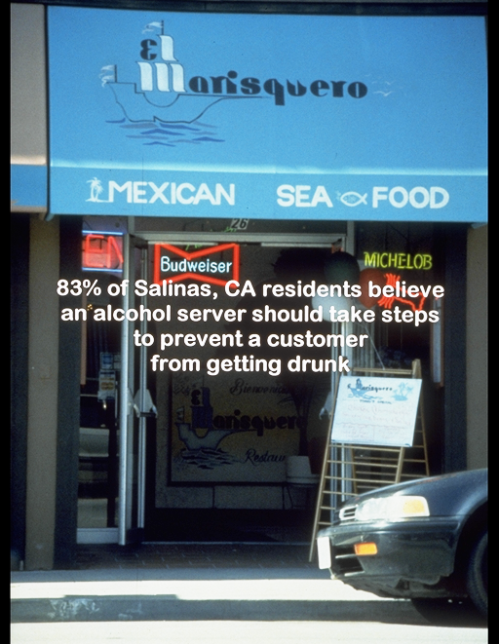
Restaurant Service

Slide 18
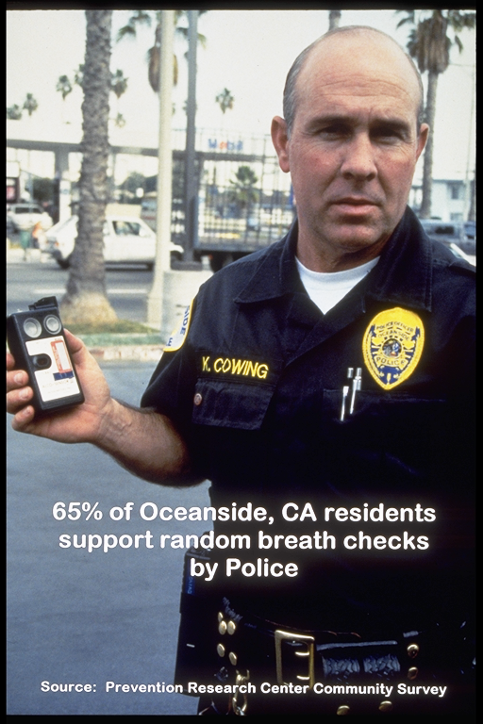
Highly visible and increased actual drinking and driving enforcement

Slide 19
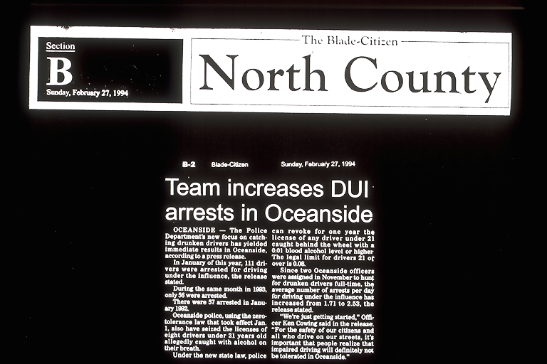

Slide 20
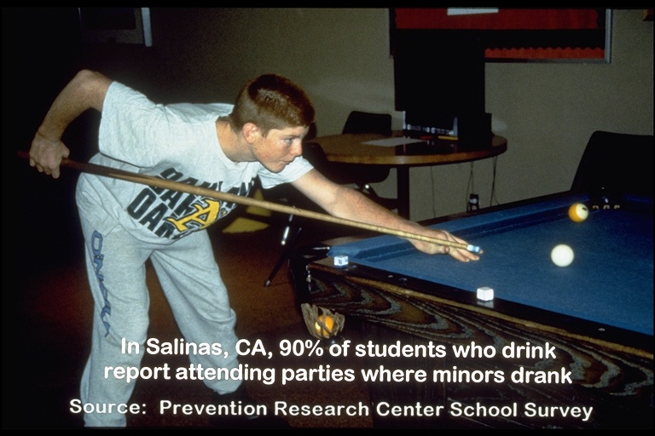
Underage Drinking
In Salinas California, 90% of students who drink
report attending parties where minors drank.

Slide 21
Intermediate Variable and Strategy Data

Slide 22
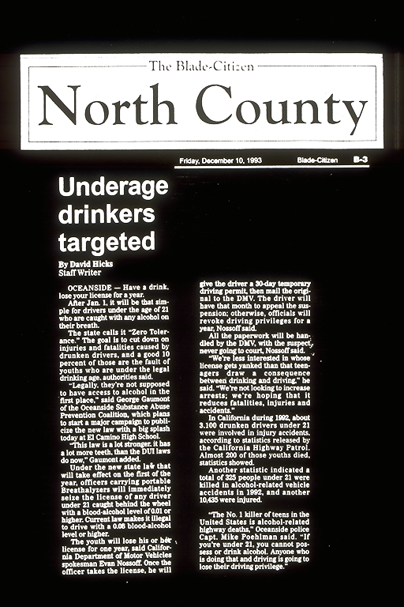

Slide 24
Underage Alcohol Prevention Activities

Slide 25
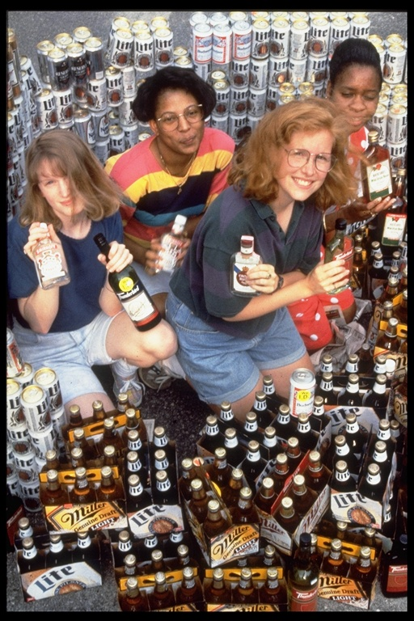
“Mountain of Beer”

Slide 26
Underage Alcohol Purchase Survey Experimental and Comparison Communities
60
PRETEST
POSTTEST
50
53
40
47
45
Percent Selling
35
30
20
19
16
10
0
Comparison
Experimental No Training
Experimental Training
Comparison
Experimental No Training
Experimental Training
Holder, et al., J. American Medical Association, 2000

Slide 27
Outcomes What were final results?

Slide 30
Examples of Community Action Projects for Environmental Prevention
COUNTRY
GOALS
STRATEGIES
RESULTS
United States
California, South Carolina
Reduce alcohol injury and death
• DUI enforcement • Alcohol service • News coverage • Underage sales • Alcohol outlets
➢
10% reduction in alcohol crashes
➢
43% reduction in violence
➢
Lower alcohol sales to youth
Minnesota
Reduce youth drinking
• Local sales policies and enforcement
➢
Lower alcohol sales to youth
Reduced traffic crashes
➢
Massachusetts
Reduce alcohol crashes
• News coverage • DUI enforcement • Alcohol outlet surveillance
➢
25% reduction in fatal crashes

Slide 31
Examples of International Community Action Projects for Alcohol Prevention
COUNTRY
GOALS
STRATEGIES
RESULTS
Sweden
STAD Project Stockholm
Reduced local alcohol and drug problems
• Responsible Beverage Service
• Joint parent/police enforcement of sales to youth
• Club policy and drug recognition by door security
➢
Reduction in sales
to intoxicated
patrons (47% to 5%)
➢
Violent crime
down by 29%
➢
Refusals of drug impaired patrons increased by 300%
Australia
Surfers Paradise Safety Action Project
Lower alcohol- involved violence
• Community forum and alcohol safety audit
• Model house policies
• Increased enforce-ment of alcohol-licensed premises
➢
Reduction in violent events: original site from 9.8 to 4.7 and
replication sites from 12.2 to 3.0

Slide 32
What Have We Learned to This Point?
➢
Environmental prevention can produce measurable results.
➢
Logic Model in environmental prevention must be based on empirical evidence about intermediate variables.
➢
Environmental strategies must be selected that have been shown to work—that is, impact key intermediate variables.
➢
Do few things well. High “dosage” to be effective.

Slide 33
Next
Learn tools and approaches to monitor and evaluate environmental strategies.
Discuss ways for communities in more effective in environmental prevention.

